Slide 1
Science 9 Space Exploration Unit E
Redding

Slide 3
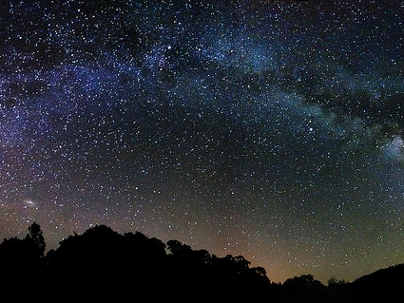
Topic 1 - For Our Eyes Only
Frames of Reference
A frame of reference is a set of axes of any kind that is used to describe positions or motions of things.
The stars, the Sun and the planets do not rotate around the Earth, but seem to because the Earth is rotating on its axis.
The Earth is our fixed frame of reference. To locate positions on Earth, the equator and the prime meridian (latitude and longitude) are the axes used.

Slide 4
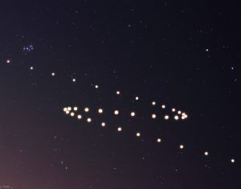
Topic 1 - For Our Eyes Only
What Our Ancestors Saw
Ancients developed their ideas of what was happening in the sky and explained it with their frame of reference. The constellations were patterns that seemed to tell stories about people. Stars are not always in the sky at the same time, but change positions over time – giving rise to the creation of calendars.
The Sun and the Moon have their own pattern or rising and setting – the Moon also has phases. Mercury, Venus, Mars, Jupiter, and Saturn were special ‘stars’ called planets – meaning ‘wanderer’.
Notes:
Objects in the sky have fascinated humans throughout time. The explanations of how these celestial objects came to be are even more fascinating.

Slide 5
Topic 1 - For Our Eyes Only
Ancient Views: Myths, folklore and legends were used to explain what ancient people observed in the night sky.
First Nations people of the Pacific Northwest – believed the night sky was a pattern on a great blanket overhead, which was held up by a spinning ‘world pole’ resting on the chest of a woman named Stone Ribs.
Aboriginal tribes – Algonquin, Iroquois and Narragansett believed the constellation Ursa Major was a bear running from hunters.
Inuit in the high Arctic – used a mitt to determine when seal pups would be born, by holding the mitt at arm’s length at the horizon.
Ancient Egyptians - The Sun God – Ra – was carried in a sacred boat across the sky every day.

Slide 6
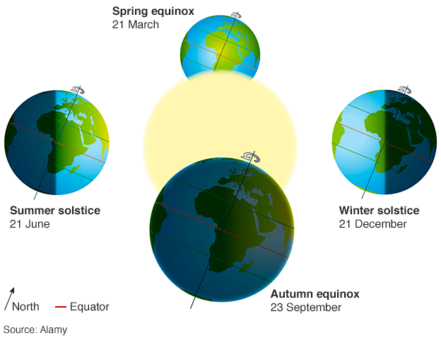
Topic 1 - For Our Eyes Only
Solstice represents the shortest and longest periods of daylight
Winter solstice: shortest period of daylight (Northern hemisphere: Dec. 21)
Summer solstice: longest period of daylight (Northern hemisphere: June 21)
The Ancient Celts set up megaliths, in concentric circles, at Stonehenge to mark the winter and summer solstices.
Ancient African cultures set large rock pillars into patterns to predict the timing of the solstices as well.

Slide 7
Topic 1 - For Our Eyes Only
Equinox represents periods of equal day and night
Autumnal equinox – occurs in the fall (Northern hemisphere - Sept. 22)
Vernal equinox – occurs in the spring (Northern hemisphere - Mar. 21)
The Mayans of Central America built an enormous cylinder shaped tower, at Chichen Itza, to celebrate the two equinoxes.
The Ancient Egyptians built many pyramids and other monuments to align with the seasonal position of certain stars.
Aboriginal Peoples of Southwestern Alberta used key rocks, which aligned with certain stars, in their medicine circles.

Slide 8
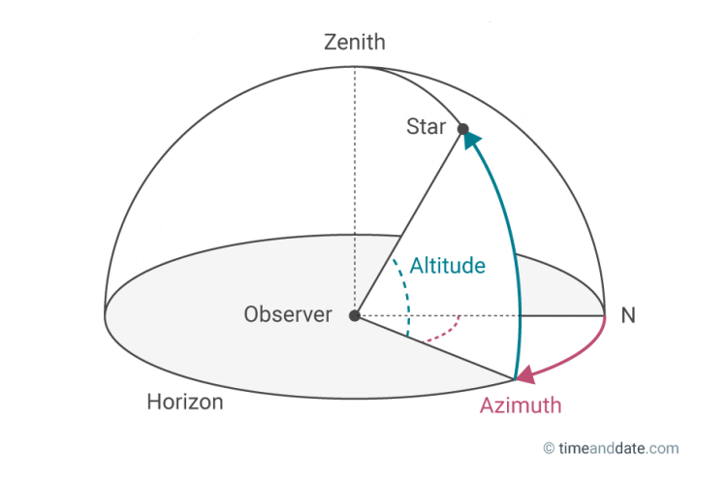
Topic 1 - For Our Eyes Only
Sky Co-ordinates
Altitude tells you "how far above the horizon the object is";
Azimuth determines "which compass direction it can be found in the sky."
Zenith is the position in the sky directly overhead.
Notes:
Altitude and Azimuth are calculated from the observer's (the person in blue) position

Slide 9
Topic 1 - For Our Eyes Only
The Stars as a Frame of Reference
Ancient cultures tried to explain the motions of the stars and planets, with their frame of reference being the Earth.
To track the actual motion of each celestial body in space, you need to use the stars as your frame of reference, instead of the Earth.
To do this you would make an observation of which celestial body you are studying and include other stars in relation to it.
Make subsequent observations and include those same stars. Over a period of time you would be able to determine in which direction the celestial body you are studying is moving.

Slide 10
Topic 1 - For Our Eyes Only
The Earth-Centred Model: The Earth was fixed and the center of the solar system with all celestial bodies in space rotating around it. Geocentric
The Sun-Centred Model: Nicholas Copernicus developed this model, in which the Sun was fixed and a rotating Earth revolved around it. Heliocentric

Slide 12
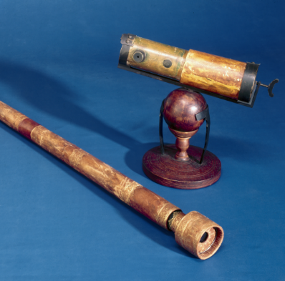
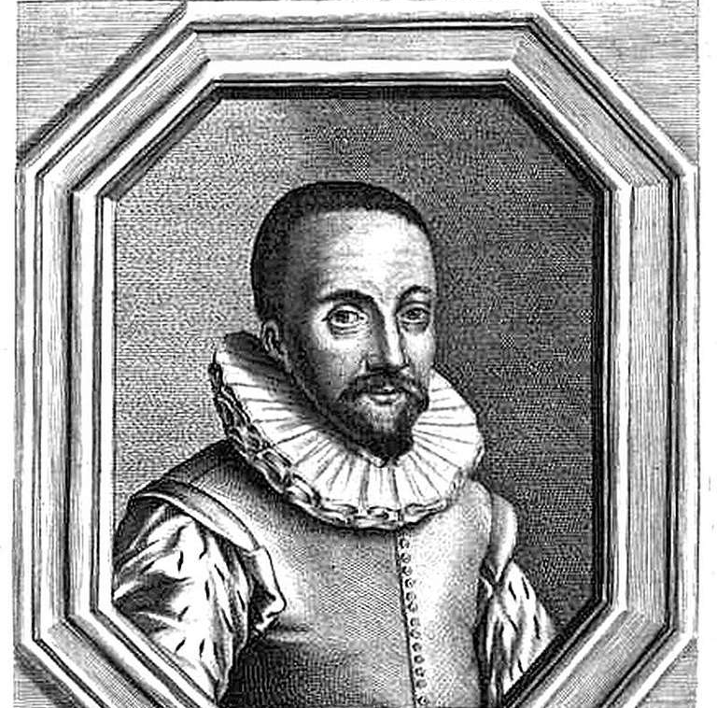
Topic 2 Stronger Eyes & Better Numbers
Optical Telescopes
In 1608, Hans Lippershey made one of the first telescopes – but it was Galileo Galilei who made practical use of it. The observations he made included:
The moon had blemishes (mountains and craters like the Earth).
Sun spots indicated that it rotates on its axis.
Jupiter’s moons orbit the planet.
Planets were disk-shaped, but because the stars were still pinpoints, they were further away.

Slide 13
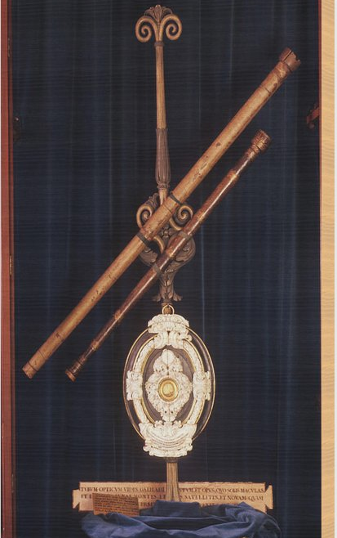
Topic 2 Stronger Eyes & Better Numbers
Galileo’s Approach to Inquiry
Galileo’s observations supported Copernicus’s Sun-centered model but not Ptolemy’s Earth-centered model.
Resolving Power is the kind of power that produces finer detail of the object being viewed because of the diameter of the objective lens.
Refractors and Reflectors: Optical telescopes are ‘light collectors’. The series of lenses or mirrors enable the optical device to collect and focus the light from stars.

Slide 14
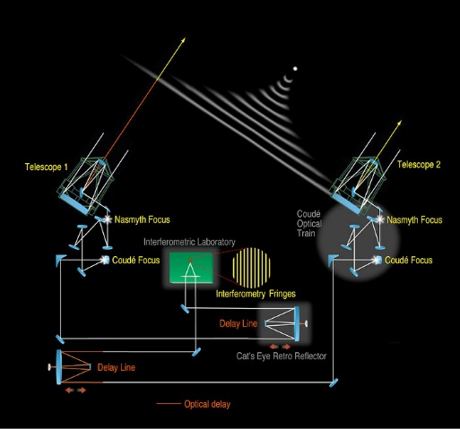
Topic 2 Stronger Eyes & Better Numbers
Interferometry: Combining Telescopes for Greater Power. The technique of using a number of telescopes in combination is called interferometry.
When working together, these telescopes can detect objects in space with better clarity and at greater distances than any current Earth-based observatory.

Slide 15
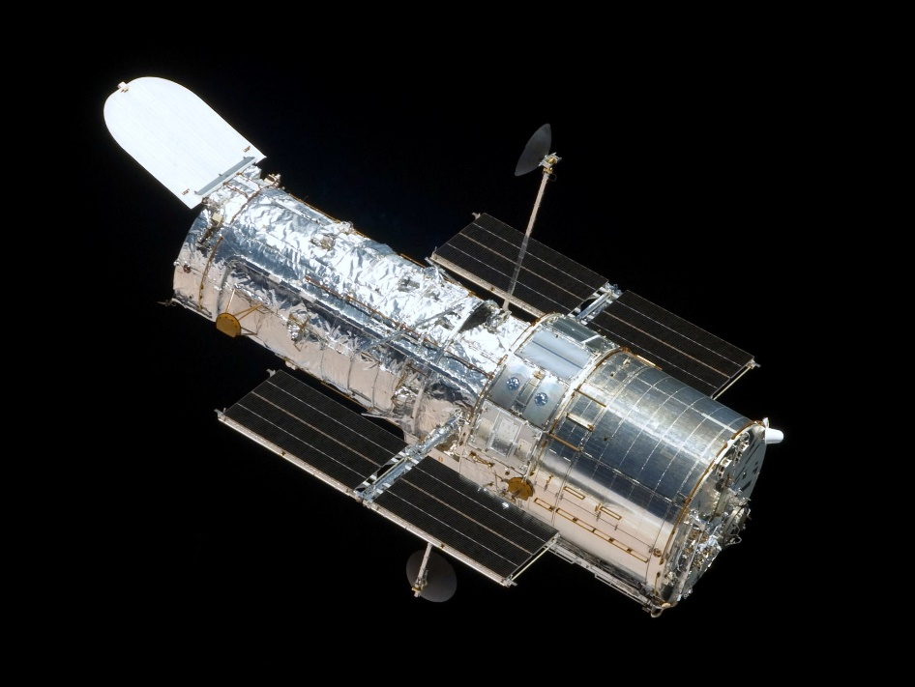
Topic 2 Stronger Eyes & Better Numbers
To improve the views of space, astronomers are able to access images from a telescope in space.
Free from the interferences of weather, clouds humidity and even high winds, the Hubble Space Telescope, launched in 1990, orbits 600 kms above the Earth, collecting images of extremely distant objects.
It is modular (parts can be removed and replaced) and is serviced by shuttle astronauts.

Slide 16
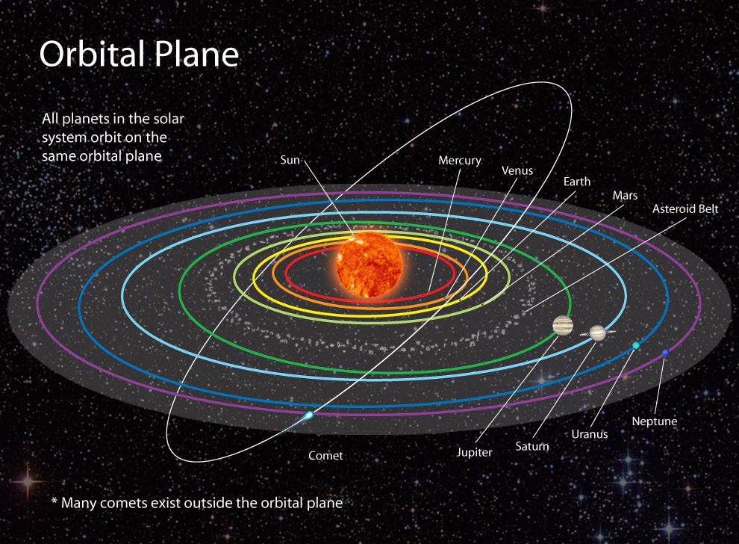
Topic 2 Stronger Eyes & Better Numbers
Universal Gravitation
Isaac Newton stated the law of universal gravitation eighty years after Kepler’s contribution about elliptical orbits of the planets.
Newton’s law states that there is a gravitational force between all objects that pulls them together.
An orbit is the result of the attractive force of gravity balancing the straight forward movement of a planet because of velocity.

Slide 18
Topic 3 The Spectroscope: New Meanings In Light
Spectral Lines
Isaac Newton passed a beam of light through a prism to produce a spectrum of colors. If you pass the light through a narrow slit before sending it through a prism (a spectroscope is a device that does this) the spectrum will be in more detail.
Joseph von Fraunhofer used a spectroscope to observe the spectrum produced by the Sun. He noticed dark lines, called spectral lines, but didn’t know what they meant. He found these spectral lines throughout the solar system.

Slide 19
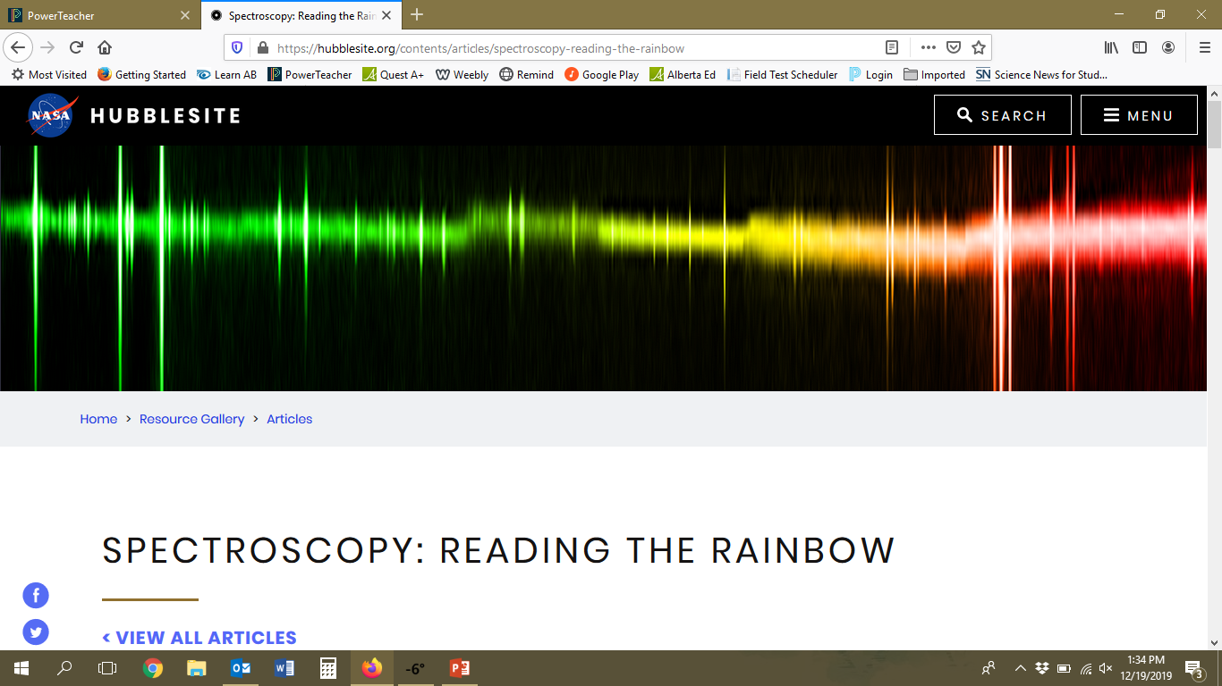
https://hubblesite.org/contents/articles/spectroscopy-reading-the-rainbow

Slide 22
Topic 3 The Spectroscope: New Meanings In Light
Spectroscopy: The Science of Colour
The significance of the spectral lines was discovered about 50 years later when Kirschoff and Bunsen, two chemists used a spectroscope to observe various chemicals when they were heated. They found some of the lines missing in some of the chemicals. Each particular element had its own unique spectral lines.
This led to the science of spectroscopy – the study of spectra, as a part of chemistry. They found that there were three types of spectra.

Slide 23
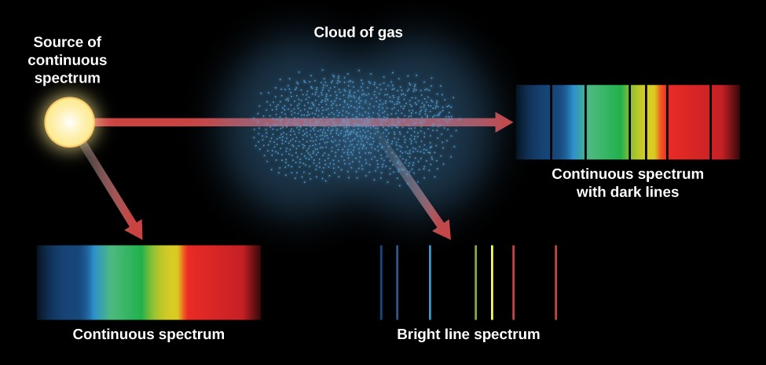
Topic 3 The Spectroscope: New Meanings In Light

Slide 24
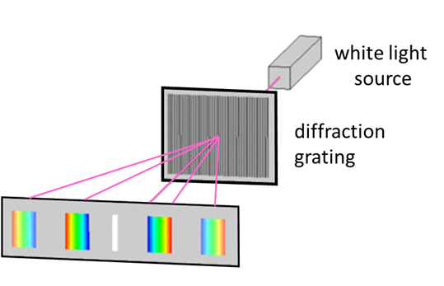
Topic 3 The Spectroscope: New Meanings In Light
Diffraction Gratings
Besides splitting light using spectroscopes or prisms, a diffraction grating can, by using thousands of closely spaces slits produce much b
Spectroscopy for Astronomers
Astronomers refract the light from distant stars to determine what the star is made of. Stars have dark bands in distinct sequences and thicknesses on their spectra. Each element that is present in the star creates its own black-line ‘fingerprint’

Slide 25
Red shift and blue shift – Objects in motion

Slide 26
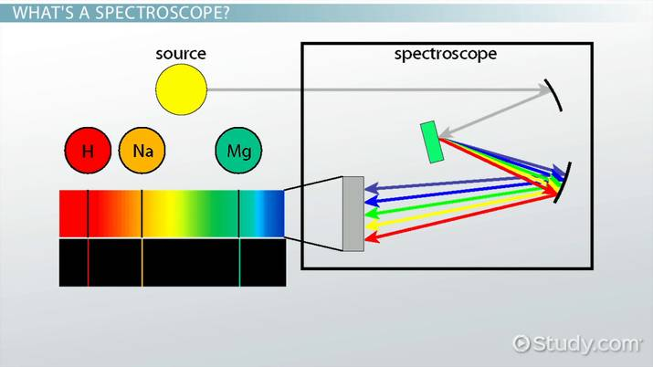
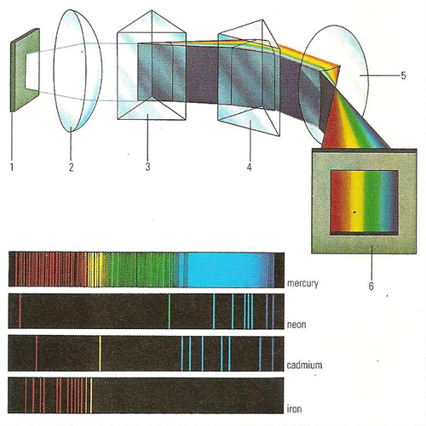
Topic 3 The Spectroscope: New Meanings In Light

Slide 27
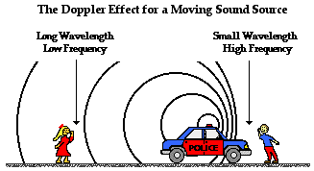
Topic 3 The Spectroscope: New Meanings In Light
The Doppler Effect
A change in the pitch (frequency) of sound waves because they are stretched or squeezed is known as the Doppler effect. Changes in the sound waves can be measured to determine how fast and in what direction a light-emitting object is moving.
The spectrum of an approaching star shows the dark bands shifting to the blue end of the spectrum, whereas, the shift is to the red part of the spectrum if a star is moving away from the Earth.

Slide 28
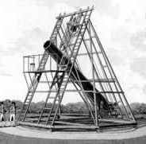
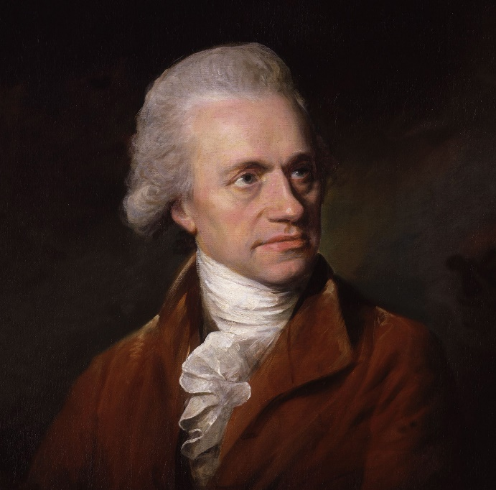
Topic 4 Bigger and Smarter Telescopes
New Discoveries
Bigger telescopes enable astronomers to discover new bodies in space. Sir William Herschel built a huge reflecting telescope and discovered the planet Uranus with it in 1773.
The largest refracting telescope was built at the Yerkes Observatory near the end of the nineteenth century. With it, Gerald Kuiper discovered methane gas on Saturn’s moon, Titan, and two new moons of Uranus.

Slide 29
Topic 4 Bigger and Smarter Telescopes
Combining Telescopes (Interferometry)
The technique of using a number of telescopes in combination is called interferometry. When working together, these telescopes can detect objects in space with better clarity and at greater distances than any current Earth-based observatory.
Ex: The Hubble telescope!
Ex: The New Technology telescope (NTT)

Slide 30
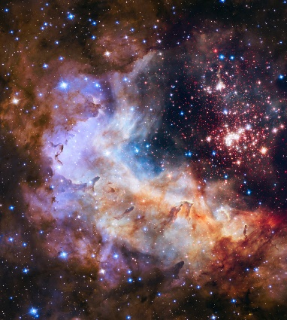
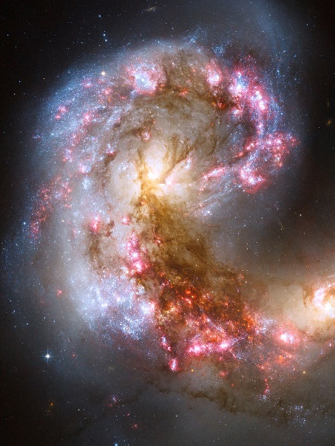
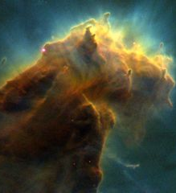
Topic 4 Bigger and Smarter Telescopes
The HST makes one complete orbit of the Earth every 95 minutes!
To improve the views of space, astronomers are able to access images from a telescope in space. Free from the interferences of weather, clouds humidity and even high winds, the Hubble Space Telescope, launched in 1990, orbits 600 kms above the Earth, collecting images of extremely distant objects. It is a cylindrical reflecting telescope, 13 m long and 4.3 m in diameter.

Slide 31
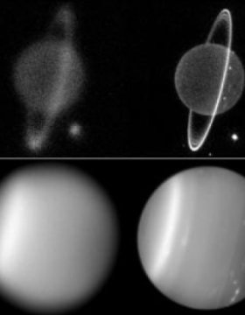
Topic 4 Bigger and Smarter Telescopes
Adaptive Optics
The NTT (New Technology Telescope) is called ‘adaptive optics’ because computers control the image, always adapting the mirror to changes in the Earth’s atmosphere. Astronomers attach adaptive optic technology to older telescopes as well. The computers remove the blurred effect of the atmosphere.

Slide 32
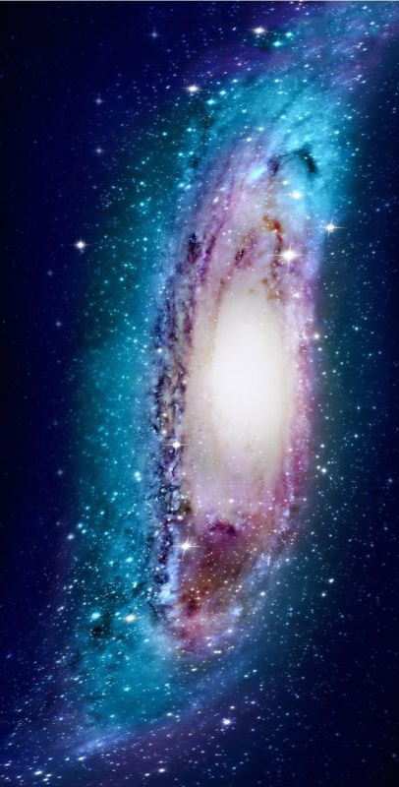
Topic 4 Bigger and Smarter Telescopes
Distance to the Stars
A galaxy is a grouping of millions or billions of stars, gas and dust. It is held together by gravity.
The Milky Way Galaxy is the galaxy our solar system is a part of. It is shaped like a flattened pinwheel, with arms spiraling out from the center.
Black holes are actually invisible to telescopes. Their existence is only known by an indirect method – when celestial material comes close to a black hole it becomes very hot and very bright

Slide 33
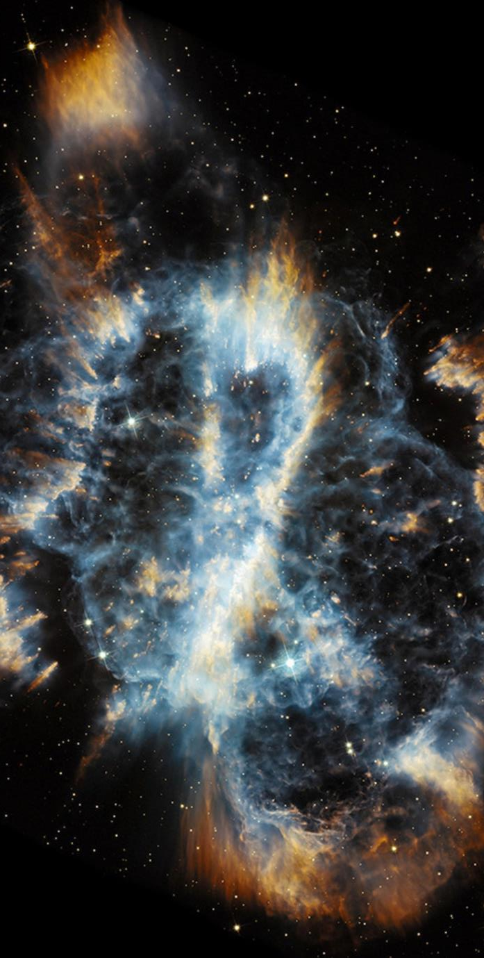
Topic 4 Bigger and Smarter Telescopes
Birth of Stars: Stars form in regions of space where there are huge accumulations of gas and dust called nebulae. Interstellar matter, which makes up part of the nebulae, originated from exploding stars.
Telescopes enable astronomers to see further into space and identify distant stars. The problemthey still have is how far are they from the Earth? The answer to this question lies in two methods.
Triangulation and Parallax are two ways to measure distances indirectly, on the ground, or in space.

Slide 34
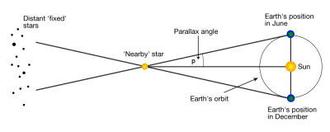
Topic 4 Bigger and Smarter Telescopes
Triangulation (Parallax): based on the geometry of a triangle. By measuring the angles between the baseline and a target object, you can determine the distance to that object.
To measure the distance indirectly, you need to know the length of one side of the triangle (baseline) and the size of the angles created when imaginary lines are drawn from the ends of the baseline to the object.

Slide 35
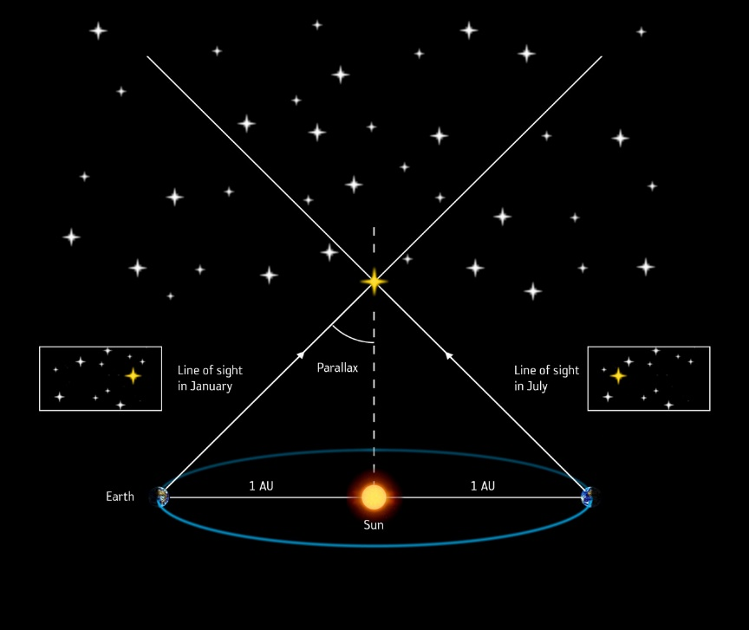
Topic 4 Bigger and Smarter Telescopes
Parallax is the apparent shift in position of a nearby object when the object is viewed from two different places.
Astronomers use a star’s parallax to determine what angles to use when they triangulate the star’s distance from the Earth. The larger the baseline, the more accurate the result. The longest baseline that astronomers can use is the diameter of Earth’s orbit.
Measurements have to be taken six months apart to achieve the diameter of the orbit.

Slide 36
Topic 4 Bigger and Smarter Telescopes

Slide 38
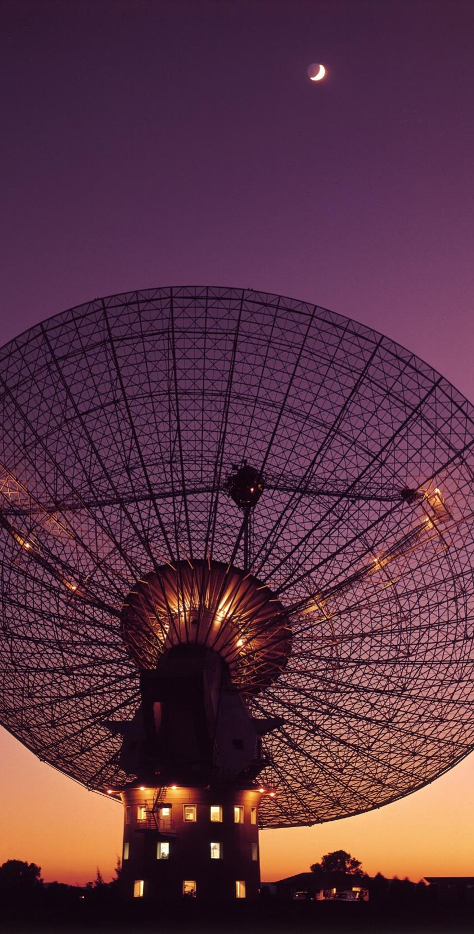
Topic 5 - What Channel Is This?
Radio Telescopes
Radio waves are received from stars, galaxies, nebulae, the Sun and even some planets. With the development of radio telescopes, astronomers gain an advantage over optical telescopes, because they are not affected by weather, clouds, atmosphere or pollution and can be detected day or night.

Slide 39
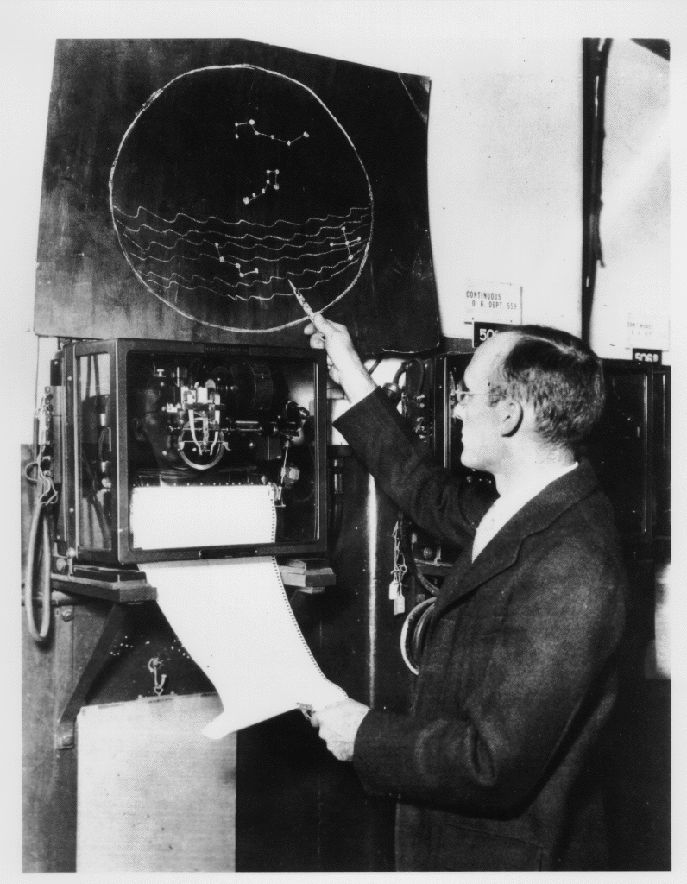
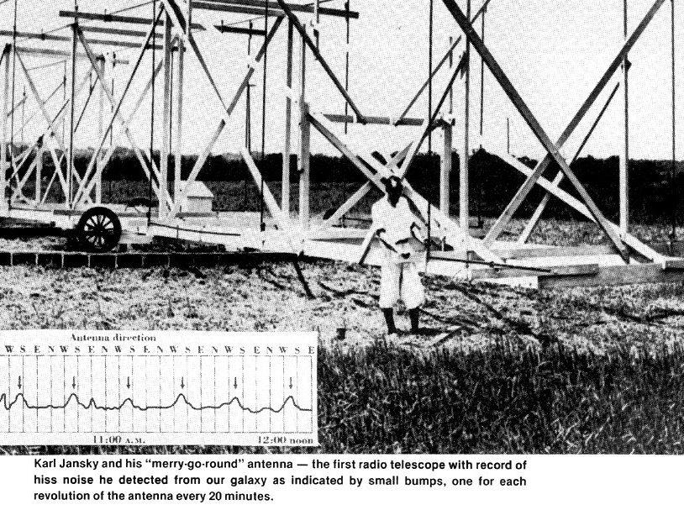
Topic 5 - What Channel Is This?
In 1932 Karl Jansky built a radio antenna that was able to identify radio waves from space.
Grote Reber built a radio dish based on Jansky’s antenna findings, where he ‘listened’ to the sky during the 1930’s. He discovered that the strongest radio waves came from specific places in space.
The static Reber heard became louder when he tuned into these radio objects. The loudest being our Sun in the Milky Way Galaxy.

Slide 40
Topic 5 - What Channel Is This?
Bigger Radio Telescopes
Radio waves have wavelengths that are millions of times longer than light waves, meaning that these waves give less resolution, but can penetrate dust clouds in the galaxy, where light waves cannot.
Seeing Radio Waves
Radio telescope waves provide data, which astronomers graph, using computers to store the data and false color it to produce images of the radio waves, which are coded to the strength of the waves. Blues for low intensity, and as the signal gets stronger the colors go through greens, yellows, reds and whites. Radio observations have provided a whole new outlook on objects we already knew, such as galaxies, while revealing pulsars and quasars that had been completely unexpected.

Slide 41
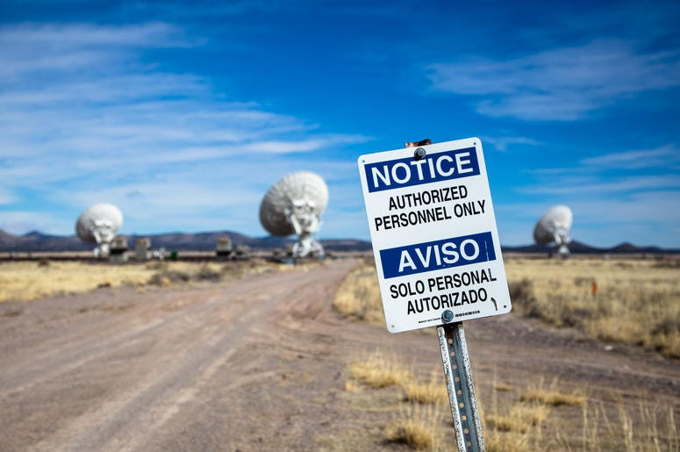
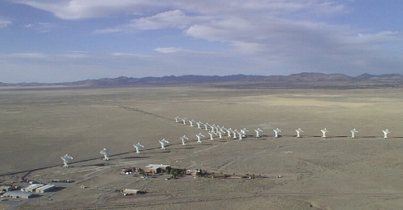
Topic 5 - What Channel Is This?
Connecting Radio Telescopes
By combining several small radio telescopes ( just like they do with optical telescopes ) greater resolving power can be achieved. The greater the distance between the radio telescopes the more accurately they can measure position.
Sorocco, New Mexico, which uses 27 telescopes arranged in a Y, can improve accuracy even more.

Slide 43
Topic 6 Above the Atmosphere and Under Control
There are three basic parts to a Rocket:
• The structural and mechanical elements are everything from the rocket itself to engines, storage tanks, and the fins on the outside that help guide the rocket during its flight.
• The fuel can be any number of materials, including liquid oxygen, gasoline, and liquid hydrogen. The mixture is ignited in a combustion chamber, causing the gases to escape as exhaust out of the nozzle.
• The payload refers to the materials needed for the flight, including crew cabins, food, water, air, and people.

Slide 45
Topic 6 Above the Atmosphere and Under Control

Slide 46
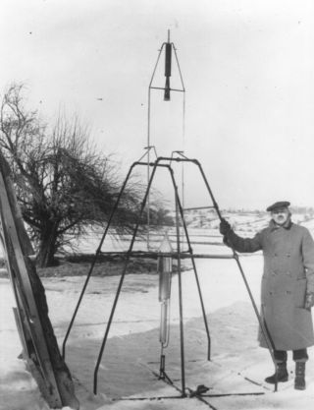
Topic 6 Above the Atmosphere and Under Control
Rocket Fuel
Rockets need combustible fuel to make them fly. All fuels create exhaust which comes out the end of the rocket. The speed of the exhaust leaving the rocket is called the exhaust velocity, which determines the range of the rocket. The gravitational escape velocity had to be achieved (28,000 km/h), if humans were to venture into space.
Robert Goddard launched the first liquid fuel rocket in 1926. The rocket was staged (having more than one section that drops off once its fuel is used up, making the rest of the rocket lighter and able to fly higher.

Slide 47
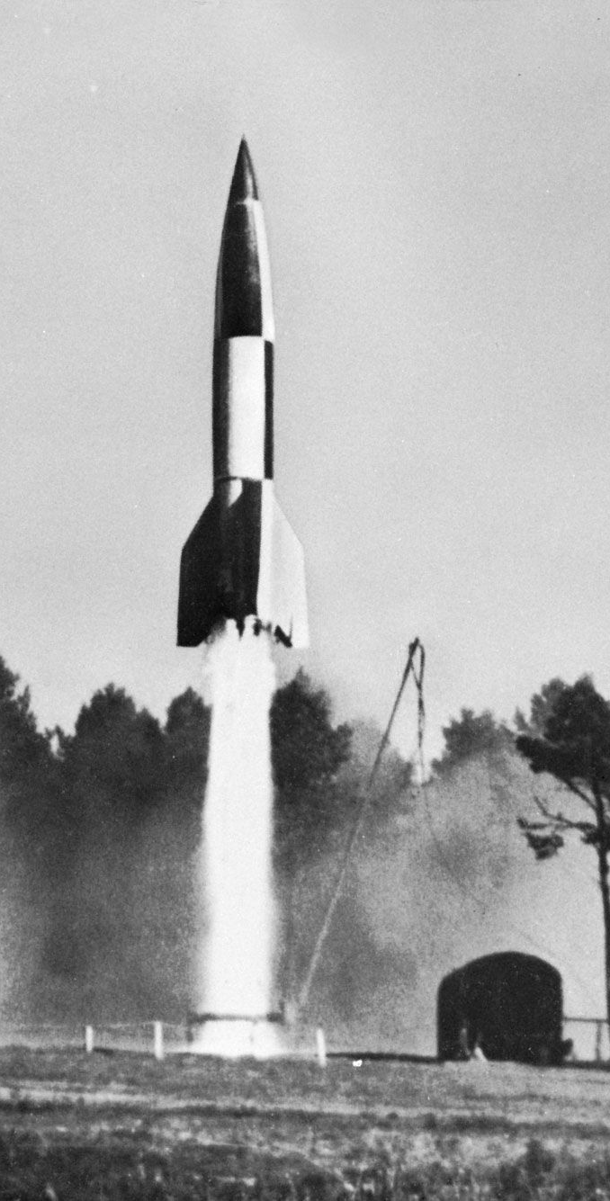
Topic 6 Above the Atmosphere and Under Control
The V-2 Rocket
Werner von Braun built the 1st ballistic missile for the Germans during World War II (1942). A ballistic missile is a bomb that is powered by a rocket engine. The V-2 rocket successfully found a target that was 200kms away. The Americans captured von Braun and his rocket team. As a result of their work NASA was born.
The Russians were not far behind as Sergi Korolev designed the Vostok, Voshkod and Soyuz rockets which carried ‘cosmonauts’ into space first.

Slide 48
Topic 6 Above the Atmosphere and Under Control
Computers – Making Adjustments
In the 1960’s the Americans and the Russians were racing to launch spacecraft into orbit using rockets. As computers became smaller they were put onboard the spacecraft and worked with computers on the ground to control the flight.
A technique called gravitational assist is a method of acceleration which enables a spacecraft to achieve extra speed by using the gravity of a planet. The planet’s gravity attracts the craft causing it to speed up and change direction (a slingshot effect), sending it on to the next planet.
Computers improve our ability to see the stars better. Charge coupled devices (CCD’s) record these images, by converging light signals into digital format. They are then sent by a computer where they are processed in ways that can remove ‘noise’ and sharpen images.

Slide 50
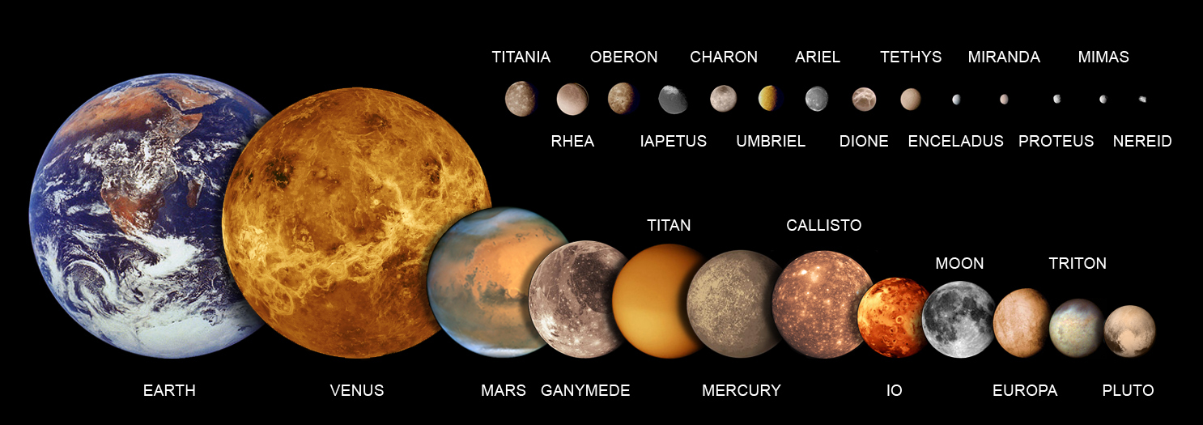
Topic 6 Above the Atmosphere and Under Control
Satellites and Orbits
Satellites can be natural – small bodies in space that orbit a larger body ( the Moon is a satellite of the Earth ), and they can be artificial – small spherical containers loaded with electronic equipment, digital imaging and other instruments that are launched into Earth’s orbit.

Slide 51
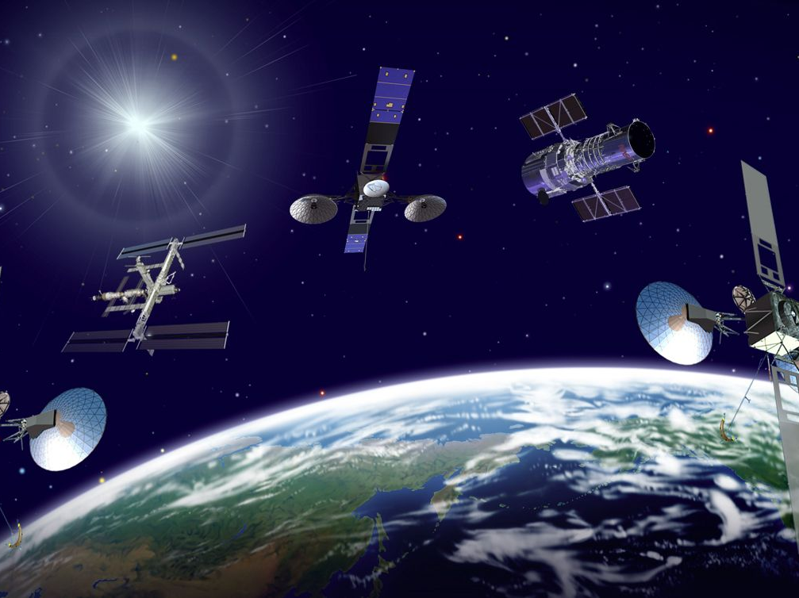
Topic 6 Above the Atmosphere and Under Control
Communication Satellites
These satellites provide ‘wireless’ technologies for a wide range of applications. Digital signals have resulted in clearer communications and more users. Anik 1 (launched by Canada in 1972) transmitted the first television broadcasts by satellite.

Slide 52
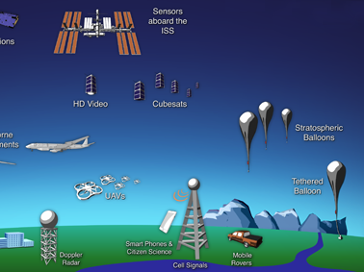
Topic 6 Above the Atmosphere and Under Control
Remote Sensing
Those satellites in low orbits perform remote sensing – a process in which digital imaging devices in satellites make observations of Earth’s surface and send this information back to Earth.
The activities include providing information on the condition of the environment, natural resources, effects of urbanization and growth. This information is usually used for planning purposes. Satellites as Personal Tracking Devices ( GPS )

Slide 53
Topic 6 Above the Atmosphere and Under Control
Satellites for Observation and Research
A geosynchronous orbit is one that enables a satellite to remain in a fixed position over one part of the Earth, moving at the same speed as the Earth. Numerous applications are now possible including:
• Monitoring and forecasting weather
• LANDSAT & RADARSAT (are not in geosynchronous orbit) – follow ships at sea, monitor soil quality, track forest fires, report on environmental change, and search for natural resources.
• Military and government surveillance

Slide 54
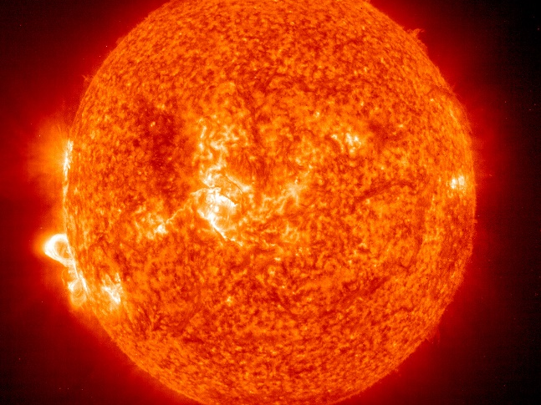
Topic 7: The Solar System Up Close
The Sun is made up of mostly hydrogen gas. It is 1.4 million km in diameter.
Its temperature is about 15 million degrees Celsius. 600t of hydrogen are converted, by nuclear fusion, into helium per second. This is the energy released from the Sun.
The Sun emits charged particles in all directions. This solar wind bombards the Earth at 400km/s, but the magnetic field of the Earth protects us.

Slide 56
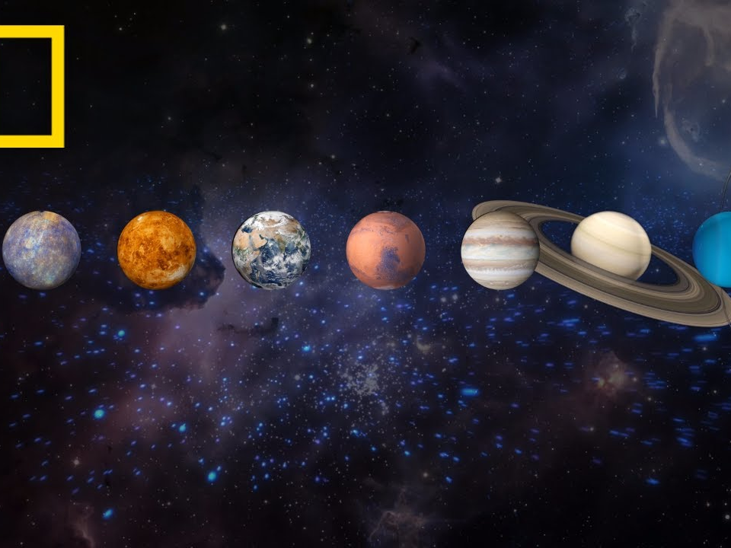
Topic 7: The Solar System Up Close
Traveling through The Solar System
The formation of our solar system is based on the ‘protoplanet hypothesis’, which follows three steps:
1. A cloud of gas & dust in space begin swirling
2. Most of the matter (more than 90% of it) accumulates in the center – forming the Sun
3. The remaining materials accumulate (forming planets) and circle the Sun

Slide 57
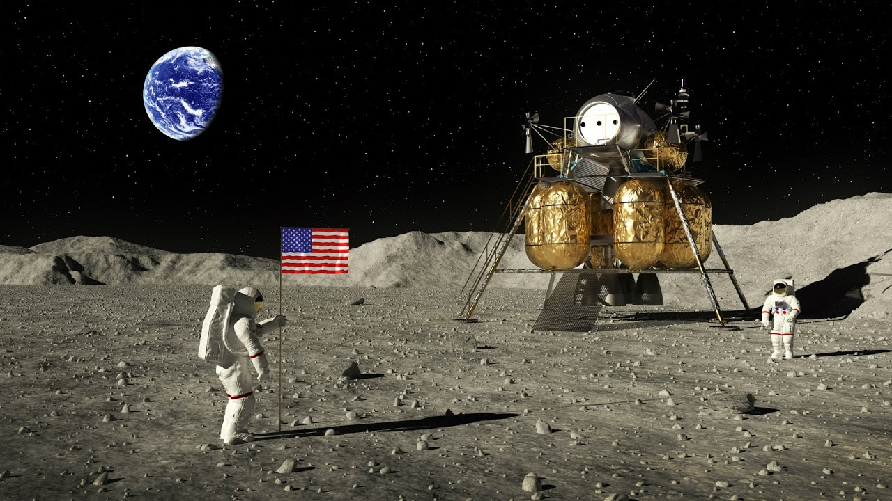
Topic 7: The Solar System Up Close
The Moon
The first other world to see up close was the Moon. On July 17, 1969 Neil Armstrong and Edwin Aldrin landed on the moon for a first hand look.

Slide 58
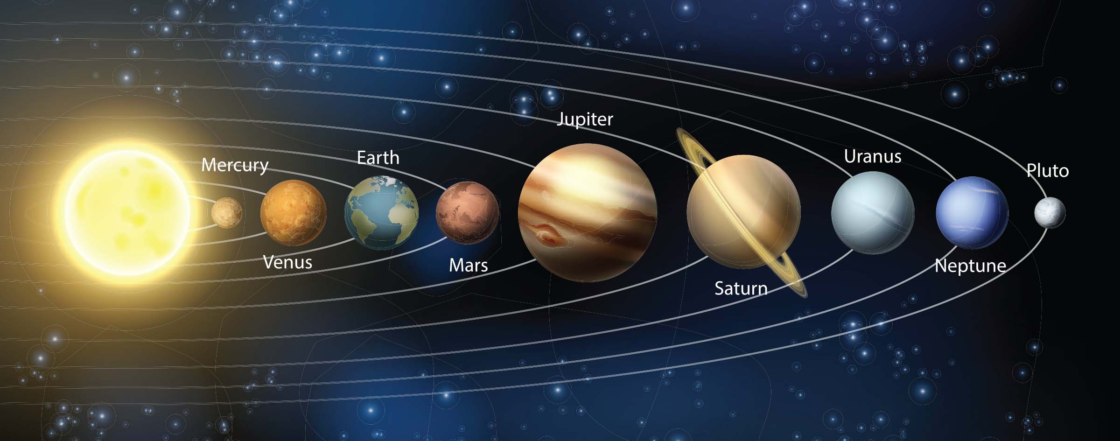
Topic 7: The Solar System Up Close
The Inner Planets - Mercury, Venus, Mars and the Earth - are considered the terrestrial planets because of their composition. The Outer Planets – Jupiter, Saturn, Uranus, Neptune, and Pluto – are similar because of their gaseous composition

Slide 59
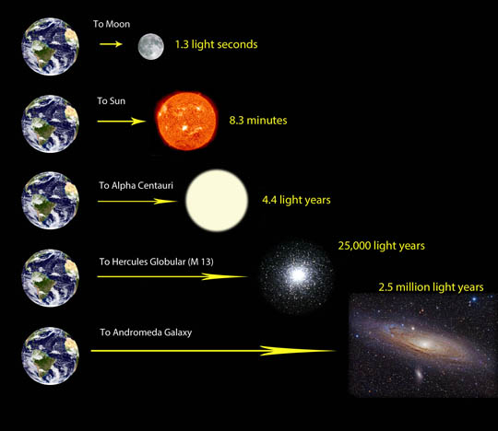
Topic 7: The Solar System Up Close
The astronomical unit is used for measuring ‘local’ distances in the solar system. It is equal to the distance from the center of the Sun to the center of the Earth (approximately 149,599,000 kms).
A light year is equal to the distance light travels in 1 year (approximately 9.5 trillion kms). It is used for longer distances – to stars and galaxies. The distance to our nearest star, Proxima Centauri is a little over 4 light years.

Slide 60
Topic 7: The Solar System Up Close
When you view an object in the sky you are seeing it as it was in the past. It has taken the light a very long time to reach the Earth. Light from the Sun takes about 8 minutes to reach the Earth, whereas light from Pluto takes about 5 hours. The farther away, the longer light takes to reach the Earth. Light from the stars in the center of the universe takes about 25,000 years to reach the Earth. The Hubble telescope is capturing light from 12 billion years ago!!!

Slide 61
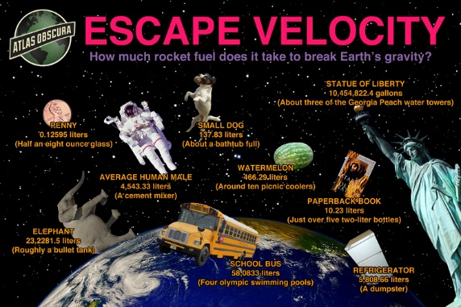
Topic 8: People in Space
Breaking Free of Earth’s Gravity
The energy it takes to get up into orbit and stay there is huge. Gravity must be overcome and to do so, takes a speed of 8km/s. This is called escape velocity.
Even when the gravity of the Earth is overcome, there are other hazards in this ‘unfriendly to humans’ space environment, which can cause a mission to fail and possibly be a disaster, resulting in loss of life, economic setbacks and many years of work.

Slide 62
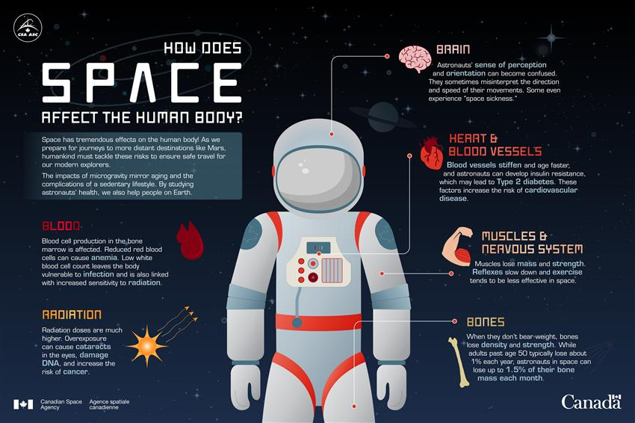

Slide 64
Topic 8: People in Space
The Space program – Notable Achievements
Sputnik: The Soviet Union was the 1st to successfully orbit a satellite in 1957
Vostok: The first person in space was also a Russian. Yuri Gagarin orbited the Earth in Vostok 1 at an altitude of 302 km for 108 minutes. In 1963 Valentina Tereshkova was the 1st female to travel into space in Vostok 6.
Freedom 7: Project Mercury brought the first American - Alan Shepherd - into orbit on May 5, 1961, aboard Freedom 7. Shepherd flew a suborbital flight, which is just above the atmosphere, but not completely in orbit. The 1st orbital flight was made by John Glenn in 1962.
Moon Landing - Apollo 11 lunar (Moon) landing almost didn’t occur, because the original landing site was found to be too rocky. With a precise amount of fuel, an alternate landing site had to be chosen on the first try, or the mission would be scrubbed. In the summer of 1969 Neil Armstrong and Edwin Aldrin were the 1st humans to set foot on another place in space, when they landed on the Moon.
Meeting In Space: The Apollo/Soyuz joint mission was tested in 1975. It was the first international space mission. The universal docking model was tested and was successful.

Slide 65
Topic 8: People in Space
Life Support Compatibilities

Slide 66
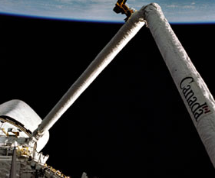
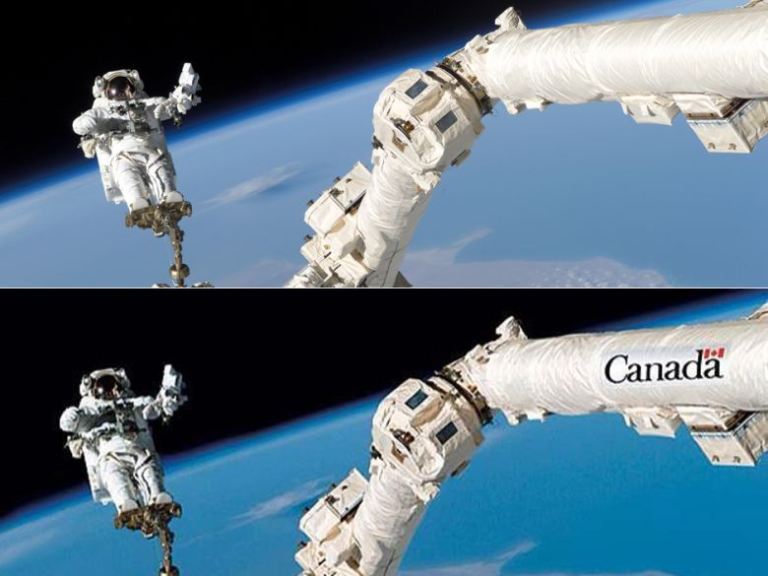
Topic 8: People in Space
Shuttle, Space probes and Space Stations
Shuttles transport personnel and equipment to orbiting spacecraft. Columbia was the 1st in 1981
Space probes carry instrumentation for exploration of space
International Space Stations are orbiting space centers where research, experimentation, and further exploration can be carried out by people living there for extended periods of time
The Canadarm - 1981

Slide 67
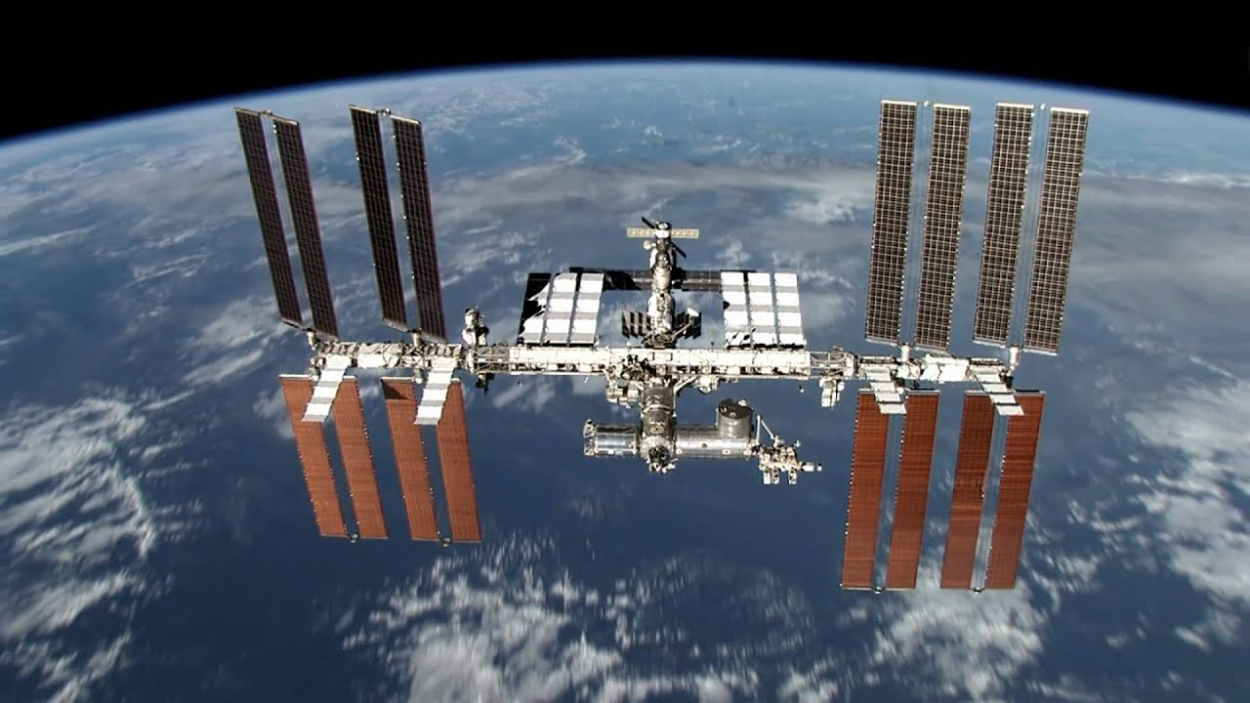
Topic 8: People in Space
The International Space Station - A Home In Space Outside Earth’s atmosphere, life-support systems have to be artificially produced. Clean water, fresh air, comfortable temperatures and air pressure are essential to life.
All these support systems, including a power supply to operate them, must be operational on the International Space Station at all times.

Slide 69
Topic 8: People in Space
Recycling Water
Almost 100% of the water in the station must be recycled. This means that every drop of wastewater, water used for hygiene, and even moisture in the air will be used over and over again. Storage space is also a problem, making recycling essential for survival.
The main functions of the life-support systems include:
• Recycling wastewater
• Using recycled water to produce oxygen
• Removing carbon dioxide from the air
• Filtering micro-organisms and dust from the air
• Keeping air pressure, temperature and humidity stable

Slide 70
Topic 8: People in Space
Shocking NASA Inventions We Use Everyday

Slide 71
Topic 8: People in Space
Producing Oxygen
Electrolysis of water (remember H2O can be split into hydrogen and oxygen). The astronauts use the oxygen and the hydrogen is vented into space.
To survive in space (which is a cold vacuum), technologies have needed to be developed to overcome the hazards of this harsh environment.
A manned flight to Mars would last 2 to 3 years, which is a long time to be in an enclosed environment.
Space is a vacuum with no air or water. Cosmic and solar radiation, and meteoroids are the greatest dangers. Because there is no atmosphere, the temperatures in space have both extremes - from extremely hot, to extremely cold.
There is also no atmospheric pressure to help regulate the astronaut’s heartbeats.

