Slide 1
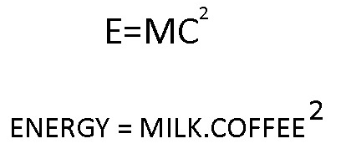
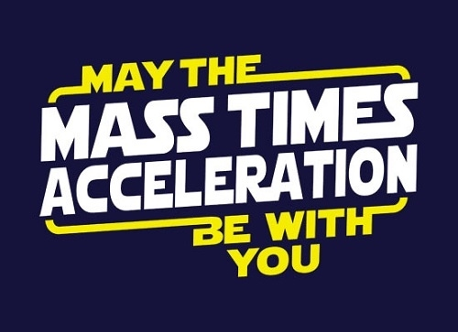
Energy Flow in Technological Systems
Unit B – science 10
redding

Slide 2
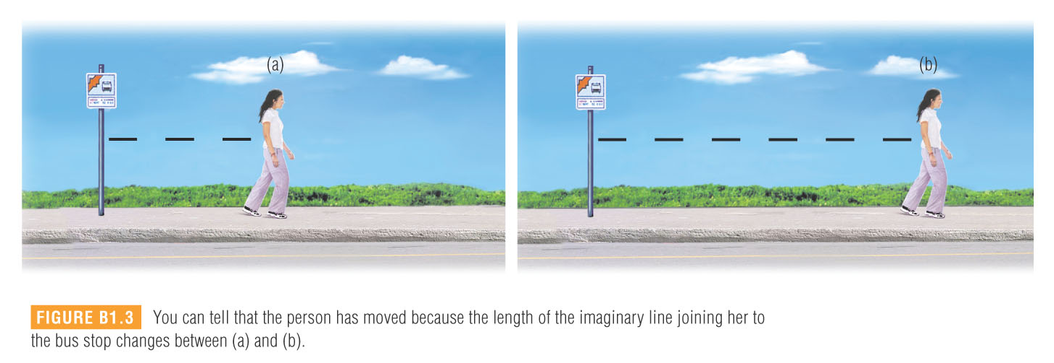
Motion
The term uniform motion describes an object that moves at a constant rate in the same direction.
True uniform motion is nearly impossible to maintain in real life situations

Slide 3
Average Speed
t = 1.2 s
5.0 m
The car moved a distance of 5.0 m in a time of 1.2 s. It did not exhibit uniform motion because it sped up and slowed down.
The average speed of the car is defined as a change in distance during a time interval.
v_{avg} = average speed (m/s)
Δd = distance travelled (m)
Δt = time elapsed (s)
The Δ is the greek letter delta and means “change in.”

Slide 4


examples:
Practice Problems p. 128
1) A huge ocean wave, or tsunami, travels a distance of 4.0 x 10⁶ m in 3.6 x 10⁴ s. Calculate the average speed of the tsunami.
1.1 x 10² m/s
2) A Concorde airplane could fly at an average speed of 694 m/s. Calculate how long it would have taken the Concorde to fly around the world, which is approximately 4.00 x 10⁷ m.
5.76 x 10⁴ s
3) An electric train is travelling at an average speed of 6.9 m/s for 4.0 s. Calculate the distance travelled by the train.
28 m

Slide 5
Distance-Time Graphs
A motorboat is travelling at a constant speed. A person on the shore is recording the distance the boat travels away from the first marker buoy every 2.0 s.
Time t (s) | Distance from First Marker d (m)
0.0 | 0
2.0 | 10
4.0 | 20
6.0 | 30
8.0 | 40
10.0 | 50
A distance vs time graph can be plotted to analyze the motion of the boat.
Distance vs Time
Distance (m)
text p.129
Time (s)

Slide 6
Distance vs Time
change in distance
slope
Distance (m)
change in time
average speed =
Time (s)
The slope of a line on a distance-time graph is equal to the average speed of the object.

Slide 7
Distance vs Time
Distance (m)
= 5.0 m/s
(0,0)
(6.0,30)
Time (s)
So, the boat is moving at a constant rate of 5.0 m/s.

Slide 8
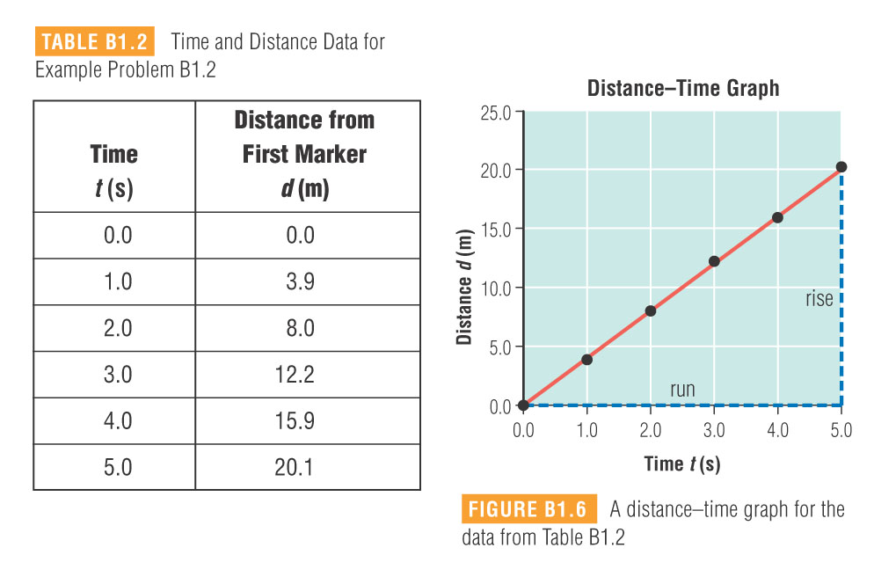

Slide 9
Distance vs Time
The graph shows the motion of three different cars.
1
2
Distance (km)
3
All three cars have a constant speed, because the slope of their line does not change.
Time (h)
text p.130
Car 1 is travelling at a constant speed, faster than car 2 (slope is steeper).
Car 2 is travelling at a constant speed, slower than car 1 (slope is not as steep).
Car 3 is stopped. The slope is zero, therefore the speed is zero. The distance does not change as time passes.

Slide 10
Speed-Time Graphs
Time When Boat Passes Marker t (s) | Speed of the Boat as it Passes Each Marker v (m/s)
0.0 | 5.00
2.0 | 5.00
4.0 | 5.00
6.0 | 5.00
8.0 | 5.00
10.0 | 5.00
The boat is exhibiting uniform motion, so that means the speed does not change.
Speed vs Time
Speed (m/s)
text p.130
A horizontal line has a slope of zero, and that means that the speed stays constant as time passes.
Time (s)

Slide 11
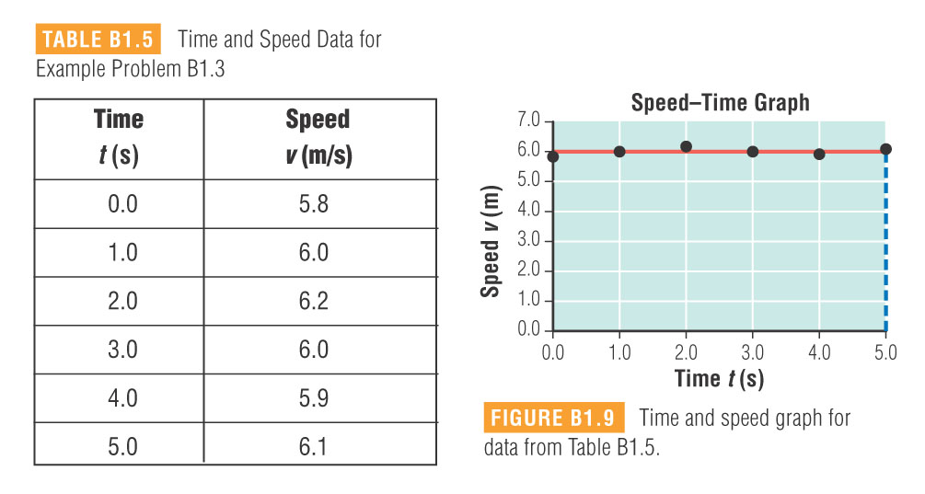

Slide 12
The slope of a line on a speed-time graph indicates that an object is either speeding up or slowing down.
Speed vs Time
A
Object A is increasing its speed (positive slope).
Speed (m/s)
B
Object B is decreasing its speed (negative slope).
Time (s)
text p.131

Slide 13
The area under the line of a speed-time graph determines the distance the object travels.
Speed vs Time
A boat is travelling at a rate of 10 m/s for 5.0 s.
The area under the line forms a rectangle.
10
Speed (m/s)
area = length x width
Time (s)
5.0
The boat travels a distance of 50 m.
= 50 m

Slide 14

Homework:
read pages 126 – 133
B1.1 Check and Reflect page 135 #’s 1 – 9

Slide 15
Scalars and Vectors
Scalar:
A scalar quantity has magnitude (size) only, but no direction.
Examples include: time, mass, distance and speed.
Vector:
A vector quantity has both magnitude and direction.
Examples include: displacement, velocity and force.

Slide 16
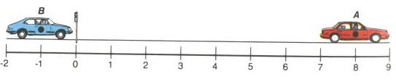
Position
The position of an object is the separation between that object and a reference point. (which is usually “zero” on the scale)
The position of car B is 1.0 m to the left of the reference.
The position of car A is 8.0 m to the right of the reference.
Since we stated the direction, position is a VECTOR quantity.

Slide 17
Distance
Distance, on the other hand, needs no frame of reference.
You measure the distance between two objects by measuring their separation.
Car A is 9.0 m from car B no matter where you put the reference point.
Since we did not state the direction, distance is a SCALAR quantity.

Slide 18
Displacement
5.0 m
The displacement of an object is defined as its change in position, relative to where it started.
direction!
The car has moved a distance of 5.0 m.
The displacement of the car is 5.0 m to the right.
Since we stated the direction, displacement is a VECTOR quantity.

Slide 19
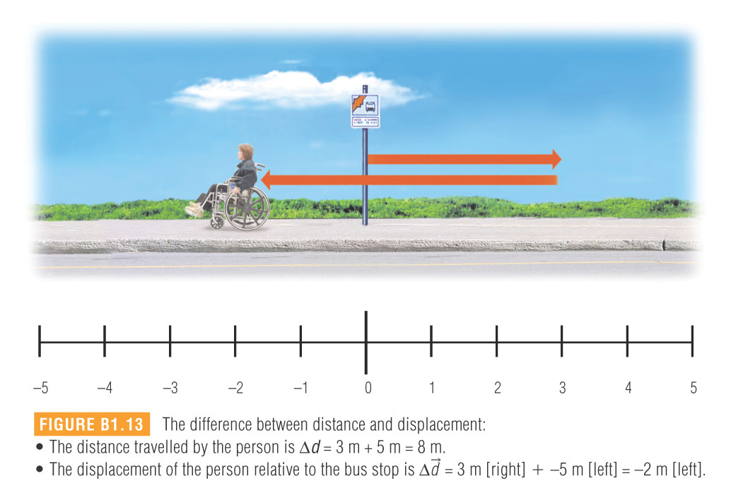

Slide 20

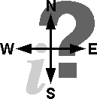
Vector Sign Conventions
When using vector quantities in formulas, we do not write the directions using words.
Instead, we use positive (+) and negative (-) signs.
positive directions
negative directions
forward
backward
up
down
right
left
east
west
north
south

Slide 21
Average Velocity
t = 1.2 s
5.0 m
The car has a displacement of 5.0 m to the right in 1.2 s.
The average velocity of the car is defined as a change in position during a time interval. It is called an average velocity because it does not take into account speeding up and slowing down.
= average velocity (m/s)
= displacement (m)
Δt = time (s)
We use the arrows “→” to indicate vector quantities.

Slide 22
5.0 m
t = 1.2 s
= 4.2 m/s to the right
Since we stated the direction, average velocity is a VECTOR quantity.

Slide 23
examples:
Practice Problems p. 141
8) A student walks 10.0 m [E] in 7.00 s. Then he walks another 12.0 m [E] in 8.00 s. Determine:
a) the displacement of the student in 15.00 s
22.0 m [E]
b) the average velocity of the student.
1.47 m/s [E]
9) A boat travels at a velocity of 8.00 m/s [N] for 14.0 s. What is the displacement of the boat?
112 m [N]
10) An airplane flying at a velocity of 900 km/h [W] travels 400 km west. How long will the plane be in flight?
0.444 h

Slide 24
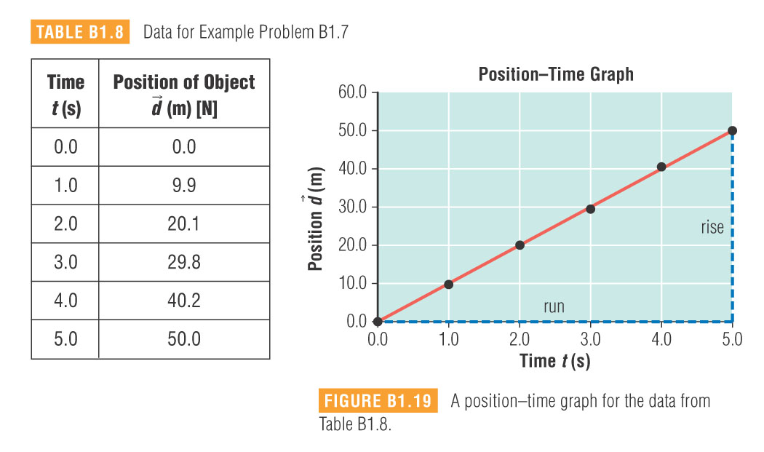
The only difference between distance-time graphs and position-time graphs is that direction is included. This means that the slope is equal to the velocity.

Slide 25
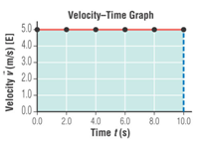
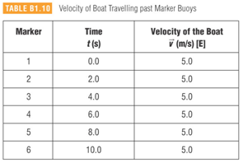

Slide 26
Homework:
read pages 137 – 144
B1.2 Check and Reflect Page 145 #’s 1, 2, 5, 6, 7

Slide 27
Acceleration is defined as a change in velocity during a specific time interval.
= acceleration (m/s²)
= change in velocity (m/s)
= time interval (s)
= final velocity (m/s)
where
= initial velocity (m/s)
Since velocity is a vector quantity, it has both magnitude and direction.
So, an accelerating object can be changing speed and/or direction. In this course, we will focus on objects that are changing speed.

Slide 28
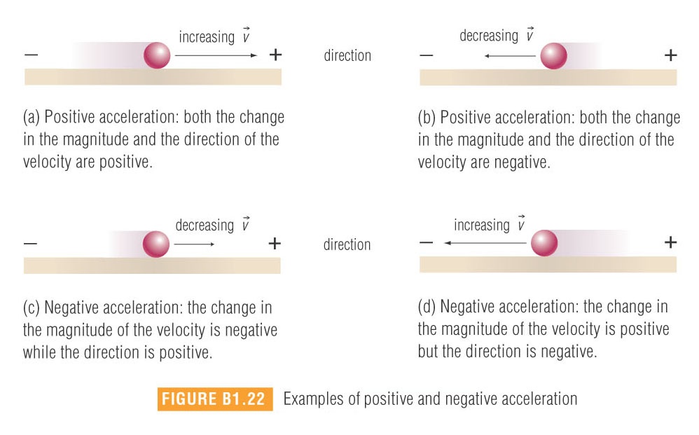

Slide 29


Metres per second squared??
change in velocity
Let’s look at the formula to better understand what this really means . . .
units: (m/s)
change in time
“metres per second per second”
units: (s)
So, for example, an object with an acceleration of 2.0 m/s² changes its velocity by 2.0 m/s each second.
Acceleration can be described as a rate of change of velocity.
So, “metres per second squared” is the same as “metres per second per second.”

Slide 30
examples:
Practice Problems p. 147
12) A shuttle craft accelerates from rest to a velocity of 50 m/s [upward] in 4.00 s. What is the acceleration?
13 m/s² [upward]
13) A baseball thrown at 25.0 m/s strikes a catcher’s mitt and slows down to rest in 0.500 s. What is the magnitude of the ball’s acceleration?
50.0 m/s²
14) A hockey puck travelling at 10.0 m/s strikes the boards, coming to rest in 0.0300 s. What is the magnitude of the puck’s acceleration?
333 m/s²
15) A car driver applies the brakes and slows down from 15.0 m/s [E] to 5.00 m/s [E] in 4.00 s. Determine the car’s acceleration.
2.50 m/s² [W]

Slide 31

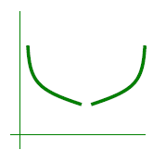
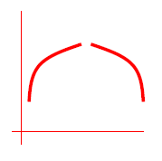

Position-Time Graphs
Recall that the slope of the line on a position-time graph is the velocity of the object, and that an accelerating object is changing its velocity.
So, that would give us a position-time graph where the line has a changing slope.
A curved line on a position-time graph means the object is accelerating.
If you see either one of these curves, then it is positive acceleration.
If you see either one of these curves, then it is negative acceleration.

Slide 32
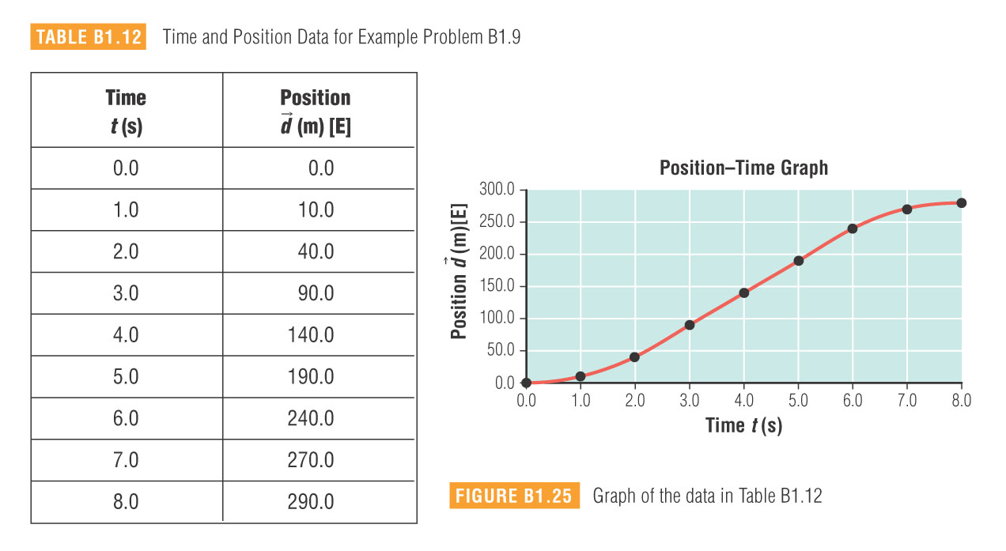
Use the graph to describe the motion of the object in each time interval:
a) t = 0.0 s to t = 3.0 s
b) t = 3.0 s to t = 6.0 s
c) t = 6.0 s to t = 8.0 s
increasing velocity
constant velocity
decreasing velocity

Slide 33
Velocity-Time Graphs
Time t (s) | Velocity of Boat v (m/s) [E]
0.0 | 0.0
1.0 | 2.0
2.0 | 4.0
3.0 | 6.0
4.0 | 8.0
5.0 | 10.0
A motorboat is accelerating in an easterly direction and the velocity of the boat is recorded every second for 5.0 seconds.
text p. 152
Velocity vs Time
A velocity-time graph is used to describe the motion of the boat.
Velocity (m/s)
Time (s)

Slide 34
Velocity vs Time
change in velocity
slope
Velocity (m/s)
change in time
acceleration =
Time (s)
The slope of a line on a velocity-time graph is equal to the acceleration of the object.

Slide 35
Velocity vs Time
Velocity (m/s)
= +2.0 m/s²
Time (s)
(0,0)
(3.0,6.0)
So, the boat is accelerating at a constant rate of 2.0 m/s² east.

Slide 36
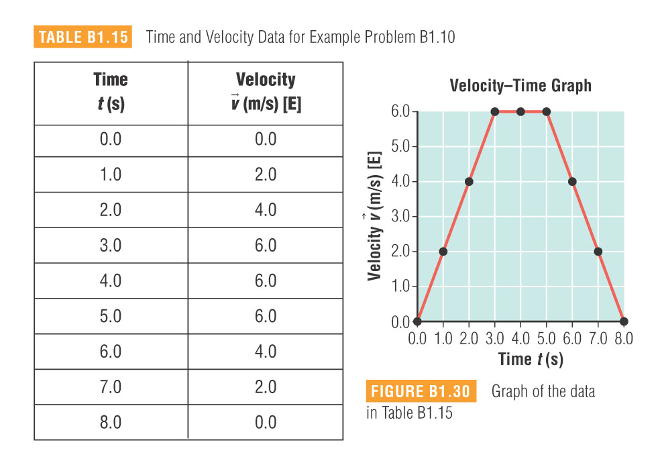
Use the graph to describe the motion of the object in each time interval:
a) t = 0.0 s to t = 3.0 s
b) t = 3.0 s to t = 5.0 s
c) t = 5.0 s to t = 8.0 s
increasing velocity
constant velocity
decreasing velocity

Slide 37
The graphs can be related to each other, but that doesn’t mean you look at them the same way.
d vs t
v vs t
1) An object moves at a
constant velocity.
d vs t
v vs t
2) An object stops moving.

Slide 38
d vs t
v vs t
3) An object speeds up at a constant rate.
4) An object slows down at a constant rate.
d vs t
v vs t

Slide 39
Homework:
read pages 146 – 153
B1.3 Check and Reflect page 154 #’s 1 – 10

Slide 40
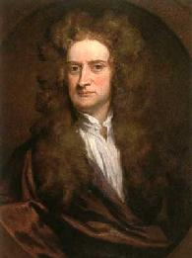
Force
A force can be described as a
or a
.
The unit for force is the newton.
symbol: N
We will only review forces briefly and qualitatively, but the formula for calculating forces is:
force = mass × acceleration
(N)
(m/s²)
(kg)
Sir Isaac Newton
(1642 – 1727)
“One newton equals one kilogram metre per second squared.”

Slide 41

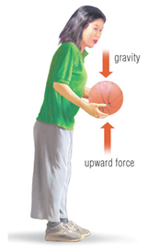
Balanced Forces
When the forces acting on an object are balanced, it will remain at a constant velocity (including zero).
Force 1 and force 2 are balanced (equal in magnitude and opposite in direction).
To lift a ball up at a constant speed, you must apply a force that is equal to the force that gravity pulls on the ball with (i.e. the weight of the object).

Slide 42

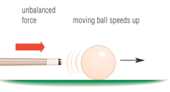
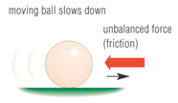
Unbalanced Forces
If the forces acting on an object are unbalanced, then the object will accelerate.
The direction of the acceleration will be in the direction of the strongest force.
Forces can be used to transfer energy, or convert energy from one form to another.

Slide 43
Work & Energy
Work and energy are two concepts which are very closely related to one another.
energy: the ability to do work
work: the transfer of energy from one object to another, or from one
form of energy to another.
In physics, we speak about work being done on an object.
W = work (J)
= applied force (N)
= distance the object moves (m)

Slide 44
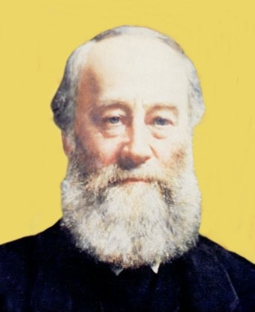

The S.I. unit for work is the joule.
1 joule = 1 J
The joule, like the newton, is a derived unit. To see how we break it down from it’s fundamental units, we look at the formula:
James Prescott Joule
(1818 – 1889)
“One joule is equal to one newton-metre.”
(J)
(N)
(m)
The joule broken down into its fundamental units.
So, the unit that we use for energy is also the joule.
Work is a transfer (or conversion) of energy.

Slide 45

The direction the object moves must be in the same direction as the applied force, otherwise no work is being done.
For each of the following examples, do I do any work?
1) I carry a 2.0 kg wheel of cheese 12.0 m across the room.
The force that I apply to hold the cheese up is vertical, and the cheese only moves horizontally.
These directions are perpendicular!

Slide 46
2) I lift a 2.0 kg wheel of cheese from the ground to the top of a table.
The direction of the displacement is the same as the direction as the applied force.
3) I push against a wall with a force of 130 N for 10.0 s.
The wall did not move.

Slide 47
examples:
Practice Problems p. 160
18) A tugboat is towing a tanker through a canal using a towrope. Calculate the work done by the tugboat if it applies an average horizontal force of 6.50 x 10³ N on the towrope while towing the tanker through a horizontal distance of 150 m.
9.75 x 10⁵ J
19) A large crane did 2.2 x 10⁴ J of work in lifting a demolition ball a vertical distance of 9.5 m. Calculate the average force exerted by the chain on the ball.
2.3 x 10³ N
20) A large crane does 2.2 x 10⁴ J of work in lifting an object. How much energy is gained by the object?
2.2 x 10⁴ J

Slide 48
Work Input
and
Work Output
The work (or energy) input can be calculated using the formula
W = Fd.
When doing work, sometimes some energy is lost as useless heat because of a resistive force, like friction.
The work (or energy) output is the amount of energy the object or system gains as a result of the work being done.
It is the work input minus any energy lost as the result of friction.

Slide 49
Calculating Work From Force vs Displacement Graphs
Force vs Displacement
To calculate work from a force-displacement graph, we calculate
THE AREA UNDER THE CURVE.
By “under the curve,” we mean the area between the line and the x-axis.
Force (N)
5.0
Let’s say we wanted to calculate the work done on the object in moving it 10.0 m.
The area under the curve forms a rectangle.
area = length x width
10.0
Displacement (m)
= (5.0 N) (10.0 m)
= 50 J
So, the work done was 50 J.

Slide 50
Homework:
read pages 155 – 160
B1.4 Check and Reflect Page 161 #’s 1 – 10

Slide 51


Mass
Weight
vs
The mass of an object is a measure of the amount of matter that makes it up.
The mass of an object has nothing to do with the amount of gravity.
An object will have the same mass on Earth as it does on the moon, or even in a region where there is no gravity.
Mass is a scalar quantity, and is measured in kilograms (kg).

Slide 52




The weight of an object is the gravitational force exerted on it by a large body (usually Earth).
Weight is a force, and is therefore a vector quantity and measured in newtons (N).
= weight (N)
m = mass (kg)
= acceleration due to gravity (m/s²)
On Earth, g = 9.81 m/s²
The difference between mass and weight . . .

Slide 53



Potential Energy
Potential energy is energy stored in an object because of its state or position.
Examples include:
chemical potential energy
elastic potential energy
In this course, we will focus on gravitational potential energy.
The reference point is usually whatever the object will hit if it is dropped.
= gravitational potential energy (J)
m = mass (kg)
g = acceleration due to gravity (m/s²)
h = height above reference (m)

Slide 54
h₁
When held above the table top, we see that the apple does not have a lot of gravitational potential energy.
Move the apple horizontally so that the ground is now the reference point and the apple has a lot more gravitational potential energy.
We are NOT creating energy when we do this.
h₂
Instead, we are just changing the proportion of Ep versus other forms of energy.
The point is: the gravitational potential energy can be set to zero at any point you choose.
Only CHANGES in potential energy can be measured!!

Slide 55
examples:
Practice Problems p. 174
1) A child with a mass of 25.0 kg is at the top of a slide in an amusement park. If the vertical height of the slide is 4.00 m, calculate the gravitational potential energy of the child relative to the ground.
981 J
2) An 800-g bird has 47.0 J of gravitational potential energy when it is perched high up in a tree. Calculate the bird’s vertical height from the ground.
5.99 m
3) A hanging sign is 3.00 m above the ground and has 1.47 x 10³ J of gravitational potential energy. Calculate the mass of the sign.
49.9 kg

Slide 56
Homework:
Read pages 164-171
(Section B2.1)
Read pages 173 – 178
B2.2 Check and Reflect Page 178 #’s 1 – 11

Slide 57

Kinetic Energy
Kinetic energy is energy due to motion.
Any moving object that has mass, has kinetic energy.
The kinetic energy of an object varies directly as its mass.
So, for example, if you double the mass of an object, its kinetic energy will double.
= kinetic energy (J)
m = mass (kg)
The kinetic energy of on object varies directly as the square of its speed.
v = speed (m/s)
This is a “direct squared” relationship!
So, for example of you double the speed of an object, its kinetic energy will increase by a factor of four.

Slide 58
examples:
Practice Problems p. 179
4) Calculate the kinetic energy of an electron with a mass of 9.11 x 10⁻³¹ kg moving at a uniform speed of 2.00 x 10⁵ m/s.
1.82 x 10⁻²⁰ J
5) A small toy moving horizontally at a uniform speed of 2.2 m/s has a kinetic energy of 18 J. Calculate the mass of the toy.
7.4 kg
6) A baseball with a mass of 300 g has a kinetic energy of 304 J. Calculate the speed of the baseball.
45.0 m/s
7) A moving toy with a mass of 7.4 kg has a kinetic energy of 18 J. Calculate the speed of the toy.
2.2 m/s

Slide 59
Homework:
read pages 179 – 181
B2.3 Check and Reflect Page 182 #’s 1 – 7, 10

Slide 60



Mechanical Energy
The term mechanical energy means the sum of an object’s potential and kinetic energy.
When work is done on an object, the object gains energy as a result.
An object is gaining kinetic energy if it increases its speed.
An object is gaining gravitational potential energy if it is getting higher above the reference point (the ground).

Slide 61
The Law of Conservation of Mechanical Energy
The law of conservation of mechanical energy is:
“Within a closed, isolated system, energy can change form, but the total amount of mechanical energy remains constant.”
A closed, isolated system means that it is isolated from external forces, so no work can be done on it (i.e. energy can’t be added or taken away). It is sometimes referred to as a frictionless system. Friction “dissipates” energy as useless heat.
All this really means is that potential energy is being converted to kinetic energy, or vice versa.
You can divide both sides by the mass!!
So, we can say:

Slide 62
examples:
Practice Problems p. 183
8) A seagull flying horizontally at 8.00 m/s carries a clam with a mass of 300 g in its beak. Calculate the total mechanical energy of the clam when the seagull is 30.0 m above the ground.
97.9 J
9) A 55.0 kg high-jump athlete leaps into the air in an attempt to clear the bar. At the top of the leap, the athlete has a total mechanical energy of 3.00 x 10³ J and is moving at 8.33 m/s. Calculate the gravitational potential energy of the athlete.
1.09 x 10³ J
10) A construction worker drops a 2.00 kg hammer from a roof. When the hammer is 50.0 m above the ground, it has a total mechanical energy of 1.88 x 10³ J. Calculate the kinetic energy of the hammer.
899 J

Slide 63
examples:
Practice Problems p. 184
11) A 10.0 kg water balloon is dropped from a height of 12.0 m. Calculate the speed of the balloon just before it hits the ground.
15.3 m/s
12) A 30.0 kg child on a trampoline jumps vertically into the air at an initial speed of 1.60 m/s. Calculate how high the child will rise.
0.130 m
13) A 20.0 g dart is fired from a dart gun with a horizontal speed of 4.10 m/s. The total mechanical energy of the dart is 0.481 J. Calculate the gravitational potential energy of the dart.
0.313 J

Slide 64
examples:
14) A pendulum consists of a 500 g metal ball suspended on a 50.0 cm string. The ball is pulled horizontally and up a total vertical distance of 10.0 cm. It is then released. At the bottom of the arc, the mechanical energy of the ball was determined to be 0.491 J. What was the speed of the ball at the bottom of its arc?
1.40 m/s

Slide 65
Homework:
read pages 183 – 188
B2.4 Check and Reflect Page 188 #’s 1, 2, 5, 6, 7, 9

Slide 66



We use machines to convert the energy added to it (energy input)
to a different form of energy (useful energy output) that we may want to do work (useful work output).
A system will always lose some energy as wasted heat.
In other words, the useful energy input is never equal to the useful energy output.
A perfect machine, which is 100% efficient in converting energy, is only theoretical.

Slide 67
Efficiency
Efficiency is a measurement of how effectively a machine converts input energy into useful energy output.
This gives us the efficiency as a decimal between 0 and 1.
Efficiency is sometimes expressed as a percent.

Slide 68

examples:
Practice Problems p. 216
In lifting a car, the total mechanical energy input of a hydraulic hoist is 5.61 x 10⁴ J, while the useful mechanical energy output is 1.96 x 10⁴ J. Calculate the percent efficiency of the hoist.
1.96 x 10⁴ J
5.61 x 10⁴ J
x 100 % = 34.9 %
=

Slide 69
2) A small electric motor has an efficiency of 85%. In lifting a small load, it produces 15 J of mechanical energy output. Calculate the mechanical energy input of the motor.
total work output
efficiency
total work input =
x 100
15 J
85%
=
x 100
=
18 J

Slide 70
3) A Bunsen burner supplies 4.00 x 10³ J of heat to a small beaker of water. Only 125 J of heat is gained by the beaker and water. Calculate the percent efficiency of the burner.
=
125 J
4.00 x 10³ J
x 100
=
3.13 %

Slide 71

Where does all of our energy come from?
  Solar Energy Sources - Are derived directly or indirectly from the sun
    Solar radiation
      is radiated from the fusion reactions and is captured on the earth by plants, and solar panels
    Wind Energy
      Is the result of the sun heating the earth
      This causes convection currents to form which can then turn turbines and be converted into electrical energy
    Water Energy
      Is the result of the sun heating the water
      This causes evaporation that leads to rain → flowing rivers → dams

Slide 72
Continued…
    Biomass (indirect)
      Is any form of organic matter
      Examples are wood, plants, animal wastes, etc.
      These can combust (burn) to release chemical energy that is converted into thermal energy
    Fossil Fuels (indirect)
      Examples are oil, natural gas and coal
      Fossil fuels were formed from plants and animals that lived a long time ago

Slide 73
  Non-Solar Energy Sources
    Nuclear Energy
      Fission and Fusion
    Geothermal Energy
      Thermal energy from the earth’s interior
      Water is heated and transported up through geysers and hot springs
      Humans can us this to create steam and run turbines
    Tidal Energy
      Movement of the ocean in tides
      It is caused by the moon
      This can be used to turn turbines and create electricity

Slide 74
Continued…
Renewable Energy
  Ones that are continuous and always available
  Examples: wind, solar, water, geothermal, tidal & biomass
Non-Renewable Energy
  Ones that are limited and irreplaceable
  Examples: nuclear & fossil fuels

Slide 75
Perspective:
Our ancestors used our renewable resources as energy
Our energy demand has skyrocketed and we consume different energy forms
Conventional oil
Coal
Natural gas
Hydro
nuclear
Our demand for resources has grown as well as our population! So energy is becoming an important topic!

Slide 76
Energy Consumption/Conservation
FOSSIL FUEL | Yearly Consumption (x 10¹⁶ J) | Reserves Remaining (x 10¹⁶ J) | Estimated Years Remaining
Conventional Oil | 150 | 6 088 | 40
Coal | 96 | 21 362 | 216
Natural Gas | 92 | 5 893 | 62

Slide 77
How can we stop this trend?
Everyone reduce their consumption
Search for new fossil fuel reserves
Search for alternative energy sources
Get industries to use less energy
a) Energy-efficient lighting, heating & cooling equipment
b) Cogeneration – using waste energy from one process to power a second process (ex: heating a building)

Slide 78
Homework:
read pages 215 – 226
B3.3 Check and Reflect Page 220 #’s 1-12
B3.4 Check and Reflect Page 227 #’s 1-12

