Slide 1
Unit B Ecosystems & Population Change
Biology 20 – Redding 2019

Slide 2
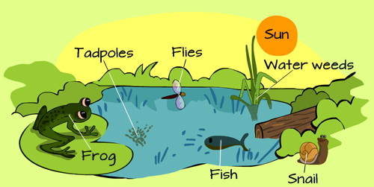
Chapter 3 Ecosystems and their Diversity

Slide 3
Ecosystems and their Diversity.
Focus for the Unit:
What are the major biotic and abiotic characteristics that distinguish aquatic and terrestrial ecosystems?
What data would one need to collect in a field study to illustrate the major abiotic characteristics and diversity of organisms?
What mechanisms are involved in the change of populations over time?
In what ways do humans apply their knowledge of ecosystems to assess and limit the impact of human activities?
Launch Lab – Page 77
Work with a partner to complete the analysis questions based on the Mountain Pine Beetle vs an Ecosystem.
Share as a class

Slide 4
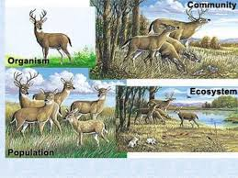
Individuals, Populations and Communities in Ecosystems
Organism (Species)
Organisms that can breed with one another and form fertile offspring
Population
A group of organisms of the same species living in a specific area at a specific time
Community
Populations of different organisms interacting with one another in a specific area
How are these different from an ecosystem?

Slide 5
Individuals, Populations and Communities in Ecosystems
Interactions between organisms and their environment can be divided into four levels: individuals, populations, communities, and ecosystems.
Abiotic elements of a community change over time, affecting organisms and their interactions on all levels.
The Biosphere
Includes all the ecosystems in the world and their interactions
Includes all parts of the earth where living organisms are found
Extends several kilometers into the atmosphere and several meters into the soil

Slide 6
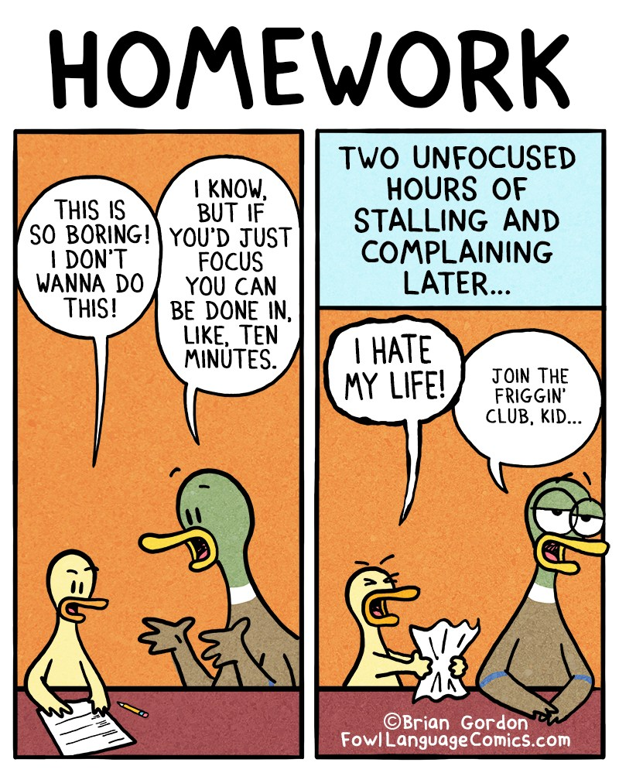
Homework:
New Vocabulary
Handout
Go back through section 3.1 and answer the 4 textbook questions
Copy the summary from 3.1 into your notes
Complete the section 3.1 Questions 1-8

Slide 7
Classifying and Naming Organisms
Taxonomy – practice of classifying living things

Slide 8
The 6 Kingdoms of Life
Archaea: Single-celled prokaryotic organisms that live in extreme environments
Bacteria: Single-celled prokaryotic organisms that live in a wide range of habitats
Protista: Consists of both single and multi-celled eukaryotic organisms
Fungi: Single and multi-celled eukaryotes that secrete enzymes to digest their food
Plantae: Eukaryotic multi-celled organisms that use photosynthesis
Animalia: Eukaryotic multi-celled organisms that are heterotrophs

Slide 9
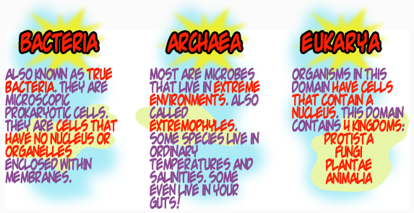
The 3 Domains of Life
The six-kingdom system has recently been revised as we have developed a better understanding of the relationships between some organisms
There are three major domains, which are large groups that encompass all of the kingdoms
Archaea
Bacteria
Eukarya

Slide 10
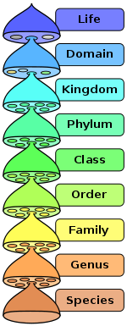
The Levels of Classification
There are 8 separate levels of classification
These 8 levels are, from most inclusive to most exclusive:
Domain, Kingdom, Phylum, Class, Order, Family, Genus, Species
This system (minus the Domain classification) was developed by Carolus Linnaeus

Slide 11
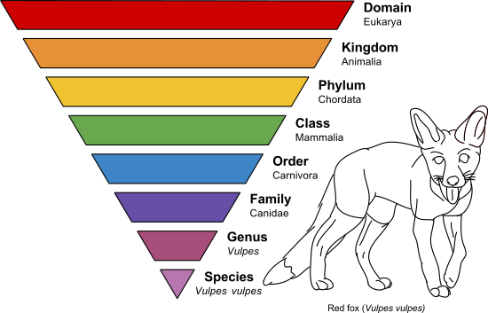
Naming Systems
We now use binomial nomenclature to identify and classify species
Every organism is therefore referred to through its genus and species name
These names are recorded in Latin and occasionally Greek (so that they are consistent regardless of the language of the scientist that classifies the organism)

Slide 12
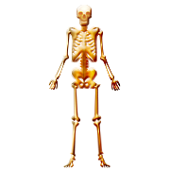
Classifying the Human
Domain: Eukarya
Kingdom: Animalia
Phylum: Chordata
Class: Mammalia
Order: Primates
Family: Hominidae
Genus: Homo
Species: sapiens

Slide 13
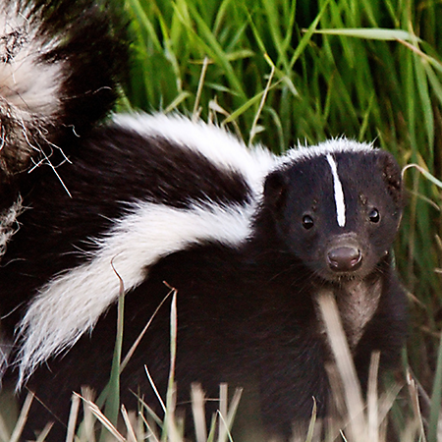
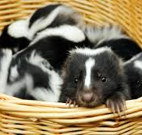
Changing Names
With the ability to genetically sequence the DNA of any organism, we can now verify whether or not a particular organism is correctly classified
We can compare an organisms’ DNA to other organisms that we suspect are related
For instance, skunks have recently been removed from the family that contains the weasels and have been placed in their own family

Slide 14
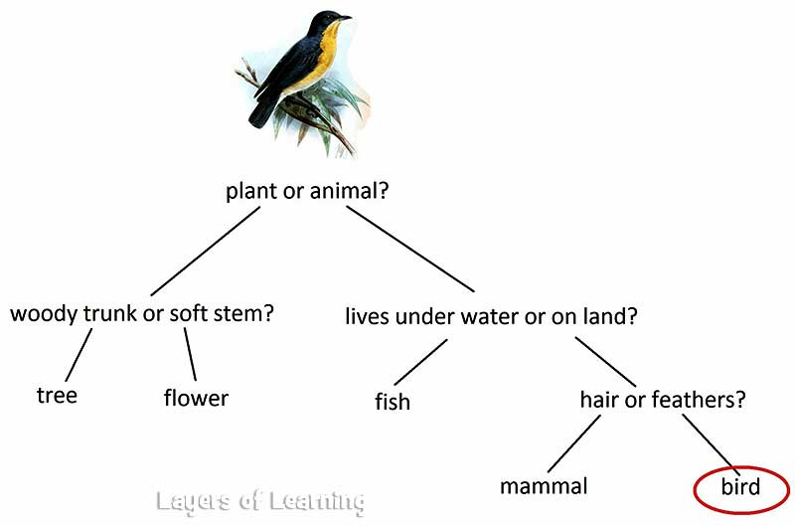
Dichotomous Keys
One of the easiest ways to classify an organism is to use its visible characteristics
One way to accomplish this is through the use of a dichotomous key
These keys use pairs of descriptions to simplify the identification of an organism

Slide 15
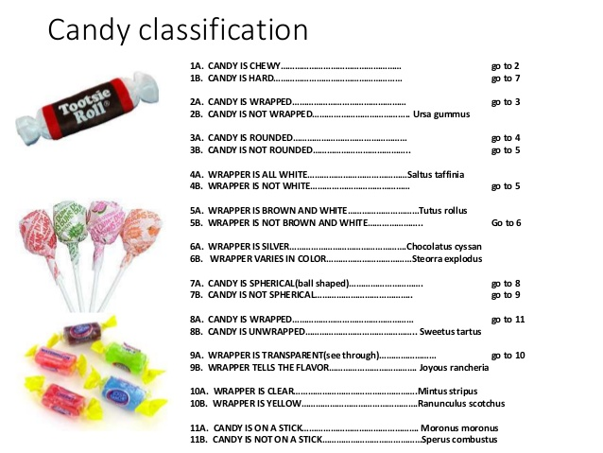
Complex and specific keys would fill up many pages, and rely on very careful observations
Therefore, keys are usually specific, and would not start at the phylum level, but most likely at the level of order or family

Slide 16
Homework:
Go back through section 3.2 and answer the 2 textbook questions
Copy the summary from 3.2 into your notes
Complete Investigation 3B
Complete the section 3.2 Questions 1-6

Slide 17
Biomes

Slide 18
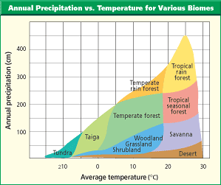
Studying Organisms in Ecosystems
Climate and Biomes
Average weather conditions in a particular region
Temperature and precipitation levels are indicators for biome categorization but there are other factors – proximity to water, elevation, latitude etc…

Slide 19
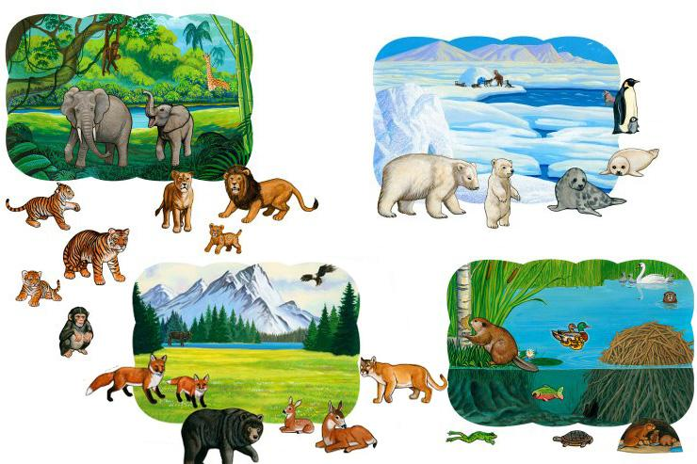
Habitats
Can vary tremendously within a biome. Habitats have particular abiotic and biotic characteristics.
Range – the geographical area where populations of organisms can be found. Can be large or small, depending on their life style.
Niche – The role that the organism plays in its environment. Can also be large or small depending on the organisms lifestyle.

Slide 20
Ecological Niches

Slide 21
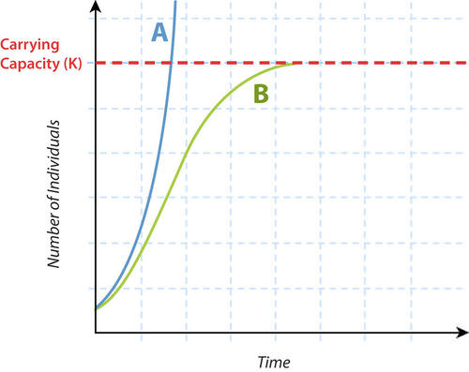
Factors that Limit Population Growth
Biotic - Living
Abiotic – Non-living
Competition
Interspecific
intraspecific
Predation
Parasitism
Disease
Soil salinity
Minerals
Moisture levels
Humidity
Temperature
Sunlight

Slide 22
Limits to Ecosystem Growth

Slide 23
Homework:
Go back through section 3.3 and answer the 5 textbook questions
Copy the summary from 3.3 into your notes
Complete Thought Lab 3.2 & 3.3
Complete the section 3.3 Questions 1-5

Slide 24
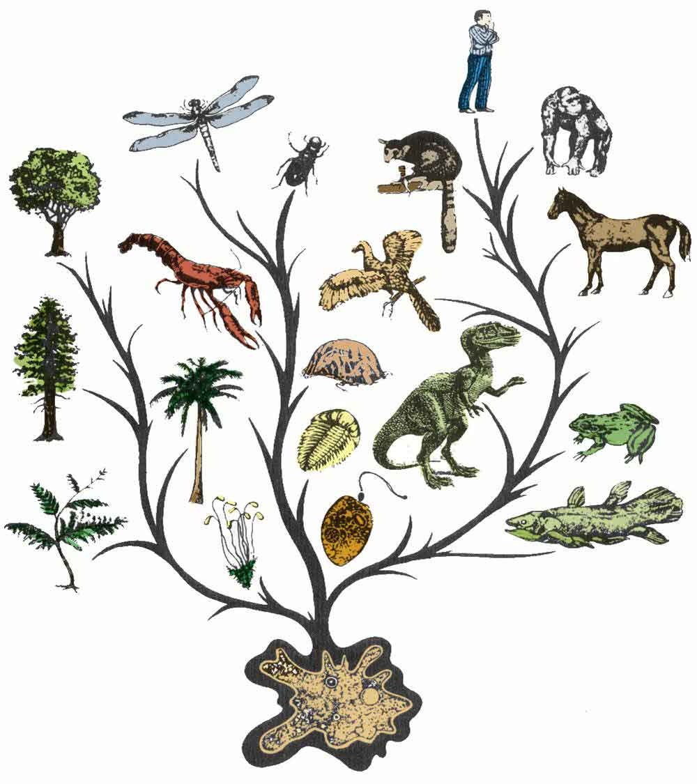
Chapter 4 Mechanisms of Population Change

Slide 25
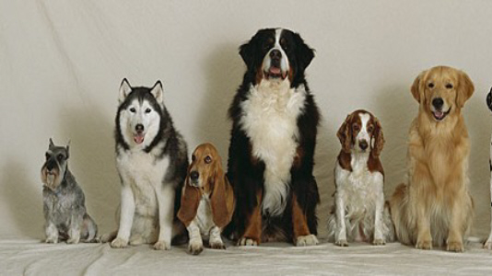
Adaptation, Variation and Natural Selection
Organisms that live long enough to reproduce will pass on their traits to the next generation
Those organisms that are best adapted to their environments will be most likely to survive
Adaptations can be either structural, behavioural, or physiological

Slide 26
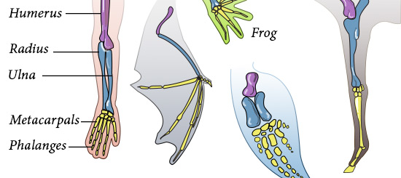
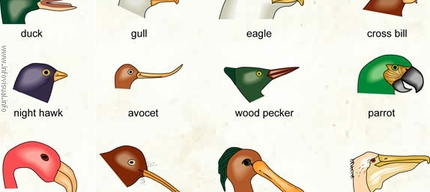
Structural Adaptations

Slide 27
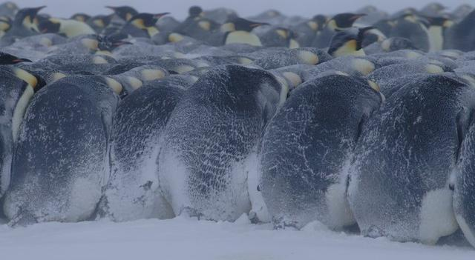
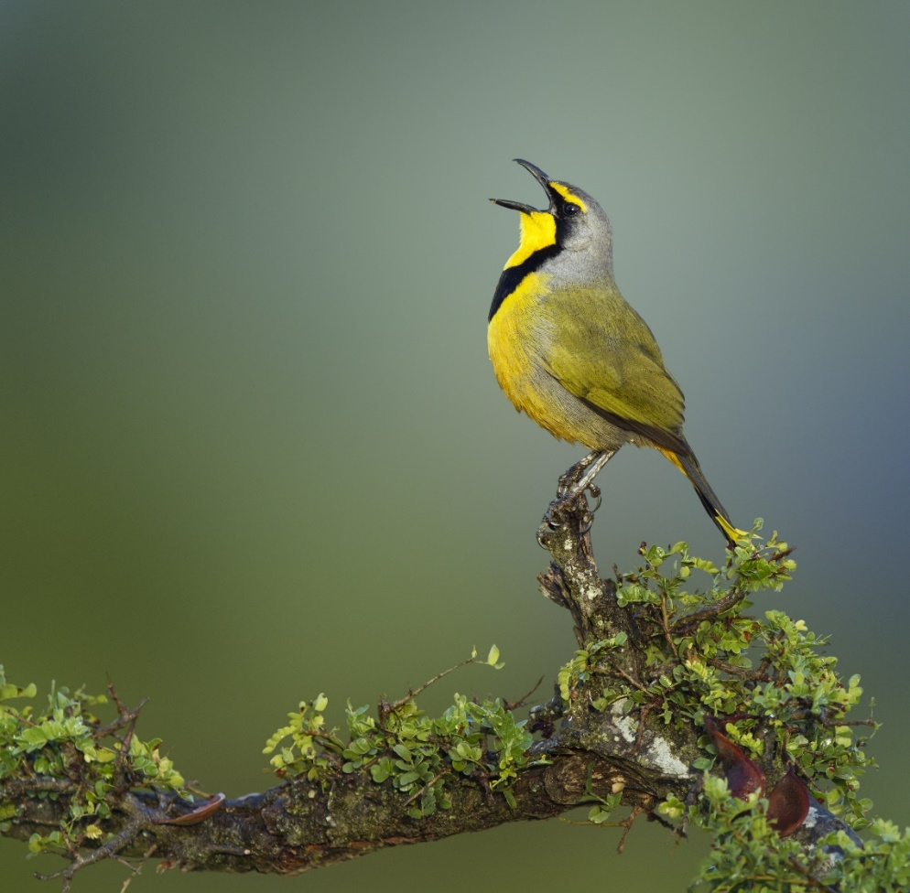
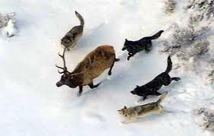
Behavioural Adaptations

Slide 28
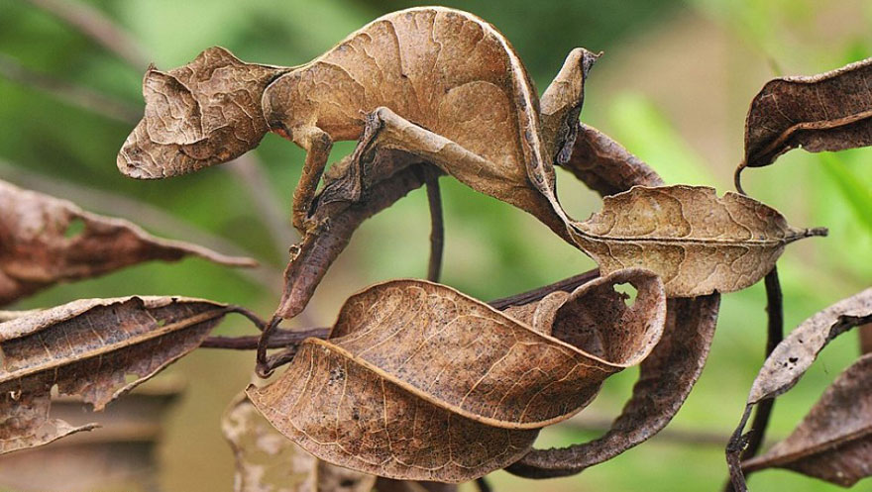
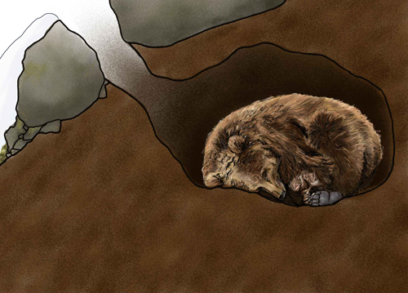
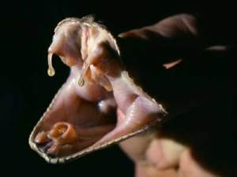
Physiological Adaptations

Slide 29
The Source of Adaptations
Adaptations are due to the gradual change in the characteristics of a population over time
Although variations can result in adaptations, not all variations are beneficial

Slide 30
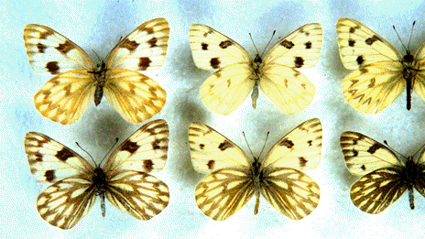
Variation Within Species
Variation is the result of genetic changes and recombination
The recombination of genes can occur during sexual reproduction

Slide 31
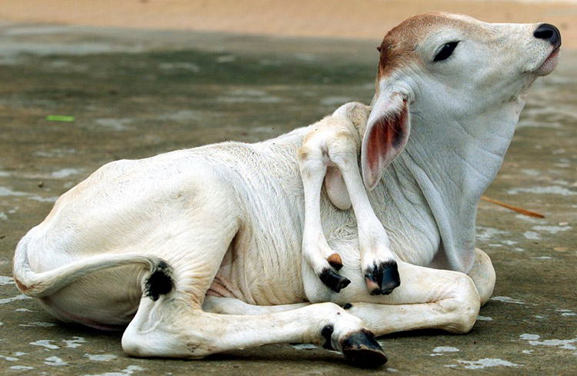
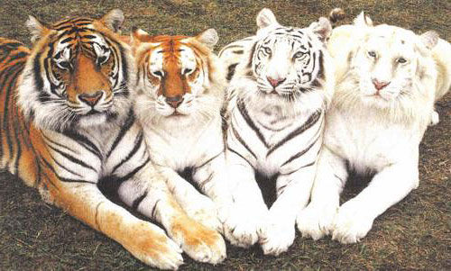
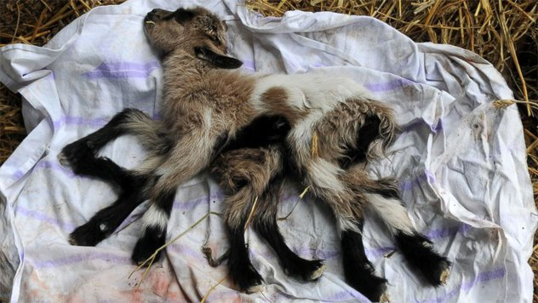
Mutations and Variation

Slide 32
The Effect of Mutations
Genes code for proteins
A change in the genetic code will alter the sequence of amino acids that forms a protein
This change in the amino acid sequence will change the shape of the protein, which changes its action
Some mutations occur in somatic cells (the cells that make up body tissues)
These mutations will disappear when the organism dies
However, if mutations occur in germ line cells (those that produce sperm or eggs), the mutations will be passed on to the next generation

Slide 33
The Effect of Mutations

Slide 34
Mutations and Selective Advantage
Some mutations produce a change in an individual that is beneficial
These mutations increase the individual’s chance of survival and will most likely be passed on to the next generation

Slide 35
Case Study: Venom-Resistant Squirrels
In California, some ground squirrels have developed a mutation that makes them more resistant to rattlesnake venom
Therefore, the ground squirrels with the mutation have a greater chance of survival and therefore will pass on their traits to the next generation
Ultimately, the majority of the squirrel population will have this beneficial adaptation because they are more likely to survive to reproduce

Slide 36
Case Study: Pesticide Resistance
In 1955, the World Health Organization initiated a widespread program to kill malaria-carrying mosquitoes using DDT
This program was initially very successful in decreasing mosquito populations, but they quickly reappeared
Because of the reduced effectiveness of DDT and its negative environmental effects, the spraying program was discontinued

Slide 37
Case Study: “Superbugs”
1928
In 1928, Sir Alexander Fleming discovered that penicillin could be used to kill bacteria
1941
Penicillin was first used as a medicine in 1941
1945
By 1945, there were already reports of penicillin-resistant strains of bacteria
now
There are now bacterial strains that are resistant to all known antibiotics

Slide 38
Natural Selection
Individuals that have beneficial adaptations that are passed on to their offspring will change the population as those traits are passed on to the next generation
For natural selection to occur, there must be variation within the species
In a population, individuals are selected for by their environment
It is important to consider that individuals do not change during their lifetime – rather, the population changes over time
The environment will exert a selective pressure on a population

Slide 39
Example: Selective Pressure
In a population of grasses, some of the grasses are better adapted to survive drought conditions
If a drought occurs, it exerts a selective pressure that favours those plants that are drought-resistant
This causes a change in the makeup of the population

Slide 40
Natural Selection & the Environment
Natural selection does not anticipate changes in the environment
Instead, random changes occur and produce traits that may be beneficial in the future
When the environment changes, then those variations that have been produced increase the ability of some organisms to survive

Slide 41
Natural Selection & the Environment

Slide 42
Homework:
Go back through section 4.1 and answer the 5 textbook questions
Copy the summary from 4.1 into your notes
Complete the section 4.1 Questions 1-9
Interactive Notebook pages

Slide 43
Developing a Theory to Explain Change
People have been asking questions for centuries regarding how life developed on Earth
Theories have developed through observations, analysis of data and the formulation of hypotheses
The most important Greek philosophers (Plato and Aristotle) believed that life existed on Earth in a perfected and unchanged form

Slide 44
Creationist Theories
Creationists believe that God created all organisms in their original state during a period of creation
This particular period can vary, depending on literal interpretation (a 6-day creation followed by a day of rest) or more figurative interpretations (each day corresponding to a longer period of time)
Literal creationists believe that the Earth is between 5000 and 6000 years old
They attribute massive geological changes to cataclysmic events, such as the biblical flood (found in Genesis, chapters 6 – 9)
However, there is a diverse range of creationist

Slide 45
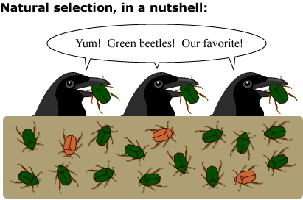
Developing the Theory of Natural Selection
The theory of natural selection has developed over many centuries
Because of the influence of the Roman Catholic Church in Europe, few evolutionary theories appeared until the 1700s

Slide 46
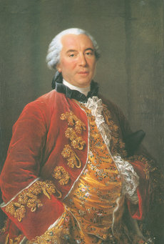
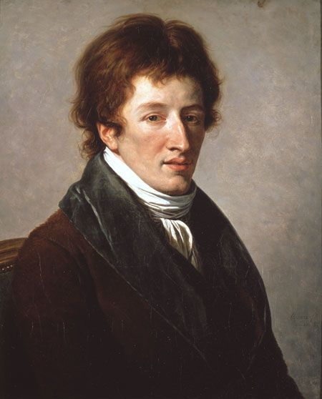
Developing the Theory of Natural Selection
Georges-Louis Leclerc, Comte de Buffon
One of the first people to challenge the idea that life forms do not change
Georges Cuvier
Largely credited with developing the science of paleontology
The deeper the fossils in the rock the older they are and the more different from current species they become
Earth experiences many destructive events

Slide 47
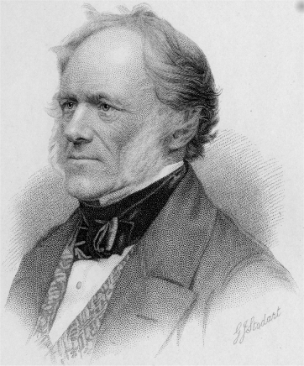
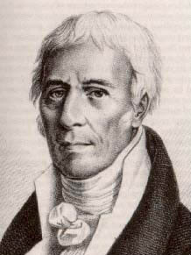
Developing the Theory of Natural Selection
Charles Lyell
Suggested, unlike Cuvier, that the geological processes that occur on Earth take long times, meaning the Earth was quite old
The earth did not experience chaotic events, it changed slowly
Jean-Baptiste Lamarck
Developed an early idea regarding how animals change over time
Theory of acquired characteristics

Slide 48
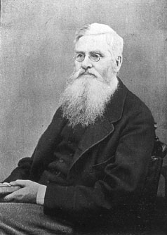
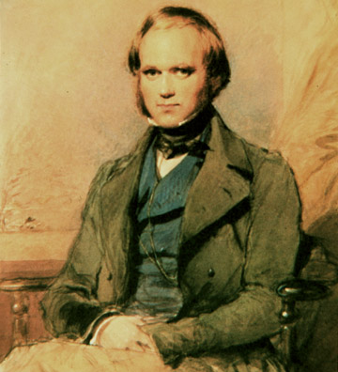
Developing the Theory of Natural Selection
Charles Darwin
Alfred Russel Wallace
Traveled aboard the HMS Beagle on a voyage to survey the coast of South America
He made numerous observations regarding the organisms that he saw along the way
At the same time that Darwin was studying his observations made on the Beagle voyage, Wallace was studying organisms in South America and Malaysia

Slide 49
The Theory of Evolution by Natural Selection
Both Darwin and Wallace were influenced by Thomas Malthus’ Essay on the Principles of Population that stated that populations produced more offspring than an environment could support
Darwin and Wallace reasoned that competition for limited resources would select for favorable traits

Slide 50
Darwin’s On the Origin of Species
Darwin’s book proposed two main ideas based on his observations:
Present forms of life have descended from ancestral species
The mechanism for modification is natural selection that takes place over a long period of time

Slide 51
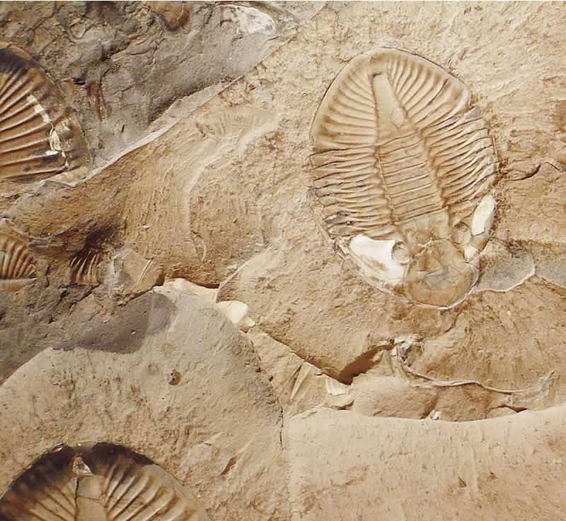
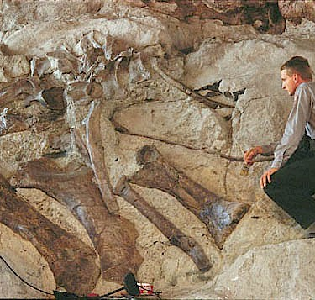
Fossils
Fossils are formed within sedimentary rock
The layer in which a fossil is found often is indicative of the age of that particular specimen
Younger fossils are in younger rock
The deeper into the rock you go the more dissimilar the fossils become to today’s species

Slide 52
Transitional Fossils
Often there were apparent gaps in the fossil record
Over time, transitional fossils are found that fill the gaps and link different species together

Slide 53
Examples of Biogeographical Evidence
Close environments having similar species
Animals on islands resembling animals on the mainland
Animals on different continents being similar along plates

Slide 54
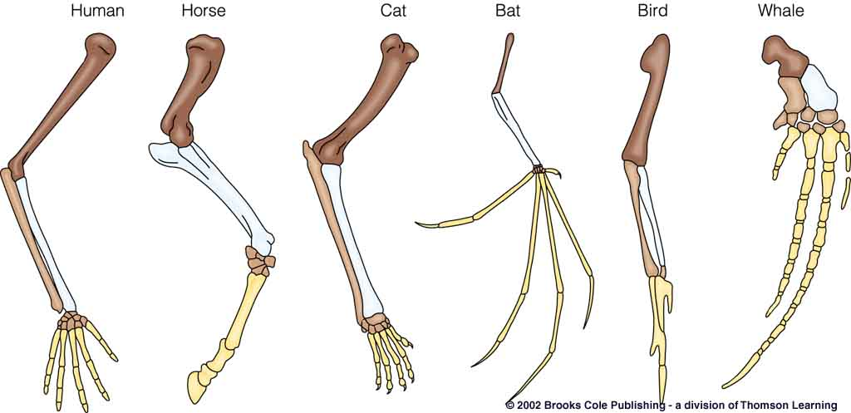
Anatomy
Many closely related organisms have homologous structures (structures that have the same origin and general elements, but different functions)

Slide 55
Homologous Structures and Evolution
Homologous structures point to a common ancestor
Variations in the structure over time made the homologous structures useful adaptations for different environments
Analogous structures (those with a similar function, but different origins) do not lend evidence to evolution

Slide 56
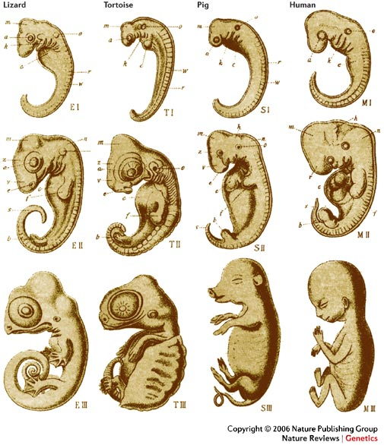
Embryology
Most vertebrate embryos are similar to each other at some point in their development
This points to a common ancestral origin
Molecular Biology
Evolutionary relationships can be studied and traced using DNA
We have learned that some traits are shared by all organisms:

Slide 57
Genetics
When Darwin proposed his theory of evolution, very little was understood regarding genetics. We now know the following:
Species pass on their traits to offspring using genetic material
The genetic material can randomly change (mutations), leading to variation in traits

Slide 58
Evolution – Why does it matter?

Slide 59
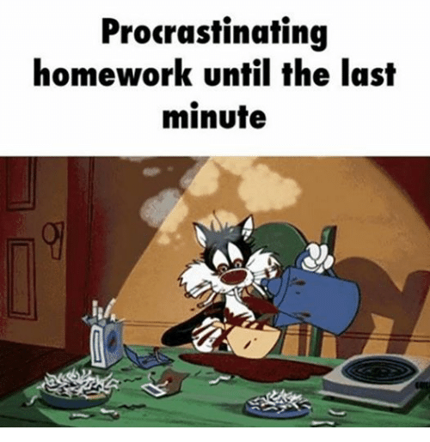
Homework:
Go back through section 4.2 and answer the 9 textbook questions
Copy the summary from 4.2 into your notes
Complete Thought Lab 4.3
Complete the section 4.2 Questions 1-10

Slide 60
How Species Form
Two species may appear very similar, but be considered different species. How does this happen?
Reproductive isolation
For speciation to occur, species must be prevented from breeding
Therefore, there must be biological or geographical barriers that prevent breeding
If the populations are separated for a long enough time, changes occur in the populations through natural selection
Transformation - new species develop gradually due to a mutation
Divergence - come from a common ancestor
Adaptive radiation - the diversification of a common ancestral species into a variety of differently adapted species

Slide 61
Speciation

Slide 62
The Speed of Evolution
Since Darwin’s time, evolutionary biologists have suggested that evolution is very slow
This would indicate that the large differences we see between species now are the sum of all of the small changes over a long period of time
However, sudden changes seen in the fossil record do not support this in some cases

Slide 63
A New Idea – Punctuated Equilibrium
Punctuated equilibrium proposes that evolutionary history consists of long periods where very little changes that is broken up by rapid periods of change
This theory proposes that when a species first diverges from a parent species, major morphological changes occur
This can occur when a species enters a new area
When this occurs, new selection pressures will select for different adaptations, resulting in the next generation being quite different from the parent generation

Slide 64
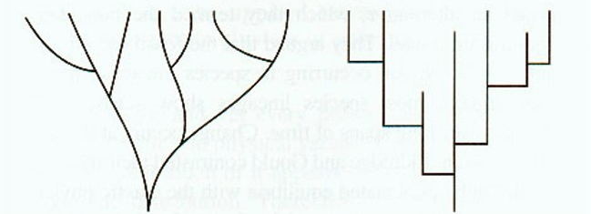
Gradualism vs. Punctuated Equilibrium

Slide 65
Summary – The Theory of Evolution by Natural Selection
Life forms have developed from ancestral species.
All living things are related to on another by varying degrees through common descent.
All living things on Earth share a common origin (or ancestor)
4. The mechanism by which one species evolves into another involves random heritable genetic mutations. Mutations that increase the survival advantage of an individual will most likely be passed on to offspring. Over time the successful mutation spreads throughout the population and causes a change in the population

Slide 66
Summary: The Origin of Life

Slide 67
Homework:
Go back through section 4.3 and answer the 3 textbook questions
Copy the summary from 4.3 into your notes
Complete the section 4.3 Questions 1-8

Slide 68
What Caused Life's Major Evolutionary Transitions?

