Slide 1
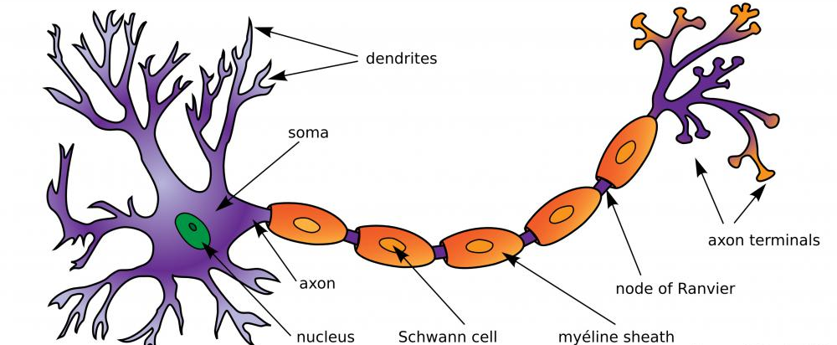
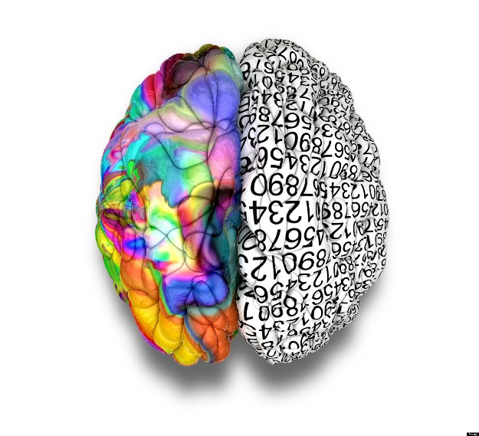
Unit A: The Nervous and Endocrine Systems
Semester 2 - 2015
Redding
Biology 30
Semester 2
Chapters 11, 12 & 13 McGraw Hill Ryerson

Slide 2
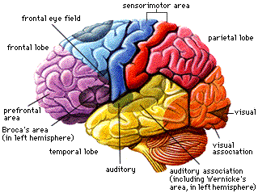
Chapter 11 The Nervous System
Redding – Unit A Biology 30

Slide 3
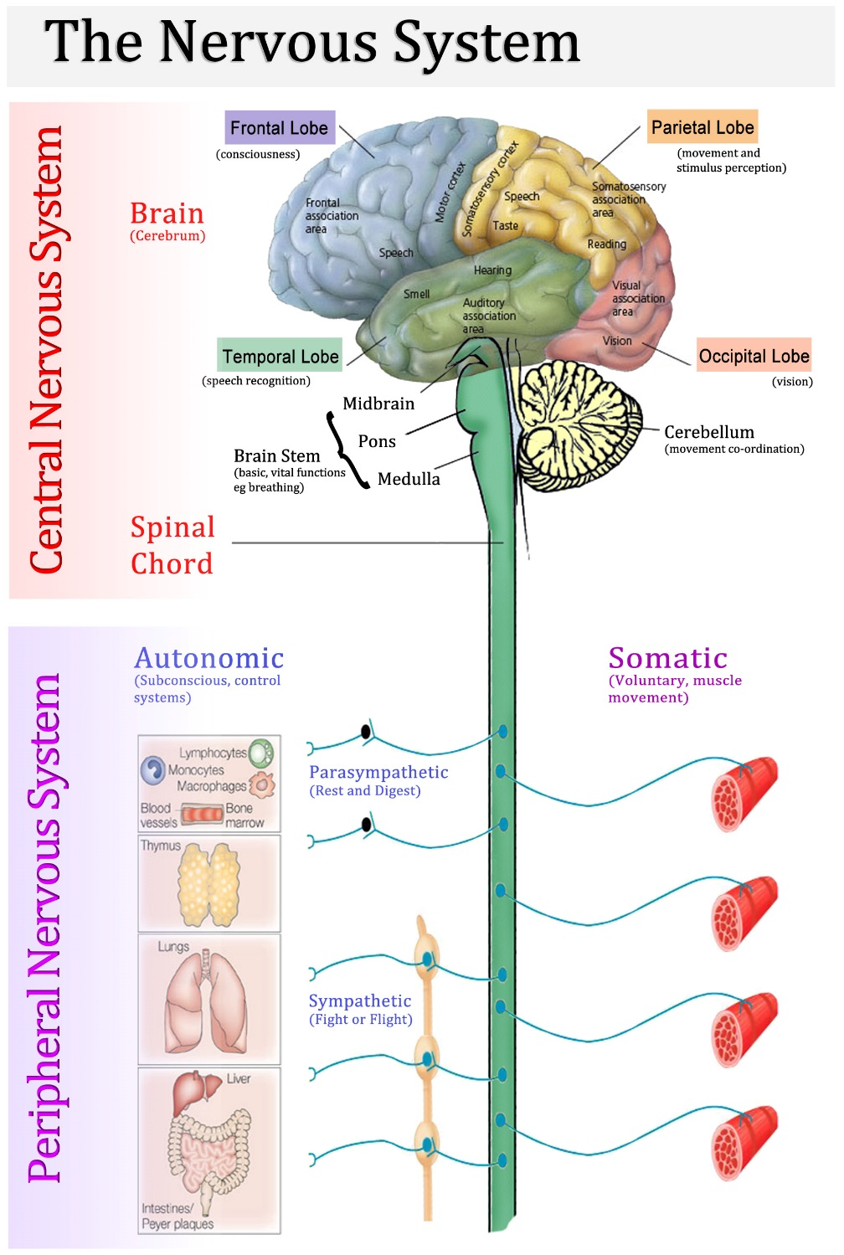
Structures & Processes of the Nervous System
Homeostasis – a relative stability within the body. It is critical for survival because a body can only survive in a narrow range of conditions.
The nervous system help to coordinate this.
Composed of the brain and spinal cord as well as the bodies nerves

Slide 4
Structures & Processes of the Nervous System
The organization of the Nervous System
Central Nervous System (CNS) – Brain and Spinal Cord
Integrates and processes information sent by nerves
Peripheral Nervous System (PNS) – Nerves
Carry sensory messages to the CNS and send information from the CNS to muscles and glands
Divided further into the autonomic and somatic systems
Autonomic (unconscious) – controls glandular secretions and the functioning of smooth and cardiac muscle
Further divided into sympathetic and parasympathetic (work in opposition)
Somatic (conscious) – receptors in the head and extremities, carry info to and from the CNS to skeletal muscles

Slide 5
Structures & Processes of the Nervous System

Slide 6
Structures & Processes of the Nervous System
Cells of the Nervous System
Neurons – outnumbered 10:1, carry chemical messages
The structural functional unit of the NS
Respond to stimuli and transmit signals
Three types – sensory, inter and motor
Glial Cells – account for half the volume of the NS
Nourish the neurons, remove their wastes and defend against infection
Individual neurons are organized into tissues called nerves

Slide 7
Structures & Processes of the Nervous System Reflex Arcs

Slide 8
Structures & Processes of the Nervous System
Structure of a Neuron
Dendrites – short branching terminals that receive impulses
Cell Body – contains the nucleus, site of metabolic activity
Axon – conducts the impulse away for the cell body
Myelin Sheath – gives the axon a white appearance, axons can be covered in myelin or not
Schwann Cells – glial cells that insulate the neuron and speed up the rate of reaction
Nodes of Ranvier – breaks in the myelin that conduct the nerve impulse

Slide 9
Structures & Processes of the Nervous System

Slide 10
Structures & Processes of the Nervous System
The Nerve Impulse:
Resting Membrane Potential
Created by large negatively charged proteins that keep the inside of the cell more negatively charged compared to the outside
Provides energy for a nerve impulse if stimulated
Polarization – the process of generating a resting membrane potential
Usually around -70mV
Sodium – Potassium Pump
Separation of charge, sodium (3) goes out and potassium (2) comes in
Requires ATP
Results in an excess positive charge on the outside of the cell

Slide 11
Structures & Processes of the Nervous System
The Action Potential – occurs at the nodes of Ranvier
Depolarization – occurs if the membrane potential goes higher than -70mV. If it hits -55mV dramatic changes occur
Threshold – -55mV, once reached, the permeability of the axon changes
Depolarization – sodium flows in
Repolarization – potassium flows out
Hyperpolarization – potential goes below -70mV, cannot refire (refractory period)

Slide 12
Action Potential

Slide 13
Structures & Processes of the Nervous System
Continued…
The signal then propagated down the neuron – salutatory conduction
Multiple Sclerosis – breakdown of the myelin sheath.

Slide 14
Structures & Processes of the Nervous System
Signal Transmission across a Synapse (neuromuscular junction)
What happens when a signal reaches the end of a neuron???
Uses chemical messengers – neurotransmitters, to move along the signal.
Can be excitatory – trigger ion channels to open
Can be inhibitory – trigger ion channels to close

Slide 15
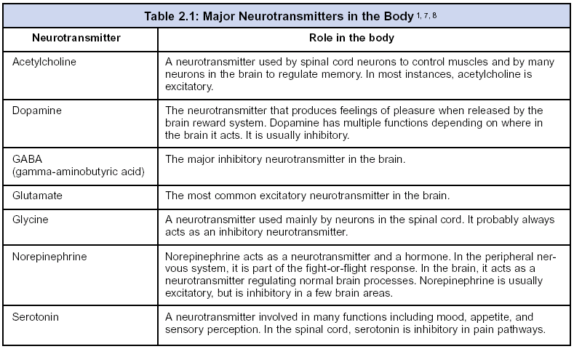
Neuromuscular Junction

Slide 16
The Central Nervous System
The Brain
Surrounded by the meninges (blood brain barrier), connected by the corpus callosum
Comprised of the Hindbrain, Midbrain and Forebrain
Hindbrain: Cerebellum, Medulla, Pons
Midbrain: relay station for visual and auditory info
Forebrain: Thalamus, Hypothalamus, Cerebrum

Slide 17
The Central Nervous System
Hindbrain
Cerebellum – unconscious coordination of posture, reflexes and body movements. Also includes fine motor skills
Medulla – controls involuntary responses such as heart rate, blood pressure, breathing, swallowing and coughing
Pons – relays info from the left and right cerebrum, cerebellum and the rest of the brain

Slide 18
The Central Nervous System
Forebrain
Thalamus – another relay station for the senses (except smell)
Hypothalamus – Helps to regulate homeostasis in the body. Coordinates action of the pituitary gland by producing and releasing hormones
Cerebrum
Frontal – intelligence, memory, personality and voluntary muscle movements
Parietal – skin and body position
Temporal - auditory
Occipital - visual

Slide 19
The Central Nervous System – Stroop Effect

Slide 20
The Central Nervous System - Homunculus
How much of our motor cortex is donated to various areas in our bodies
Which areas have the greatest muscle control?

Slide 21
The Central Nervous System
Broca’s and Wernicke’s Area
Broca’s Area – coordinates muscles for speaking and translates thought into speech. If damaged speech would be impaired but understanding language would still remain
Wernicke’s Area – language comprehension. If damaged words would still be uttered but they wouldn’t make sense

Slide 22
The Peripheral Nervous System
Divided into Somatic and Autonomic
Somatic – voluntary
Autonomic – involuntary
Divided into:
Sympathetic – fight or flight!
Uses mainly norepinephrine as a neurotransmitter (excitatory)
Parasympathetic – rest and digest
Uses acetylcholine

Slide 23
The Peripheral Nervous System Divisions of the Autonomic System

Slide 24
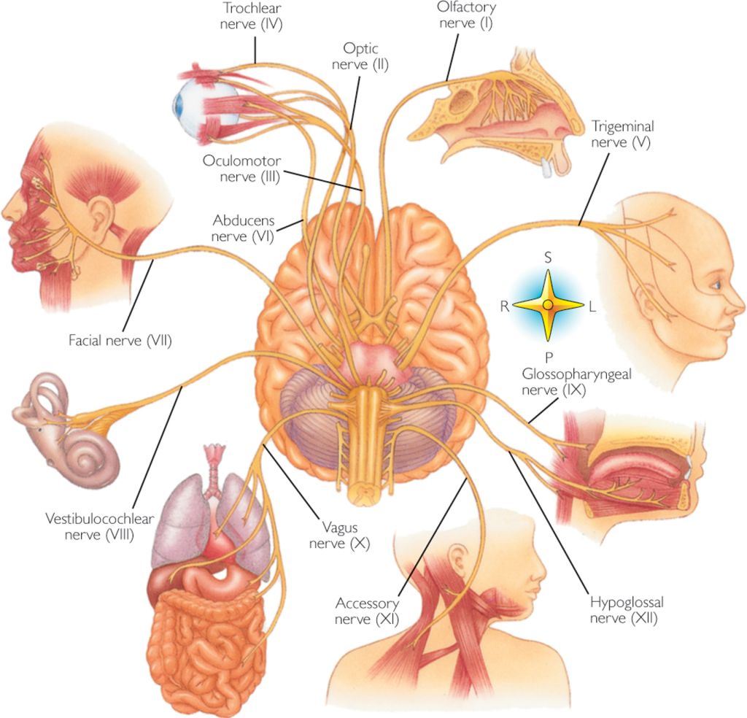
Chapter 12 Sensory Reception
Redding – Unit A Biology 30

Slide 25
Sensory Receptors and Sensation
Sensory receptors – nerve endings (Table 12.1)
Photoreceptors – rods and cones
Chemoreceptors – tongue and nose
Mechanoreceptors – touch, position, pressure (skin, hair and ears)
Thermoreceptors - skin
Sensation – interpretation at the cerebral cortex
Sensory adaptation – filtering out redundant, insignificant information
Sensation VIDEO vs Perception? VIDEO

Slide 26
Sensory Reception

Slide 27
Sensory Reception

Slide 28
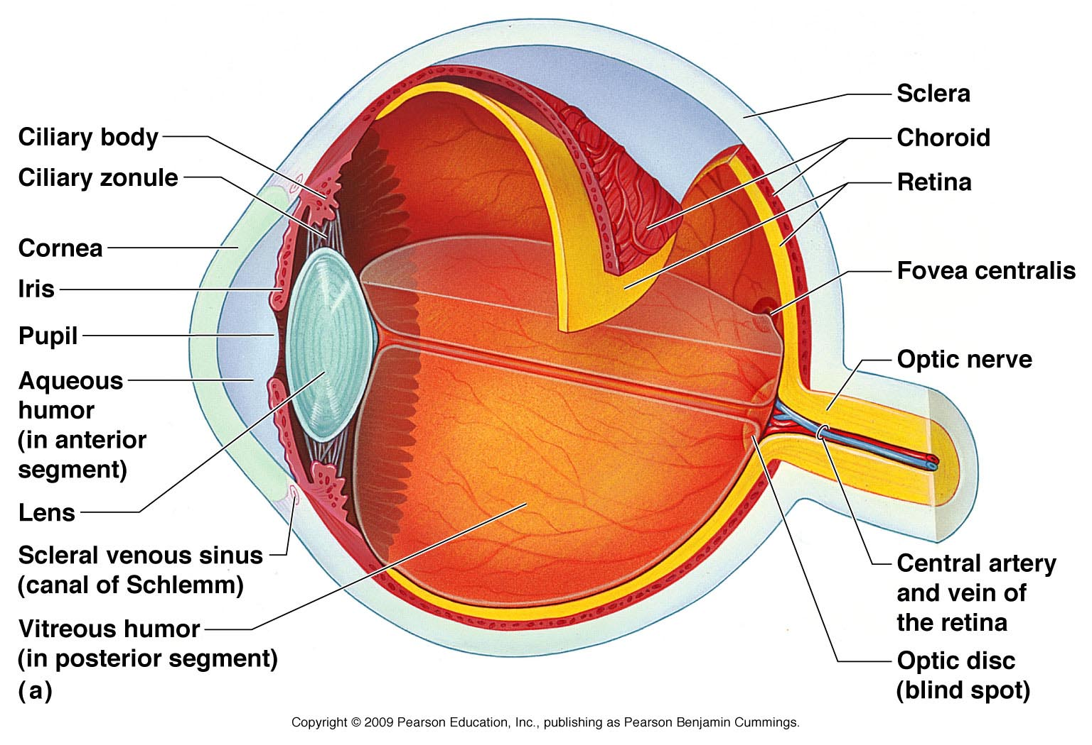
Photoreception: The Eye: You need to know the functions of each piece
Sclera
Cornea
Iris
Pupil
Ciliary Muscles
Rods
Cones
Fovea Centralis
Lens
Humours
Optic Nerve

Slide 29
Sensory Reception: Photoreception:
Accommodation: the ability for the lens to change shape to bring an image into focus
Distant object – ciliary muscles relax and suspensory ligaments become tight, causing the lens to flatten
Near object – ciliary muscles contract and suspensory ligaments relax, causing the lens to become more rounded

Slide 30
Sensory Reception: Photoreception:
Conditions affecting the Cornea and Lens
Cataracts – as the lens ages protein can start to degenerate. The lens becomes opaque. Can be corrected with surgery in some cases
Astigmatism – uneven curvature of the cornea
Myopia (nearsighted) – eyeball too long, focuses object in front of the retina. Hard time seeing distant objects. Corrected with a concave lens
Hyperopia (far sighted) – eyeball too short, focuses objects behind the retina. Hard time seeing objects up close. Corrected with a convex lens

Slide 31
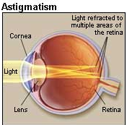
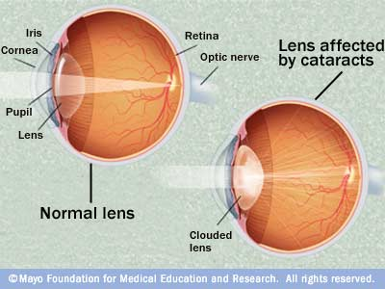
Sensory Reception

Slide 32
Sensory Reception
Can you find your blind spot?
Check out page 416 in your textbook!

Slide 33
Mechanoreception & Chemoreception
Hearing and Balance – Capturing Sound.
Sound Waves – small fluctuations in air pressure
Three major divisions of the ear
Outer: pinna, auditory canal
Middle: tympanum, ossicles, oval window and Eustachian tube
Inner: cochlea, organ of corti, basilar membrane and tectorial membrane

Slide 34
Mechanoreception & Chemoreception

Slide 35
Hearing
Humans can hear between 20 – 20000Hz
High Frequency Waves stimulate hair cells closer to the oval window
Low Frequency Waves stimulate hair cells farthest from the oval window
In terms of amplitude, anything over 80 dB is damaging to our ears (Figure 12.3 on page 423)

Slide 36
Mechanoreception & Chemoreception
Balance and Coordination
The Semicircular Canals – contain mechanoreceptors that help to detect body rotation and head rotation (Rotational/Dynamic Equilibrium)
Utricle and Saccule (Vestibular Chamber) – help us to maintain balance when moving the head forward and back. (Gravitational Equilibrium)
Contain otoliths – calcium carbonate granules that move in response to the body and help your brain determine the position of your head.

Slide 37
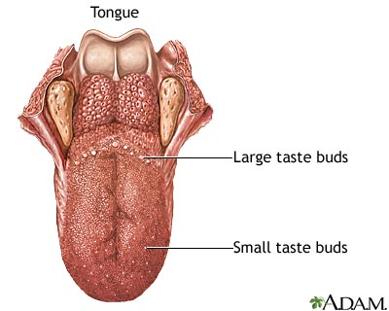
Mechanoreception & Chemoreception
Taste
Sweet, Salty, Sour, Bitter and Umami
Each taste bud can detect all of these tastes. There are no specific regions of the tongue as once thought.

Slide 38
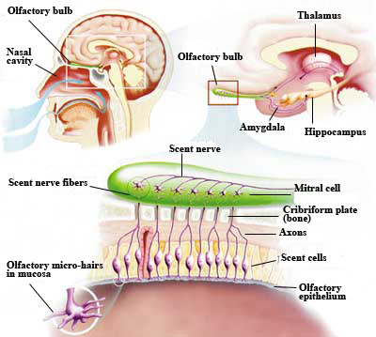
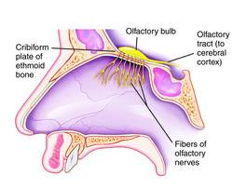
Mechanoreception & Chemoreception
Smell
Olfactory cells lining the upper nasal cavity
Linked to the olfactory bulb of the brain

Slide 39
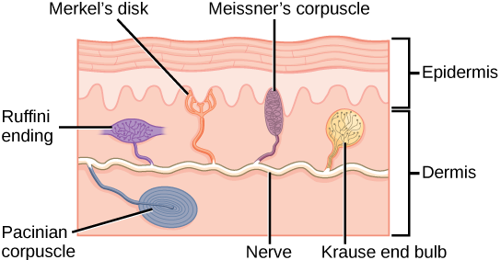
Mechanoreception & Chemoreception
Touch (skin)
Nerve Endings – pain, heat, cold
Merkel Discs – touch
Krause bulbs – touch
Root hair – touch
Meissner corpuscles – touch
Pacinian corpuscles – pressure
Ruffini ends – pressure

Slide 40
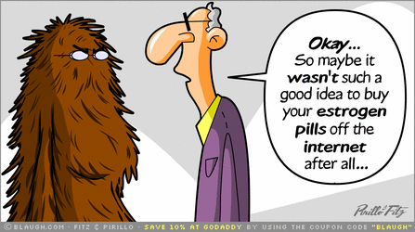
Chapter 13 Hormonal Regulation of Homeostasis
Redding – Unit A Biology 30

Slide 41
Glands & Hormones of the Endocrine System
Endocrine glands – secrete into the blood stream
Hormones – secreted by the endocrine glands. Chemical messengers
Endocrine system – comprised of the endocrine glands and the hormones that they secrete. Compared to the nervous system its response takes more time but has longer lasting effects.
Connected with the nervous system… how?

Slide 42
Glands & Hormones of the Endocrine System

Slide 43
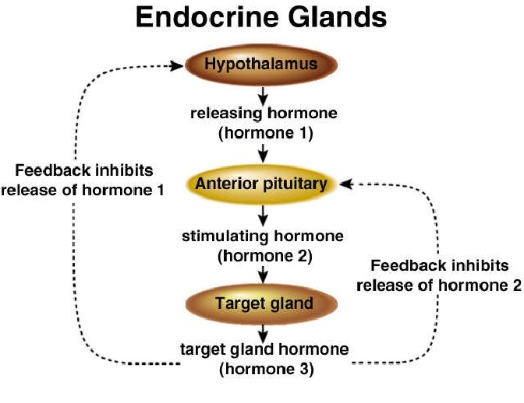
Glands & Hormones of the Endocrine System
Refer to page 440 for the chart of hormones and their endocrine glands – you will need to know them!
Regulators and Controls – Negative Feedback
How it works: when certain blood concentrations of hormones are reached or when target cells have responded to certain hormones, the endocrine gland releasing the hormone is inhibited.

Slide 44
Hormonal Regulation of Growth, Development and Metabolism
Pituitary Gland (Master Gland!) Controlled by the hypothalamus
Divided into two parts:
Anterior - true hormone synthesizing gland
Posterior - considered part of the nervous system because it stores and releases hormones instead of producing them
Each part is responsible for releasing certain hormones

Slide 45
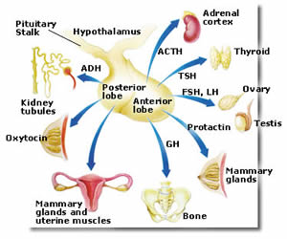

Slide 46
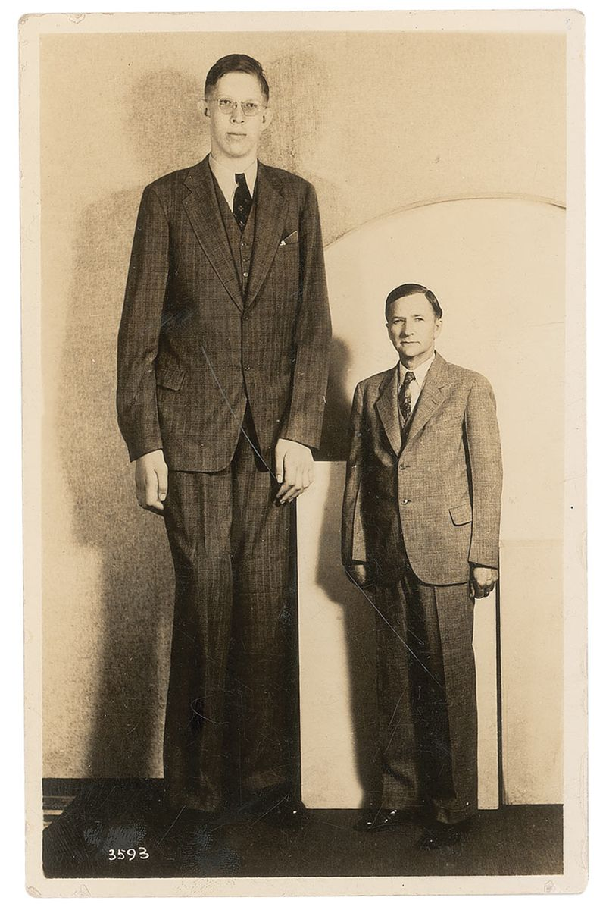
Hormonal Regulation of Growth, Development and Metabolism
Human Growth Hormone (hGH)
Increase protein synthesis
Increase cell division and growth or cartilage, bone and muscle
Promotes elongation of bone
Breakdown and release of adipose tissue
Insufficient hGH – dwarfism
Overproduction after puberty – acromegaly
Overproduction during puberty – gigantism

Slide 47
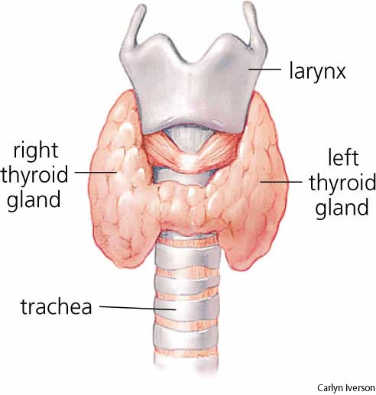
Hormonal Regulation of Growth, Development and Metabolism
The Thyroid Gland
Thyroid Stimulating Hormone – released from the anterior pituitary causes the thyroid to secrete thyroxine, which stimulates metabolism
Hypothyroidism – slow metabolism in adults, cretinism in children
Hyperthyroidism – high metabolism in adults and in some cases can become Graves’ Disease

Slide 48
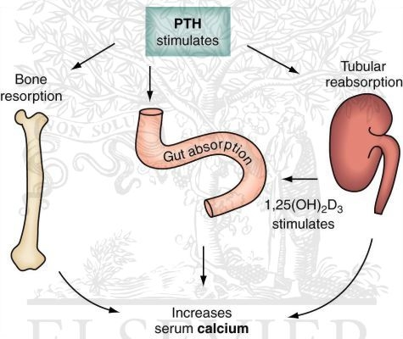
Hormonal Regulation of Growth, Development and Metabolism
The Parathyroid Gland – controls calcium levels
Increase concentration of calcium turns off the feedback loop

Slide 49
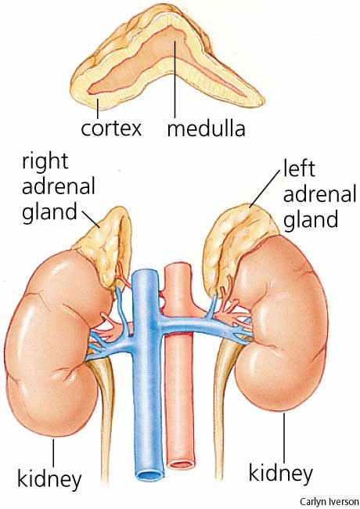
Hormonal Regulation of the Stress Response
The human body has two Adrenal Glands which are located on the top of each kidney
Comprised of an inner (medulla) layer and an outer (cortex) layer. Each structure produces different hormones and have a different function from one another

Slide 50
Hormonal Regulation of the Stress Response
Adrenal Medulla
Adrenal Cortex
Epinephrine and norepinephrine
Short term stress response
Fight or flight like the sympathetic nervous system!
Glucocorticoids (cortisol) and mineralocorticoids (aldosterone) increase blood sugar and blood pressure, respectively
Long term stress response
Can be damaging if cortisol is over produced

Slide 51
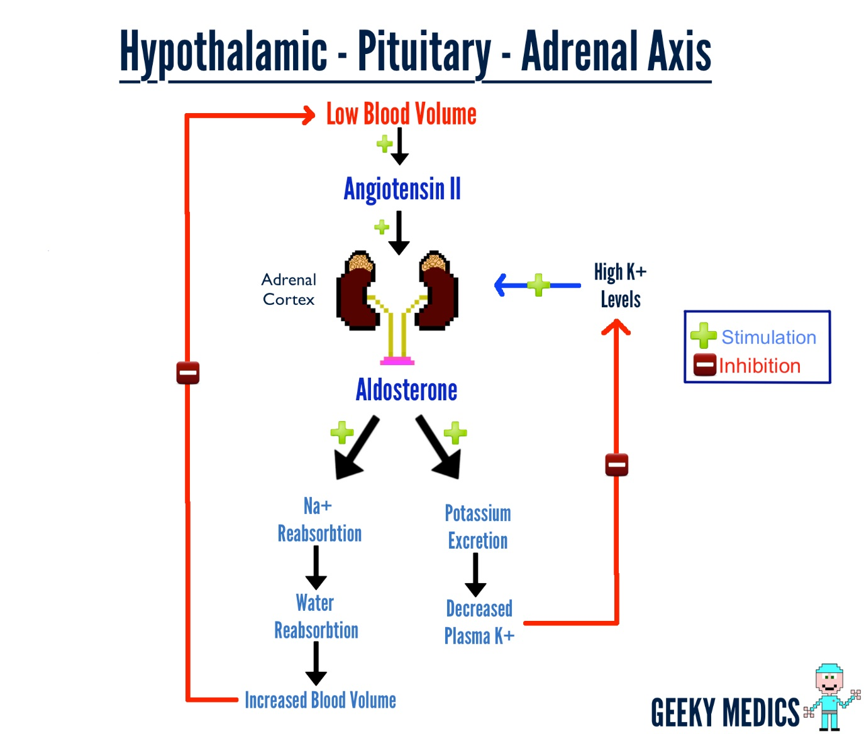
Hormonal Regulation of the Stress Response

Slide 52
Hormonal Regulation of Blood Sugar
The Pancreas: located behind the stomach and attached to the small intestine
Islets of Langerhans – secrete two hormones, insulin and glucagon (regulated by negative feedback)
Alpha cells – secrete glucagon, which turns glycogen in fat and in the liver back to glucose and puts it back into the blood stream
Beta cells – secrete insulin, which turns glucose in the blood stream into glycogen so it can be stored in the liver, muscles and fat

Slide 53
Hormonal Regulation of Blood Sugar
Did you know!?
Two Canadian’s – Frederick Banting and Charles Best from Toronto Ontario were able to isolate insulin for the first time
They tied off a dogs pancreas, isolated the islets or langerhan and extracting insulin from it.
They helped to develop a method of delivering insulin to diabetics with help for the University of Alberta.

Slide 54
Hormonal Regulation of Blood Sugar
Diabetes I
Diabetes II
Beta cells are destroyed by antibodies produced by a person’s immune system
Cannot produce insulin
Daily injections
AKA – Juvenile Diabetes
Insulin dependent
Insulin receptors become damaged and do not respond to insulin
AKA adult onset
Non-insulin dependent
Weight gain and diet can cause this. Can develop into type I if not treated

