Slide 1
Organic Chemistry Unit III
Chapters 9 & 10
Redding – 2019
Chemistry 30

Slide 2

9.1 What is organic chemistry?
Today, organic chemistry is a major branch of chemistry that deals with compounds of carbon
excluding oxides (such as CO(g)) and ionic compounds of carbon-based ions such as carbonate, cyanide, and carbide ions
Na2CO3(s), NaCN(s), and CaC2(s)

Slide 3
Sources:
Coal, oil sands, heavy oil, crude oil, and natural gas are non-renewable sources of fossil fuels.
They are also the primary sources of hydrocarbons—compounds containing carbon atoms bonded to hydrogen atoms.
Hydrocarbons are the starting points in the synthesis of thousands of products, including specific fuels, plastics, and synthetic fibres.

Slide 4
Refining
The refining of coal and natural gas involves physical processes; for example, coal may be crushed.
Components of natural gas are separated either by solvent extraction or by condensation and distillation. Oil sands refining involves a chemically enhanced physical process followed by the complex refining of the bitumen/tar.
Crude oil refining is more complex but many more products are obtained from crude oil.

Slide 5
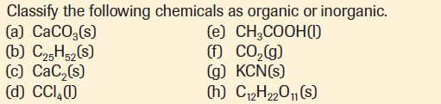
9.1 – Check and reflect

Slide 6
Case Study – Page 359-60
Have a look at the case study in your textbook
Answer the 4 Case Study questions (omitting the extension questions)
Each of you will hand in one set of questions for grading
Make sure to clearly indicate your responses and write in complete sentences

Slide 7
9.2 – Alkanes from Natural Gas
Natural gas has varying composition but it is primarily methane, CH4(g)
Methane is the smallest of the alkane molecules.
An alkane is a class of hydrocarbons that contains only single bonds and only carbon and hydrogen atoms.

Slide 8
9.2 – Alkanes from Natural Gas
Most of the natural gas consumed in Alberta is further refined into separate components.
At these refining (fractional distillation) plants, a simplified description is that the natural gas is cooled under high pressure to condense all the components except the methane gas.
The condensed (liquid) portion is then slowly distilled to separate out the ethane, propane, butane, and pentane fractions

Slide 9
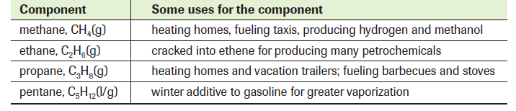
Uses of Natural Gas Components

Slide 10
Naming Alkanes
Although hydrocarbons can be classified according to empirical properties, a more common classification is based upon the chemical formulas of the compounds. (CnH2n+2).
Hydrocarbons whose empirically determined molecular formulas indicate that the carbon-to-carbon bonds are only single bonds are called alkanes

Slide 11
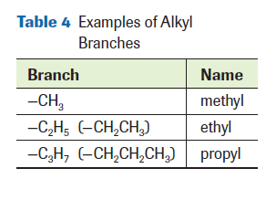
Names and branches of alkanes
The name of the compound indicates whether there are branches on a carbon chain. Prefixes identify groups of atoms that form branches on the structures of larger molecules.
A branch is any group of atoms that is not part of the main structure of the molecule. For example, a branch consisting of only singly bonded carbon and hydrogen atoms is called an alkyl branch. In the names of alkyl branches, the prefixes are followed by a -yl suffix

Slide 12
Structural Isomers
Chemical formulas tell you the total number of each kind of atom in a molecule. Except for the three smallest molecules there are several structures that can have the same molecular formula.
For example, C4H10 has two different structural formulas, both satisfying the rules for chemical bonding.

Slide 13
Cycloalkanes
On the evidence of empirical formulas and chemical properties, chemists believe that organic carbon compounds sometimes take the form of cyclic hydrocarbons—hydrocarbons with a closed ring.
When all the carbon–carbon bonds in a cyclic hydrocarbon are single bonds, the compound is called a cycloalkane (CnH2n).

Slide 14
9.3 – Alkenes and Alkynes
A double or a triple bond between two carbon atoms in a molecule affects the chemical and physical properties of the molecule.
Organic compounds with carbon–carbon double or triple bonds are said to be unsaturated, because they have fewer hydrogen atoms than compounds with carbon–carbon single bonds.

Slide 15
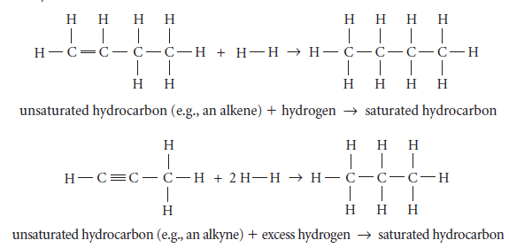
Changing alkenes/alkynes → alkanes
Addition of a sufficient quantity of hydrogen, called hydrogenation, converts unsaturated hydrocarbons to saturated ones.

Slide 16
Naming
Since the location of a multiple bond affects the chemical and physical properties of a compound, an effective naming system should specify the location of the multiple bond.
The longest or parent chain of carbon atoms must contain the multiple bond, and the chain is numbered from the end closest to the multiple bond.
The number that indicates the position of the multiple bond on the parent chain precedes the ending (-ene or -yne) of the parent chain.

Slide 17
Drawing structural formulas
1st
Whenever you need to draw a structural formula for any hydrocarbon, first look at the end of the name to find the parent chain.
2nd
Draw the parent alkene or alkyne first, and then add the branches listed in the name.
3rd
Be sure to finish the formula with sufficient hydrogen atoms to complete four bonds for each carbon atom.

Slide 18
Cyclo Alkene/Alkyne
As the name of this class of hydrocarbons suggests, its molecules have a cycle of carbon atoms with at least one double bond.
The structural formulas and names of cycloalkenes follow the same IUPAC rules as those for cycloalkanes.

Slide 19
Ethane cracking
Ethene (ethylene) is produced world wide by cracking either ethane or naphtha Cracking is an industrial process in which larger hydrocarbon molecules are broken down at high temperatures, with or without catalysts, to produce smaller hydrocarbon molecules.

Slide 20
Continued…
Ethane cracking is also called dehydrogenation. The term cracking usually refers to breaking a large molecule down into a smaller molecule.
In the case of ethane cracking, two hydrogen atoms are removed (“cracked”) from an ethane molecule to convert it into an ethene molecule.

Slide 21
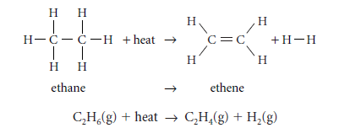

Slide 22
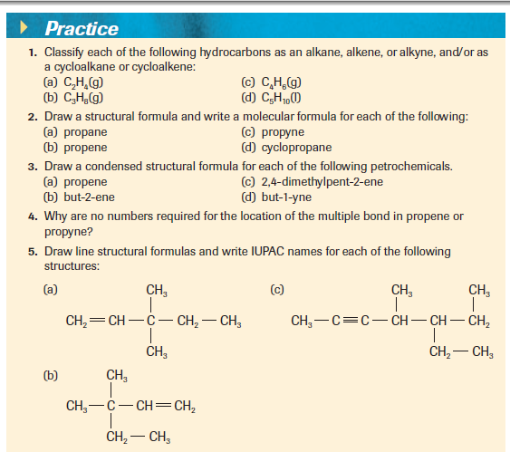
Practice

Slide 23
9.4 - Aromatics
Today, chemists define aromatics as benzene, C₆H₆ (l), and all other carbon compounds that contain benzene-like structures and properties.
Aromatic hydrocarbons are found naturally in petroleum (such as crude oil and natural gas) and are most often burned.

Slide 24
Continued…
The molecular formula of benzene is C₆H₆
The melting point of benzene is 5.5 °C, the boiling point is 80.1 °C, and tests show that the molecules are non-polar.
There is no empirical support for the idea that there are double or triple bonds in benzene.
X-ray diffraction indicates that all the carbon–carbon bonds in benzene are the same length.
Evidence from chemical reactions indicates that all carbons in benzene are identical and that each carbon is bonded to one hydrogen.

Slide 25
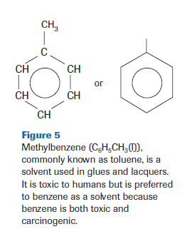
Naming Aromatics
Simple aromatics are usually named as relatives of benzene. If an alkyl group is bonded to a benzene ring, it is named as an alkylbenzene a substitute for a hydrogen atom.
Since all of the carbon atoms of benzene are equivalent to each other, no number is required in the names of compounds of benzene that contain only one branch.

Slide 26
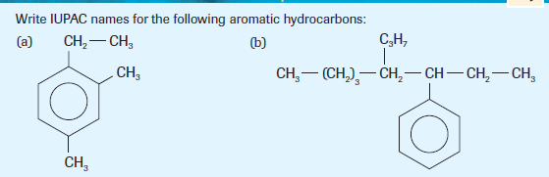
Continued…
For some larger molecules, it is more convenient to consider the benzene ring as a
branch. In such molecules, the benzene ring is called a phenyl group, C6H5

Slide 27
9.5 & 9.6 Refining and Combustion
Physical Processes – Oil Refining
Fractionation: Chemists take advantage of the fact that different hydrocarbons have different boiling points
Because of this, we can separate them physically and collect them from a batch of crude oil

Slide 28
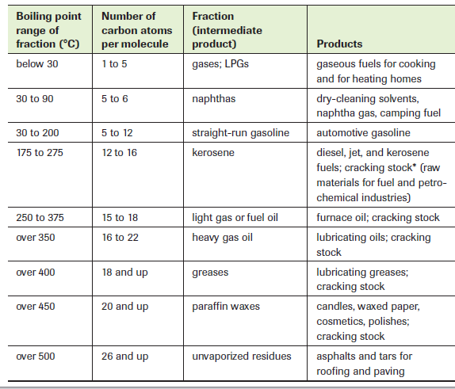

Slide 29
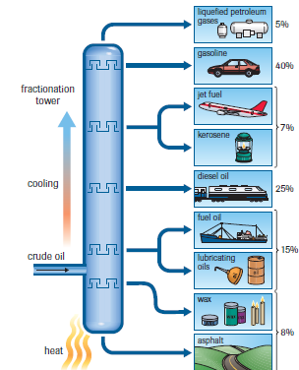
What it looks like:
A fractional distillation (fractionation) tower contains trays positioned at various levels. Heated crude oil enters near the bottom of the tower. The bottom of the tower is kept hot, and the temperature gradually decreases toward the top of the tower.
The concentration of components with lower boiling points increases from the bottom to the top of the tower. The percentage distributions shown vary with the type of crude oil and with seasonal demands.

Slide 30
Chemical Processes
Cracking
large molecules → smaller molecules + carbon
Hydrocracking
Large molecules + hydrogen → smaller molecules
Catalytic Reforming
Aliphatic → aromatic molecule + hydrogen
Alkylation
Aliphatic molecules → more branched isomer

Slide 31
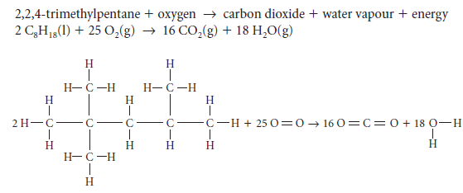
Complete Combustion
Hydrocarbons react with oxygen to produce heat, water vapour and carbon dioxide gas

Slide 32
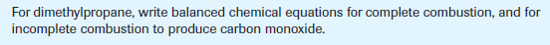
Incomplete Combustion
Can produce, carbon monoxide, carbon (soot) and carbon dioxide:

Slide 33
Catalytic reforming & Alkylation
Catalytic reforming is a chemical process used to convert petroleum refinery, naphtha's, typically having low octane ratings, into high-octane liquid products called reformates are components of high-octane gasoline (also known as high-octane petrol).
Alkylation is the introduction of an alkyl group into an organic compound by substitution or addition.

Slide 34
10.1: Petrochemicals in Alberta
This industry is an important economic and social addition to the fossil fuel, agriculture, and tourism industries of Alberta.
1
The chemical industry is Canada’s most knowledge-based industry. About 30% of workers in the chemical industry have university degrees.
2

Slide 35
10.2: Organic Halides and Addition/Substitution Reactions
Organic halides are organic compounds in which one or more hydrogen atoms have been replaced by halogen atoms.
The functional group for organic halides is the halogen atom. A functional group determines the most important chemical and physical properties of a class of compounds.
Organic halides include many common products, such as freons (chlorofluorocarbons) used in refrigerators and air conditioners, and Teflon® (polytetrafluoroethylene), used in cookware and labware.

Slide 36
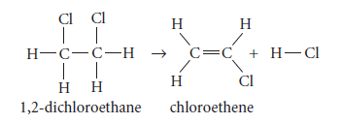
Organic Halides
IUPAC nomenclature for halides follows the same format as that for branched-chain hydrocarbons. The branch is named by shortening the halogen name to fluoro-, chloro-, bromo-, or iodo-

Slide 37
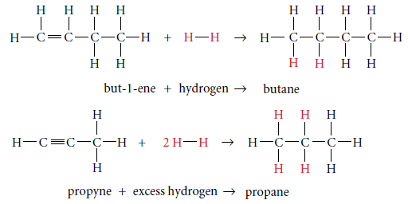
Addition Reactions
Unsaturated hydrocarbons react with small diatomic molecules, such as bromine and hydrogen. This type of reaction is an addition reaction. Addition reactions usually occur in the presence of a catalyst.

Slide 38
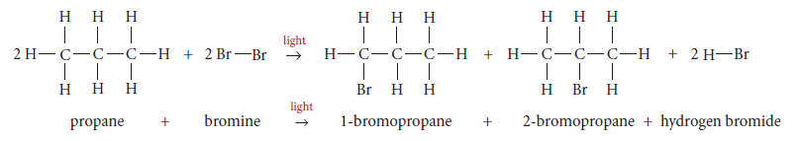
Substitution Reactions
Substitution reactions involve breaking a carbon–hydrogen bond in an alkane or aromatic ring and replacing the hydrogen atom with another atom or group of atoms.

Slide 39
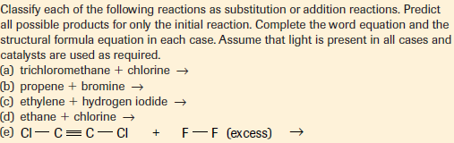
Practice

Slide 40
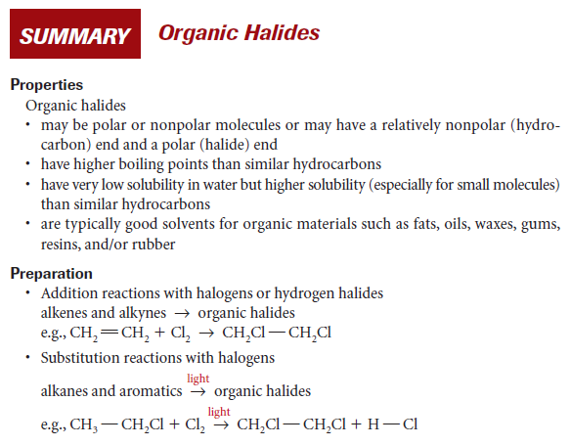
Review

Slide 41
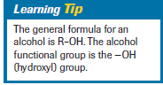
10.3: Alcohols & Elimination Reactions
Chemists first classified alcohols by their empirical properties and their empirically determined formulas. Laboratory work showed that alcohols all contain one or more hydroxyl groups, –OH. The –OH group is the functional group for alcohols.
Shorter-chain alcohols are very soluble in water because of their size, polarity, and hydrogen bonding.

Slide 42
Naming Alcohols
Simple alcohols are named from the alkane of the parent chain. The -e is dropped from the end of the alkane name and is replaced with -ol.
The number of carbon atoms in the alcohol is communicated by the standard prefixes: meth-, eth-, prop-, etc. Single bonds between the carbon atoms are communicated by the “an” in the middle of the name, for example, ethanol rather than ethenol.

Slide 43
Rules:
Identify
Identify the longest continuous carbon chain on which the alcohol functional group—the hydroxyl (–OH) group—is located
Write
Write the prefix for the name to indicate the number of carbons in the longest chain
Add
Add an “an” to the prefix to indicate that all of the carbon–carbon bonds are single bonds
Number
Number the carbon chain from the end nearest the hydroxyl group;
Add
If necessary, add the locant (number) for the hydroxyl group to the name;
Complete
Complete the parent name with “-ol” to indicate that the compound is an alcohol
Indicate
Indicate the presence of any substituent as a prefix
Add
If necessary, add the locant (number) to indicate the location of the substituent;
Double-check
9. Double-check to make sure that the numbers are necessary to differentiate this compound from a similar compound;

Slide 44
Types of Alcohols
• primary (1°) alcohols, in which the carbon atom carrying the –OH group is bonded to one other carbon atom, as in CH3CH2CH2CH2OH(l), butan-1-ol
• secondary (2°) alcohols, in which the carbon atom carrying the –OH group is bonded to two other carbon atoms, as in CH3CHOHCH2CH3(l), butan-2-ol
• tertiary (3°) alcohols, in which the carbon atom carrying the –OH group is bonded to three other carbon atoms, as in (CH3)3COH(l), 2-methylpropan-2-ol

Slide 45
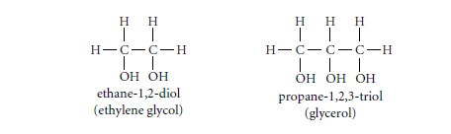
Polyalcohols
Alcohols that contain more than one hydroxyl group are called polyalcohols; their names indicate the number and positions of the hydroxyl groups.
Draw the structural formula for butane-1.3-diol

Slide 46
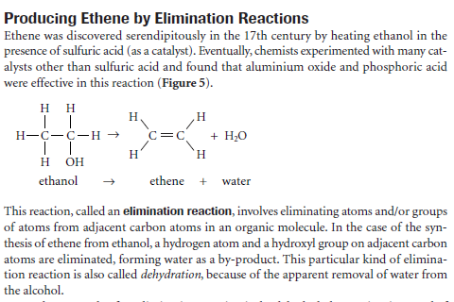
Elimination Reactions

Slide 47
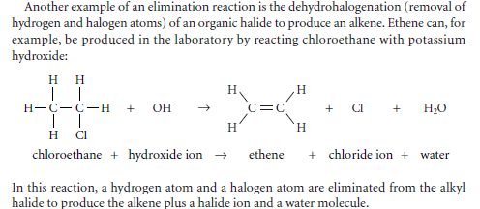
Another Example:

Slide 48
10.4 - Carboxylic Acids, Esters, &
Esterification Reactions
The family of organic compounds known as carboxylic acids contain the carboxyl group, –COOH, which includes both the carbonyl and hydroxyl functional groups.
Carboxylic acids undergo a variety of organic reactions. In a condensation reaction, a carboxylic acid combines with another reactant, forming two products—an organic compound and a compound such as water. For example, a carboxylic acid can react with an alcohol, forming an ester and water. This type of condensation reaction is known as an esterification reaction.

Slide 49
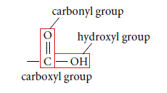
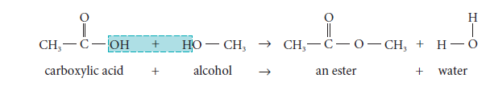
Example:

Slide 50
Naming: Acids
Carboxylic acids are named by replacing the -e ending of the corresponding alkane name with -oic, followed by the word “acid.”The first member of the carboxylic acid family is methanoic acid, HCOOH, commonly called formic acid Methanoic acid used in removing hair from hides and in coagulating and recycling rubber.

Slide 51
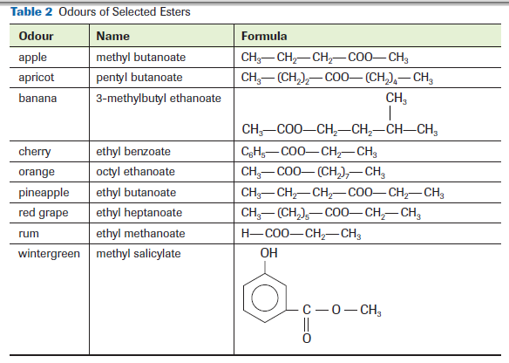
Examples of popular Esters

Slide 52
Naming: Esters
Esters are organic “salts” formed from the reaction of a carboxylic acid and an alcohol.
The first part is the name of the alkyl group from the alcohol used in the esterification reaction.
The second part comes from the acid. The ending of the acid name is changed from -oic acid to -oate.

Slide 53
Practice

Slide 54
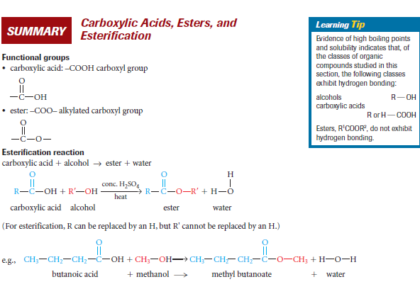
Wrap Up

Slide 55
10.5 – Polymerization Reactions
Polymers: large molecules made by linking together many smaller molecules, called monomers, much like paper clips in a long chain.
Plastics are synthetic polymers, but many natural polymers have similar properties recognized since early times. Amber from tree sap, and tortoise shell, for example, can be processed and fashioned into jewelry or ornaments.
Rubber and cotton are plant polymers, and wool and silk are animal polymers.

Slide 56
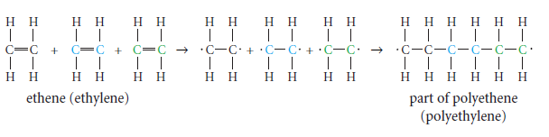
Addition Polymerization
Many plastics are produced by the polymerization of alkenes. For example, polyethene (polyethylene) is made by polymerizing ethene molecules in a reaction known as addition polymerization

Slide 57
Try this- Draw a structural formula of three repeating units of:
a polymer of but-1-ene
a polymer of 1-chloro-1,2,2-trifluoroethene

Slide 58
Condensation Polymers
Including the synthetic fibres nylon and polyester, and natural polymers like proteins and DNA
Produced by condensation polymerization reactions. These reactions involve the formation of a small molecule (such as H2O, NH3, or HCl)
The small molecule is said to be “condensed out” of the reaction.
The monomer molecules bond at the site where atoms are removed from their functional groups. To form a condensation polymer, the monomer molecules must each have at least two functional groups, one on each end.

Slide 59
Example of Condensation
Joining of two amino acids:

Slide 60
Forming a disaccharide:

Slide 61
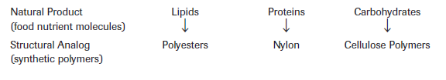
Comparing Natural with Synthetic Polymers
Food nutrients and their synthetic structural analogs are an example of natural product chemistry, where chemists copy and modify the structure of chemicals found in nature.

Slide 62
Polyesters
When a carboxylic acid reacts with an alcohol in an esterification reaction, a water molecule is eliminated and a single ester molecule is formed.
The two reactant molecules are linked together into a single ester molecule. This esterification reaction can be repeated to form not just one ester molecule, but many esters joined in a long chain, a polyester

Slide 63
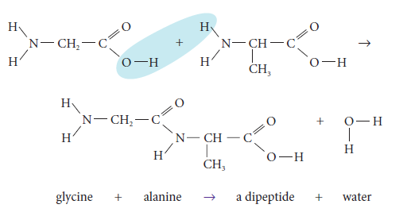
Proteins and Nylon
Proteins are a fundamental structural material in plants and animals. Scientists estimate that there are more than ten billion different proteins in living organisms on Earth. Remarkably, all of these proteins are constructed from only about 20 amino acids.

Slide 64
Continued…
Many synthetic polymers, such as nylon, form in similar ways to proteins. Nylon is a synthetic condensation polymer. For both the natural polymer (protein) and the synthetic polymer (nylon), the polymer forms by the reaction of a carboxyl group (–COOH) with a –NH2 group with amide linkages (–CONH–).

Slide 65
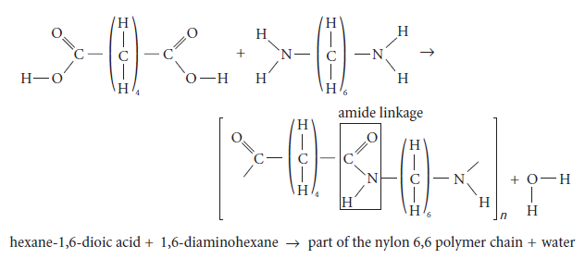
Continued…
Polymers with amide linkages are called polyamides. Amide linkages in proteins are called peptide linkages and the polymers are called polypeptides.

Slide 66
Draw a structural formula representation of the nylon subunits joined together
H₂N(CH₂)₆NH₂ and HOOC(CH₂)₆COOH.

Slide 67
Carbohydrates and Cellulose Acetate
The monomers of carbohydrates—compounds with the general formula Cx(H2O)y—are simple sugar molecules. The sugar monomers undergo a condensation polymerization reaction in which a water molecule is formed, and the monomers join together to form a larger molecule

Slide 68
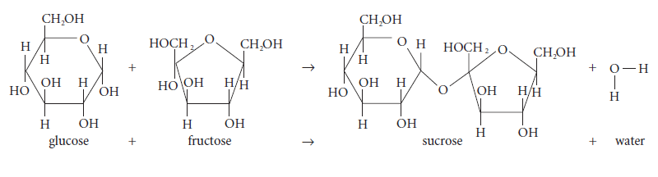
Disaccharide Synthesis

Slide 69
Cellulose
Starchy foods such as rice, wheat, corn, and potatoes provide us with readily available energy. They are also the main method of energy storage for the plants that produce them, as seeds or tubers.
Starches are polymers of glucose, in either branched or unbranched chains; they are, thus, polysaccharides.
We have, in our digestive tracts, very specific enzymes.

Slide 70
Continued…
One breaks down starch. However, the human digestive system does not have an enzyme to break down the other polymer of glucose: cellulose. Cellulose is a straight-chain, rigid polysaccharide with glucose–glucose linkages different from those in starch or glycogen.

Slide 71
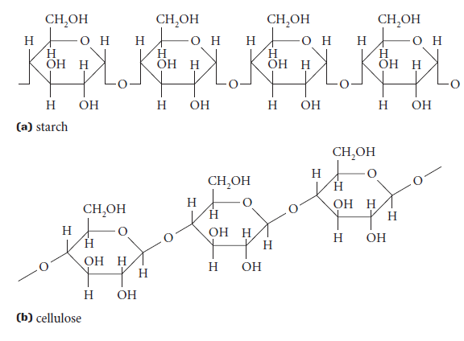
Starch vs Cellulose

Slide 72
Cellulose Acetates—Structural Analogs of Polysaccharides
Chemists have researched & developed polymers that are modifications of natural polymers. These natural synthetic polymers are called biopolymers. For example, starch and cellulose have been made into synthetic polymers.

Slide 73
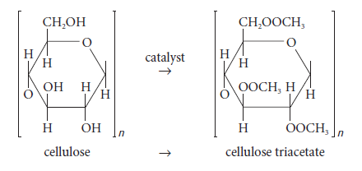
Still rigid but more flexible!

