Slide 1
Unit D
Chemical Equilibrium & Acid-Base Systems
Redding – 2019
Chemistry 30

Slide 2
Equilibrium Systems
Chapter 15

Slide 3
Equilibrium in Chemical Systems
The simplest equilibrium systems are static: Nothing is moving or changing to create the balance. A textbook sitting on a level desktop is an example of static equilibrium.
Chemical equilibrium is also a balance between two opposing agents of change, but always in a dynamic system.
In order to effect reaction between the reactants in a process the reactants
must collide and must collide often.
must collide often with sufficient kinetic energy
must collide often with sufficient kinetic energy in just the right reaction orientation

Slide 4
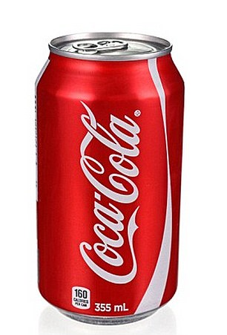
Explaining Equilibrium
Chemical systems are simpler to study when separated from their surroundings by a definite boundary. This separation gives an experimenter control over the system so that no matter can enter or leave. Such a physical arrangement is called a closed system.

Slide 5
How does the reaction reach equilibrium?
Evidence obtained from many reactions contradicts the assumption that reactions are always quantitative.
There is direct evidence for the presence of both reactants after the reaction appears to have stopped.
This apparent anomaly can be explained, in terms of collision–reaction theory, by the idea that a reverse reaction can occur
The final state of this chemical system can be explained as a competition between collisions of reactants to form products and collisions of products to re-form reactants.

Slide 6
Types of Equilibrium
We assume that any closed chemical system with constant macroscopic properties (no observable change occurring) is in a state of equilibrium, usually classified, for convenience, as one of three types.
Phase equilibrium involves a single chemical substance existing in more than one phase in a closed system. Water placed in a sealed container evaporates until the water vapour pressure (concentration of water in the gas phase) rises to a maximum value, and then remains constant
Solubility equilibrium involves a single chemical solute interacting with a solvent substance, where excess solute is in contact with the saturated solution.

Slide 7

Types of Equilibrium
A chemical reaction equilibrium involves several substances: the reactants and products of a chemical reaction.
All three types of equilibrium are explained by a theory of dynamic equilibrium a balance between two opposite processes occurring at the same rate. K_{c} is called the concentration equilibrium constant of the A $⇌$ B equilibrium.
For the generic equilibrium a A + b B $⇌$ c C + d D
the Law of Mass Action expression/Equilibrium constant expression is:
$K_{c}=\frac{{\left[C\right]}^{c}{\left[D\right]}^{d}}{{\left[A\right]}^{a}{\left[B\right]}^{b}}$ or it can be written as $K_{p}=\frac{{P_{C}}^{c}{P_{D}}^{d}}{{P_{A}}^{a}{P_{B}}^{b}}$if A-D are gases.

Slide 8

Types of Equilibrium
Equilibria in which all the reactants and products are in the same state/phase are said to be homogeneous equilibria. Where any of the reactant/product terms are in a different state/phase the equilibrium is said to be heterogeneous.
Since their concentrations are constant, the concentration terms of pure solids and single liquids are excluded from the Law of Mass Action Equation
Examples
(a) 2 SO₂ (g) + O₂(g) $⇌$ 2 SO₃(g) $K_{p}=\frac{{P_{SO3}}^{2}}{{P_{SO2}}^{2} {P_{O2}}^{}}$
(b) CuSO₄•5H₂O(s) $⇌$ CuSO₄(s) + 5 H₂O(g) $K_{p}={P_{H2O}}^{5}$
(c) H₂(g) + Br₂(g) $⇌$ 2 HBr(g) $K_{p}=\frac{{P_{HBr}}^{2}}{{P_{H2}}^{} {P_{Br2}}^{}}$
(d) HF(aq) + H₂O(l) $⇌$ H₃O⁺(aq) + F–(aq) $K_{a}=\frac{\left[H_{3}O^{+}\left(aq\right)\right][F^{–}\left(aq\right)]}{\left[HF\left(aq\right)\right]}$

Slide 9
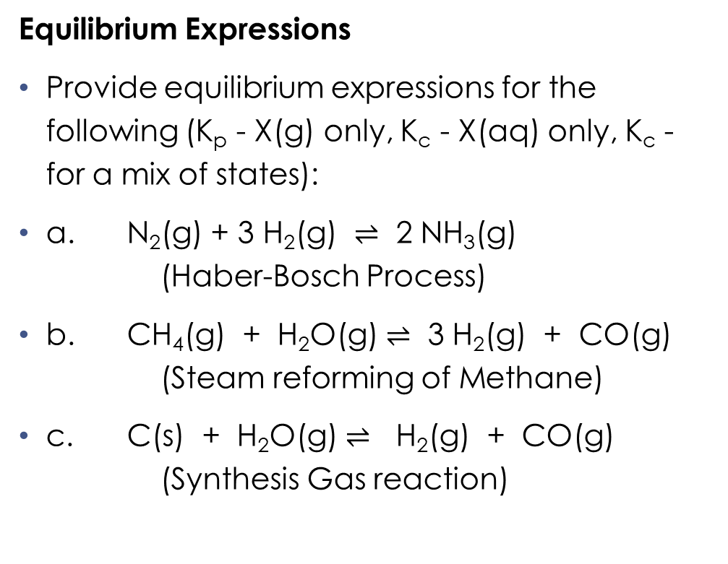
Types of Equilibrium
Equilibrium Expressions
Provide equilibrium expressions for the following (K_{p} - X(g) only, K_{c} - X(aq) only, K_{c} - for a mix of states):
a. N₂(g) + 3 H₂(g) $⇌$ 2 NH₃(g) (Haber-Bosch Process)
b. CH₄(g) + H₂O(g) $⇌$ 3 H₂(g) + CO(g) (Steam reforming of Methane)
c. C(s) + H₂O(g) $⇌$ H₂(g) + CO(g) (Synthesis Gas reaction)

Slide 10
Chemical Reaction Equilibrium
Chemical reaction equilibria are more complex than phase or solubility equilibria, due to the variety of possible chemical reactions and the greater number of substances involved.
Ex: When hydrogen and iodine are added to the flask, the colour of the iodine vapour is the only easily observable (empirical) property. An equilibrium equation describes this evidence theoretically.
H₂(g) + I₂(g) ←→ 2 HI(g),

Slide 11
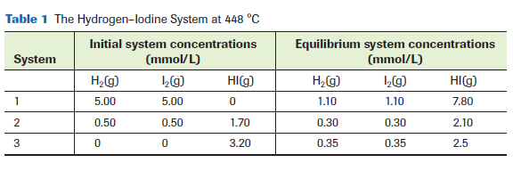
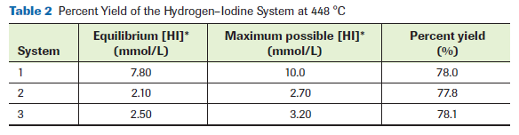
Experimental Data

Slide 12
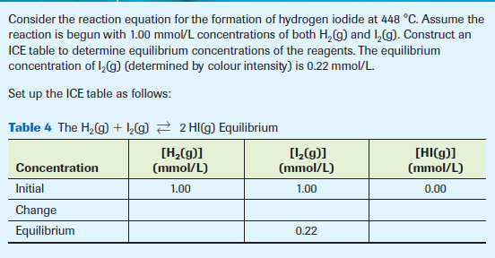
Practice

Slide 13
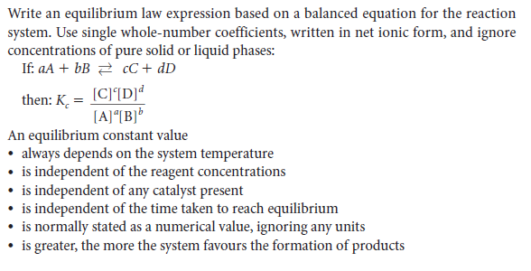
Summary

Slide 14
Predicting Final Equilibrium Concentrations
For simple homogeneous systems, it is possible to algebraically predict reagent concentrations at equilibrium using a known value for Kc and initial reactant concentration values. For more complex systems, the calculation becomes more difficult—such systems are left for more advanced chemistry courses ☺

Slide 15
Qualitative Change in Equilibrium Systems
According to Le Châtelier’s principle, when a chemical system at equilibrium is disturbed by a change in a property of the system, the system always appears to react in the direction that opposes the change, until a new equilibrium is reached
The application of Le Châtelier’s principle involves a three-stage process: an initial equilibrium state, a shifting non-equilibrium state, and a new equilibrium state.

Slide 16
Le Châtelier principle:
If a system at equilibrium is subjected to a change of pressure, temperature, or the number of moles of a component, there will be a tendency for a net reaction in the direction that reduces the effect of this change.
Equilibrium can shift or change at any time. Certain factors contribute to this change:
Volume
Temperature
Concentration
Adjusting an equilibrium state by adding and/or removing a substance is by far the most common application of Le Châtelier’s principle. Works with Aqueous systems

Slide 17
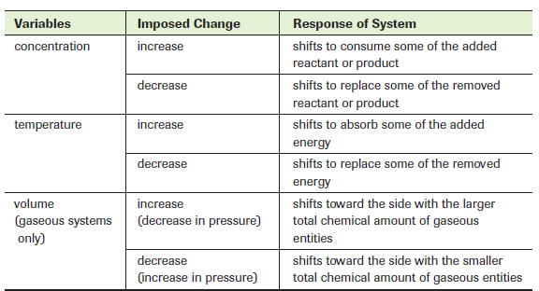
Summary

Slide 18
Water Ionization
The conductivity observed in pure water must be the result of ions produced by the ionization of some water molecules into hydronium ions and hydroxide ions. Because the conductivity is so slight, the equilibrium at SATP must greatly favour the water molecules.

Slide 19
Examples:
A 0.15 mol/L solution of hydrochloric acid at 25 °C is found to have a hydronium ion concentration of 0.15 mol/L. Calculate the amount concentration of the hydroxide ions.
Calculate the amount concentration of the hydronium ion in a 0.25 mol/L solution of barium hydroxide.
Determine the hydronium ion and hydroxide ion amount concentrations in 500 mL of an aqueous solution for home soap-making containing 2.6 g of dissolved sodium hydroxide.

Slide 20
Example:
Calculate the amount concentration of hydronium ions in a 0.100 mol/L aqueous solution of ammonia that is used in a spray bottle for window cleaning solution. A reference states that there is 2.1% reaction of dissolved ammonia with water (ionization) at this concentration, at SATP.

Slide 21
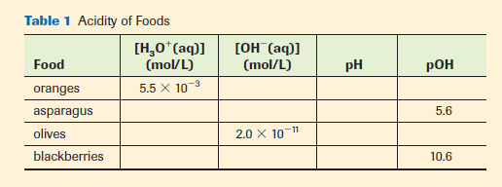
pH and pOH
Do you remember the formulas?

Slide 22
Equilibrium in Acid-Base Systems
Unit IV – Chapter 16

Slide 23
Acid Strength & Equilibrium
An acid is described as weak if its characteristic properties are less than those of a common strong acid, such as hydrochloric acid. Weak acids are weaker electrolytes and react at a slower rate than strong acids do; the pH of solutions of weak acids is closer to 7 than the pH of strong acids of equal concentration.

Slide 24
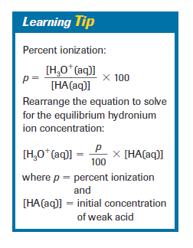
Acid Strength & Equilibrium
strong acids were explained as ionizing quantitatively by reacting with water to form hydronium ions, whereas weak acids were explained as ionizing only partially (usually 50%).
A strong acid is explained as an acid that reacts quantitatively with water to form hydronium ions.

Slide 25
Example:
In a 0.10 mol/L solution of acetic acid, only 1.3% of the CH₃COOH molecules have reacted at equilibrium to form hydronium ions. Calculate the hydronium ion amount concentration.

Slide 26
Proton Transfer
According to the Brønsted–Lowry concept, a Brønsted–Lowry acid is a proton donor and a Brønsted–Lowry base is a proton acceptor.
A Brønsted–Lowry neutralization is a competition for protons that results in a proton transfer from the strongest acid present to the strongest base present.
A Brønsted–Lowry reaction equation is an equation written to show an acid–base reaction involving the transfer of a proton from one entity (an acid) to another (a base). Some entities are amphiprotic

Slide 27
Conjugate Acid and Base
A pair of substances with formulas that differ only by a proton is called a conjugate acid–base pair. An acetic acid molecule and an acetate ion are a conjugate acid–base pair. Acetic acid is the conjugate acid of the acetate ion, and the acetate ion is the conjugate base of acetic acid.

Slide 28
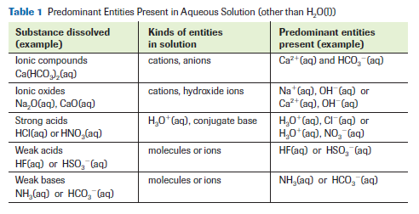
Predicting Acid-Base Rxns

Slide 29
Predicting Acid-Base Rxns
We theorize that the only significant reaction in any acid–base system involves proton transfer from the strongest acid present to the strongest base present. For an aqueous solution system, we first must list all the entities present as they exist in aqueous solution.

Slide 30
Examples:
What will be the predominant reaction if spilled drain cleaner (sodium hydroxide) solution is neutralized with vinegar? Are reactants or products favoured in this reaction?
Ammonium nitrate fertilizer is produced by the quantitative reaction of aqueous ammonia with nitric acid. Write a balanced acid–base equilibrium equation.

Slide 31
Summary
List
List all entities (ions, atoms, or molecules including H2O(l)) initially present as they exist in aqueous solution. (Refer to Table 1, page 728.)
Identify and label
Identify and label all possible aqueous acids and bases, using the Brønsted–Lowry definitions.
Identify
Identify the strongest acid and the strongest base present, using the table of Relative Strengths of Aqueous Acids and Bases (Appendix I and Databooklet).
Write
Write an equation showing a transfer of one proton from the strongest acid to the strongest base, and predict the conjugate base and the conjugate acid to be the products.
Predict
Predict the approximate position of the equilibrium, using the generalization developed in the Learning Tip on page 729, and the table of Relative Strengths of Aqueous Acids and Bases (Appendix I and Databooklet).

Slide 32
Acid Ionization
One important way that chemists communicate the strength of any weak acid is by using the equilibrium constant expression for a Brønsted–Lowry reaction equation showing the acid ionizing in (reacting with) water
Note that first six acids have Ka values given only as “very large.”
For each of them, the actual acid species present is H₃O⁺(aq). All of the other acids listed on the table are considered to be weak acids, and they vary greatly in extent of reaction with water at equilibrium.

Slide 33
Examples:
The pH of a 1.00 mol/L solution of acetic acid is carefully measured to be 2.38 at SATP. What is the value of Ka for acetic acid?
A student measures the pH of a 0.25 mol/L solution of carbonic acid to be 3.48. Calculate the Ka for carbonic acid from this evidence.
The pH of a 0.400 mol/L solution of sulfurous acid is measured to be 1.17. Calculate the Ka for sulfurous acid from this evidence.

Slide 34
Examples: Making an assumption!
Predict the [H₃O⁺(aq)] and pH for a 0.200 mol/L aqueous solution of methanoic acid. Look up the value of Ka for methanoic (formic) acid in the Relative Strengths of Aqueous Acids and Bases data table (Appendix I).
Predict the [H₃O⁺(aq)] and pH for a 0.500 mol/L aqueous solution of hydrocyanic acid.

Slide 35
Base Strength and Ionization - Kb
The Brønsted–Lowry concept specifies that the strongest base possible in aqueous solution must be hydroxide ions. So, hydroxide ion is considered to be “the” strong base—somewhat parallel to the strong acids.
A difference is that many ionic substances contain hydroxide ions initially, before being dissolved; whereas hydronium ions are always formed by the reaction of some entity with water, after a substance dissolves.

Slide 36
Continued…
Recall that for solutions of all ionic hydroxides, such as NaOH(aq) or Ca(OH)₂(aq), we assume that the compound dissociates completely upon dissolving. Therefore, finding the hydroxide ion concentration does not involve any reaction with water or any reaction equilibrium.
Example: Find the hydroxide ion concentration of a 0.064 mol/L solution of barium hydroxide.

Slide 37
Example:
A student measures the pH of a 0.250 mol/L solution of aqueous ammonia and finds it to be 11.32. Calculate the Kb for ammonia from this evidence. Show the establishment of the reaction equilibrium using an ICE table.

Slide 38
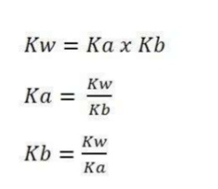
Calculating [OH(aq)] from Kb
The second type of calculation involving a Kb value is the prediction of the basicity of any weak base solution. We can calculate the concentration of hydroxide ions from the initial weak base concentration and the Kb value.
There is an automatic problem, however, because tables of relative acid–base strengths do not normally list Kb values. We use the automatic relationship between conjugate acid–base pairs to deal with this problem.

Slide 39
Examples:
Solid sodium benzoate forms a basic solution. Determine Kb for the weak base present.
Calculate Kb for the weak base aqueous ammonia, commonly used in commercial window cleaning solutions. Write the equation for the equilibrium.
Find the hydroxide ion amount concentration, pOH, pH, and percent reaction (ionization) of a 1.20 mol/L solution of baking soda.

Slide 40
What about Amphoterics?
Finally, we deal with the problem of amphoteric entities. If an entity can react as either a Brønsted–Lowry acid or base, how do you know which will be the predominant reaction in its aqueous solution?
Read the Ka value for the entity from the table of Relative Strengths of Aqueous Acids and Bases. Calculate the Kb value for the entity from Kw and the Ka value (from the table) of its conjugate acid.

Slide 41
Continued…
The higher of the “K” values tells you which reaction predominates, and, therefore, whether the entity reacts as an acid or as a base in aqueous solution.
Example: Which reaction predominates when NaHSO₃(s) is dissolved in water to produce HSO₃⁻(aq) solution? Will the solution be acidic or basic?

Slide 42
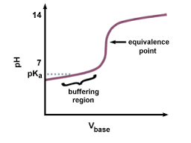
Interpreting pH Curves
The pH values and changes provide important information about the nature of acids and bases, the properties of conjugate acid–base pairs and indicators, and the stoichiometric relationships in acid–base reactions.

Slide 43
Buffering Regions, Endpoints, and Indicators
Endpoint refers to that point in a titration analysis where the addition of titrant is stopped. The endpoint is defined (empirically) by the observed colour change of an indicator.
Equivalence point refers to that point in any chemical reaction where chemically equivalent amounts of the reactants have been combined. The equivalence point is defined (theoretically) by the stoichiometric ratio from the reaction equation.
Buffering is the property of some solutions (often called buffer solutions) of resisting (counteracting) any significant change in pH when an acid or a base is added.

Slide 44
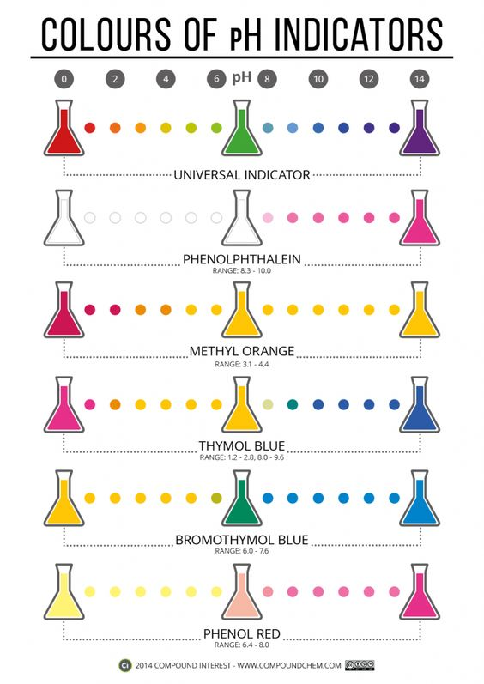
Indicators
Any acid–base indicator is really two entities for which we use the same name: a Brønsted–Lowry conjugate acid–base pair. At least one (most often both) of the entities is visibly coloured, so you can tell simply by looking when it forms or is consumed in a reaction. Phenolphthalein is a common example where the conjugate base form is bright red/pink and the conjugate acid form is colourless.

Slide 45
Continued…
Typically, common indicators such as methyl red have quite complex molecular formulas, so we use a (very simplified) shorthand to identify them, for convenience.
When an indicator equilibrium is shifted to the point where equal concentrations of both forms exist, an intermediate colour may be observed.
For example, we symbolize the (invisible) acid form of phenolphthalein as HPh, and the (bright red/pink) base form as Ph-.

Slide 46
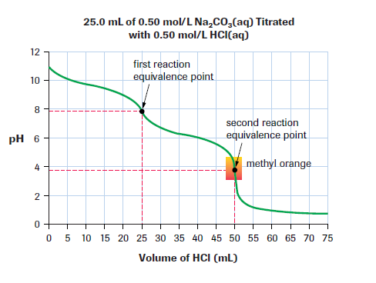
Polyprotic Entities and Sequential Reactions
Chemists interpret curves as indicating how many quantitative reactions have occurred, sequentially, for that particular acid–base titration.
Normally only one proton is donated during a reaction, however and entity can react several times during a reaction as well

Slide 47
Combining Formulas
For purposes of stoichiometric calculation, we can combine sequential quantitative Brønsted–Lowry reaction equations into a single “overall” reaction equation. This example is for the titration of sodium carbonate solution with hydrochloric acid.

Slide 48
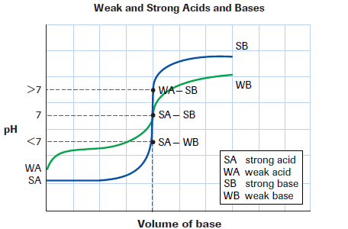
pH Curve Shape versus Acid and Base Strength

Slide 49
pH Curve Buffering Regions and Buffer Solutions
The term buffer refers specifically to the combination of any weak acid with its conjugate base, in the same solution. Buffer solutions have a specific pH due to the nature and concentration of the entities present, and change pH very little when other acids or bases are added—provided that the quantity added is much less than the quantities of the conjugate pair entities present in the buffer.

