Slide 1
ENVIRONMENTAL CHEMISTRY
Ms. Redding
Science 9

Slide 2
A hair raising dilemma
Topic 1

Slide 3
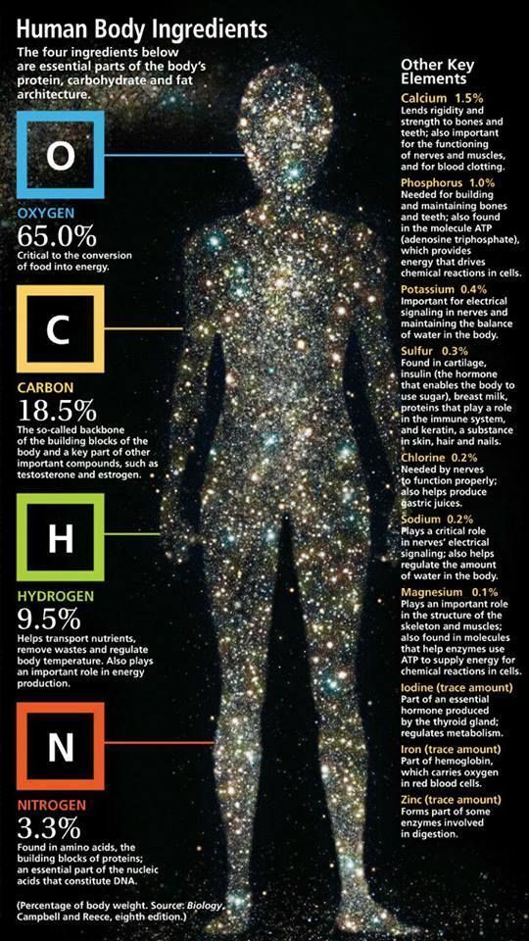
What does chemistry have to do with biology?
We are all made of chemicals
Food also made of chemicals
These chemicals or nutrients are used for:
Energy
Growth
Body- building
Cell repair

Slide 4
Organic vs inorganic nutrients

Slide 5
Organic Molecule | Role in Nutrition | Dietary Source
Carbohydrates | Energy source for metabolism | Rice Grains Potatoes Fruits
Protein | Structural molecule for body, helps chemical reactions | Meat Eggs Dairy Legumes Nuts
Lipids | Storage of unused chemical energy | Vegetable oil Nut oil Legumes Some dairy

Slide 6
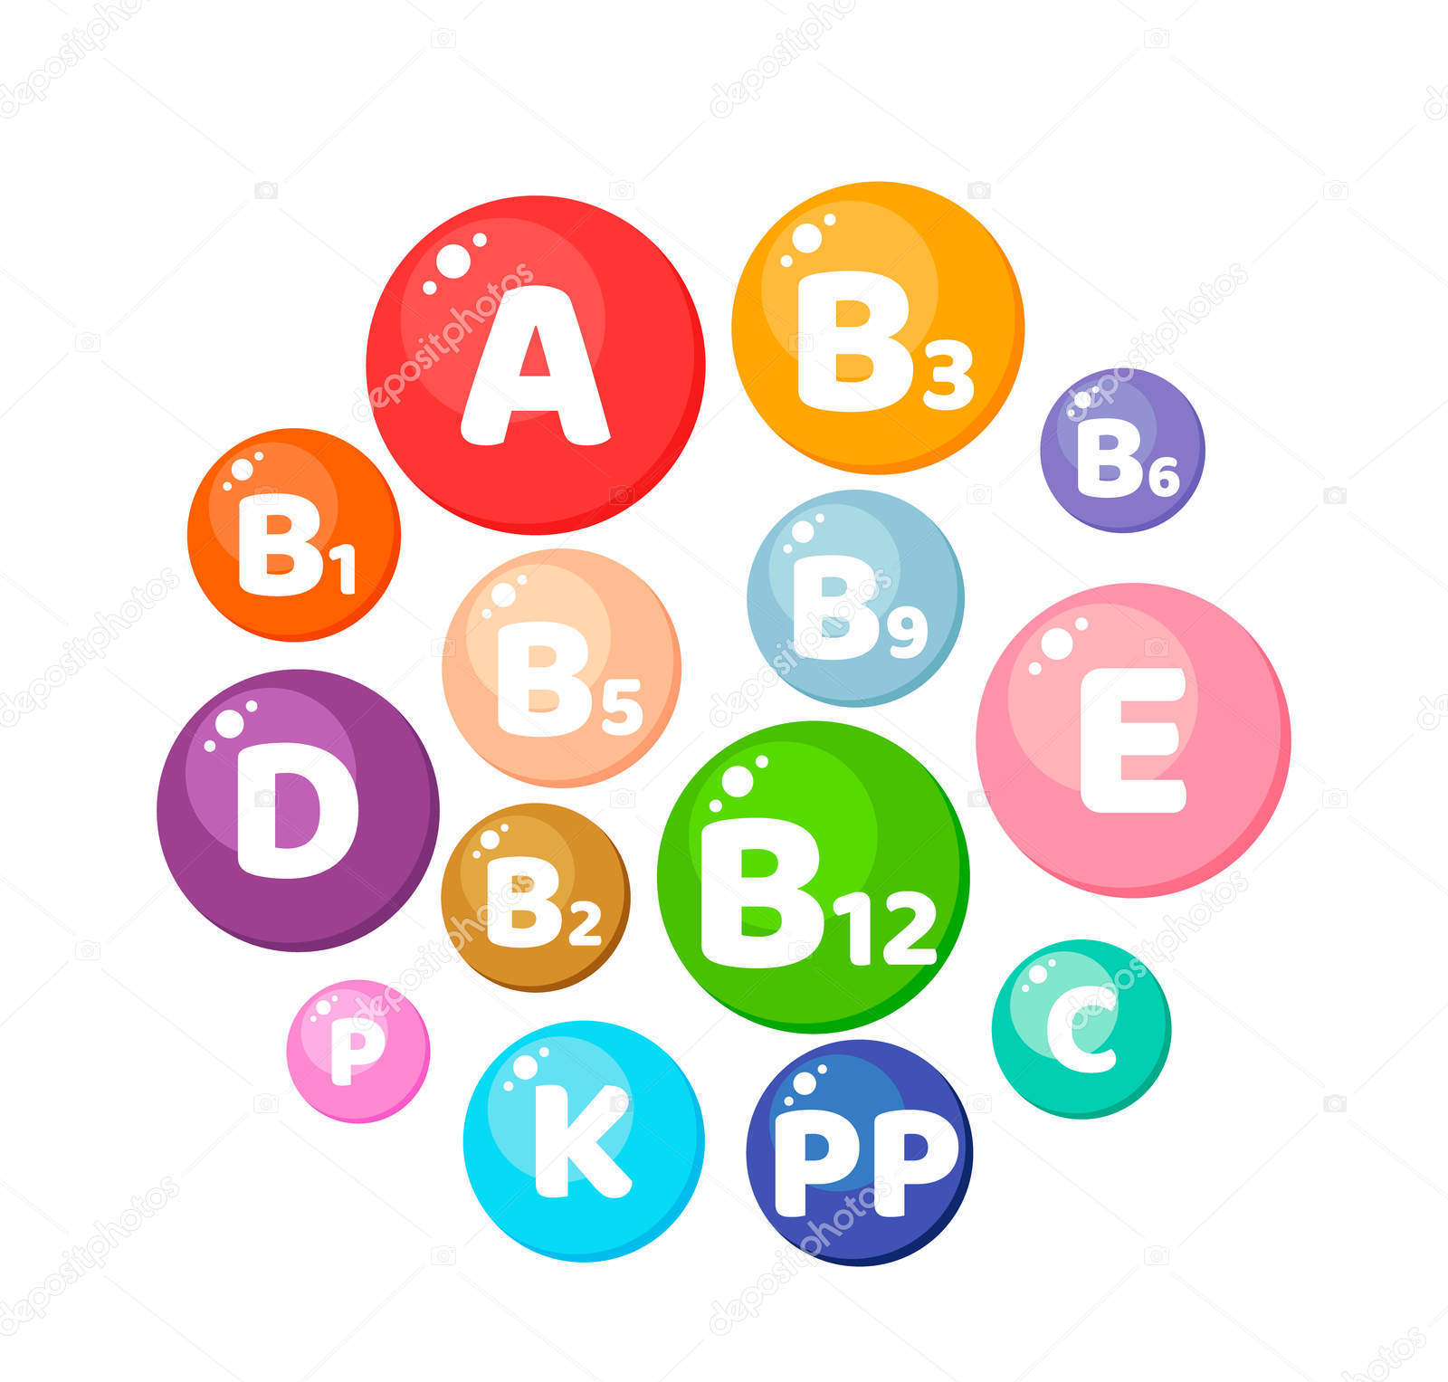
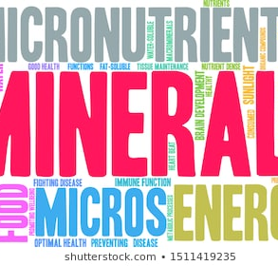
Elements for Healthy Bodies: Minerals
Minerals you need a lot of is called a macromineral
Minerals you only need a little of are called trace elements, which are found in enzymes and vitamins
All living things need 16 naturally occurring elements
Plants need 18 elements
We need 22 elements

Slide 7
Elements for healthy bodies
calcium
phosphorous
Needed for strong bones and teeth
Nerve conduction
Muscle contraction
Blood clotting
Bone formation
Forms compounds that store and release energy (ATP)

Slide 8
Elements for healthy bodies
magnesium
potassium
Component of Bones and teeth
Essential for enzyme function
Helps regulate nerve function
Helps regulate nerve signals and muscle activity (heart rate)
Protein formation
Regulates acid/base

Slide 9
Other elements for healthy bodies
Sulphur?
Used in some amino acids
Iron?
Red blood cells, regulates oxygen transport
Iodine?
Major part of thyroid hormones that regulate metabolism

Slide 10
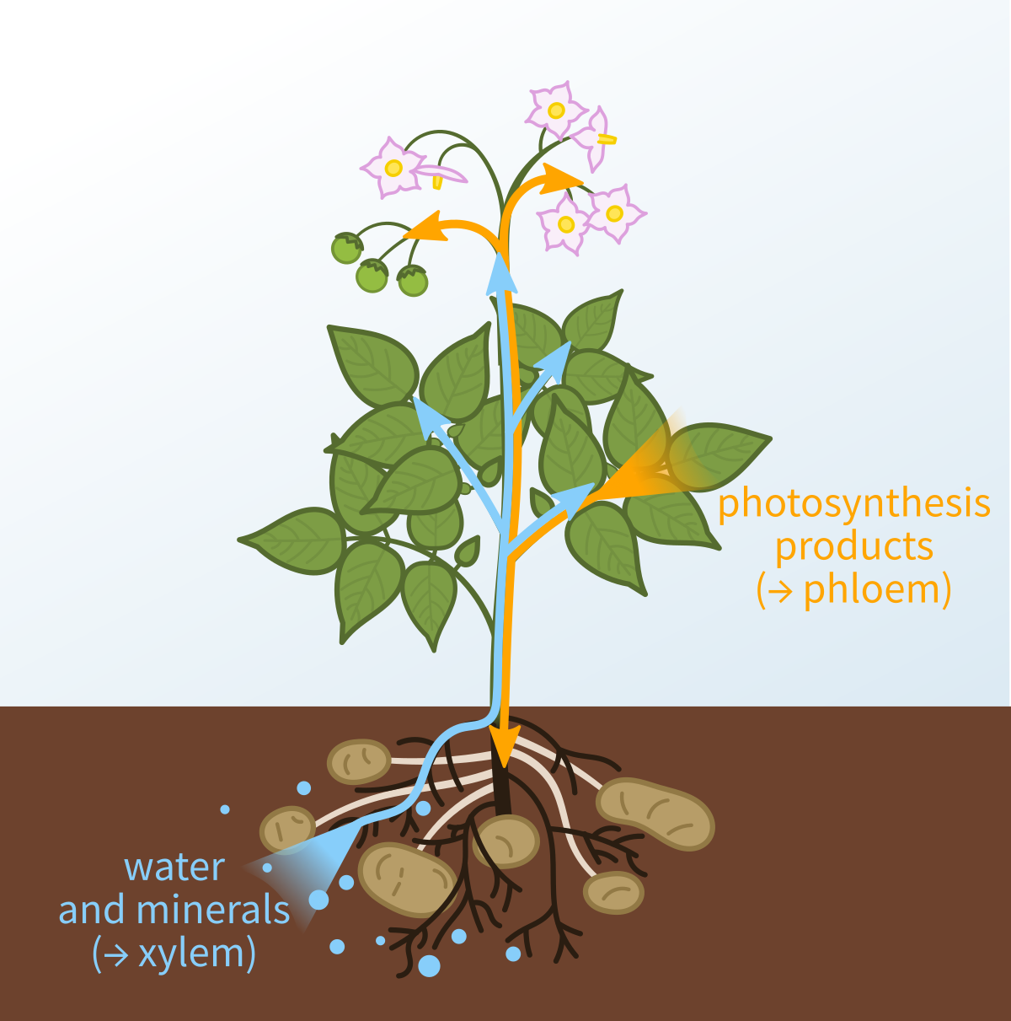
Getting these Minerals
As humans, we cannot extract the mineral directly from the ground
But plants can… and do
Root hairs specially designed to uptake and concentrate these minerals
They are then transported to other parts of the plant where they are used to create organic compounds such as proteins, lipids and vitamins.
Without plants, we would not be able to obtain the nutrients we need.

Slide 11
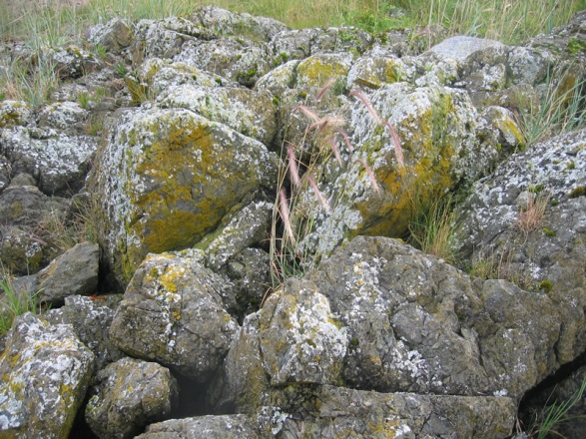
Substrates
Other organisms get their minerals through absorbing them from a substrate
A substrate is a material on which an organism moves or lives.
Some organisms attach themselves to the substrate, others obtain their nutrients from their substrate.
For example – the lichens in this photo are using the rocks as a substrate.

Slide 12
Fertilizers: Nutrients for Plants
Often, we help plants grow by giving them fertilizer
Fertilizers imitate nitrogen cycle, adding nitrates, ammonia and urea
Phosphorus provided as phosphate compounds
Potash acts as source of potassium
Notes:
12

Slide 13
Impact of Using Fertilizers
Use of artificial fertilizers has increased amount of nitrogen in environment as much as 140 million tonnes/year
What are the pros and cons of this use?

Slide 14
Pros
Cons
Fertilizer and water can be an expensive price for productivity
Single crop = increased chance of impact by disease
Pesticides can be used to reduce loss of crops, but are not without cost or environmental impact
Eg: Harmful Algal Blooms
Increased plant growth
Land not normally suitable for farming, can yield large crops when
High yield crops plants
Fertilizer used
Properly watered

Slide 15
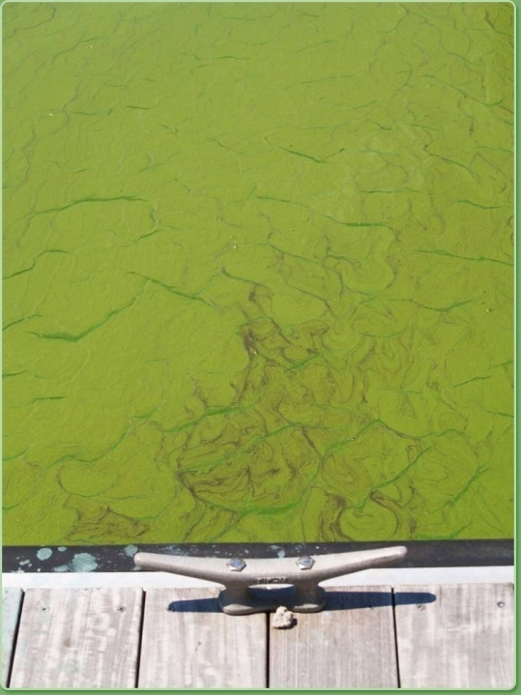
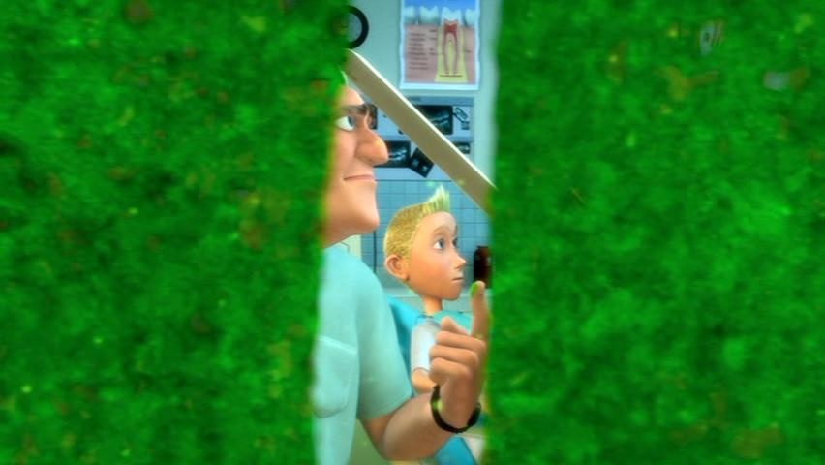
Harmful Algal Bloom
Rapid growth of algae that can deplete the oxygen dissolved in the water and block sunlight required by other organisms in the aquatic ecosystem
15

Slide 16
Summary
Living things need nutrients to survive
These nutrients can be organic or inorganic
We obtain our nutrients from our food which includes plants
Plants are capable of absorbing minerals from the soil, and using them to make proteins, lipids and vitamins
Fertilizers are one way that can be used to enhance plant growth, but their use in not without impact

Slide 17
A growing concern
Topic 2

Slide 18
Pesticides
Three types of pesticides
Herbicides: these chemicals are designed to kill plants. Some are selective (eg. Killex), while others are not (eg. Round-up)
Insecticides: these chemicals are designed to kill insects eg. Raid, DDT, dieldrin
Fungicides: these are designed to kill fungus

Slide 19
Ingestion vs Absorption
Ingestion – taking in a material. For us, this is equivalent to eating
Absorption – this can occur in several ways:
Digestive tract
Respiratory tract (after inhalation)
Skin

Slide 20
DDT
DDT (dichlorodiphenyltrichloroethane) is an insecticide that kills mosquitos and other insects.
Originally seen as great, was going to solve the problem of malaria
Hand unforeseen consequences higher up the food chain due to BIOACCUMULATION and BIOMAGNIFICATION
Birds feeding on insects were laying eggs with shells too thin to allow chicks to survive.

Slide 21
Bioaccumulation vs Biomagnification
Bioaccumulation is an increase in concentration of a material from the environment over time in an organism in a food chain
Biomagnification is an increase in concentration of a pollutant from one link in a food chain to another
In order for this to occur, the pollutant must be long-lived, mobile, soluble in fats, and biologically active

Slide 22
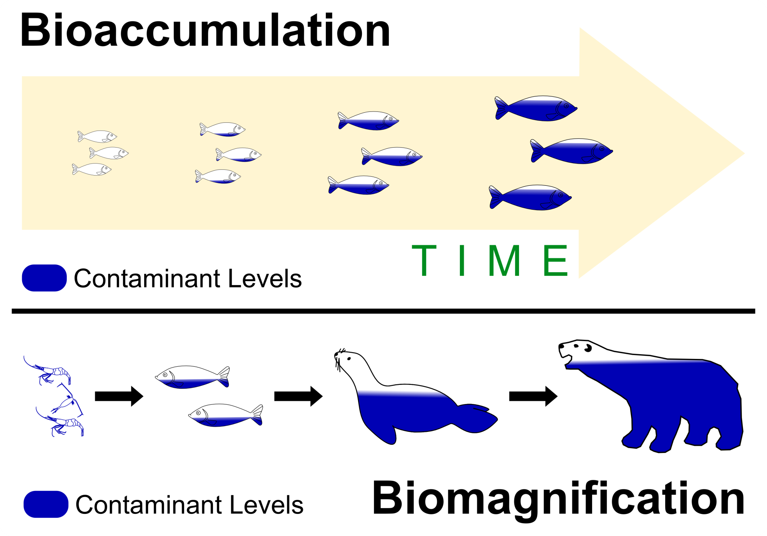

Slide 23
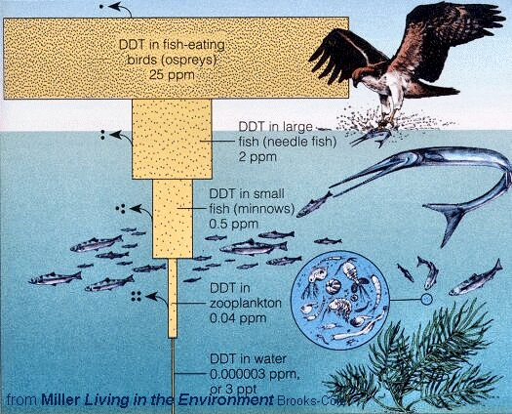

Slide 24
DDT Restriction
Four reasons restriction of DDT has been a struggle:
DDT helped reduce malaria incidence; incidence increased again after DDT banned
Replacements not as safe or effective
Substitutes are more expensive
Pesticide resistance is on the rise

Slide 25
How do you spell relief?
Topic 3

Slide 26
What are acids and bases?
What are the properties of acids and bases?
What is the pH scale?
What is the affect of acids and bases on living things?
How can we counter the effects of acid precipitation on the environment?

Slide 27
What are acids and bases?
Acids:
Bases:
Chemicals that produce acidic substances -pH less than 7
Examples:
Phosphoric Acid:
flavoring in food
Component of fertilizer
Detergent
Sulfuric acid
battery acid
Chemical s that produce basic substances- pH more than 7
Examples:
Sodium hydroxide (NaOH)
Component of household cleaners
Bleaching paper
Film processing
Aluminum hydroxide
Key ingredient in Antacids

Slide 28
What are the properties of acids & bases?
Acids
Bases
Taste: Sour
Feels: Stings
Acidic: adjective used to describe acids
Taste: Bitter
Feels: Slippery
Basic: adjective used to describe bases
Tasting and feeling unknown chemical are UNACCEPTABLE methods of identification.
Can look for a noticeable colour change when the acid or base reacts with a chemical indicator.

Slide 29
Indicators
Are substances that have a colour change when they react with acids and bases
What is an example we have seen this year?
Bromothymol Blue
Universal Indicator (has a range of colours based on pH)

Slide 30
Litmus- A chemical indicator
Mixture of plant compounds extracted from certain lichens
Looks light pink before reactions
In the presence of acid it turns red.
In the presence of base it turns blue
This is not an exact value… it just give an approximation of how acidic or basic a substance is

Slide 31
pH Scale
More specific way of comparing acids and basis
Scale is from 0-14
pH: 7.0 is neutral
Lower than 7 is acidic, higher than 7 is basic
Each pH unit represents a 10X increase in acidity or alkalinity
Universal indicator or pH paper will change a colour characteristic of a certain pH
Colours are matched against a chart that shows the range of colours for known pH values.

Slide 32
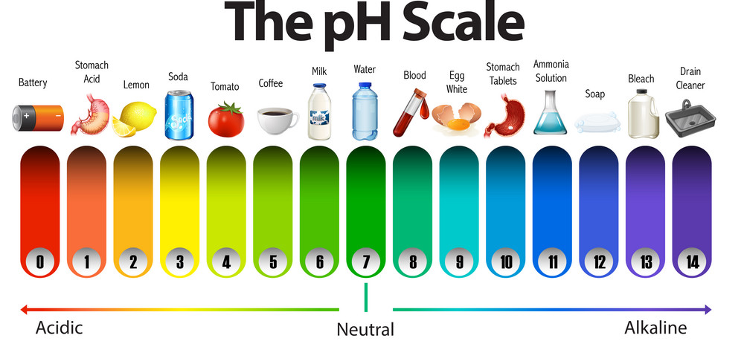
pH Scale
How does a pH scale work?

Slide 33
What is Acid Precipitation?
Rain and Snow containing acidic compounds
SO_{2(g)} + H₂O_{(l)} → H₂SO_{3(aq)} Sulfurous Acid
SO_{3(g)} + H₂O_{(l)} → H₂SO_{4(aq)} Sulfuric Acid
2NO_{2(g)} + H₂O_{(l)} → HNO_{2(aq)} + HNO_{3(aq)} Nitrous and Nitric Acid
CO_{2(g)} + H₂O_{(l)} → H₂CO_{3(aq)} Carbonic acid
What are the four oxides listed above that form acid rain?

Slide 34
What are the four major problems associated with acid precipitation?
Destroys aquatic ecosystems
Reduces productivity of crops due to damage to plants
Harms other vegetation
Accelerates decay of building

Slide 35
Using Chemistry to Control Acid Effects
Liming
Involves adding calcium carbonate (limestone) to an acidified lake
The calcium carbonate neutralizes the acid in the lake in what is referred to as an acid-base neutralization reaction
Scrubbers
Use limestone mixed with water.
Toxic gases are passed through this mixture that absorbs sulfur particles, preventing them from entering the atmosphere.

Slide 36
Using Chemistry to Control Acid Effects
Catalytic converters
They contain a ceramic or wire honeycomb coated in a metal such as platinum that act as a catalyst for complete combustion
The converter aids in the formation of carbon dioxide and water so that less carbon monoxide and nitrogen oxides are produced

Slide 37
Using Chemistry to Control Acid Effects
Scrubbers
For use in coal burning power plants
Remove or capture oxide emissions
Wet scrubber- removed sulfur dioxide by reacting gases with calcium oxide
Disadvantage: Waste calcium sulfite ended up in landfill
Metal Scrubber sorbants:
More environmentally friendly
Metal beads used to trap oxides can be reused
Trapped sulfur can be treated to make elemental sulfur and other sulfur compounds

Slide 38
Summary
Acids and bases have distinct properties
Indicators can be used to determine how acidic or basic a substance is
The pH scale is a way of quantitatively measuring the acidity or alkalinity of a substance
Acid rain is the product of oxides released into the atmosphere during combustion
Liming, catalytic converters and scrubbers are all ways to control the effects of acid on the environment

Slide 39
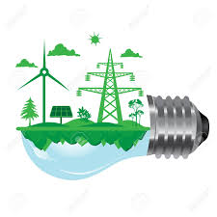
How much is too much?
Topic 4

Slide 40
Topic 4: How much is too much?
Key Concepts Overview
Pollutants & Pollution
Quantitative values – parts per million, parts per billion, LD50
Dilution and Concentration of pollutants
Acute vs Chronic Toxicity
Evaluation of Risks

Slide 41
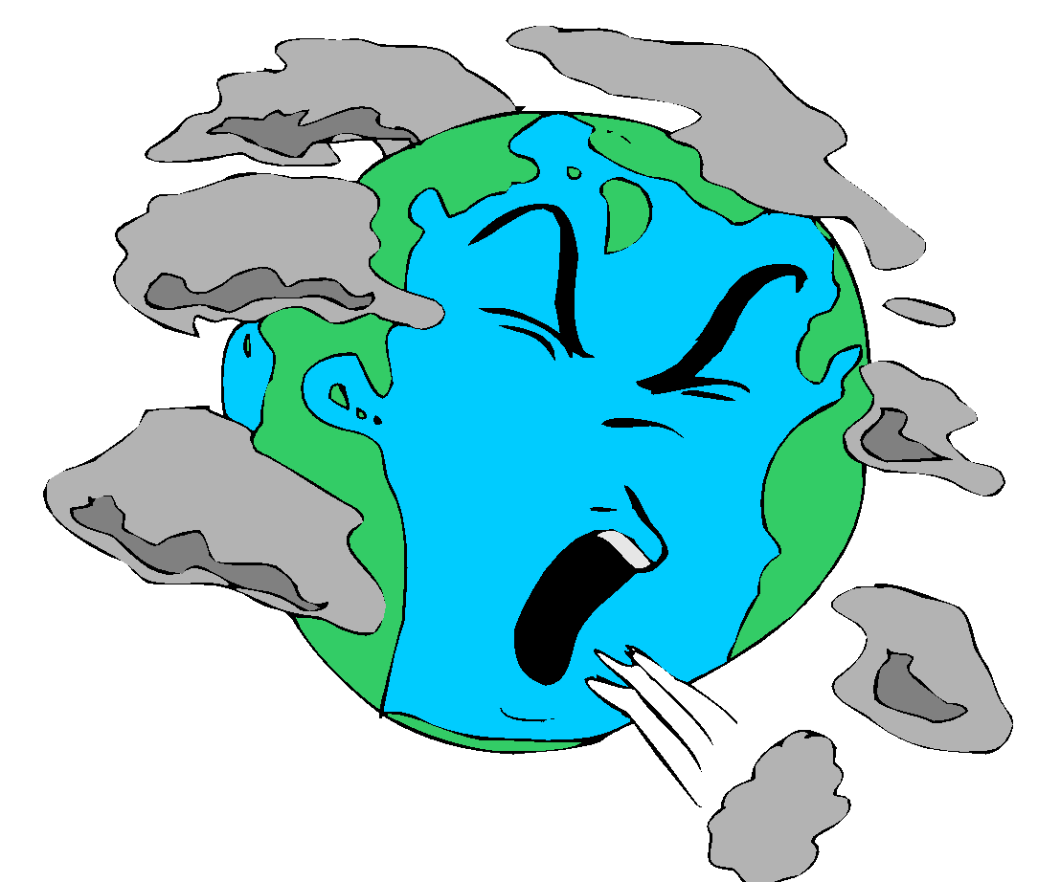
What is Pollution?
“any alteration to the environment producing a condition that is harmful to living things”

Slide 42
Pollution continued
Caused by pollutants
What are some examples of pollutants that you can think about?
Pesticides
Excess nutrients
Oxides – lead to acid precipitation
Heat
Noise
Light

Slide 43
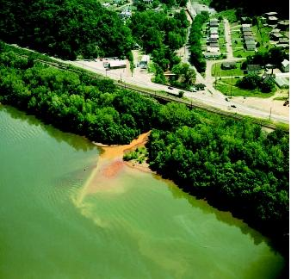
Sources
There are two main categories of pollution sources
Point source: small, defined area causing pollution
Non-point source: wide area, not easily defined where pollution is coming from or what its effects may be
http://mysticriver.org/storage/photos/nonpointsources.jpg?__SQUARESPACE_CACHEVERSION=1279905022852
http://www.waterencyclopedia.com/images/wsci_03_img0431.jpg

Slide 44
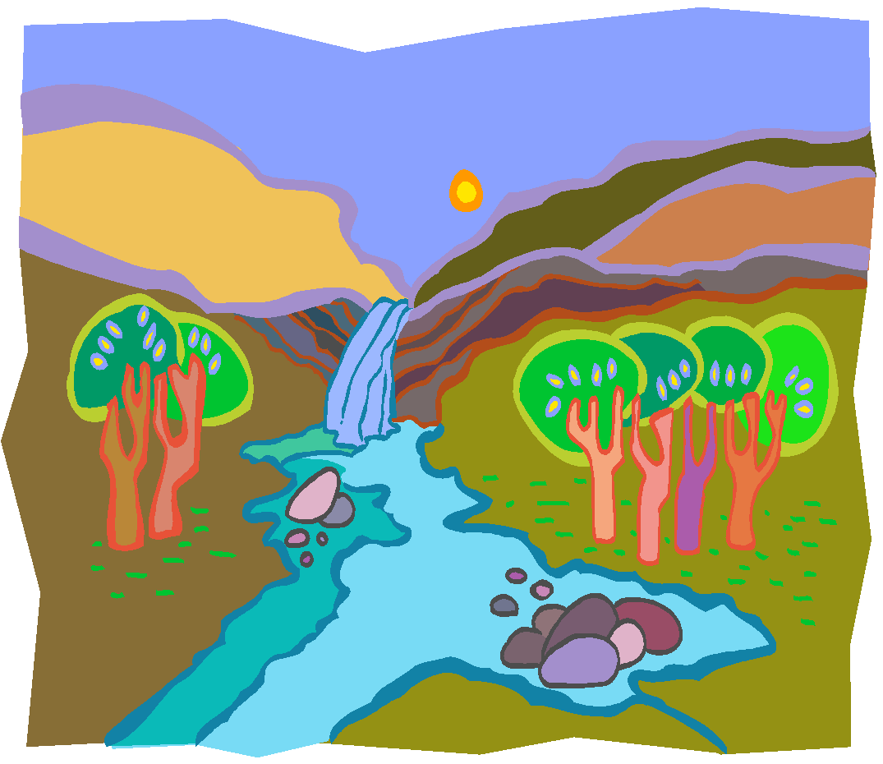
Dilution and Concentration
Dilution means pollution is becoming less concentrated.
What could help dilute pollution in a stream?
In the air?
What factors could concentrate pollution?

Slide 45
Quantifying Pollution
As you saw in your DDT In the Food Chain activity, most times concentration of pollutants is reported as a “parts per” value – usually parts per million (ppm) or parts per billion (ppb)

Slide 46
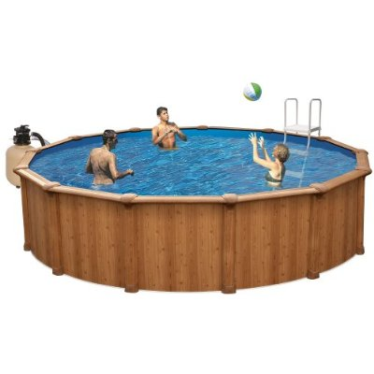
The volume of water in this swimming pool is 18 000 L
This is the same as 18 000 000 mL
If the concentration of chromium in the water was 3 ppm this would mean that for every million mL of water, 3 of those would contain chromium.
http://ecx.images-amazon.com/images/I/41I-TdujhyL._SL500_AA400_.jpg

Slide 47
Parts per million
For a ppm reading we need to compare prefixes with a difference of 1 000 000
Example:
125 g of yogurt contains 7 mg of cholesterol
Convert mass of yogurt to kg: 125 g = 0.125 kg
7 mg / 0.125 kg = 56 ppm

Slide 48
Toxicity
When something is TOXIC it means it is harmful in some way
Acute Toxicity – causes serious harm after a single exposure
Chronic Toxicity – affects are not evident until the toxin has accumulated to a certain level – usually over many exposures
Many heavy metals are considered to have chronic toxicity which is why we try and limit our exposure

Slide 49
Lethal Dose 50
Otherwise known as LD50
This is the amount of a material that will kill 50% of a population it is tested on.
A SMALL LD50 means it is more toxic (see table 3.4 on page 218)
Not all individuals will react to all materials in the same way
Some individuals in a population could be resistant or highly tolerant to a material

Slide 50
Risk Management
Many substances will have different effects in animals vs humans (Thalidomide)
Tests on animals can be misleading
Sometimes known risks are acceptable depending on the situation
Every chemical has the potential to cause harm depending on type, duration and quantity of exposure.

Slide 51
Let’s Think About It…
Marathon runners who consume large quantities of water during a race run the risk of experiencing a condition called “water intoxication” in which they suffer seizures with symptoms resembling epilepsy. Your friend uses this as proof that any chemical is hazardous in excess amounts, but also claims logically this means that any chemical is also safe if it is in a small enough dose. What is the error in this statement?

Slide 52
Getting away from it all
Topic 5

Slide 53
Topic 5: Getting Away from It All
We have already learned that we can have pollution from many different sources and that some pollutants are more harmful in small doses
Ex. Botulism toxin, tetrodotoxin
We also know that substances that we need can also be considered harmful
Ex. Phosphates, nitrates, copper
How do we monitor levels of all substances so we can make sure there is enough of everything we need but not too much to cause problems

Slide 54
Remember…
We talked about DDT being a persistent toxin
Persistent means that it cannot be broken down easily in the environment or at all
Heavy metals and petrochemicals are also persistant
A non-persistent toxin can be broken down into non-toxic compounds by naturally occurring processes
Fertilizers, manure, sewage are non-persistent pollutants

Slide 55
Water, water everywhere…
Because water is such a good solvent, much of environmental monitoring involves testing water for the presence of different pollutants.
This can be done using chemical tests and using biological indicators

Slide 56
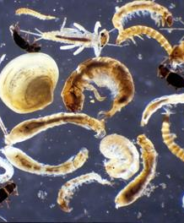
Macroinvertebrates
These are organisms that tell us about the quality of the environment by their presence or absence in water
Good quality water will have a large variety of organisms but a higher occurrence of organisms that need lots of oxygen:
Stonefly, mayfly, caddisfly, beetle

Slide 57
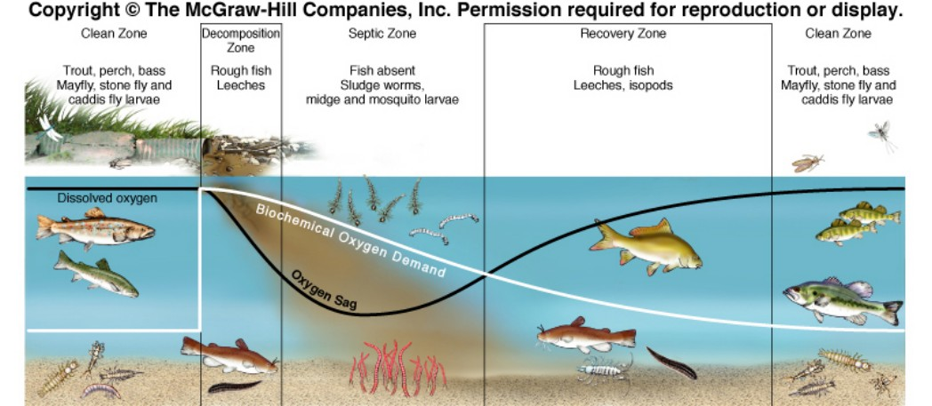
Dissolved Oxygen Sag in a River

Slide 58
Topic 5 Summary
Monitoring is required to keep track of persistent and non-persistent
Water is often monitored for the presence of pollutants because it is such a good solvent
We can test for materials using chemical tests or using biological indicators

Slide 59
NIMBY: there is no away in throwing!
Topic 6

Slide 60
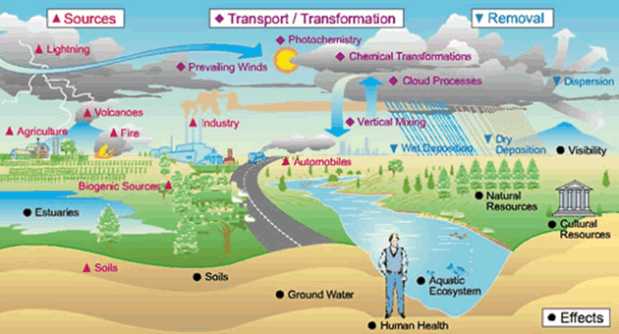
Topic 6 - NIMBY
Contrary to what used to be believed, pollution is not stationary – it does not only affect the area the pollutant is released in
http://www.nature.nps.gov/air/aqbasics/images/AQBasicSources.gif

Slide 61
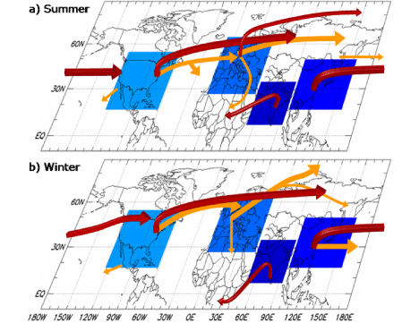
Circumpolar Winds
These winds carry pollution across the northern hemisphere, causing contamination of air hundreds of kilometers from the source
http://www.epa.gov/airtrends/2008/graphics/Figure34.gif

Slide 62
Waste Water Treatment
Goal is to take water that has been “used” and return it to the environment with minimal pollutants
Primary Treatment – physical separation of large solids and sediments
Secondary Treatment – bacteria decompose organic matter and, once removed (BIOSOLIDS), the remaining water is treated with chlorine, ozone or UV light
Tertiary Treatment – percolation of water through plant bed to remove phosphates or nitrates

Slide 63
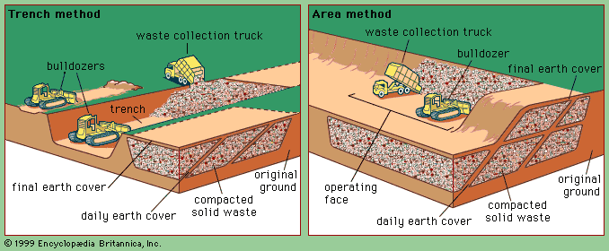
Sanitary Landfills
Used for normal household and industrial waste
Garbage is compacted and covered daily with earth and sometimes clay.
Clay liner at bottom prevents leachate from reaching groundwater supplies.
Methane gas – a product of anaerobic biodegradation of waste – is piped off before it becomes a hazard

Slide 64
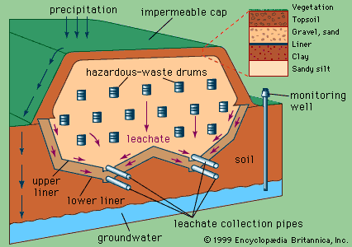
Secure Landfills
where hazardous waste is placed in or on land and that is designed, constructed and operated to prevent any pollution from being caused by the facility outside the area of the facility
Must be separated from water supplies by several meters of sand and clay
Testing/monitoring wells located outside of landfill are tested regularly to ensure to seepage has occurred.

Slide 65
How Can Nature Help?
Remember what BIO means…?
We often think of something that is biodegradable as more environmentally friendly
Sometimes when things biodegrade they break down into materials that are just as hazardous or more so than the original
Bioremediation is a way of using living things (often bacteria) to solve a problem – biodegradation can be a form of bioremediation.
Did you know that some bacteria can use the hydrocarbons in petrochemicals as an energy source? These can be used to help clean up oil spills!

