Slide 1
Introduction to Chemical Analysis
8.1 – Chemistry 20
Redding

Slide 2
Introduction to Chemical Analysis
Analysis of an unknown chemical sample can include both qualitative analysis—the identification of a specific substance present—and quantitative analysis—the determination of the quantity of a substance present. While there are many analytical technologies and procedures used, three methods predominate:
colorimetry, or analysis by colour, which uses light emitted, absorbed, or transmitted by the chemical (Section 8.1)
gravimetric analysis, which uses stoichiometric calculations from a measured mass of a reagent (Section 8.2)
titration analysis, which uses stoichiometric calculations from a measured solution volume of a reagent (Section 8.4)

Slide 3
Introduction to Chemical Analysis
Aqueous ion colour is due to the ion’s interference with visible light. Ions absorb specific wavelengths, which makes analysis possible.
A specific colour identifies a particular ion. The percentage of light that is absorbed depends on how many ions are in the light path, that is, on the concentration of that ion.

Slide 4
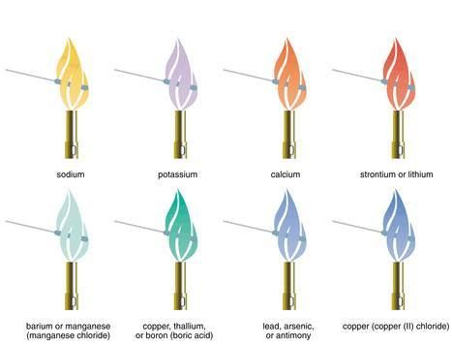
Continued…
We can also use flame tests to detect the presence of several metal ions, such as copper(II), calcium, and sodium (see the Selected Ion Colours table on the inside back cover). In a flame test, a clean platinum wire is dipped into a test solution and then held in a nearly colourless flame.
There are other ways to conduct flame tests: You could dip a wood splint in the aqueous solution and then hold it close to a flame; you could hold a tiny solid sample of a substance in the flame; or you could spray the aqueous solution into the flame.

Slide 5
Gravimetric Analysis
8.2 – Chemistry 20
Redding

Slide 6
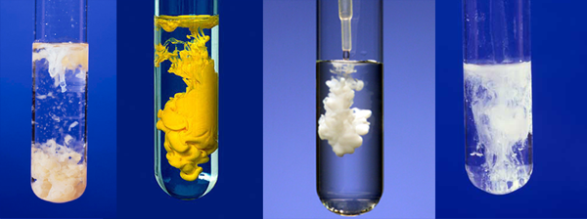
Quantitative Analysis
In one type of chemical analysis, precipitation is part of the experimental design. As you know, precipitation occurs when a reaction forms a slightly soluble product. In a quantitative analysis involving precipitation, the sample under investigation is combined with an excess quantity of another reactant to ensure that all the sample reacts.

Slide 7
Precipitation Completeness
In a gravimetric analysis where a precipitation reaction is used, it is not possible to predict the quantity of excess reagent required, because you do not initially know the amount of the limiting reagent; that is why you are doing an analysis. For such reactions, use the following trial-and-error procedure to verify that a sample of limiting reagent has completely reacted:
1. Precisely measure a sample volume of the solution containing the limiting reagent.
2. Add (while stirring) an approximately equal volume of the excess reagent solution.
3. Allow the precipitate that forms to settle, until the top layer of solution is clear.
4. With a medicine dropper, add a few more drops of excess reagent solution. Allow the drops to run down the side of the container, and watch for any cloudiness that may appear when the drops mix with the clear surface layer
5. If any new cloudiness is visible, the reaction of the limiting reagent sample is not yet complete. Repeat steps 2 to 4 of this procedure as many times as necessary, until no new precipitate forms during the test in step 4
6. When no new cloudiness is visible (the test does not form any further precipitate), the reaction of the sample of limiting reagent is complete.

Slide 8
Homework:
Page 316 Questions 1-5
Page 319 Questions 1-4
Worksheet for 8.2

Slide 9
Stoichiometry: limiting and excess reagents
8.3 – Chemistry 20
Redding

Slide 10
Calculating the Mass of Excess Reagents
For reacting a precisely measured quantity of one reagent with an excess of another, we use a “rule of thumb,” a general but inexact guideline that works for most situations. For questions in this textbook, assume that a reasonable quantity of excess reagent to use is 10% more than the quantity required for complete reaction, as determined in a stoichiometric calculation
Ex: You decide to test the method of stoichiometry using the reaction of 2.00 g of copper(II) sulfate in solution with an excess of sodium hydroxide in solution. What would be a reasonable mass of sodium hydroxide to use?

Slide 11
Continued…
Ex: A chemistry teacher wishes to have students perform a precipitation reaction. Vials containing precisely measured 1.50 g samples of barium chloride are given to each student group. A stock supply of pure solid sodium sulfate is available in the laboratory. Both reagents are colourless in aqueous solution.
What would be a reasonable mass of sodium sulfate for each group to use to ensure complete reaction of their barium chloride sample?
When the precipitate is filtered, which aqueous ion should not be present in the filtrate?
Describe a procedure that students could use to test the filtrate to see whether the limiting reagent has all reacted.
What should the students do if the test shows the limiting reagent has not all reacted?

Slide 12
Identifying Limiting and Excess Reagents
Another application of stoichiometry is the identification of limiting and excess reagents in a chemical reaction, when two known quantities of chemicals react. Which one is the limiting reagent? This is determined using the same stoichiometric principles as before. Like all stoichiometry problems, the mole ratio from the balanced chemical equation is the key part of the solution
Ex: If 10.0 g of copper is placed in a solution of 20.0 g of silver nitrate, which reagent will be the limiting reagent?

Slide 13
Continued…
Ex: In the reaction of a 10.0 g sample of copper with 20.0 g of silver nitrate in solution in Sample Problem 8.2, what mass of copper will be in excess (left over when the reaction is complete)? What mass of silver will be produced?
Ex: In an experiment, 26.8 g of iron(III) chloride in solution is combined with 21.5 g of sodium hydroxide in solution. Which reactant is in excess, and by how much? What mass of each product will be obtained?

Slide 14
Homework:
Page 327 Questions 1-8
Worksheet for 8.3

Slide 15
Titration analysis
8.4 – Chemistry 20
Redding

Slide 16
Vocabulary
Titration – process of carefully measuring and controlling the addition of a solution, called a titrant, from a burette into a fixed volume of another solution, the sample.
Equivalence Point – the point at which the exact theoretical amount of titrant has been added to the sample and completely reacted.
Endpoint – a sudden observable change in the solution that is permanent

Slide 18
Practice
Determine the concentration of hydrochloric acid in a commercial solution that is used to treat concrete prior to painting. A 1.59 g mass of sodium carbonate, Na₂CO₃(s), was dissolved to make 100.0 mL of solution. Samples (10.00 mL) of this standard solution were then taken and titrated with solution, which was prepared by diluting the original commercial solution, HCl(aq), by a factor of 10. The titration evidence collected is shown in the Table. Methyl orange indicator was used.

Slide 19
Standardizing Titrant Solutions
Knowing the concentration of all solutions before a titration begins is key. You must know this in order to proceed with your experiment.
Standard Solution – have a high certainty of concentration, like a stock solution
Primary Standard – mass and purity of a compound can be measured with high precision, usually obtained from a manufacturing facility, not created in a classroom laboratory setting? WHY?
Standardizing – means to find the concentration of a solution after it has been prepared, by reacting it with a solution that has been prepared from a primary standard.

Slide 20
Question???:
When adding titrant to a burette, it is critical that the concentration of the solution remain constant. Ideally, the burette should be cleaned and dried just before use to make sure that no impurities change the titrant concentration. It is extremely difficult, however, to quickly dry a burette that has just been cleaned. What technique is used to solve this problem?

Slide 21
Answer:
Once the burette has been washed with distilled water, rinse the burette with a small volume of titrant. It will not matter if the inside of the burette is wet, as long as the liquid in it is the same solution that will be used to fill it.

Slide 22
Question???:
One purpose of doing multiple trials for an analysis is to immediately identify any mistakes in procedure because these will cause discrepant results. What is the other reason for doing multiple trials?

Slide 23
Answer:
Doing multiple trials and averaging the answers, increases the certainty and reliability of the result.

Slide 24
Question???:
Acid–base titrations, typically do not produce any visible product, which presents a problem. There is no direct way of knowing when such a reaction is complete.
Explain how this problem is overcome by using another substance that is not part of the reaction, what characteristic of this substance is useful, and what characteristic of the reaction solution is detected by this substance.

Slide 25
Answer:
An indicator is used. This is a substance that changes colour in response to changes in pH (hydronium ion concentration) in the reaction solution.

Slide 26
Homework:
Page 332 Questions 1&2
Worksheet for 8.4

Slide 27
Acid – base titration curves
8.5 – Chemistry 20
Redding

Slide 28
Titrations
During titration the indicator shows a momentary colour change when the titrant stream contacts the flask
Endpoint is indicated by a permanent colour change to the sample
The endpoint can indicate equivalence point when you use the right indicator
Do you remember what the equivalence point is?

Slide 29
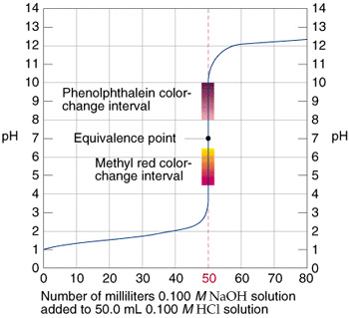
Interpreting pH Titration Curves
We sometimes look at the net ionic equation to see exactly what substances are reacting during the titration to cause the change in pH
Find the Net Equation for hydrochloric acid and sodium hydroxide
What does this look like on a graph???

Slide 30
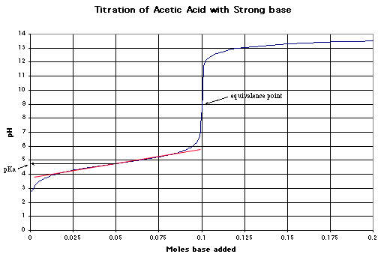
Strong Base & Weak Acid

Slide 31
Summary
An indicator for an acid-base titration analysis must be chosen to have an endpoint at very nearly the same pH as the pH at the equivalence point of the reaction solution
pH of the solution at the equivalence point for strong mono-protic acid-strong mono-protic base reactions is 7
The pH of a solution at the equivalence point for any other acid-base reaction must be determined experimentally, by plotting a titration pH curve

Slide 32
Question:
Which of the following indicators would produce an endpoint colour of orange: bromocresol green, methyl red, phenopthalein or methyl violet
Can you think of what types of pH curves these indicators would be suitable for?

Slide 33
Homework:
Page 339 Questions 1-9
Worksheet for 8.5

