Slide 1
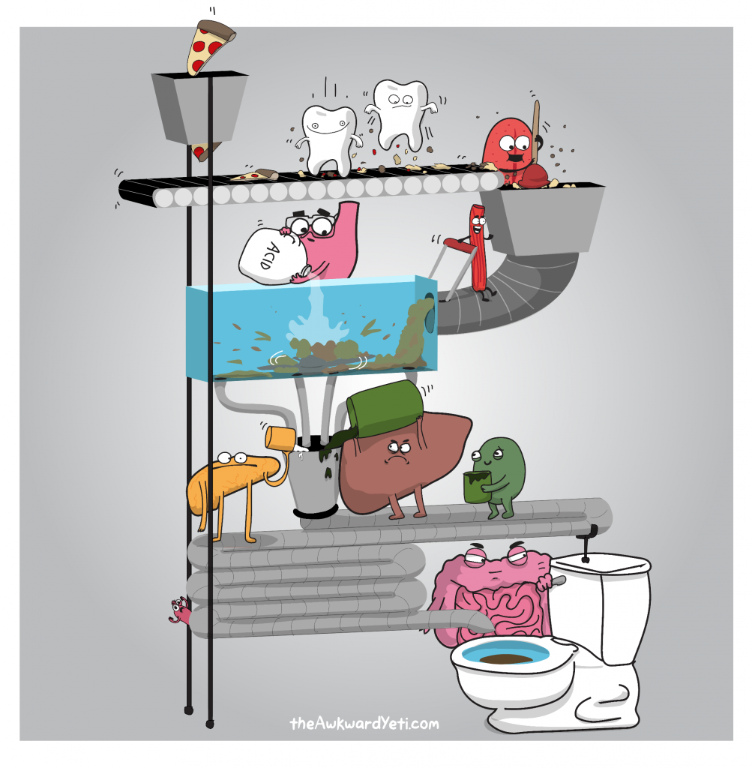
Chapter 6
Digestion and Human Health

Slide 2
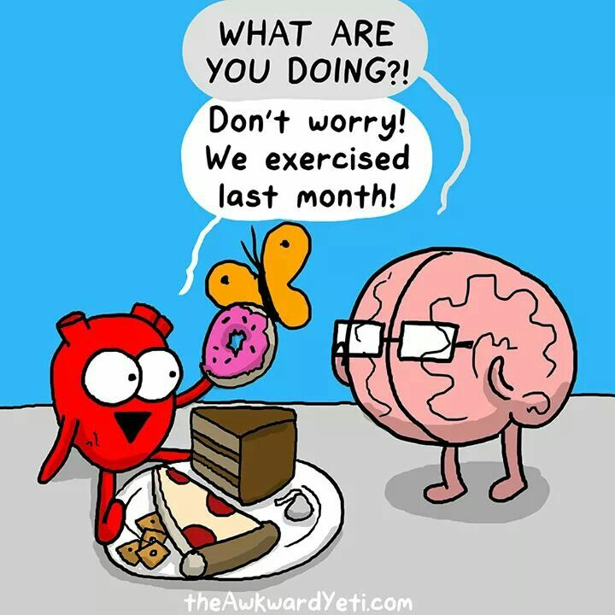
Chapter 6
Digestion and Human Health
6.1 The Molecules of Living Systems
6.2 The Human Digestive System
6.3 Health and the Digestive System

Slide 3
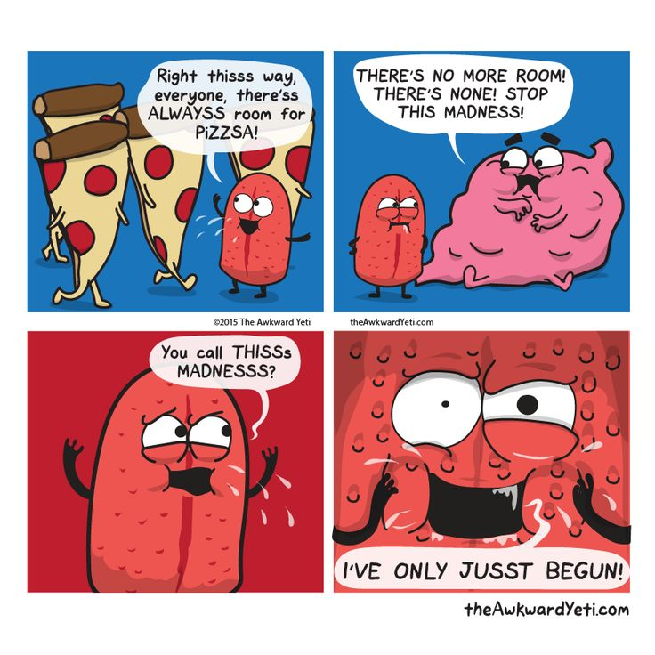
6.1 The Molecules of Living Systems
In this section, you will:
describe the chemical nature of carbohydrates, lipids, and proteins
explain, in general terms, how carbohydrates, lipids, and proteins are synthesized and how they are broken down (hydrolyzed)
understand how to perform standard tests to identify macromolecules

Slide 4
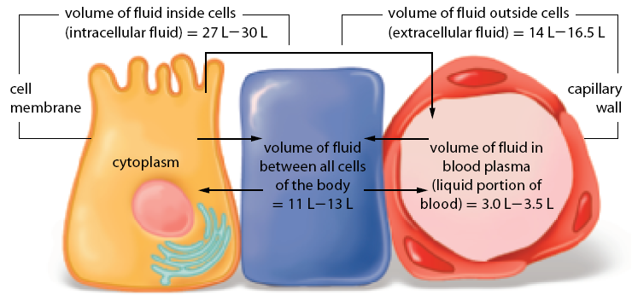
Distribution of Body Fluids

Slide 5
Macromolecules
Macromolecule | Example(s) of subunits | Main functions | Examples of macromolecules
carbohydrates | sugars (such as glucose) and polymers of glucose | energy storage | sugars, starches, and glycogen
lipids | glycerol and three fatty acids or glycerol and two fatty acids | energy storage and cell membranes | fats, oils, and phospholipids
proteins | polymers of amino acids | transport, blood clotting, support, immunity, catalysis, and muscle action | hemoglobin, fibrin, collagen, antibodies, enzymes, actin, and myosin
nucleic acids | polymers of nucleotides | transfer and expression of genetic information | DNA and RNA

Slide 6
Assembling macromolecules
All macromolecules are assembled the same basic way
A hydroxyl group is removed from one subunit and a hydrogen is removed from the other
Called dehydration synthesis
Water is put into a macromolecule to split it up (hydrolysis)
Page 207 in textbook

Slide 7
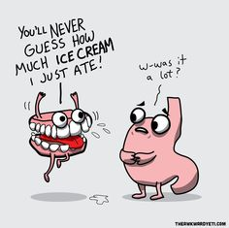
Carbohydrates
Macromolecules that always contain oxygen, hydrogen and carbon and almost always in the same proportion
Two main types:
Simple Sugars – monosaccharide's (3-7 carbon atoms)
Polysaccharides – consist of two or more linked simple sugars

Slide 8
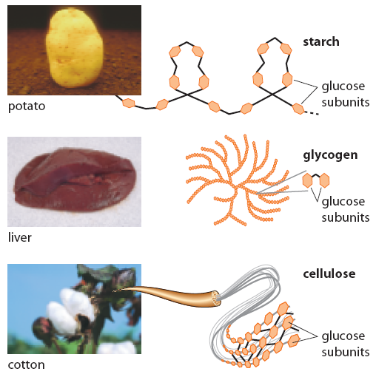
Polysaccharides

Slide 9
Synthesis of a Disaccharide

Slide 10
Lipids
Have two important properties in common
They are insoluble and store over twice as much energy as the next biological molecule
Long term energy storage – fats and oils
Some are involved in cell membranes, some are also in steroids (testosterone and estrogen)
Form when glycerol reacts with 3 fatty acids

Slide 11
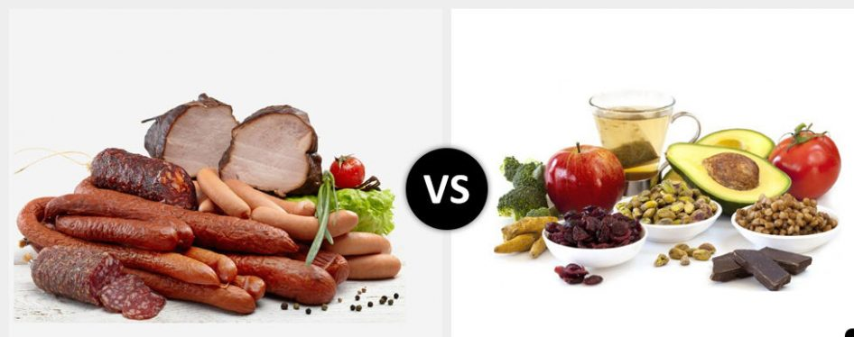
Types of fat:
Saturated – no double covalent bonds
  Mostly animal fat
  Solid at room temperature
Unsaturated – contains double covalent bonds
  Mostly plant fats
  Liquid at room temperature

Slide 12
Proteins
Most cellular structures are made of proteins
Assembled from smaller subunits – amino acids
Amino acids form peptide bonds

Slide 13
An amino acid is the subunit of proteins.
Synthesis of a Dipeptide

Slide 14
Nucleic Acids
Direct growth and development of all organisms using a chemical code
Two types:
  DNA – contains genes
  RNA – when a gene is needed, its copied from DNA to RNA and then to a protein

Slide 15
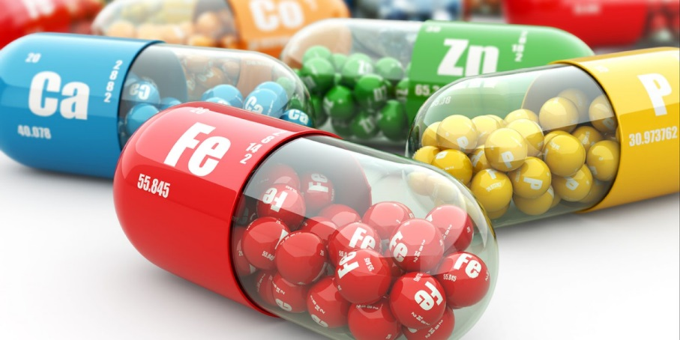
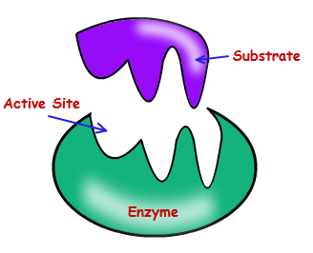
Vitamins Minerals:
NOT macromolecules
Are essential to the structure and function of all cells
  Used in many processes that synthesize macromolecules
  Act as catalysts
  speed up the rate of rxn
Enzymes:

Slide 16
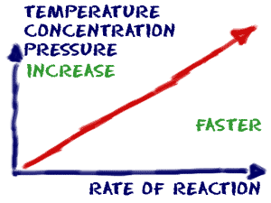
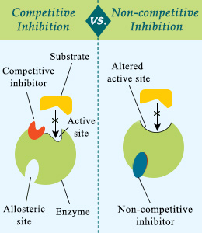
Reaction rates
Enzyme fits with a substrate
Factors that affect Enzymes:
  Temperature
  pH
  Inhibitors:
    Competitive
    Non-competitive

Slide 17
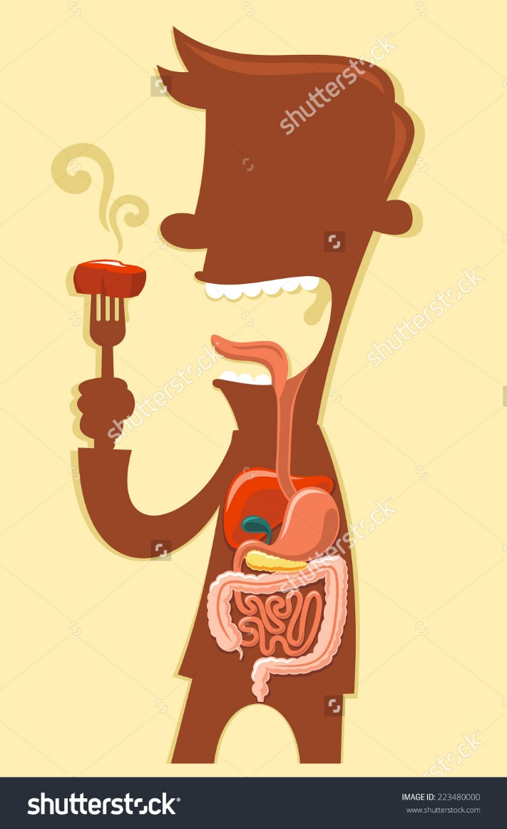
6.2 The Human Digestive System
In this section, you will:
identify the main structures and functions of the digestive system
describe the physical and chemical processing of food through the digestive system and into the bloodstream
explain the action of enzymes in chemical digestion
identify and describe, in general terms, how digested molecules enter the bloodstream

Slide 18
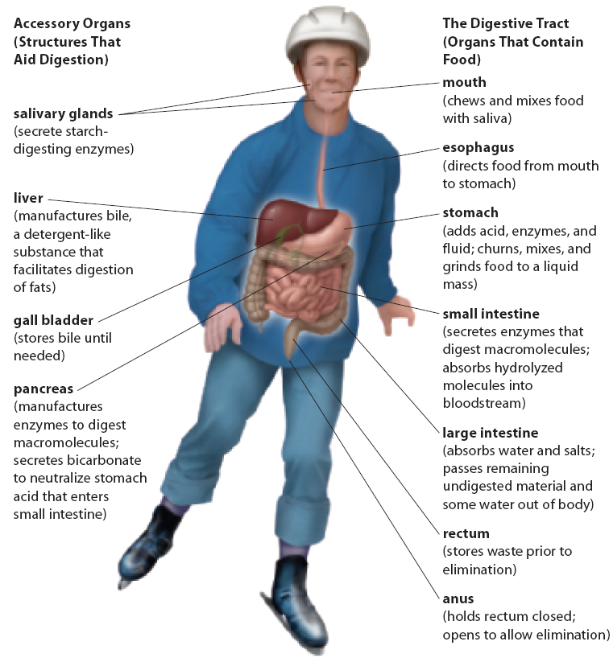
Digestive
System

Slide 19
Digestive
Tract

Slide 20
Secretions of the Digestive Tract
Secretion | Site of production | Function
saliva | mouth | contributes to starch digestion via salivary amylase; lubricates the inside of the mouth to assist in swallowing
mucus | mouth, stomach, small intestine, and large intestine | protects the cells lining the innermost portion of the digestive tract; lubricates food as it travels through the digestive tract
enzymes | mouth, stomach, small intestine, and pancreas | promote digestion of food masses into particles small enough for absorption into the bloodstream
acid | stomach | promotes digestion of protein
bile | liver (stored in gall bladder) | suspends fat in water, using bile salts, cholesterol, and lecithin to aid digestion of fats in small intestine
bicarbonate | pancreas and small intestine | neutralizes stomach acid when it reaches the small intestine
hormones | stomach, small intestine, and pancreas | stimulate production and/or release of acid, enzymes, bile, and bicarbonate; help to regulate peristalsis

Slide 21
The Mouth to the Esophagus – Part #1
Smell or taste triggers three pairs of salivary glands
Chemical digestion starts in the mouth – salivary amylase begins to break down starches
Physical digestion also begins in the mouth
As you chew the food is turned into a lump like mass (bolus)
The bolus enters the esophagus which moves it to the stomach through peristalsis

Slide 22
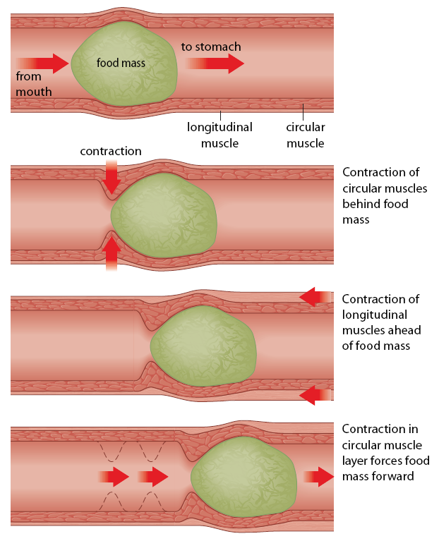
Peristalsis:
Enter to the stomach is controlled by the esophageal sphincter

Slide 23
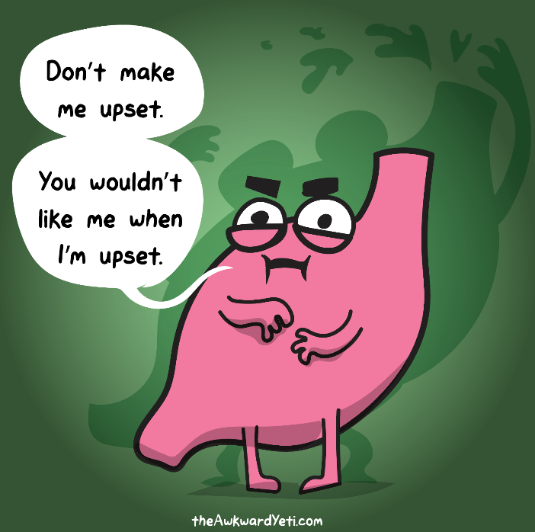
The stomach
Responsible for storing, digesting and pushing food
Can hold up to 2-4L of food
J-shaped organ, lined with muscle
The pyloric sphincter controls the exit of the stomach’s contents
Physical and chemical digestion occur to produce Chyme
Little absorption happens here besides some small amount of salt and water

Slide 24
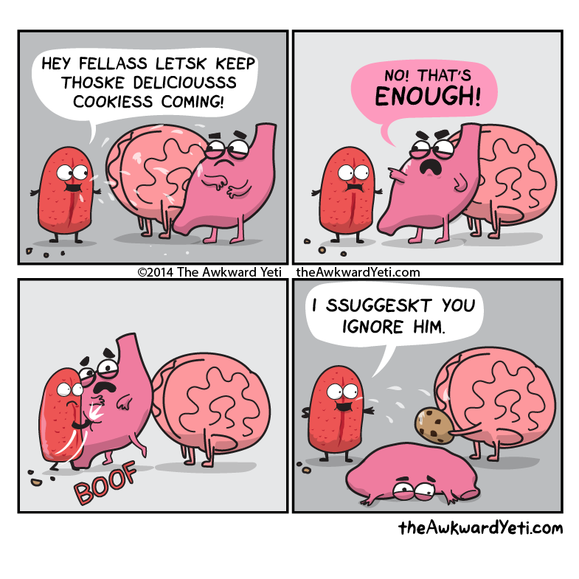
How does the stomach not digest itself???
Three reasons:
Only secretes gastric juice when food is present
Some stomach cells secrete mucus
Produces pepsin – which is a protein digesting enzyme that remains inactive unless HCl is present

Slide 25
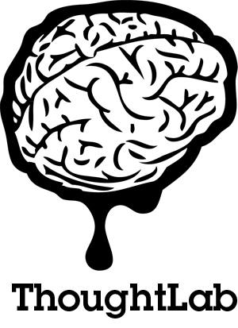
Thought Lab 6.2
On page 221 in your textbooks
Read through the lab and with a partner, answer the analysis questions

Slide 26
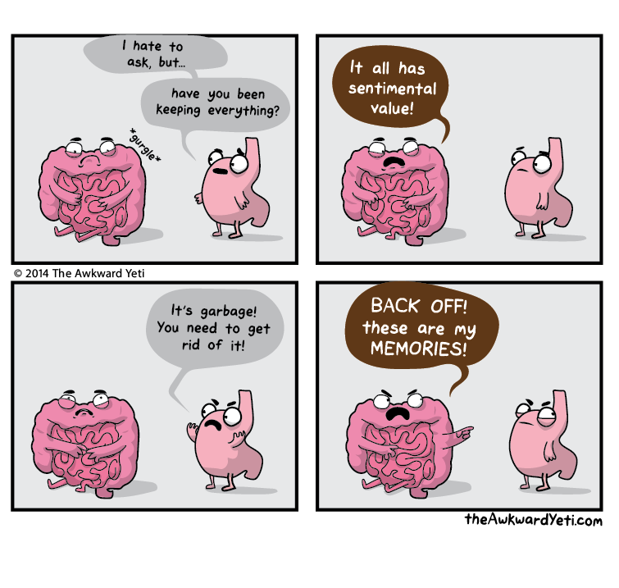
The small intestine
Digesting and absorbing nutrients
4 times the length of the large intestine
Segmentation – physical digestion
Main function – to complete digestion of macromolecules (hydrolyzes them)
Three parts:
Duodenum, jejunum and ileum

Slide 27
Continued…
Duodenum – u shaped, channels from the pancreas and liver are her
  Receives chyme from the stomach
  Contains villi and microvilli – conduct absorption of substances to the bloodstream and the lymphatic system
Jejunum
  Continues to break down food
Ileum
  Absorbs nutrients and pushes remaining material to the large intestine

Slide 28
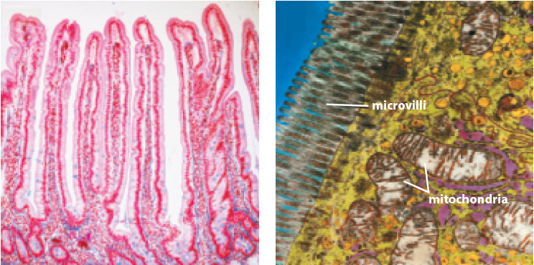
Villi in the Small Intestine

Slide 29
Accessory Organs
Pancreas – delivers fluid to the duodenum:
  Trypsin and chymotrypsin – digest protein
  Pancreatic amylase – digests starch
  Lipase – digests fat
Liver – largest internal organ in the body
  Bile – contains bile pigments and salts. Pigments do not take part in digestion. Salts help to digest fat (breaking it down to help lipases out)
Gall Bladder – stores bile between meals

Slide 30
Selected Enzymes of the Digestive System
Enzyme | Where enzyme acts/pH | Substrate (food) digested | Products of digestion | Origin of enzymes
salivary amylase | mouth/7 | starch, glycogen | maltose (disaccharide) | salivary glands
pancreatic amylase | small intestine/8 | starch, glycogen | maltose | pancreas
carbohydrases • sucrase • maltase • lactase | small intestine/8 | sucrose maltose lactose | glucose + fructose glucose glucose + galactose | small intestine
pancreatic lipase | small intestine/8 | lipids | fatty acids and glycerol | pancreas
proteases • pepsin • trypsin • chymotrypsin | stomach/1–2 small intestine/8 small intestine/8 | protein peptides peptides | peptides smaller peptides smaller peptides | stomach pancreas pancreas
peptidases | small intestine/8 | peptides | smaller peptides and amino acids | pancreas and small intestine
nucleases | small intestine/8 | nucleic acids | nucleotides and components | pancreas
nucleosidases | small intestine/8 | nucleotides | bases, sugars, and phosphates | small intestine

Slide 31
Absorption of Nutrients
Top: Glucose is actively transported into cells of the intestinal wall to move into the bloodstream.
Middle: Amino acids are actively transported into the cells of the intestinal wall to move into the bloodstream.
Bottom: Glycerol and fatty acid molecules diffuse into the cells of the intestinal wall where they are resynthesized into fats, coated with proteins, and move into lymph vessels for eventual transport into the bloodstream.

Slide 32
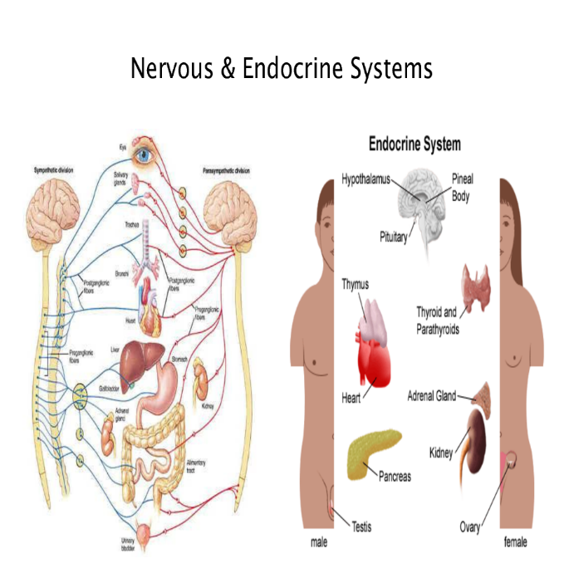
Regulation of processes by the small intestine
Coordinated by the nervous and endocrine systems
When food arrives in the stomach, Gastrin stimulates HCl release
The inhibitions of stomach contractions is aided by GIP, secretin and CCK
Page 229-230 in your text

Slide 33
The large intestine
Shorter, 1.5m long
Each day receives about 500ml of indigestible food that needs to be passed
Water and salts are still absorbed
Chyme is further broken down – feces
Finally passed to the rectum and anal canal (20 cm is length)
Opening of anus controlled by two sphincters, one under voluntary control and the other is involuntary

Slide 34
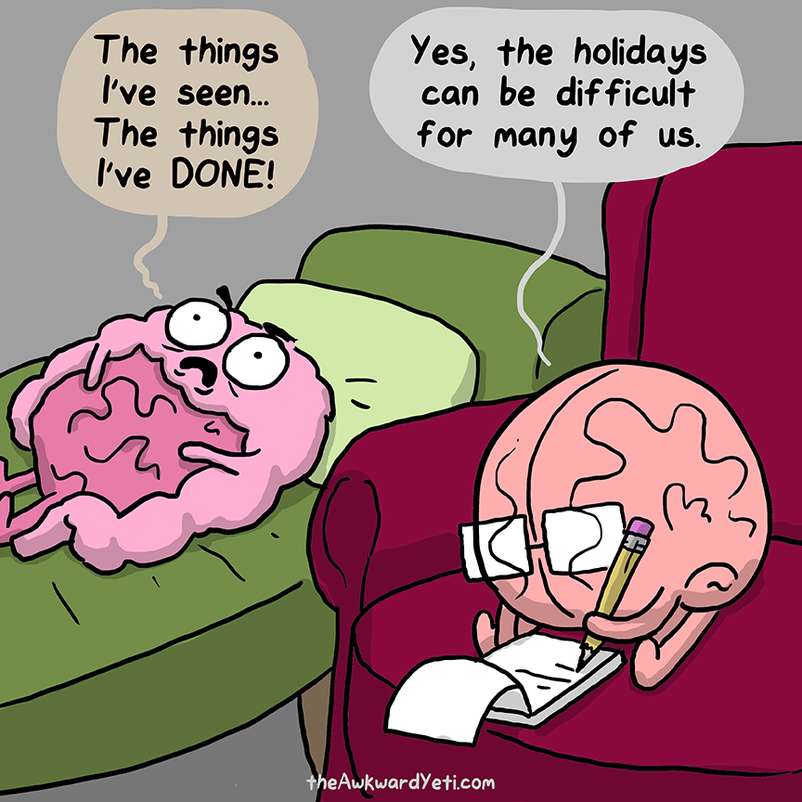
6.3 Health and the Digestive System
In this section, you will:
recognize and appreciate the relationship between health and nutritional decisions
identify conditions that adversely affect the health of the digestive system and the technologies that are available to treat them

Slide 35
Ulcers
Form when mucus is eroded in the digestive tract.
Usually occurs in the stomach
Bacteria adhere to the lining of the organ and prevent mucus from being produced

Slide 36
Inflammatory Bowel Disease
Inflammation of the intestines
Crohn’s disease – usually affects the intestine but can affect any part of the digestive tract
  Autoimmune disorder – body starts to recognize parts of its own tract as foreign
  Can be inherited, there is no cure
Colitis – inflammation and ulcer formation in the bowels
  Affects the colon
  Patients can be given meds but surgery to remove colon can also occur

Slide 37
Inflammation of the liver
Hepatitis - Three types
  A – contaminated drinking water
  B – spread through sexual contact (can be vaccinated)
  C – contact through infected blood (no vaccine)
Cirrhosis – scar tissue replaces healthy tissues
  Caused by alcoholism or hepatitis C
  Might need a liver transplant

Slide 38
Gallstones
Small hard masses found in the gallbladder
Three factors contribute to the formation of gallstones
Obesity
Alcohol intake
Heredity
Can be broken a part with ultrasound or gallbladder can be removed in severe cases

Slide 39
Psychological, Social and Cultural Conditions related to digestive disorders
Anorexia Nervosa
Bulimia
Obesity
Traditional vs modern diets

