Slide 1
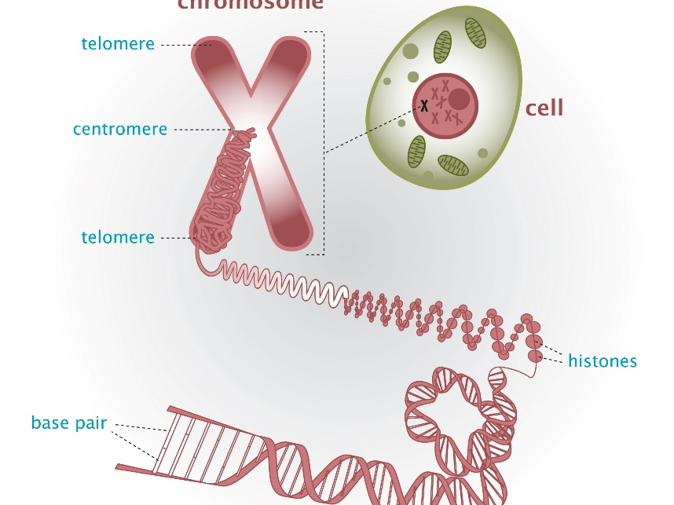
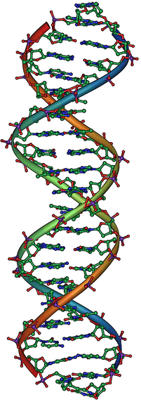
Unit C Genetics
Rebecca Redding – 2019
Biology 30
Chapters 16,17 & 18

Slide 2
Chapter 16 – Cellular Reproduction
16.1 Cell Division
  The Cell Cycle
16.2 Reproduction in Somatic Cells
  Mitosis
16.3 The Formation of Gametes
  Meiosis
16.4 Reproductive Strategies

Slide 3
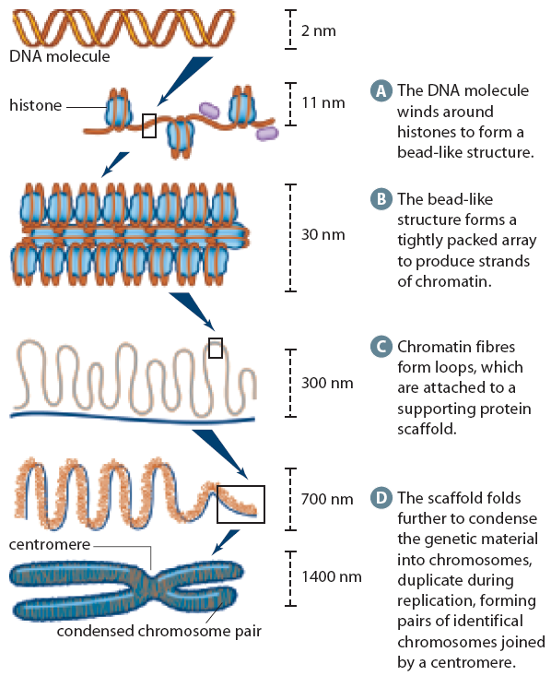
16.1 – The Cell Cycle
The life cycle of a cell – the cell cycle
Cells are small – why?
Original cells, parent cells, give rise to new, daughter cells
Organization of Genetic Information:
  DNA wound around histone proteins
  Histones become tightly packed (chromatin)
  Chromatin form loops and attach to a protein scaffold
  The scaffold folds to further condense into chromosomes

Slide 4
Fun Fact!
The folding and packaging of DNA allows the 3 billion base pairs in each cell to fit into a space just 6 microns across. (remember 1000 micrometers is 1 cm!)
If you stretched the DNA in one cell all the way out, it would be about 2m long and all the DNA in all your cells put together would be about twice the diameter of the Solar System

Slide 5
16.1 – The Cell Cycle
Chromosomes carry genes, locations of specific genes are at a specific locus.
Different forms of the same gene are called alleles
Chromosome Number in Humans
  22 Pairs of Homologous Chromosomes
  1 Pair of Sex Chromosomes
Ploidy: Haploid (n), Diploid (2n), Triploid (3n)…

Slide 6
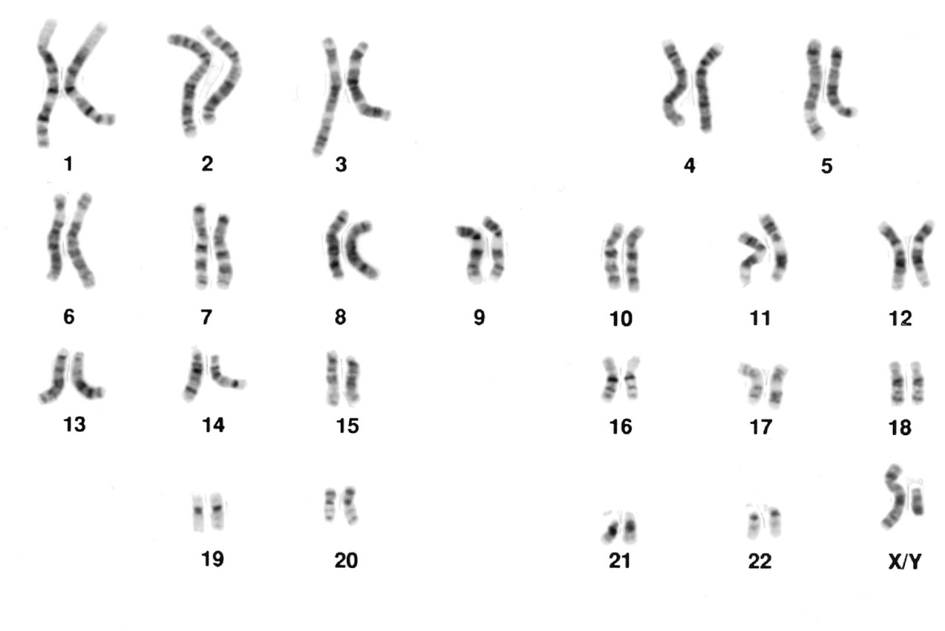
16.1 – The Cell Cycle: Karyotype

Slide 7

The Cell Cycle
Stages of the Cell Cycle
  Interphase
    G1, S and G2
  Prophase
  Metaphase
  Anaphase
  Telophase
  Followed by Cytokinesis (cytoplasm division)

Slide 8
16.2 Reproduction In Somatic Cells
Why do cells use Mitosis?
Growth
Example:
Maintenance
Example:
Repair
Example:

Slide 9
16.2 Reproduction In Somatic Cells
Interphase: Growth and DNA Replication
Prophase:
Chromatin condenses into chromosomes
Nuclear membrane disappears
Centrioles migrate
Spindle fibres form
Metaphase:
Chromosomes are guided towards the equator by spindle fibres

Slide 10
16.2 Reproduction In Somatic Cells
Anaphase:
Centromeres split and sister chromatids are pulled apart
Spindle fibres shorten
Chromosomes gather at the poles
Telophase:
Chromatids begin to unwind
Spindle fibres break down
Nuclear membrane reforms
Cytokinesis occurs.

Slide 11
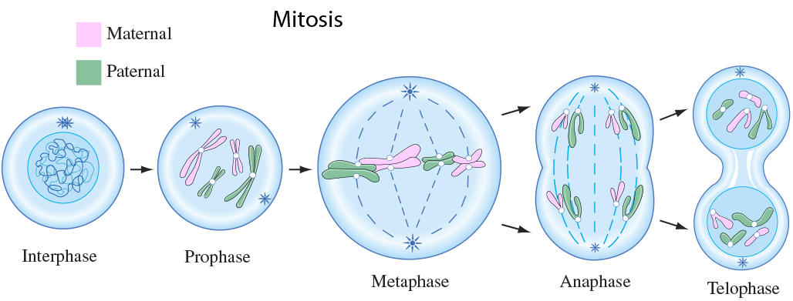
16.2 Reproduction In Somatic Cells

Slide 12
Homework
Please re-read section 16.1
Section 16.1 Review Questions
  Questions 1-7
Please re-read section 16.2
Section 16.2 Review Questions
  Questions 1-7
Read ahead!

Slide 13
16.3 – The Formation of Gametes
Meiosis
Reductional division and recombination of genetic material
Occurs in the ovaries and testes
Split into two phases – MI and MII but only ONE interphase!
Similar to mitosis except for the formation of tetrads and crossing over.

Slide 14
16.3 – The Formation of Gametes
Interphase: Growth and DNA Replication
Prophase I:
Chromatin condenses into chromosomes
Nuclear membrane disappears
Centrioles migrate
Spindle fibres form
Homologous chromosomes begin to pair up (Tetrad)
Metaphase I:
Chromosomes (Tetrads) are guided towards the equator by spindle fibres
Recombination occurs

Slide 15
16.3 – The Formation of Gametes
Anaphase I:
Centromeres split and homologous chromosomes are pulled apart
Spindle fibres shorten
Chromosomes gather at the poles
Telophase I:
Some cells will move from anaphase I into MII, while others will go through telophase first
Chromatids begin to unwind
Spindle fibres break down
Nuclear membrane reforms
Cytokinesis occurs.

Slide 16
16.3 – The Formation of Gametes
Meiosis II
Still has prophase, metaphase, anaphase and telophase except that there is no recombination or additional replication of genetic material
This stage is reductional

Slide 17
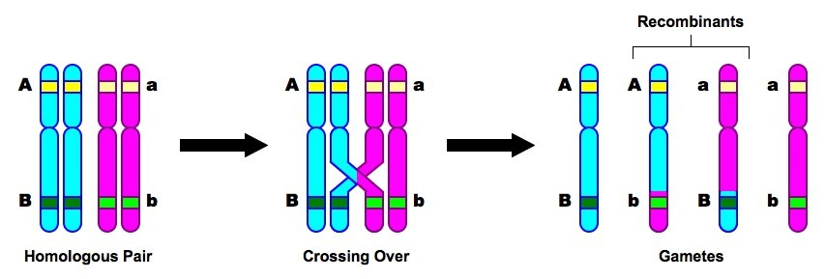
16.3 – The Formation of Gametes
Sources of Genetic Recombination
Independent assortment
  Pairs of chromosomes line up along the equator independent of other tetrads (there is no order)
Crossing Over
  Non-sister chromatids exchange information

Slide 18
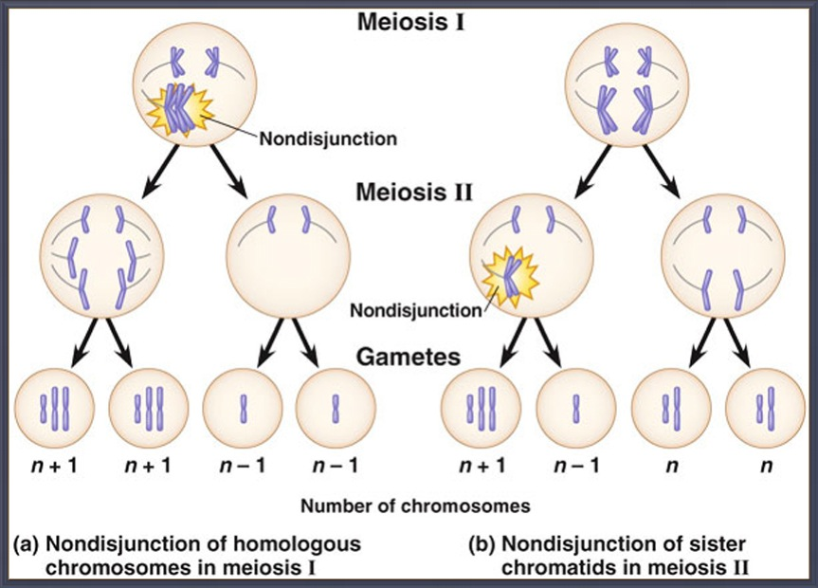
16.3 – The Formation of Gametes
Nondisjunction
Occurs during anaphase I or II
Uneven separation of chromosomes
Can cause various genetic disorders or sometimes cause the embryo to abort – Page 567

Slide 19
16.3 – The Formation of Gametes
Gamete formation in animals:
Spermatogenesis
Diploid spermatogonium at puberty becomes two daughter cells. One replenishes the spermatogonia population and the other becomes a primary spermatocyte which undergoes meiosis to form spermatids

Slide 20
16.3 – The Formation of Gametes
Gamete formation in animals:
Oogenesis
Diploid oogonium undergoes division to form 2 primary oocytes
About three months after conception, about 2 million have formed. They are arrested in prophase I until puberty.
Every month after puberty, a primary oocyte undergoes meiosis but cytoplasm is divided unevenly so only one secondary oocyte is formed as a result
Meiosis is not completed, but rather arrested in metaphase II until fertilization

Slide 21

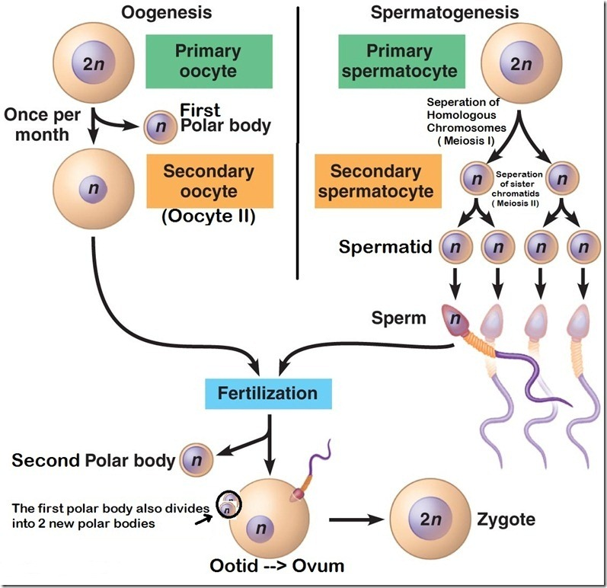

Slide 22
Homework
Please re-read section 16.3
Make notes or complete your booklet pages
Section 16.3 Review Questions
  Questions 1-10
Model Mitosis and Meiosis – Draw them out.
Read ahead!
Quiz coming soon!

Slide 23
16.4 – Reproductive Strategies
Reproduction in Prokaryotes
Binary fission
  Not mitosis! No nucleus, growing and splitting
Bacterial Conjugation
  Primitive sexual reproduction
  Still asexual
  Transfer of genetic information through a pilus
  Minimal differentiation in genetic material

Slide 24
16.4 – Reproductive Strategies
Asexual Reproduction
Budding
Miniature version grows from parents body
Vegetative Reproduction
Extending stems (runners)
Fragmentation
Broken off the parent plant and generates a new plant
Parthenogenesis
Unfertilized egg still develops into an adult
Spores
Good to move organisms great distances

Slide 25
16.4 – Reproductive Strategies
Alternation of Generations
Only in Plants
  Haploid (gametophyte) and Diploid (sporophyte) generations
Mosses
Conifers

Slide 26
16.4 – Reproductive Strategies
Alternation of Sexual Cycles
Occurs in animals
periods of alternating asexual and sexual producing phases
Eg – Cnidarian
Can be a polyp (asexual) or medusa (sexual)

Slide 27
Homework
Please re-read section 16.4
Make notes or complete your booklet pages
Section 16.4 Review Questions
  Questions 1-9
Read ahead!
Chapter Test coming soon!

Slide 28
Chapter 17:
Patterns and Processes of Inheritance
17.1 Laying the Foundations
  Intro to Genetics
17.2 Mendel’s Laws
  Patterns and Probabilities
17.3 Genetics and Society
  Pedigrees

Slide 29
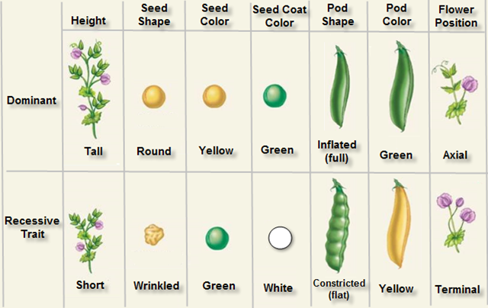
17.1 – Laying the Foundations
Gregor Mendel

Slide 30
17.1 – Laying the Foundations
The Law of Segregation: individuals have two copies of every trait. These copies segregate during gamete formation, independently of one another.
Phenotype – observable
Genotypes – alleles for a particular trait
Homozygous – AA or aa
Heterozygous - Aa

Slide 31
17.1 – Laying the Foundations
Test Cross
Used to determine the genetics on an animal with unknown genotype
Cross with homozygous recessive – Why?
Page 591 Qu 1&2

Slide 32
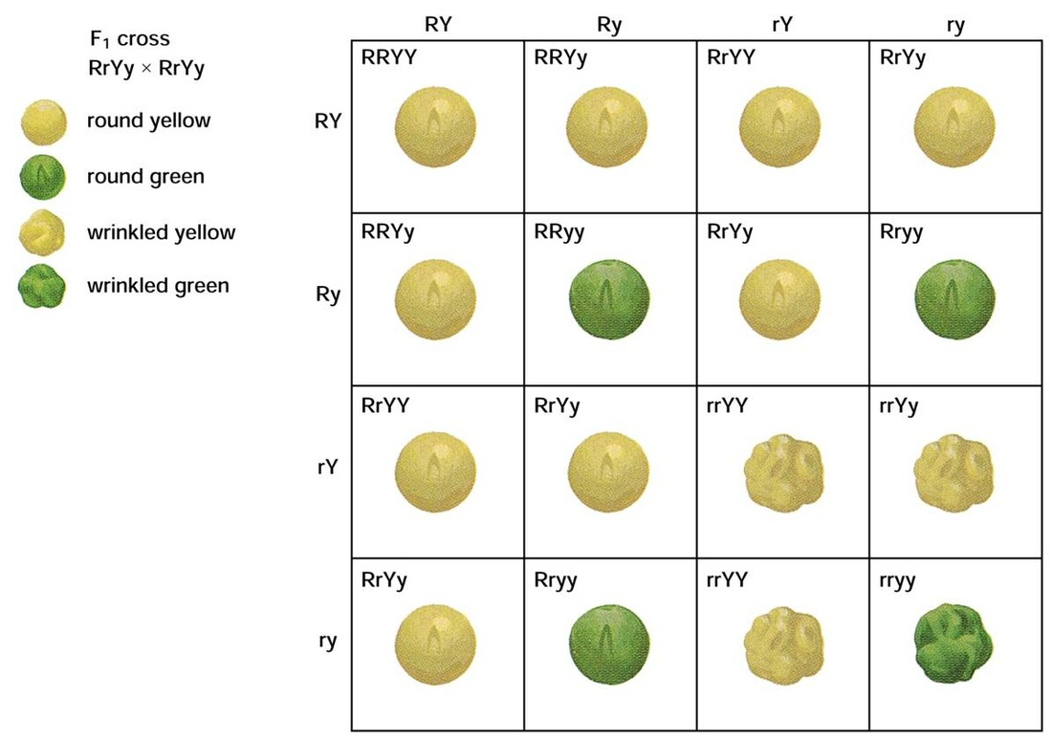
17.1 – Laying the Foundations
The Law of Independent Assortment: the two alleles for a trait will segregate independently from other alleles of other traits during gamete formation
  Dihybrid Crosses
  Gizmo – Mouse genetics

Slide 33
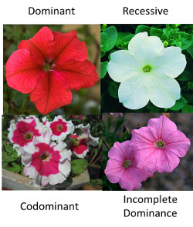
17.1 – Laying the Foundations
Incomplete dominance:
  ‘blending’
Co –dominance:
  Both alleles visible
Punnett Square Notation is different since there is no recessive
Page 596 Qu 3-7

Slide 34
Homework
Please re-read section 17.1
Make notes or complete your booklet pages
Section 17.1 Review Questions
  Questions 1-12
Read ahead!
Gizmo – Mouse genetics: Explore Learning.

Slide 35
17.2 – Extending Mendel’s Laws
Linked Genes
Genes found on the same chromosome that do not assort independently
Genes that are close enough together on a chromosome may not assort independently because they cross over together
Led to chromosome mapping

Slide 36

17.2 – Extending Mendel’s Laws
Look at recombination frequency to determine gene linkage
Recombinants are offspring that don’t look like the parents – are a mix of both, usually.
Recombination frequency allows up to build a map as % recombination = map units

Slide 37
17.2 – Extending Mendel’s Laws
Page 602 Thought Lab 17.1 Mapping Chromosomes
I will start you off, you will complete the rest

Slide 38
17.2 – Extending Mendel’s Laws
Barr Bodies
Inactive chromosome – like the second X chromosome in women.
Which chromosome forms a barr body is random
Ex: Tortishell Cats – why are male cats so rare?
Sex Linkage – Practice Problems Page 603 Qu’s 8-10

Slide 39
17.2 – Extending Mendel’s Laws
Multiple Alleles: Usually an order of dominance, but can be co-dominant or a mixture!
Ex: ABO blood types
Ex: Fur colour in rabbits
Polygenic Inheritance: controlled by many genes and result in a spectrum of phenotypes
Ex: human height
Page 606 Qu 11-17

Slide 40
Homework
Please re-read section 17.2
Make notes or complete your booklet pages
Finish the 17.1 Thought Lab
Section 17.2 Review Questions
  Questions 1-6
Read ahead!

Slide 41
17.3 – Genetics and Society
Pedigrees – factors to consider
Is the trait located on a sex chromosome or an autosome?
Autosomal – not on a sex chromosome
Sex Linkage – located on one of the sex chromosomes
Y-linked - only males carry the trait.
X-linked (recessive) - sons inherit the disease from normal parents
How is the trait expressed?
Dominant - the trait is expressed in every generation.
Recessive - expression of the trait may skip generations.

Slide 42
17.3 – Genetics and Society
Page 612 – Pedigree Symbols
Autosomal Dominant
Shows up in every generation
Both sexes equally affected
Autosomal Recessive
Skips generations
Both sexes equally affected
Sex Linked
Sexes are not affected equally
Sample Problem Page 614
Practice Page 615 Qu 18-21

Slide 43
Homework
Please re-read section 17.3
Make notes or complete your booklet pages
Complete the 17.2 Thought Lab (Partners)
Complete the 17.3 Thought Lab (Alone)
Section 17.3 Review Questions
  Questions 1-5
Read ahead!
Project – Design your own species!
Chapter Test Coming up!

Slide 44
Chapter 18 – Molecular Genetics
18.1 DNA structure
  DNA replication
18.2 Protein Synthesis
  Transcription and translation of DNA
18.3 Mutation and Recombination
  Permanent changes to DNA
18.4 Genetics and Society

Slide 45
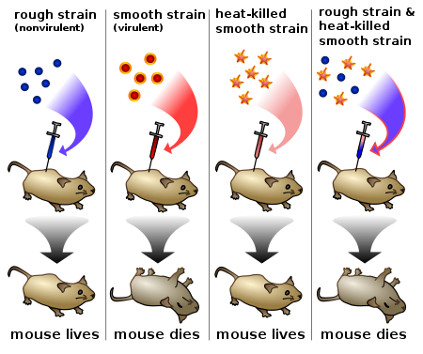
18.1 – DNA Structure and Replication
Isolating the material of heredity – the transforming principle (Griffith)
Showed that when DNA could transform
Heat killed virulent bacteria could transform non-virulent strains

Slide 46
18.1 – DNA Structure and Replication
Hershey and Chase
T2 bacteriophages were labelled with sulfur and phosphorous.
Monitored how the virus spread.
The phosphorus ended up in with the DNA and the sulfur was found outside in the protein coat
Proved DNA was responsible for directing the cells.

Slide 47
18.1 – DNA Structure and Replication
Double helix structure discovered in 1950’s by Rosalind Franklin
Chargaff – proposed that certain proportions of nucleotides were similar to one another.
  Adenine – Thymine
  Cytosine – Guanine
DNA forms an antiparallel structure with its phosphate and sugar back bone

Slide 48
18.1 – DNA Structure and Replication
RNA is similar to DNA but has a couple of differences
Ribose instead of deoxyribose
Uracil instead of Thymine
Single stranded

Slide 49
18.1 – DNA Structure and Replication
DNA Replication – semiconservative
Initiation
Starts at the origin
Helicase unwinds the DNA
Creates a replication fork or ‘bubble’
Elongation
DNA polymerase begins to add nucleotides
Occurs in the 5’-3’ direction
Creates a leading and lagging strand
Elongation is helped with a primer
Okazaki fragments result on the lagging strand
Sealed together with ligase
Termination

Slide 50
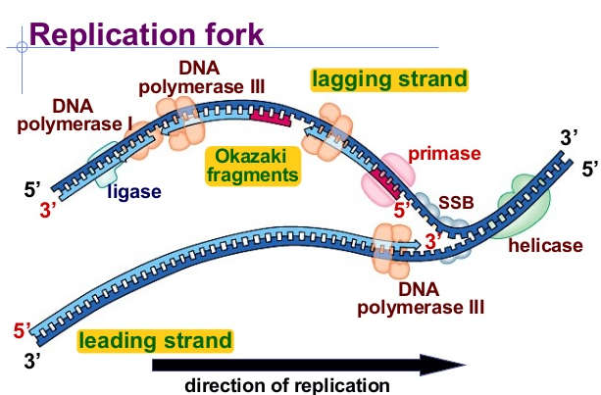
18.1 – DNA Structure and Replication

Slide 51
Homework
Please re-read section 18.1
Make notes or complete your booklet pages
Section 18.1 Review Questions
  Questions 1-10
Read ahead!

Slide 52
18.2 – Protein Synthesis & Gene Expression
Central Dogma
DNA → RNA → Protein
Transcription takes place in the nucleus and involves mRNA
mRNA moves to the cytoplasm where the mRNA sequence directs the synthesis of a polypeptide along with tRNA (Translation)

Slide 53
18.2 – Protein Synthesis & Gene Expression
The genetic code
Redundant
Continuous
Universal
Practice Problems: Page 637 Qu 3-5
Practice Problems: Page 638 Qu 6&7

Slide 54
Homework
Please re-read section 18.2
Make notes or complete your booklet pages
Species Assignment
Section 18.2 Review Questions
  Questions 1-10
Read ahead!

Slide 55
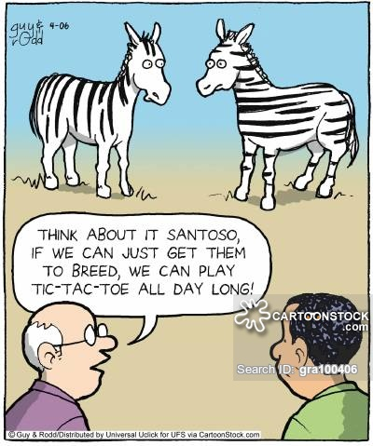
18.3 – Mutation and Recombination
What is a mutation?
What causes mutations?
Types of Mutations:
Silent mutations
Mis-sense mutations
Non-sense mutations
Frameshift mutations
Point mutations

Slide 56
18.3 – Mutation and Recombination
Causes of Mutations
Spontaneous –incorrect base pairing
Induced – triggered or caused by a mutagen
  Physical: X Rays, UV Rays (cause physical changes to the DNA structure)
  Chemical: Carcinogens, gasoline fumes, nitrates etc… (can enter the nucleus and react chemically with the DNA to cause mutations)

Slide 57
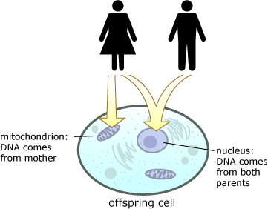
18.3 – Mutation and Recombination
What is mtDNA?
Found in the mitochondria
Passed on through females – why?
Can help us trace our ancestory

Slide 58
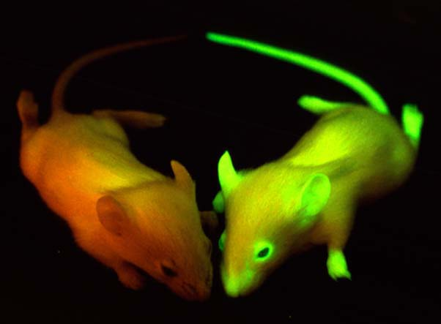
18.3 – Mutation and Recombination
Recombinant DNA
Use restriction endonucleases to cleave sequences (restriction fragments) and splice DNA
Giving animals and plants characteristics or qualities that they didn’t originally have

Slide 59
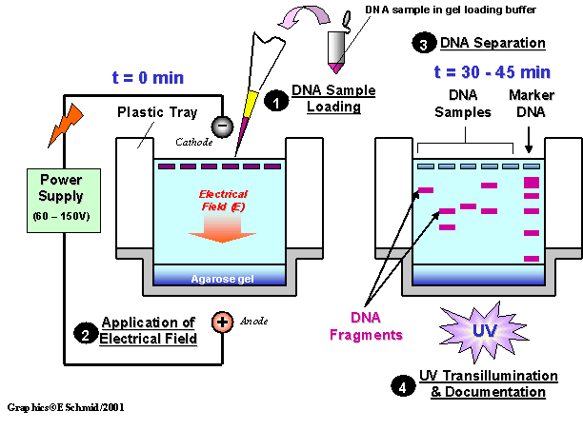
18.3 – Mutation and Recombination
Gel Electrophoresis: Video Demo

Slide 60
Homework
Please re-read section 18.3
Make notes or complete your booklet pages
Section 18.3 Review Questions
  Questions 1-7
Read ahead!

Slide 61
18.4 – Genetics and Society
What is a DNA Microarray?
A chip that contains thousands of cells. Each cell contains a nucleic acid sequence that can bind with one of the mRNA transcribed during gene expression.
Scientists use DNA microarrays to measure the expression levels of large numbers of genes simultaneously or to genotype multiple regions of a genome.
Once DNA is added to the microarray, it will be scanned and a specific pattern will emerge, allowing us to see what genes are contained within the genome we are studying.

Slide 62

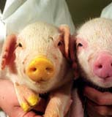
18.4 – Genetics and Society
Biotechnology Products – Thoughts?
Medicinal Bacteria
  Synthetic Insulin
Transgenic Plants
  Plants modified to create resistance to pesticides
Cloned and Transgenic Animals
  ‘Dolly’, identical twins

Slide 63
18.4 – Genetics and Society
Diagnosis and Treatment of Genetic Disorders
Amniocentesis
Amniotic fluid is draw out of the expecting mother and tested
A karyotype is prepared and analysed
Chorionic villi sampling
Can happen sooner than Amniocentesis – 9 weeks
Taken from the chorion (part of the placental tissues)

Slide 64
Homework
Please re-read section 18.4
Make notes or complete your booklet pages
Section 18.4 Review Questions
  Questions 1-7
Chapter Test coming soon
Unit Review - Start
Unit Exam coming soon!

