Slide 1
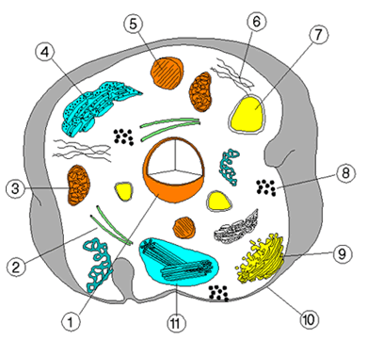
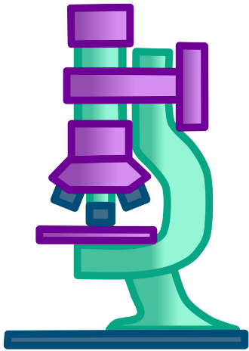
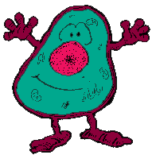
Unit c: The Cycling of Matter in Living Systems
Ms Redding
Science 10 - 2019

Slide 2
Our current understanding of the cell: Microscopy
Aristotle - “The Father of Biology.” He was one of the first Greek philosophers who used the Scientific Method of observing, recording, reasoning, and interpreting in attempt to explain the world around him.
Salvino degli Amati (Late 1200s: Italy). Made the first pair of spectacles with the lenses fashioned by craftsmen
A new branch of physics, called optics, was born to explain the movement of light

Slide 3
Our current understanding of the cell, continued… 1600s: Telescopes & Microscopes
1595 Hans and Zacharias Janssen (Holland) invent the first 2-lens compound light microscope
1665 Robert Hooke (England) developed a 3-lens system.
Hooke observed thin slices of cork and saw what he called cells
1665 Antoni van Leeuwenhoek, an expert lens crafter was the first to reveal the microbial world
His daughter helped him make his microscopes
They were the first to see the movement of different types of cells we now call protozoa, sperm, and bacteria

Slide 5
Our current understanding of the cell
A MICROSCOPE is an instrument with a lens or system of lenses for magnifying specimens. In order to use a microscope you must be familiar with the following:
Microscope Structures & Functions
Microscope Handling Protocol
Calculating Magnification
Unit Conversion
Field of View

Slide 7
Handling a microscope
Always carry the microscope in an upright position with two hands: one on the base, the other on the arm.
Use only lens paper to clean lenses.
Make sure the power switch is off before you plug it in.
Never allow the lens to touch the slide.
Never attempt to repair the microscope yourself.

Slide 8
Handling a microscope
Use stage clips to hold the slide steady.
Always start to focus on the low-power objective lens first.
Use the coarse focus first.
Never use the coarse focus on the high-power objective lens.

Slide 9
Handling a microscope
When you are finished:
Rotate to the low-power objective lens
Remove the slide
Turn the microscope off
Put the dust cover on
Remove the power cord from the socket by the plug.

Slide 10
Calculating Magnification
The MAGNIFICATION tells the reader how much larger (or smaller) the picture is than the real size of the item
In order to calculate the magnification of a system use the following formula:

Slide 11
Unit Conversion
Unit | Equivalent Measurement
Centimetre (cm) | 1/100 metre; 10^{–2} m
Millimetre (mm) | 1/10 centimetre; 10^{–3} m
Micrometre—also known as the Micron (μm) | 1/1000 millimetre; 10^{–6} m
Nanometre (nm) | 1/1000 micrometre; 10^{–9} m
Angstrom (Å) | 1/10 nanometre; 10^{–10} m

Slide 12
Field of View
The FIELD OF VIEW is the entire area that you see when you look through the microscope.
Magnification increase the size of what you see BUT decreases the amount of the object in view
Since the field of view decreases in size in direct proportion to the increase of the magnification, we can calculate the size of the other fields of view.

Slide 13
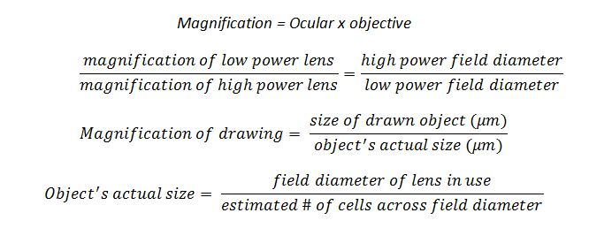

Slide 14
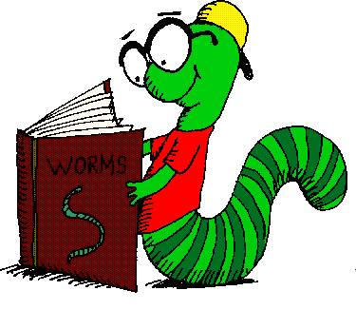
Homework!
Read Pages 242 – 246
Inquiry Lab – Page 245
Compete Analysis and Conclusion Questions
C1.1 Check and Reflect:
Complete Questions 1-8

Slide 15
Spontaneous Generation and the ‘Vital Force’

Slide 16
Development of Cell theory
Louis Pasteur – disproved the concept of spontaneous generation through a controlled experiment.

Slide 17
Development of Cell theory
Cell Theory was developed by:
Schleiden – Botanist
Schwann – Animal Physiologist
Virchow – Doctor
Cell theory States:
All living things are made up of cells
Cells come from pre-existing cells
All life functions take place in cells

Slide 19
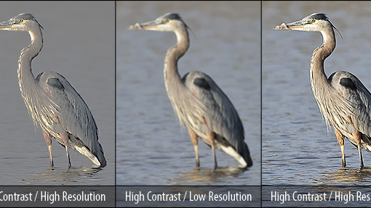
Imaging technology and Staining
Contrast:
used in bright field microscopy, where light passes straight through a specimen.
Applying stain kills the specimen
Resolution:
the ability to distinguish between two very close points

Slide 20
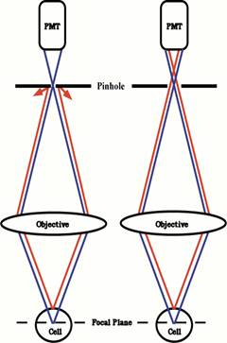
Imaging technology and Staining
Confocal Microscopy:
an optical imaging technique for increasing optical resolution and contrast of an object by eliminating out-of-focus light.
It enables the reconstruction of 3D structures
from the obtained images.
Uses a laser – Text Page 257.
Images are stored in a computer

Slide 22
Imaging technology and Staining: Electron Microscopy
Transmission Electron Microscope: TEM
is a type of microscope in which a beam of electrons is transmitted through an ultra-thin specimen, interacting with the specimen as it passes through it. An image is formed from the interaction of the electrons transmitted through the specimen; the image is magnified and focused onto an imaging device.
Scanning Electron Microscope: SEM
is a type of electron microscope that produces images of a sample by scanning it with a focused beam of electrons. The electrons interact with atoms in the sample, producing various signals that can be detected and that contain information about the sample's surface topography and composition.

Slide 23
Light Microscopes VS TEM VS SEM

Slide 24
Homework!
Read Pages 247 – 252
Worksheet 1.2 – Cell Theory
C1.2 Check and Reflect:
Complete Questions 1-7
Lab: Staining Cells – Next Class
Read Pages 253 – 260
Worksheet 1.3 – Microscopy and Imaging Technologies
C1.3 Check and Reflect:
Complete Questions 1-6

Slide 25
Our current understanding of the cell
Cell Research at the Molecular Level
Gene Mapping: describes the methods used to identify the locus of a gene and the distances between genes. The essence of all genome mapping is to place a collection of molecular markers onto their respective positions on the genome. Molecular markers come in all forms.
X-ray Crystallography: is a tool used for identifying the atomic and molecular structure of a crystal, in which the crystalline atoms cause a beam of incident X-rays to diffract into many specific directions.
Green Fluorescent Protein: used by scientists to compare healthy and disease tissues
GFP – Cats and AIDS

Slide 26
Homework!
Quiz Soon!
Read Pages 261 – 264
C1.4 Check and Reflect:
Complete Questions 1-4
Section 1.0 Review:
Complete Questions 1-13

Slide 27
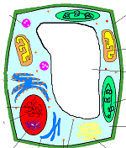
Cell Structures and Organelles
What Cells need to do to stay alive:
Intake nutrients
Move
Grow
Respond to the environment
Exchange gases
Remove wastes
Reproduce

Slide 28
Cell Structures and Organelles
Cell Organelles:
Cell Membrane
Nucleus
Cytoplasm
Cell Wall
Chloroplasts
Vacuoles
Endoplasmic Reticulum
Ribosomes
Lysosomes
Golgi Apparatus
Mitochondria
Centrioles

Slide 30
Similarities and Differences Plant and Animal Cells
Plants
Cytoskeleton
DNA
Cell Wall
Chloroplasts (chlorophyll)
Large Central Vacuole
Made of Lipids, Carbs, Protein & Nucleic Acids

Slide 31
Similarities and Differences Plant and Animal Cells
Animals
Made of Lipids, Carbs, Protein & Nucleic Acids
Cytoskeleton
DNA
Centrioles
Other specialized compounds (hemoglobin/cholesterol)

Slide 32
Homework!
Read Pages 266-272
Complete Plant and Animal Cell Worksheet
C2.1 Check and Reflect
Questions 1-10

Slide 33
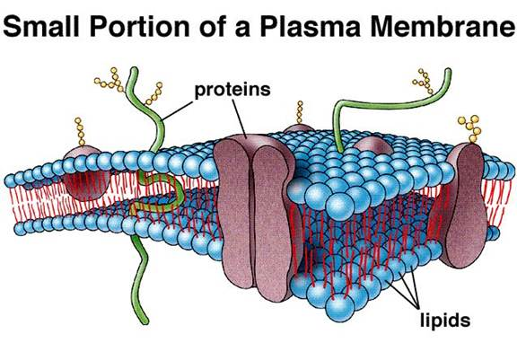
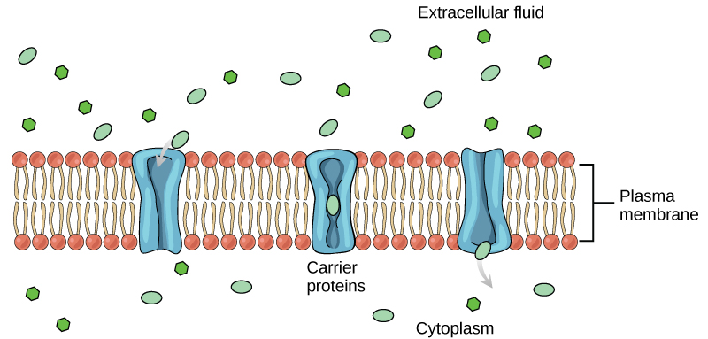
The Role of the cell membrane in transport.
Science 10 – C2.2

Slide 34
Model of a cell membrane

Slide 36
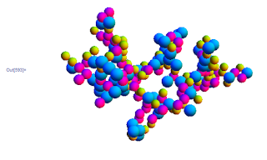
The particle model of matter
All matter is made of particles, but these particles vary in size and composition
Particles are constantly moving
Solids, liquids and gases move at different speeds
Particles attract other particles or bond to other particles
Particles have spaces between them

Slide 37
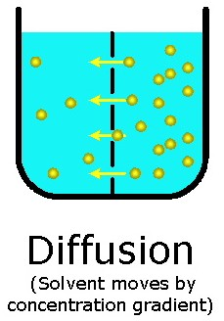
Diffusion
What is diffusion?
The movement of particles along a concentration gradient
What is a solute?
The substance that is dissolved in solution
Passive Transport
Requires no energy
Active Transport
Requires energy

Slide 39
Concentration gradient

Slide 40
Osmosis: the movement of water!

Slide 41
Continued…
Hypertonic
Solute concentration outside is greater that solute concentration inside, water leaves cell
Cell shrinks
Hypotonic
Solute concentration inside is greater that solute concentration outside, water enters cell
Cell bloats
Isotonic
Concentration of solute inside and outside is equal

Slide 43
Facilitated Diffusion/Active transport

Slide 45
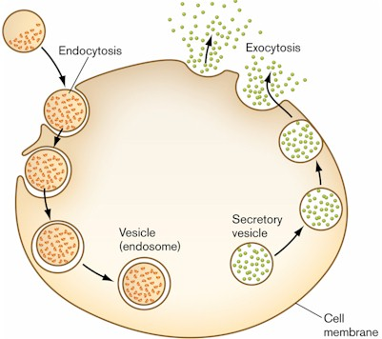
Endocytosis and exocytosis

Slide 46
Homework!
Read Pages 274-283
Building Exhibit Models
Page 282 – Choose one process
C2.2 Check and Reflect
Questions 1-10

Slide 47
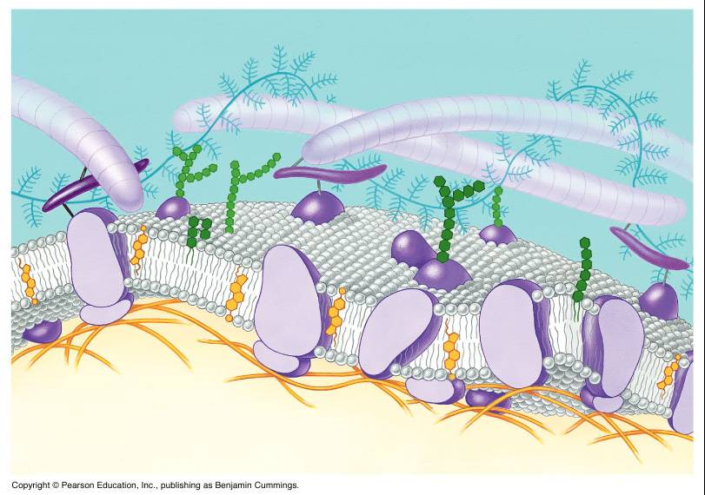
Membrane Technologies
Membrane Technologies is the research and study of natural membrane functions and there industrial and commercial use.
Industry makes & sells products that are similar to real cell membranes.
Recognition Proteins- stick out of the membrane into the cells surroundings
Receptor Proteins- bind specifically to certain molecules (Lock and Key)

Slide 48
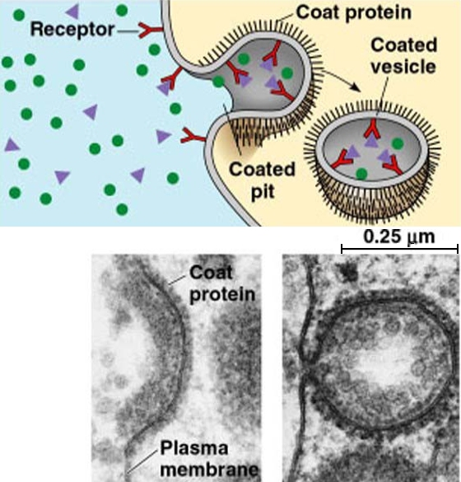
Receptor Proteins
Bind to molecules and bring them into the cell.
Can also work against us. Viruses like AIDS and influenza use this action to enter our cells.

Slide 49
Membrane proteins and disease
Disease and viruses such as HIV bind to receptor proteins and move into the cell through the receptor protein
Research is being done to find a way to change the “lock” so the diseases “keys” will not work
It is also being done to see if science can find “keys” that only work on infected cells

Slide 50
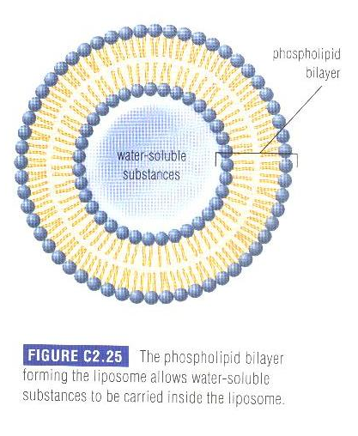
Synthetic membrane technology
Drug therapies also use structures manufactured to look like a cell membrane
Liposomes are fluid filled sacs surrounded by a phospholipid bilayer identical to that found in the cell Water soluble drugs are transported within the Liposomes so when they reach your cells the membranes of the cell and liposome can fuse thus delivering the drugs.

Slide 51
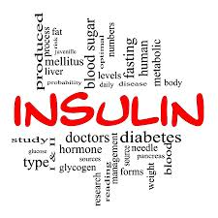
Transport of protein hormones
Insulin is a protein made in the pancreas and used to regulate the glucose within a cell
Insulin is transported through the blood and then binds to receptor proteins, the receptor proteins then allow more glucose into the cell

Slide 52
Peritoneal Dialysis
Waste fluids move from the intestines into the peritoneum, a cavity filled with dialysate fluid, this is called peritoneal dialysis
Normally the kidneys would clean this fluid and release the waste in urine
If your kidneys or liver are not functioning correctly this may be done artificially
A tube in inserted into the peritoneal cavity and clean dialysate is pumped in as the dirty fluid is removed

Slide 53
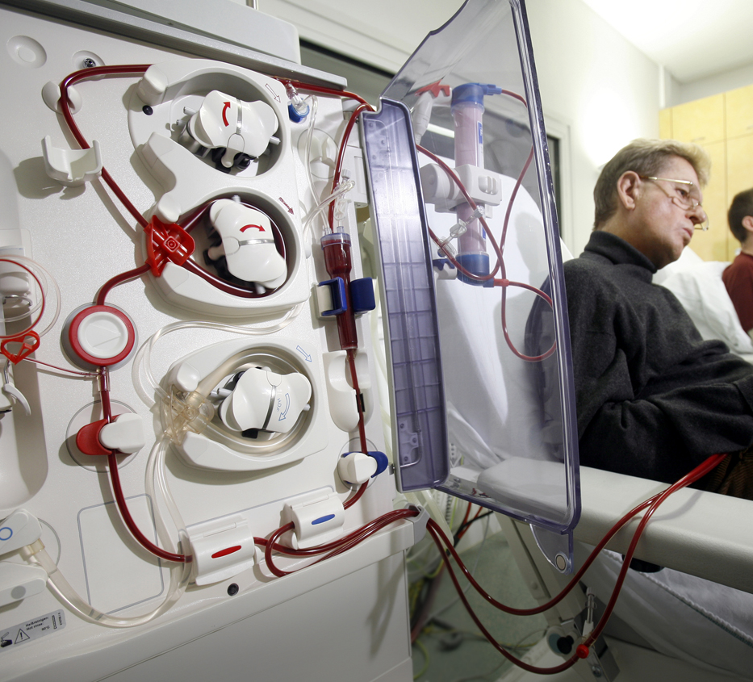
Hemodialysis
Hemodialysis is more complicated and can not be done at home
The blood of the patient is removed and cleaned by dialysate fluid outside the body then pumped back into the body.

Slide 54
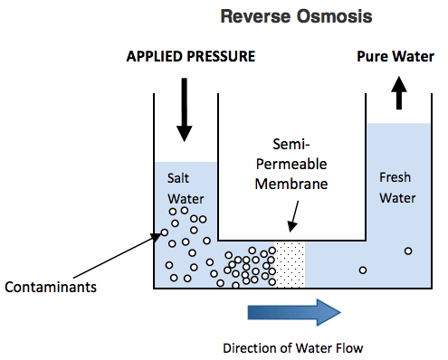
Reverse Osmosis
Desalination is the process of removing salt from sea water by pumping water through increasingly fine filters.
The pumps are doing work to move the water against the flow of Osmosis

Slide 55
Why are cells so small?
Cells are small so they can be efficient in transporting materials across their membranes.
If cells were larger then they would need more molecules transported across the cell surface so the cell could function.

Slide 56
It is not the fact that a larger cell would need more molecules transported in to it that makes it less efficient then a small cell it is the fact that when a cell gets larger the surface area (SA) to volume (v) ratio decreases.
If a cell is bigger it has a greater volume, thus needs for more molecules. To accommodate this it needs a greater surface area to allow these molecules in.
Therefore, molecules that have a higher surface area to volume ratio are more efficient.

Slide 58
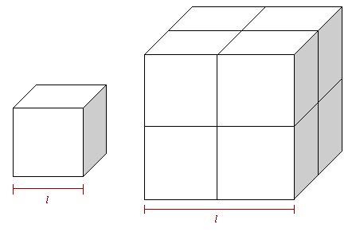
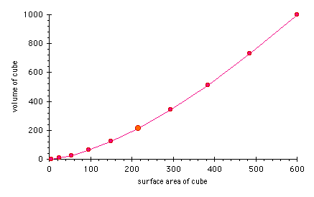
Small vs Large: Assume the following cells are cubes
Side= 1.0cm
SA= 6(1.0cm)²=6cm²
V= (1.0cm)³= 1cm³
SA / V = 6cm² /1cm³
SA to V ratio = 6
Side= 2.5cm
SA= 6(2.5cm)²=37.5cm²
V= (2.5cm)³= 15.625cm³
SA / V = 37.5cm² /15.625cm³
SA to V ratio = 2.4
The smaller cell has a better SA to V ratio therefore is more efficient then the larger cell.

Slide 59
Maximizing Potential
Multicellular organisms have developed other internal transport systems to reduce dependence on diffusion.
In humans for example, the circulatory system, digestive system and respiratory systems are involved in the transport of essential materials to all the cells of the body.

Slide 60
Maximizing Potential continued…
In humans, no one cell is more than 0.1mm away from a capillary that transports blood to bring nutrients and remove wastes.
Plants have also developed transport systems outside of cell diffusion.
The xylem is concerned with the delivery of water where the phloem distributes sugars throughout the plant.
These plant transports can carry molecules 100m in some large trees.

Slide 61
Structures in animals and plants that increase surface area
Animals:
Alveoli in the lungs increase surface area for transport of oxygen and carbon dioxide
Villi from the intestines increase surface area to absorb nutrients
Plants:
Root hairs that extend off plant's roots increase surface area to absorb water and nutrients

Slide 62
Homework!
Quiz Soon!
Read Pages 289-293
C2.3 Check and Reflect
Questions 1-8
C2.4 Check and Reflect
Questions 1-8
Section 2.0 Review
Questions 1-22

Slide 63
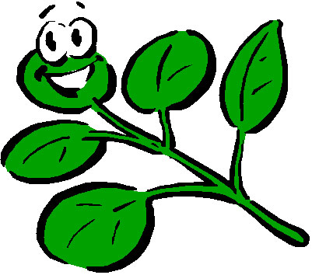
Cells, Tissues & Systems
Unit C – Section 3
Science 10 - Redding

Slide 64
Plant Structure:
Plants are multicellular organisms
There are advantages and disadvantages to having a larger structure
Division of Labour – specialized cells can perform functions more efficiently
Size – can affect the rate of diffusion in unicellular organisms. Multicellular organisms have smaller cell size and therefore more efficient exchange of gases and materials
Interdependence of cells – the more cells, the more hardy the organism will be at combating adversities

Slide 65
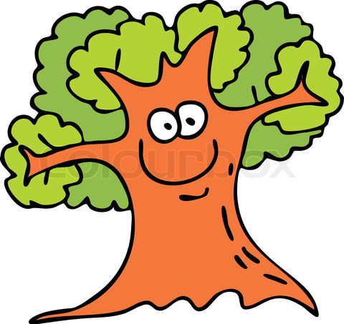
Plant Structure:
Plants as we know are multicellular:
Group of cells form tissues
Groups of tissues form organs
And groups of organs form a functioning system

Slide 66
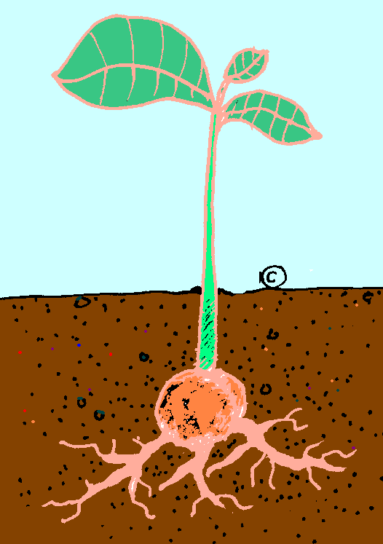
Plants have 2 main systems
Shoot System: Everything above the ground
Includes:
Leaves/stems
Buds/flowers
Tubers (swollen stems that store foods)
Root Systems: Everything below the ground
Includes:
All root systems below the ground
Aerial root systems even though they are above the ground

Slide 67
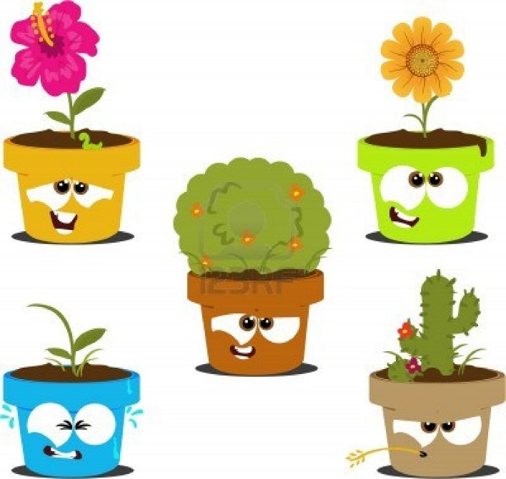
Plant Growth
Cell division and growth of a plant depend on certain areas of plant matter called Meristems
Different meristems produce root tissue or shoot tissue
There are three main types of plant tissues:
Dermal tissue – outer (this is not bark!)
Ground tissue
makes up the majority of the plant
Vascular tissue
transports material around the plant

Slide 68
About the tissues
Dermal
Exchange of matter and gas in and out of the plant
Protects the plant from disease – leaves secrete a waxy substance called the cuticle
Ground
Provides strength and support
Involved in food and water storage
Cells are tightly packed for fast rates of diffusion

Slide 69
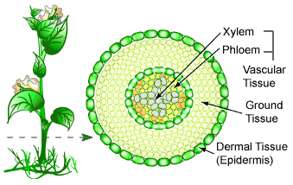
Continued…
Vascular
Xylem – moves water and minerals from the roots to the leaves. Are thick tubes made from cellulose, varying in diameter
Phloem – transports sucrose and other dissolved sugars from the leaves to other parts of the plant. Formed from long sieve tube cells

Slide 72
Specialization in Cells:
Root hairs – absorption of water and minerals from the soil. Increase the surface area of the roots for more absorption (carrots)
Dermal cells having cuticle – protects them from water loss
Guards cells containing stomata – the only cells in the epidermis that contain cholorplasts. Help with gas exhange too

Slide 73
Homework!
Read Pages 297-302
C3.1 Check and Reflect
Questions 1-6

Slide 74
The chloroplast
Unlike animal cells, many plant cells have organelles called chloroplast. Chloroplast are found in the ground level of plants in the leaves and stems. This is the place where photosynthesis takes place

Slide 75
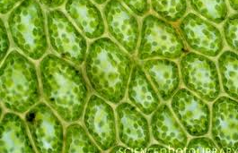
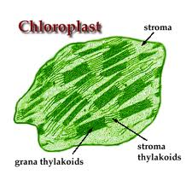
Photosynthesis
Light energy is absorbed by the chlorophyll and converted into chemical energy that is stored in the molecules of glucose for future use and cellular processes. Light and chlorophyll are not considered reactants in the equation because they are not consumed directly during the process

Slide 76
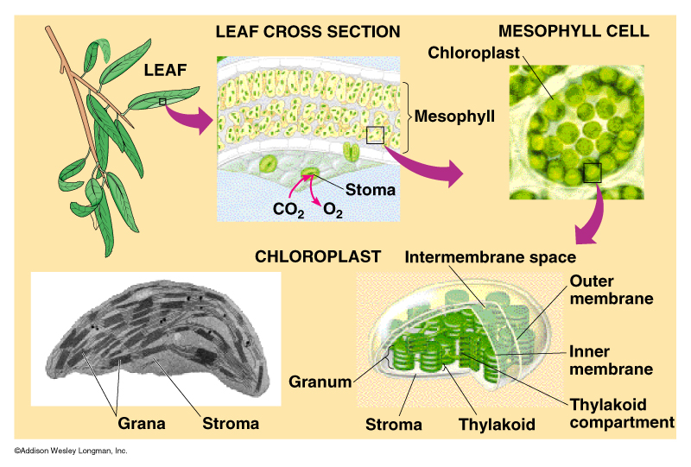

Slide 77
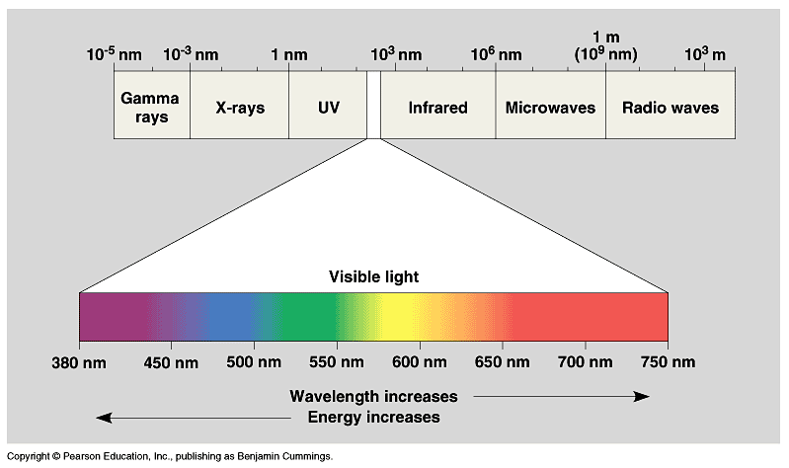
Nature of Light

Slide 78
Gas Production in Plants
There are 2 important reactions that happen in plants that produce gases:
Photosynthesis
Cellular Respiration – begins in the cytoplasm but is completed in the mitochondria

Slide 79
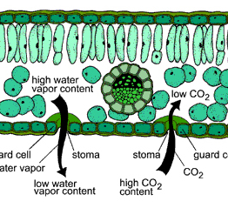
The Leaf Tissues and Gas Exchange
Dermal Tissue – specialized cells on the dermal tissue called stomata (like pores) allow for gas exchange
Most stomata are found on the underside of the leaves and they are not open all of the time as it would be inefficient and would cause water loss by the plant

Slide 80
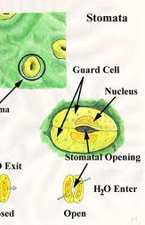
Sensitivity of the Stomata
Sensitive to environmental changes
Plants regulate their loss of water through transpiration (part of the water cycle!)
Plants in hotter climates have fewer stomata

Slide 81
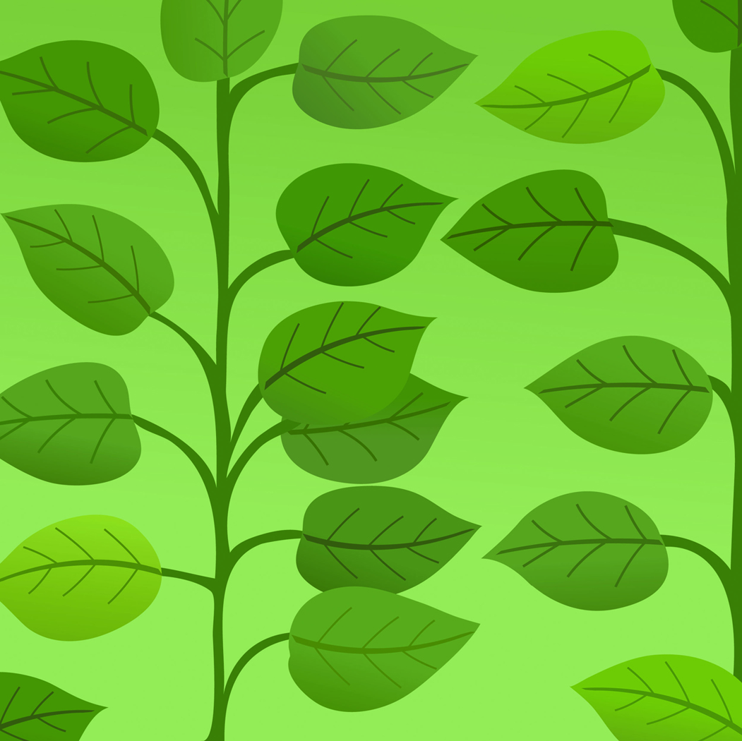
Ground tissue
Mesophyll – between the upper and lower epidermis
There are two types of mesophyll cells
Palisade tissues – responsible for photosynthesis, so you can expect that many chloroplast exist in this layer of tissue.
Spongy mesophyll tissues – gas exchange by diffusion throughout the leaf

Slide 82
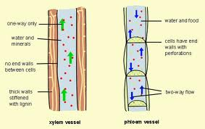
Vascular Tissue
Provides the leaf with water needed for transpiration and for photosynthesis
Vascular Bundles:
xylem and phloem tissues

Slide 83
Gas Exchange in Plants
Occurs by diffusion in plants
In the leaf, the stomata, regulated by the guard cells allow for my efficient exchange of gases and diffusion of carbon dioxide into the mesophyll tissues (spongy mesophyll and palisade layers)
The leaf is not the only place where gas exchange occurs.
Pores along woody stems and mature roots also do gas exchange through pores called: lenticels

Slide 84
Homework!
Read Pages 303-313
C3.2 Check and Reflect
Questions 1-5, 7 & 8
C3.3 Check and Reflect
Questions 1-10

Slide 85
Cohesion
Attraction of water molecules
01
Due to the polar nature of the water molecule
02
Molecules tend to hold together
03

Slide 86
Adhesion
Attraction of water molecules to other substances
01
Ex – water droplets on the side of a glass
02
Water is ‘sticky’
03

Slide 87
Root Pressure
The upward force exerted on water in the xylem and in the roots of plants
Forces water to move against gravity
Water moves upward and is drawn into cells that require it through osmosis
Meaning the cells have a high solute concentration allowing water to move into them

Slide 88
From the Root to the Leaf
At the root, root hairs absorb water and minerals from the soil through active transport.
Water enters the root hairs through osmosis because of the high concentration of solute inside the cells.
This leads to root pressure which forces the water through the cells and into the xylem
Water is then moved through the xylem tubes against gravity. In some plants the water can travel up to 100m!
Water is delivered to the leaves and evaporation of the water through the stomata and lenticels in the process of transpiration creates tension or pull
Each water molecule evaporates into its surroundings

Slide 89
Tonicity
Can affect osmosis in a plant
Increased solute concentration outside of the plant can cause the plant to dry out
Plasmolysis causes even the water in the vacuole of a cell to leave
If the plant is returned to less solute rich environment the process reverses.

Slide 90
Homework!
Read Pages 315 - 322
Lab: Tonicity of Cells
C3.4 Check and Reflect
Questions 1-5, 7 & 8

Slide 91
Control systems What are Tropisms???

Slide 92
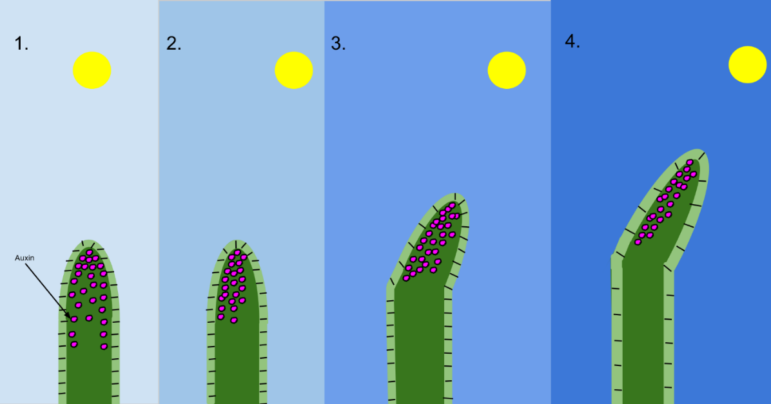
Control Systems What is phototropism?
Refers to the movement of a plant in response to a stimulus
Can be positive or negative
Positive – grows towards the light
Negative – grows away from the light

Slide 93
What is Gravitropism?
Plants also respond to the earth’s gravitational forces as well
It again, can be positive and negative
Positive – roots grow according to gravity
Negative – stems and leaves work against gravity

Slide 94
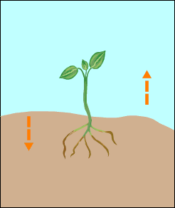
Responses of plant parts to stimuli…
Stem to light
Positive phototropism
Root to light
Weak/negative phototropism
Stem to gravity
Negative gravitropism
Root to gravity
Positive gravitropism

Slide 95
Homework!
Read Pages 323 - 328
C3.5 Check and Reflect
Questions 1-7
Section 3.0 Review
Questions 1-15
UNIT EXAM SOON!

