Slide 1
Energy & Matter in Chemical Change
Science 10 – Unit A
Redding

Slide 2
Safety Hazard Symbols
The shape of the symbol indicates severity of the chemical:
Triangle – Caution
Diamond – Danger
Octagon - Warning

Slide 3
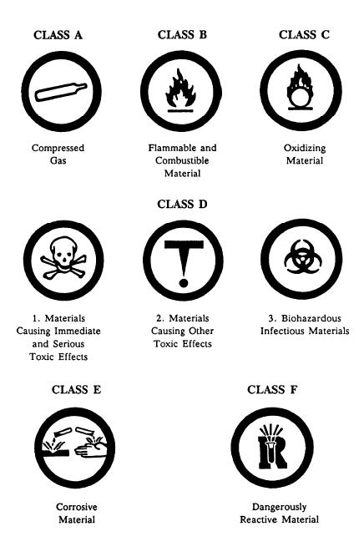
WHMIS – What does it stand for?
Workplace Hazardous Materials Safety System
Page 455 in your textbook
Know these symbols!
NEW! Pictograms for 2018

Slide 4
MSDS – Material Safety Data Sheet
Manufacturers of hazardous products must provide these sheets about their products
Identifies chemical and physical hazards associated with the product
Physical – BP, MP, toxicity, first aid…

Slide 5
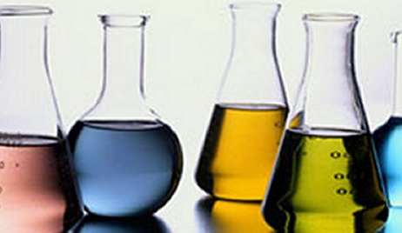
Properties and Classification of Matter Physical Properties:
Boiling Point
Melting Point
Malleability
Ductility
Colour
State
Solubility
Conductivity

Slide 6
Properties and Classification of Matter Chemical Properties:
Ability to burn
Flash point
Behaviour in air
Reaction to water
Reaction with acids
Reaction to heat
Litmus test

Slide 7
Pure Substances and Mixtures
Homogenous Mixtures: Solutions
Heterogeneous Mixtures:
1. Mechanical Mixtures
2. Colloids
3. Suspensions

Slide 8
Chemical Reactions
All Reactions share certain characteristics:
All produce new substances with their own characteristic properties
All reactions involve the flow of energy
Many reactions cause a phase change – production of gas or a precipitate.

Slide 9
Homework
Page 11 A1.1 Check and Reflect Questions 1-7
Page 17 A1.2 Check and Reflect Questions 1-9
Read Section A1.3 – We will be covering this briefly in class and you will be tested on this material.
Page 25 A1.3 Check and Reflect Questions 1-8

Slide 10
People to Mention…
John Dalton (1766 – 1844): imagined all atoms were like small spheres but they could have different properties
Used the following model to explain matter:
All matter is small and indivisible
All atoms of the same element are identical
Atoms of different elements have different properties
Atoms of different elements combine in specific ratios

Slide 11
People to Mention…
JJ Thomson (1856 – 1940): physician who discovered the electron!
Experimented with particles
Showed that a beam was made of negative charges
This shows that atoms contain smaller particles that are identical
Developed the model of the atom – ‘Plum Pudding Model’

Slide 12
People to Mention…
Ernest Rutherford (1871 – 1937): discovered the nucleus of the atom which was about 1/10000 the size of the atom.
From England but did research at Mc Gill University
Worked with Radioactive particles
Knew Thomson’s Model was wrong
Came up with a new model – Positive Centre surrounded by electrons

Slide 13
People to Mention…
Neils Bohr (1885 – 1962): Danish Physicist who worked under Rutherford
Proposed that electrons surrounded the nucleus at specific energy levels
Showed that electrons could not move below the bottom energy level and therefore, not drop into the nucleus
Came up with the Bohr Model of the Atom

Slide 14
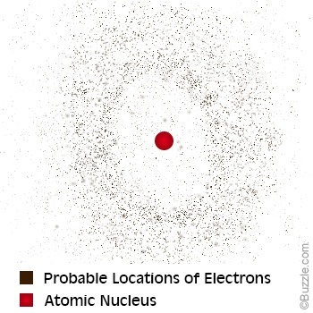
What we use today – Quantum Mechanical Model
Based on quantum mechanics
Describes how electrons exist around an atom – electron clouds
Each electron is a cloud of negative charge and instead of them existing at a specific level, they occupy the entire space all at once at different energy levels
Nucleus contains protons and neutrons
This model could change again in the future as we discover more.

Slide 15
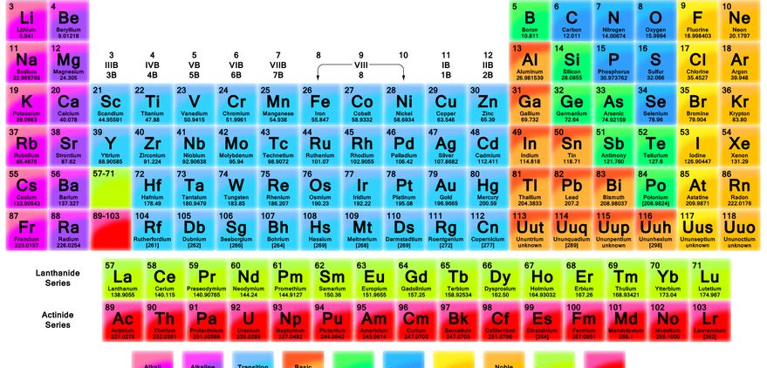

Slide 16
The Periodic Table and Atomic Structure
The Elements:
Metals – malleable and ductile, solid at room temperature
Non-Metals – only 17 elements are non-metals! Vary greatly in colour. A lot of nonmetals connect in groups (O₂, N₂, F₂…). They have different properties from metals
Metalloids – intermediate properties of metals and non-metals

Slide 17
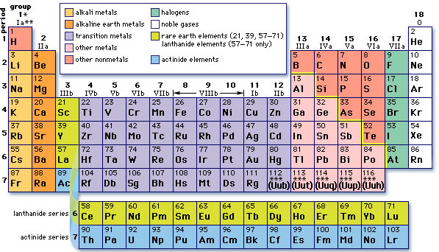
The Periodic Table
Periods – Rows or horizontal lines
Family – Groups or vertical columns
Alkali Metals – Group 1
Alkaline Earth Metals – Group 2
Halogens – Group 17, react readily with alkali metals to form salts
Noble Gases – Group 18

Slide 18
Atomic Theory
Subatomic Particles
Energy Levels: 2,8,8…
Isotopes: atoms of the same element that contain different numbers of neutrons
Mass Number: an integer equal to the total number of protons and neutrons in the nucleus of an atom
Example: Oxygen has three isotopes – all have the same number of protons (8) but each have a different number of neutrons (8,9 or 10)
Lets Draw them!

Slide 19
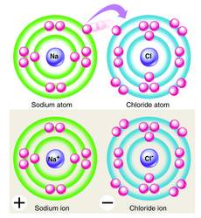
Ionization
The process of gaining or losing electrons – becoming an ion.
Cations (+) form most often when metals lose electrons
Anions (-) form mostly from nonmetals gaining electrons
Example: Lets draw out Magnesium and Fluorine atoms and ions

Slide 20
Homework
Page 39 A2.1 Check and Reflect Questions 1-12
Read Ahead! Section A2.2 – We will be covering this next class but it is important to stay ahead in your reading
Quiz coming up!

Slide 21
Naming Ionic Compounds
Naming Ionic Compounds: IUPAC
Name the cation first by using the elements name
Name the anion second by changing the ending to ‘ide’
Example:
NaCl
BaF₂
K₃N

Slide 22
Writing Formulas for Ionic Compounds
Steps involved:
Identify the ions and their charge
Drop and swap the charges
Reduce to lowest number coefficients
Example:
calcium nitride
silver oxide

Slide 23
Writing and Naming with Polyatomics
Writing: treat the polyatomic ion as an anion and do the drop and swap like you would with the other ionic compounds
Naming: easy! No need to change anything with the name
Use your data booklet for the polyatomic ion chart.
Lets try a few!

Slide 24
Multivalent Elements
Have more than one stable charge
Use Roman Numerals when writing the names (I, II, III, IV, V)
If it is not specified, assume that the most common ion is being used – periodic table will show you the most common (listed first)
Examples – FeCl₃, copper (II) sulphate, Cr₂S₃, lead (IV) oxide.

Slide 25
Naming Molecular Compounds
Naming Molecular Compounds: IUPAC
Sharing of electrons (covalent bonds), contain prefixes
Name the first element
Name the second element using ‘ide’ at the end
Add prefixes indicating the number of atoms (except 1 on the first atom)
Examples:
CO
SO₂
P₄O₁₀

Slide 26
Homework
Page 50 A2.2 Check and Reflect Questions 1-12
Read Ahead! Section A2.3 – We will be covering this next class but it is important to stay ahead in your reading
In-class assignment tomorrow
Quiz coming up on naming and writing!

Slide 27
Properties and Classification of Ionic and Molecular Compounds
Properties of Ionic Compounds:
High Melting and Boiling Points
Retention of Crystal Shape
Soluble in Water
Conductive in Solution

Slide 28
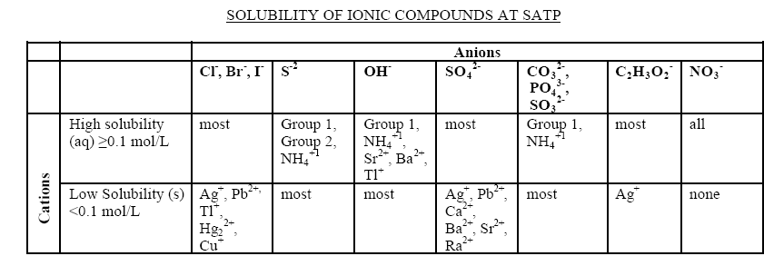
Properties and Classification of Ionic and Molecular Compounds
Properties of Ionic Compounds:
Solubility Chart

Slide 29
Properties and Classification of Ionic and Molecular Compounds
Properties of Ionic Compounds:
Use your solubility chart to indicate the solubility of the compounds on page 58.
Name or write the formula for each of the compounds in the two questions.

Slide 30
Properties and Classification of Ionic and Molecular Compounds
Properties of Molecular Compounds:
Low Melting and Boiling Points
No Malleable or ductile
Not conductive
Slightly Soluble

Slide 31
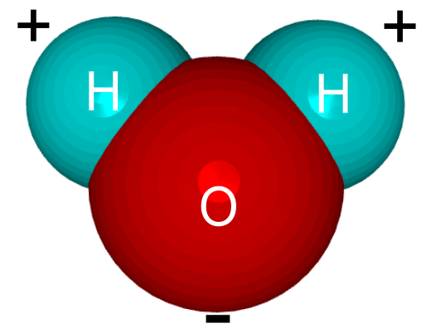
Properties and Classification of Ionic and Molecular Compounds
Special Properties of Water:
Polar – positive and negative end
Bent shape
Small and easy to get between atoms of other compounds
Universal solvent!
High boiling point and melting point – unusual for a molecular compound
Most dense as a liquid not a solid!

Slide 32
Homework
Page 61 A2.3 Check and Reflect Questions 1-9
Read Ahead! Section A2.4 – We will be covering this next class but it is important to stay ahead in your reading
In class assignment coming up!

Slide 33
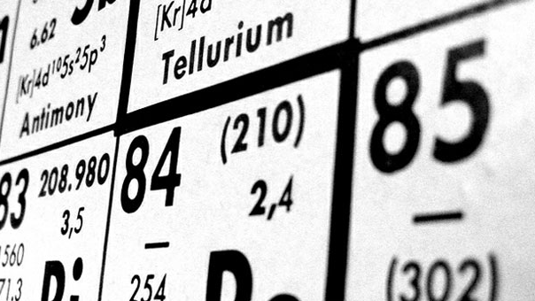
Acids
Sour
Not slippery
Corrodes metal
Red litmus
Conductive
pH less than 7

Slide 34
Bases
Bitter
Slippery
No reaction to metals
Blue litmus
Conductive
pH greater than 7

Slide 35
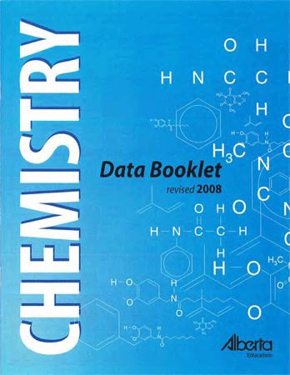
Naming Acids and Bases

Slide 36
Homework
Page 69 A2.4 Check and Reflect Questions 1-8
Read Ahead! Section A2.5 – We will NOT be covering this next class but it is testable material
Gizmo – pH analysis
Quiz coming up! Study!

Slide 37
Important Examples of Chemical Change
What were the properties of chemical reactions?
Reactions that form Gas
Sudden and dramatic – explosion
solid or liquid converts quickly to a large quantity of gas
Ex: Airbags in your car
Slow and steady – baking a cake
Reactions that form Solids
Usually happen quickly – ex: epoxy

Slide 38
Important Examples of Chemical Change
Showing States in Chemical Formulas
Elements
Metals are solid, except mercury
Most diatomic atoms are gases, except bromine and iodine
Sulfur, phosphorous and carbon are solids
Compounds
Ionic compounds are solid at room temp
Molecular compounds are difficult to predict, smaller tend to be gas and larger become liquid and solid

Slide 39
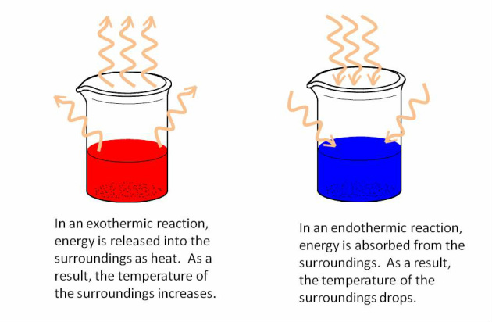
Types of Reactions: Endothermic
Absorb energy
Temperature of the system goes down
Cold packs
Photosynthesis
Energy is a reactant

Slide 40
Types of Reactions: Exothermic
Release energy
Combustions – usually
Temperature of the system increases
Cellular respiration
Energy is a product

Slide 41
The Law of Conservation of Mass
Antoine Lavoisier – 1789
The total number of atoms present before the reaction is equal to the total number of atoms present after the reaction
The mass of the reactants will equal the mass of the products but you have to take into account friction and mass being able to escape as a gas or through heat.

Slide 42
Characteristics of Chemical Reactions
All reactions involve the production of new substances
All reactions involve a flow of energy
When new substances are formed in chemical reactions, a change of state is usually observed
All chemical reactions are consistent with the ‘law of conservation of mass’

Slide 43
Writing and Balancing Chemical Equations
hydrogen + oxygen → water
oxygen + methane → carbon dioxide and water

Slide 44
Writing and Balancing Chemical Equations
iron (III) nitrate and sodium phosphate → sodium nitrate and iron (III) phosphate
nitrogen + hydrogen → ammonia

Slide 45
Homework
Page 85 A3.1 Check and Reflect Questions 1-12
Page 90 A3.2 Check and Reflect Questions 1-9
Read Ahead! Section A3.3 – We will be covering this next class but it is important to stay ahead in your reading
Quiz coming up on writing and balancing equations!

Slide 46
5 Types of Chemical Reactions
Formation A + B → AB
Decomposition AB → A + B
Combustion C_{x}H_{y} + O2 → CO₂ + H₂O
Single Replacement A + BC → AC + B
Double Replacement AB + CD → AD + CB

Slide 47
Examples
Word | Skeleton | Type
Sodium + phosphorus → ???
Magnesium + silver nitrate → ???
Water → hydrogen + oxygen

Slide 48
Examples – on your own
Word | Skeleton | Type
Carbon dioxide + water → hydrogen carbonate
Glucose → carbon + hydrogen + oxygen
Gold (III) chlorate + copper (II) sulfate → ???

Slide 49
Examples: on your own
Word | Skeleton | Type
Methane + oxygen → ???
Chlorine + silver bromide → ???
Potassium + nitrogen →

Slide 50
Homework
Page 106 A3.3 Check and Reflect Questions 1-3
Read Ahead! Section A3.4 – We will be covering this next class but it is important to stay ahead in your reading
Quiz coming up on writing and balancing equations!

Slide 51
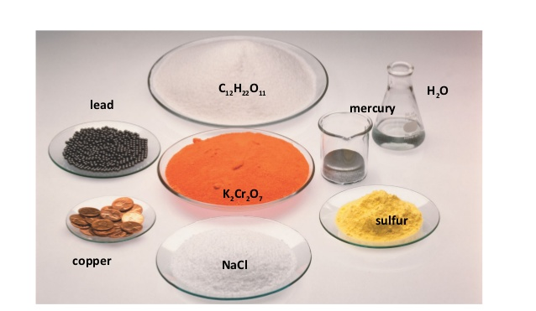
The Mole
The quantity that chemists use to measure elements and compounds is called the MOLE (symbol ‘mol’)
The number of particles in one mole of substance is called AVAGADRO’s Number (symbol N_{A})
So basically one mole of any substance will be equal to 6.02 X 10²³ particles!

Slide 52
Molar Mass
The mass of one mole of substance is referred to as molar mass. The average molar mass of each substance is listed on your periodic table.
Calculated in grams per mole (g/mol)
Record your molar mass to 2 decimal places – do not round!
The number of moles of a substance is related to its molar mass by the following equation:
m (mass in grams) = n (# of moles) X M (molar mass)

Slide 53
Examples:
How many moles of silicon are in a 56.18g sample?
What is the mass of 10 moles of water?
What is the molar mass of copper (II) sulphate?
What is the mass of 5 moles of sodium hydroxide?
How many moles are in 360g of glucose?

Slide 54
Homework
Page 112 A3.4 Check and Reflect Questions 1-13
Start Reviewing! Unit A Review Page 117 – 121 (NEXT CLASS)
Unit Exam coming up on EVERYTHING!

