Slide 1
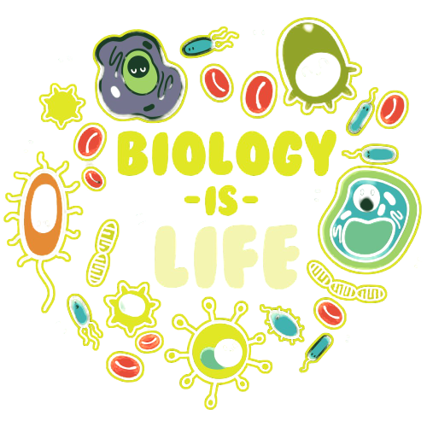
Biological Diversity
Redding – Science 9

Slide 2
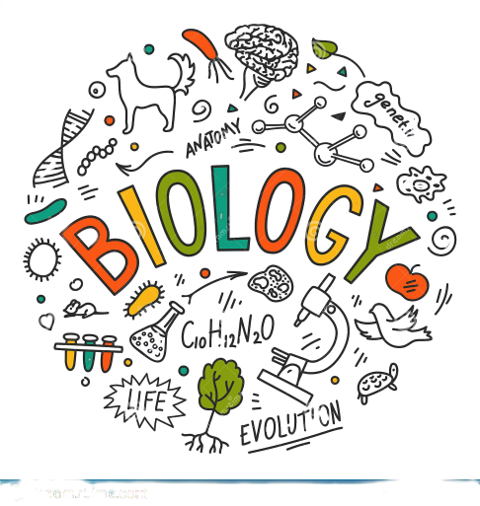
Unit Overview
Topic 1 – Biological Diversity and Survival
Topic 2 – Habitat and Lifestyle
Topic 3 – Passing it On
Topic 4 – Wearing your Genes
Topic 5 – When Plans Change
Topic 6 – The Best Selection
Topic 7 – The Sixth Extinction
Topic 8 – Pains and Gains

Slide 3
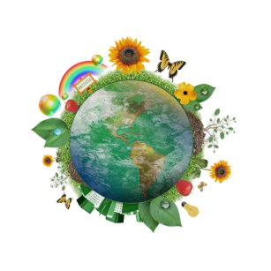
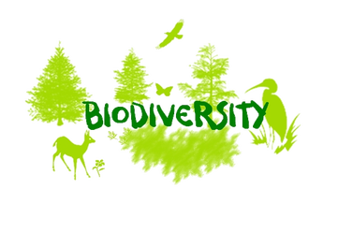
Topic 1
Biological Diversity and Survival

Slide 4
A Wealth of Diversity
Key Terms:
Biological Diversity
Variation
Species
Speciation
Adaptations – Structural and Behavioural
Diversity Index
Know These Terms

Slide 5
Activity – Page 9
A Classroom of Differences: Your school provides an excellent place to investigate variations or differences within a group of similar living things. In this case, the population consists of the students in your class and the variations are physical characteristics that you can easily measure.
Working in pairs, measure each student’s height to the nearest centimeter and record each measurement on the board
Do the same for hand span and wrist circumference.
Create three histograms comparing the differences/similarities

Slide 6
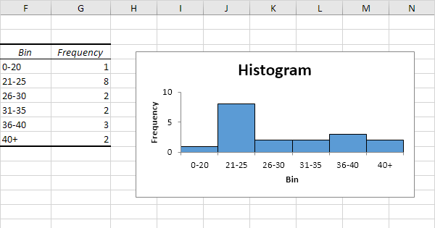
What is a Histogram? Lets Look

Slide 7
Main Components of Biodiversity
Ecosystem diversity – the different types of living communities and the environments.
Community (populations of different species living in the same area) diversity – occurs within populations of organisms living within a particular ecosystem
Species diversity – occurs within individual organisms of the same species
Genetic diversity – occurs within organisms at a cellular level, as it describes the variety of genetic material in all living things.
Species Distribution – Plant and animal species are not distributed evenly throughout the various eco-regions of the world.

Slide 8
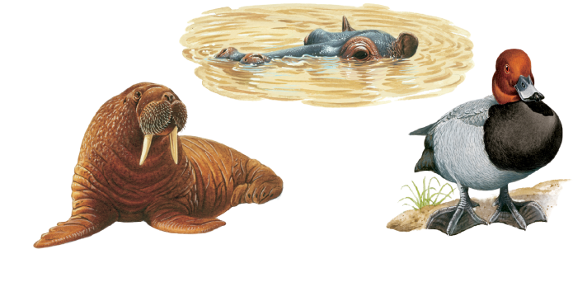
Variations for Survival
Every organism needs to adapt in order to survive in its environment. There are two types of adaptations.
Physical features of an organism are structural adaptations, whereas, actions are behavioral adaptations.
Lets think about some examples!

Slide 9
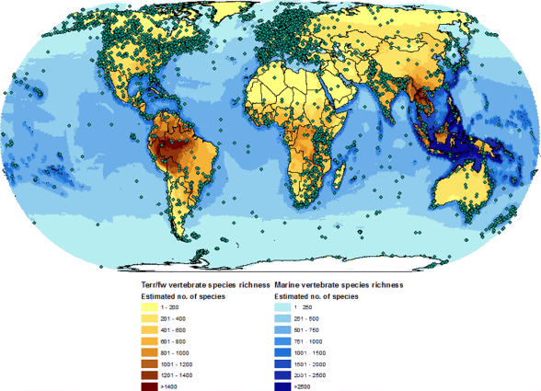
Measuring Biological Diversity
Measuring Biological Diversity To determine the biological diversity of an area, biologists use a measurement called a diversity index.
This compares the diversity of species in a certain area with the total number of organisms in that same area, or ecosystem.
It is primarily used to check on the health of an ecosystem – a healthy ecosystem has a high diversity index.

Slide 10
Topic 2
Habitat and Lifestyle

Slide 11
Variation and Competition
Key Terms:
Environment
Competition
Niche – Board and Narrow
Generalist
Specialist
Specialization
Know These Terms

Slide 12
The Niche
A niche is the role an organism has within an ecosystem.
An organism’s niche includes:
What it eats
What eats it
Its habitat
Nesting site, range and habits
What effect it has on the other populations
What effect it has on the environment A niche, for a particular organism, can change, depending on the environment in which it is located and the organisms with which it inter-relates.

Slide 13
Variation & Competition
When basic need resources (food, water, sunlight, habitat) are not plentiful, different species compete for the resource.
This competition is often not fair – because one species may have a specific variation which will give it an advantage over other species.
Adaptations play an important role when competition occurs, because the species that is best suited to survive will.

Slide 14
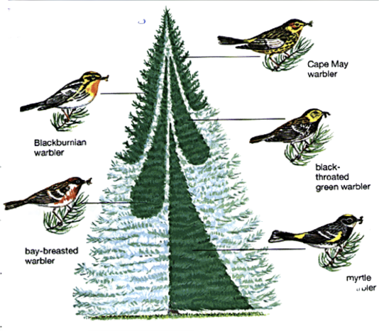
Variation & Competition
The species who does not ‘win’ the resource will likely have to switch to a different, less desirable resource in order to survive.
Some species, like warblers, visit Alberta spruce forests and avoid direct competition for the same resource, by practicing resource partitioning. This resource sharing enables competing species to share resources by accessing these resources in different ways.

Slide 15
Broad vs Narrow Niche
Organisms with a broad niche have adaptations that enable them to survive the extreme changes occurring in their environment. These species are considered to be generalists – able to spread over large areas.
Organisms with a narrow niche have specific adaptations that a particular to a certain environment. They efficiently survive because they have adaptations directed toward competing for one dependable food source, type of soil or level of light.
This specialization allows many different species to coexist in the same area, preventing one species from becoming dominant. The result of this is high diversity with low populations.
How could specialization be considered a ‘trap’???

Slide 16
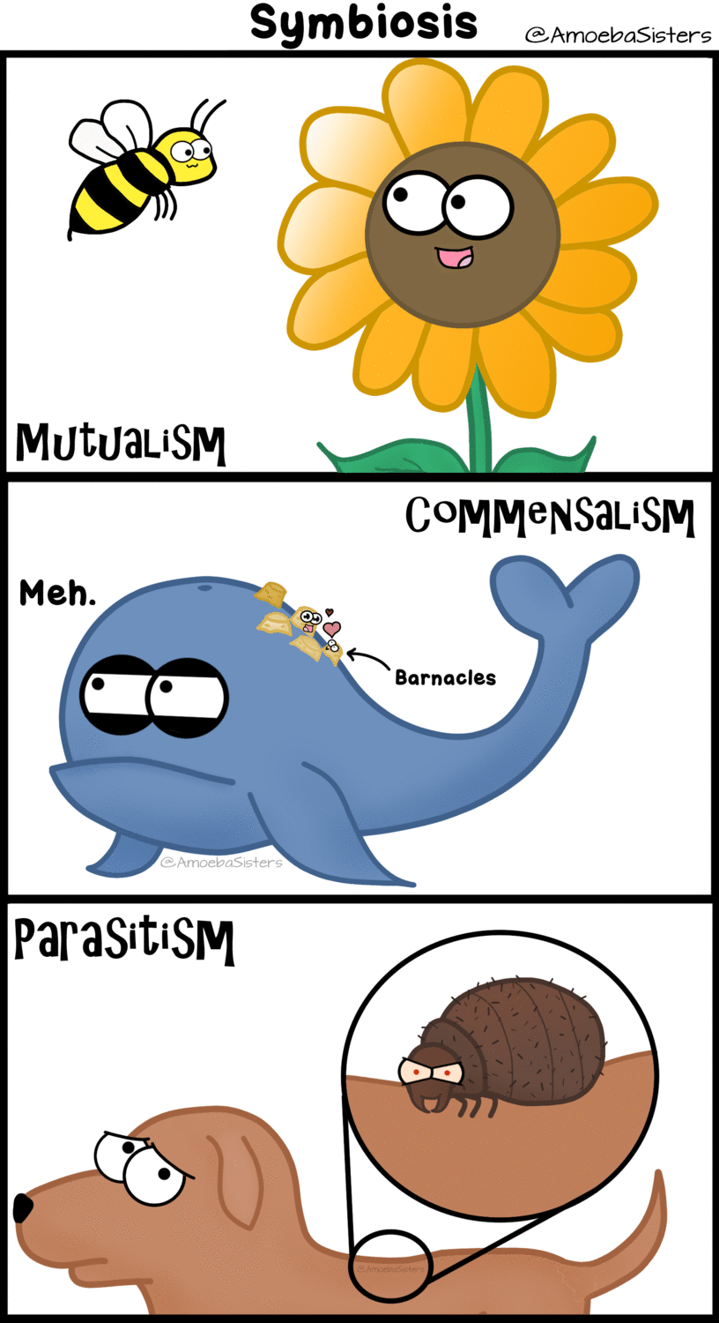
Symbiosis
Commensalism – in which one of the participating members benefits, but the other does not, and there is no harm done to that organism.
Mutualism – both organisms benefit from the relationship.
Parasitism – one organism benefits while the other organism (the victim) is harmed. (the parasite usually doesn’t kill the host, because the host represents the parasite’s food supply)

Slide 17
Topic 3
Passing it On

Slide 18
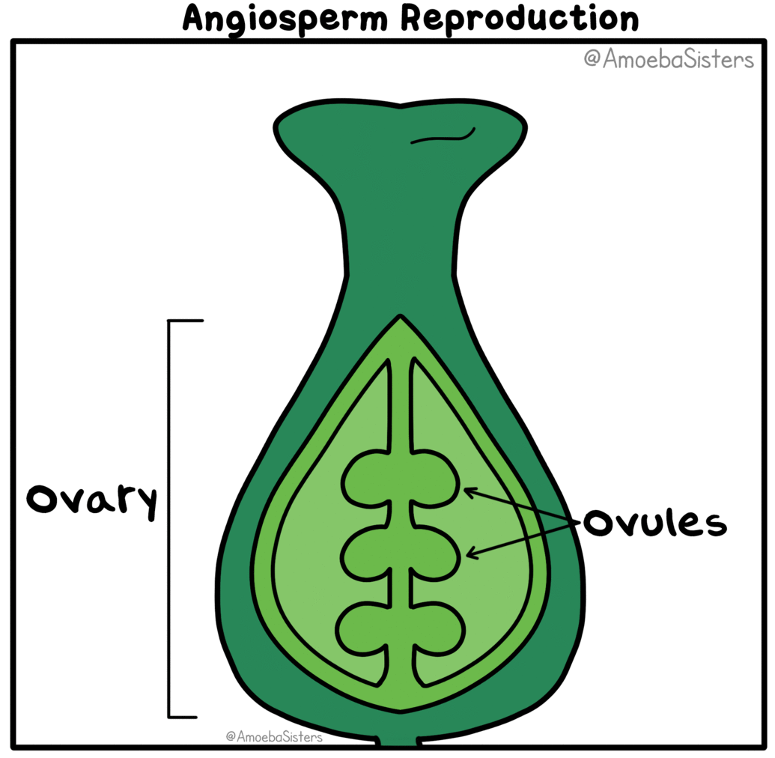
Reproduction
Key Terms:
Heritable
Reproduction
Reproductive Strategies
Asexual Reproduction
Sexual Reproduction
Plant Anatomy
Stigma, style, ovary, anther, filament
Zygote

Slide 19
Asexual Reproduction
Binary Fission - only single-celled organisms reproduce in this way. The cell duplicates its contents, including its nucleus and other organelles and then splits into two cells with each one being identical. (bacteria, amoeba, algae)
Asexual Spore Production - spores are similar to seeds, but are produced by the division of cells on the parent, not by the union of two cells.
One parent may produce many spores, each of which will grow into a new individual, identical to its parent. (fungi, green algae, moulds, ferns).
Many spores are produced to ensure that at least some of the individual organisms will survive. Zoospores can also be produced by some fungi and green algae. They move using tail-like flagella.
Budding - the parent organism produces a bud (a smaller version of itself), which eventually detaches itself from the parent and becomes a self-sufficient individual - identical to the parent. Coral also reproduces in this way, but do not detach themselves (hydra, yeast, coral, sea sponge).

Slide 20
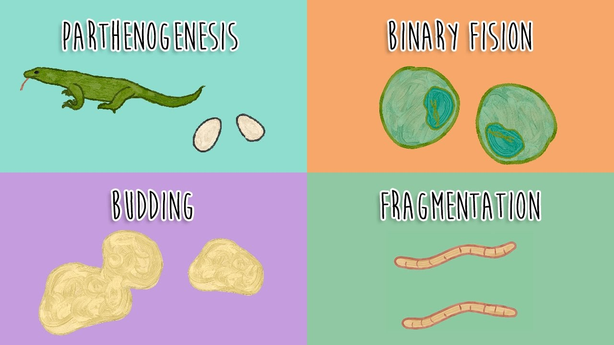
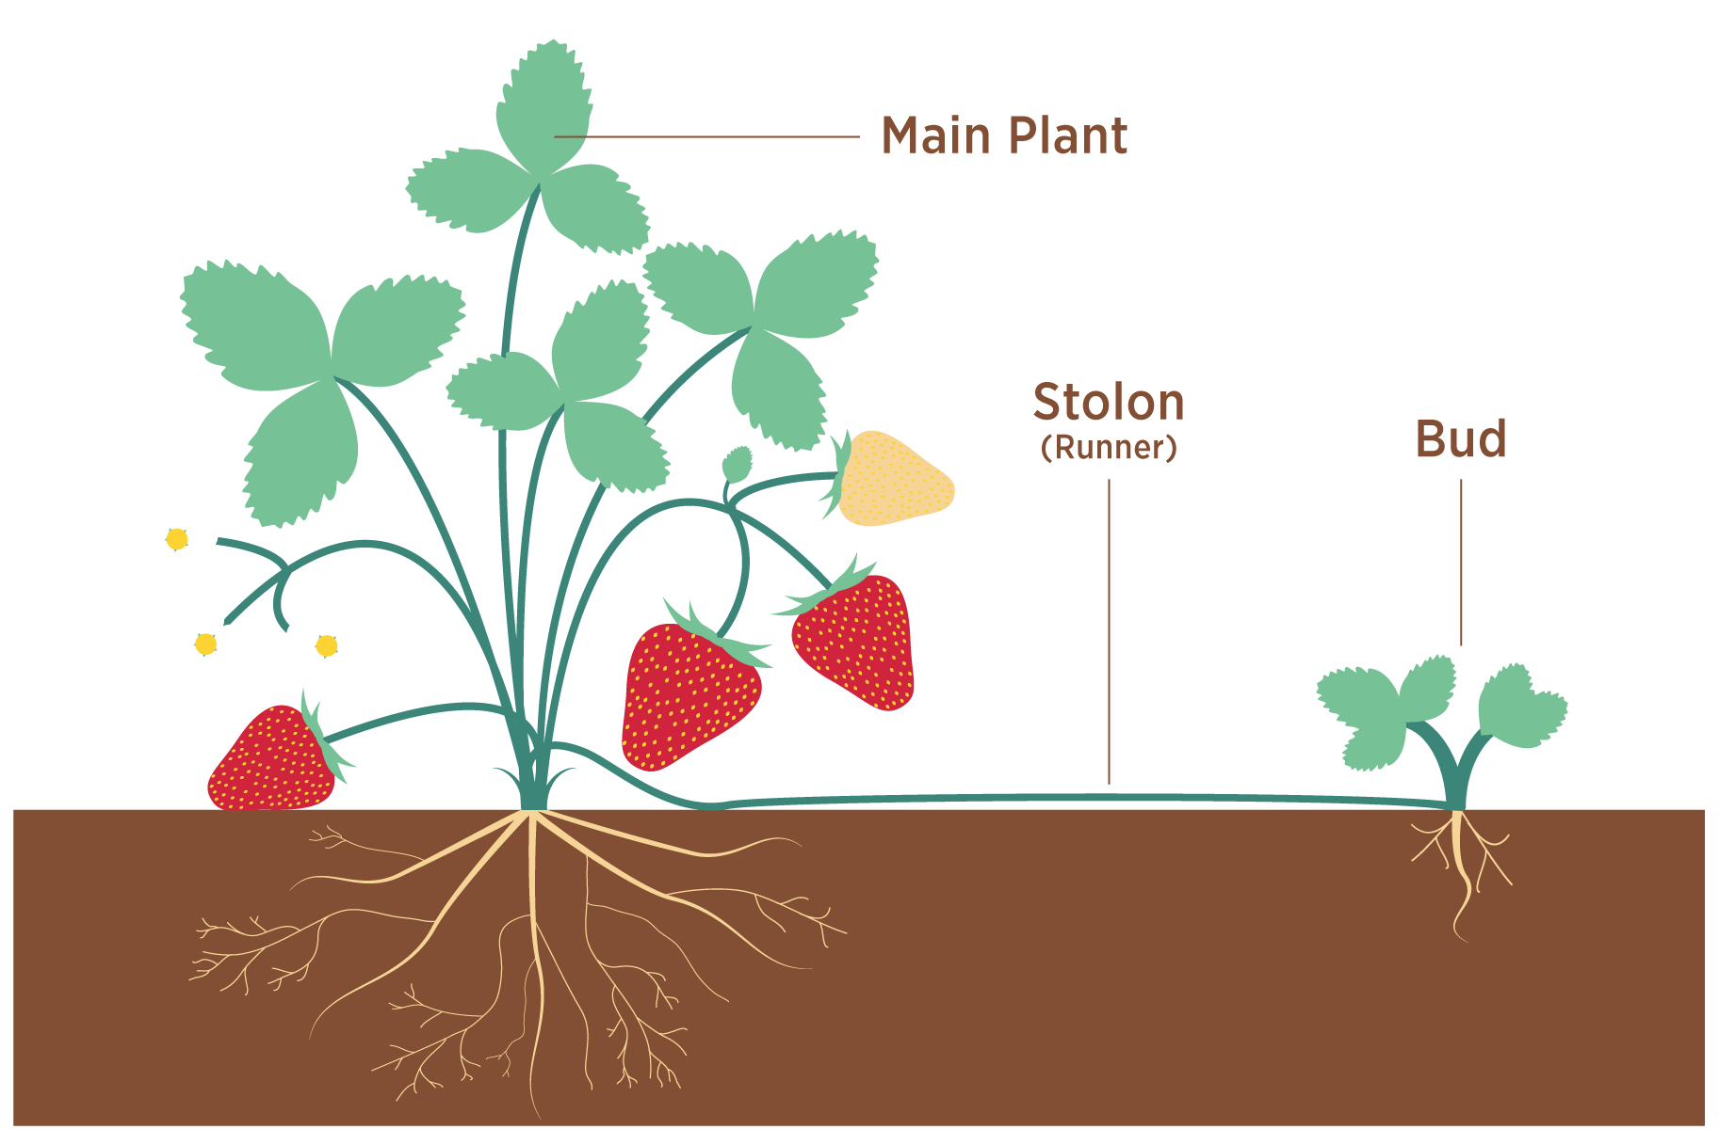
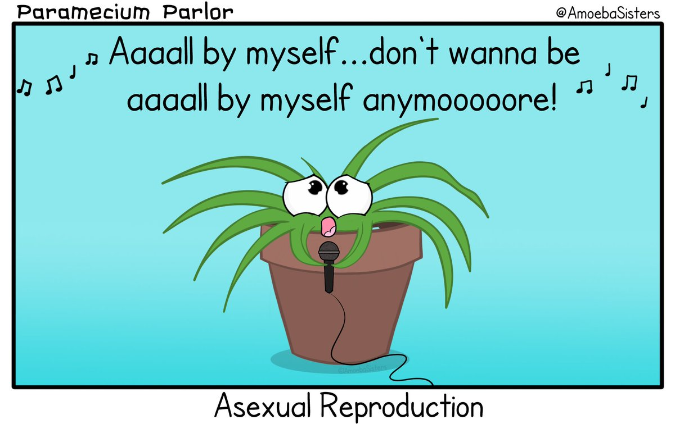
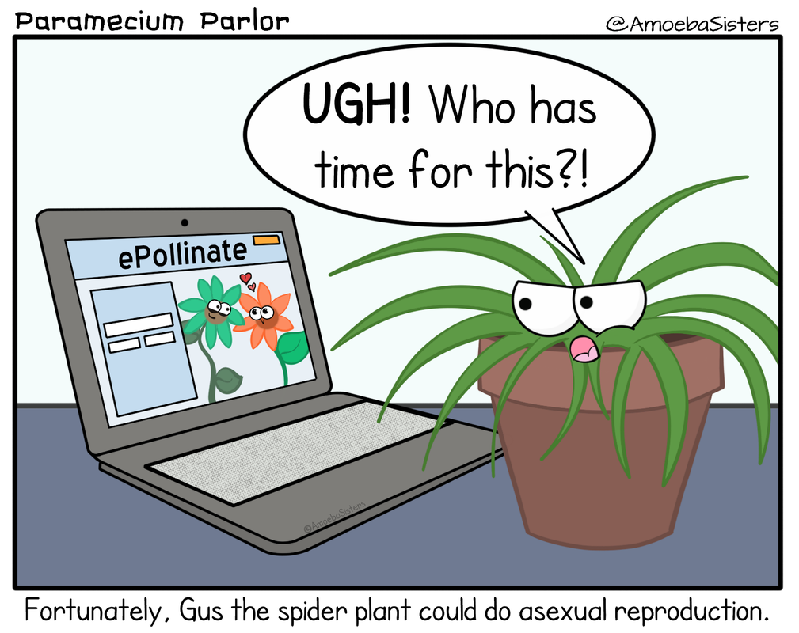
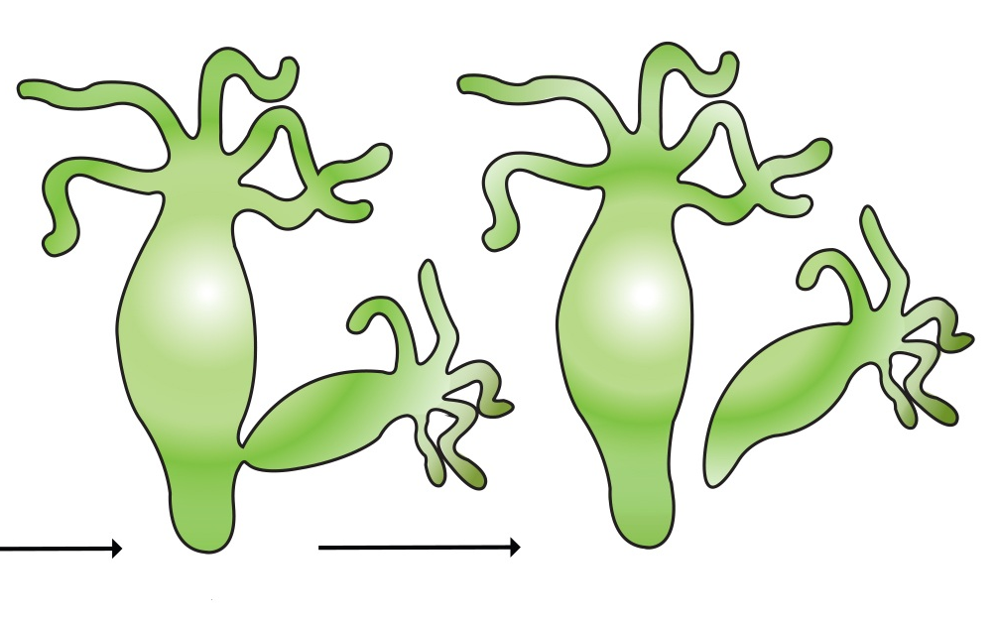

Slide 21
Asexual Reproduction in Plants
A plant continues to grow throughout its life. The rapidly growing tips of roots and stems contain specialized reproductive cells called meristem. At a certain time these cells will specialize into cells that make up roots, stems and leaves. If parts of the plant are damaged, the meristem cells make repairs.
Clones can be made from cuttings of a plant, because the meristem cells can specialize to reproduce the different parts needed to make a new plant.
Asexual reproduction can produce many plants very quickly. This is an advantage in places where the environment doesn't change very much (bacteria).
By building a large population of organisms very quickly the species is able to thrive. The great disadvantage is that when the environment changes, all of the organisms will die, if they do not have the ability to adapt to the change.

Slide 22
Sexual Reproduction
Sexual reproduction usually involves two individual organisms. The offspring that are produced from this union have a mix of characteristics, half from one parent and the other half from the other parent.
Sexual reproduction does not always involve male and female parents, but can have specialized gametes
Many organisms are capable of both sexual and asexual reproduction
Sexual reproduction has the advantage of providing lots of variation within a species, helping it to survive when the environment changes.
The main disadvantage is that this process takes a lot of energy. This means that they can only produce small populations.

Slide 23
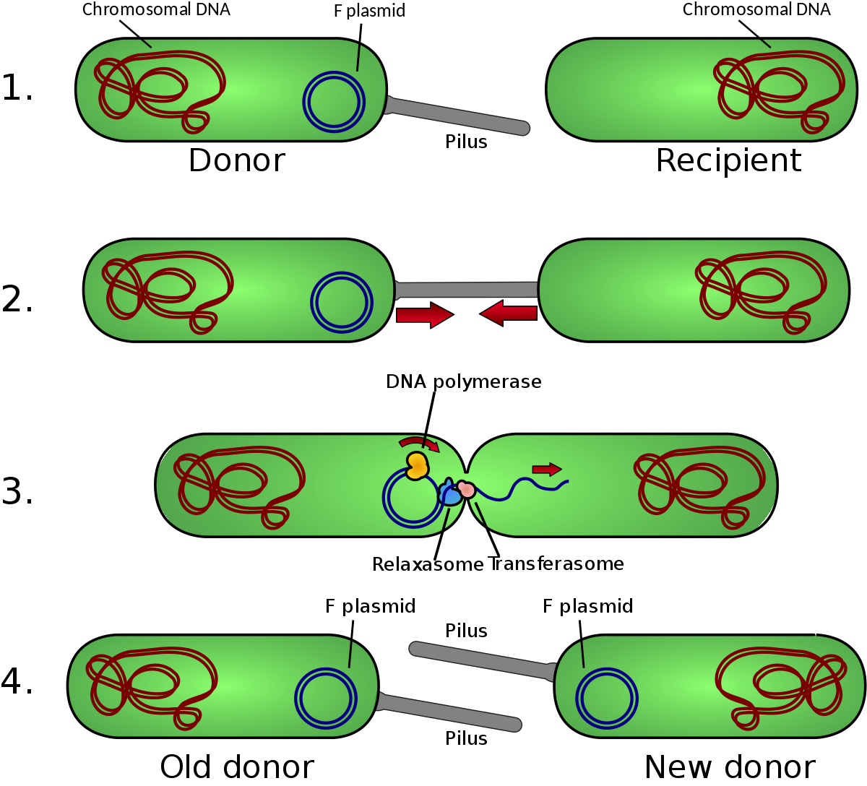
Primitive Sexual Reproduction
Bacteria are able to transfer genetic material directly from one cell to another through a process called bacterial conjugation.
It is a primitive form of sexual reproduction, since two parent cells are involved. The benefit is that new combinations of inherited characteristics may result.
Although this process is not actually reproduction, because there is no increase in the number of cells, it does result in genetic recombination.
The newly created cell can then divide by binary fission, to create identical cells with the new genetic material.

Slide 24
Sexual Reproduction in Plants
Sexual reproduction in plants involves gametes as well, male gametes and female gametes joining, during fertilization, to produce a zygote and then an embryo.
Most plants produce both male and female gametes, while some produce one or the other only
Pollen contains the male gametes and is found on the stamen. Ovules contain the female gametes and are found in the pistil. Pollination occurs when pollen is transferred from the anther of the stamen to the stigma of the pistil.

Slide 25
Sexual Reproduction in Plants
Cross-pollination occurs when pollen from one plant is carried to the stigma of another plant by wind, water or animals (bees or butterflies). Cross-fertilization occurs when a grain of the pollen forms a long tube (pollen tube), which grows down the style into the ovary.
The gametes unite to produce a zygote, which then develops into an embryo. This usually happens inside a seed, which protects the embryo and provides food (cotyledon) for the embryo when growing conditions are right. Plants which are produced, as a result of cross-fertilization, are not identical to either plant.

Slide 27
Plants can Reproduce Sexually and Asexually
Sponges and hydra are organisms that can produce both sexually and asexually.
Most plants that produce seeds can also reproduce asexually (cuttings, runners). Depending on the environmental conditions the amount of energy varies, enabling the plant organism to control its population.
Vegetative Reproduction - is the reproduction of a plant not involving a seed, including; cuttings, runners, suckers, tubers. (coleus plant, spider plants, strawberries, aspen, potatoes)
Mosses produce asexual spores in the early part of their life cycle and then egg and sperm cells are produced in a later part of the same cycle.

Slide 28
Sexual Reproduction in Animals
Sexual reproduction in animals involves gametes. The male gametes are called sperm cells, and the female gametes are called egg cells (ova).
During mating, the sperm cell and the egg cell unite to form a fertilized combination of cells called a zygote. This zygote is the first of many cells of a new individual.
This zygote will begin to divide into two cells and this continues to be repeated over and over resulting in the development of an embryo.
This embryo develops into a multi-cellular organism inside the female (in most mammals) or, outside (in an egg shell) in other animals.

Slide 30
Topic 4
Wearing your Genes

Slide 31
Genetics
Key Terms:
Genes
Continuous Variation
Discrete Variation
Dominant
Recessive
Mutagen
Mutation
Know These Terms

Slide 32
Types of Variation
Inherited (heritable) characteristics are those traits which are passed on to offspring directly from their parents. These traits are passed on by way of the genetic material that is combined from the parents during the process of sexual reproduction.
Heritable traits include, structural and distinguishing characteristics, such as eye color, hair type, skin color and earlobes.

Slide 33
Types of Variation
Continuous variations are differences in characteristics that have a range of possible variations, such as height, shoe size, hand span, skin color, hair color, etc.
Discrete variations are differences in characteristics that have a definite form, with a limited number of possibilities. This includes those individuals, within a species, that have either one characteristic, or the single, other variation, of the characteristic. Examples include: tongue rolling ability, blood groups, earlobe attachment, hairline, etc.

Slide 34
Activity – Page 38: Observing Human Characteristics

Slide 35
Dominant or Recessive
Traits are passed on from parents to offspring during sexual reproduction. Some of these traits are dominant and some are recessive.
When they are mixed, a dominant trait will show up in the offspring.
The frequency of a particular characteristic does not indicate whether it is dominant or recessive.
Frequency varies from population to population. A dominant trait, such as having six fingers, is relatively rare.

Slide 36
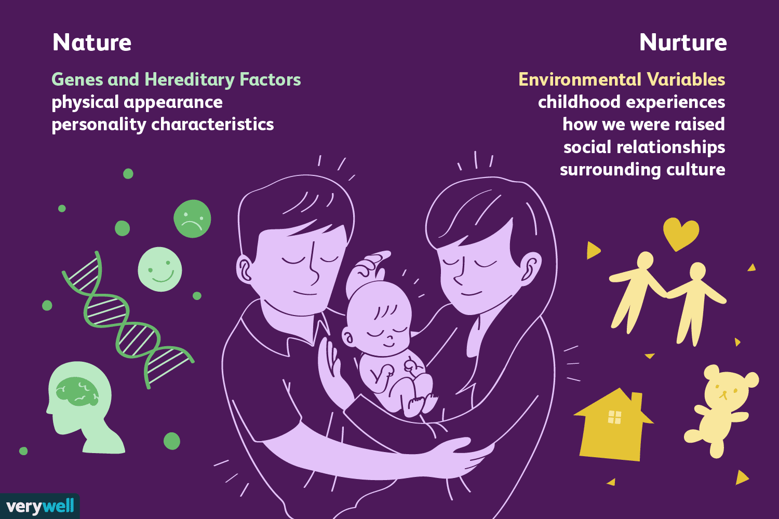
Nature vs Nurture
Not all characteristics are inherited. Some depend entirely on the environment.
Non-inherited characteristics are acquired and not necessarily passed on from generation to generation. Athleticism, artistic ability, leadership qualities are all learned during the early years of life.
Some variations may be influenced by interactions with the environment. These variations are also non-inherited

Slide 37
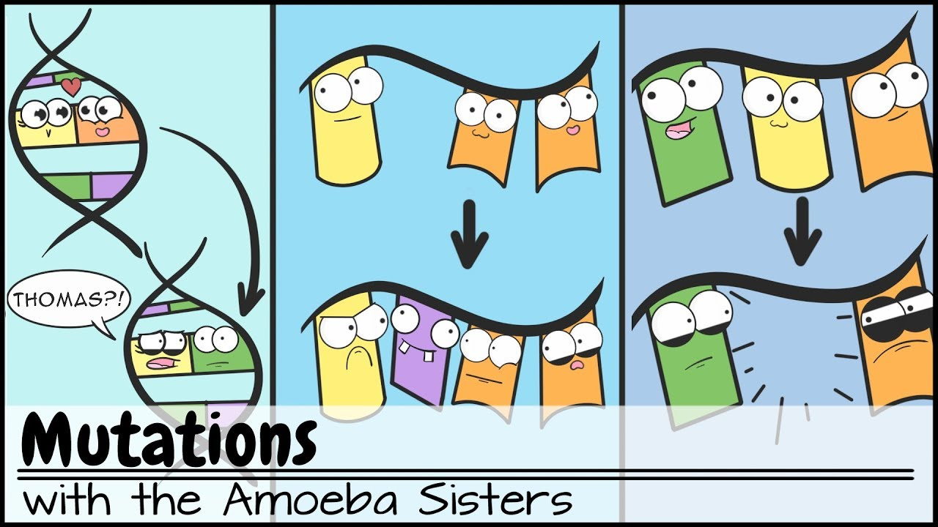
Mutations
Factors in the environment, or random events can change genetic information contained in DNA. These changes are called mutations, and can cause changes in the structure of organisms, including people.
Mutagens, such as X-rays, ultraviolet rays, cosmic rays and some chemicals can cause mutations to occur – some that have little visible effects and some that have dramatic effects. Some mutations can cause cancer, which promote rapid cell division and impair full normal cell development.
The cancerous cells can interfere with other cells and prevent certain processes from occurring as they should. If mutations occur in the DNA of reproductive cells, the changes can be passed on from the parent to the offspring, increasing the variation within a species.

Slide 38
Topic 5
When Plans Change

Slide 39
DNA
Key Terms:
DNA
Chromosomes
Gene
Somatic Cells
Biotechnologies
Mitosis
Meiosis
Know These Terms

Slide 40
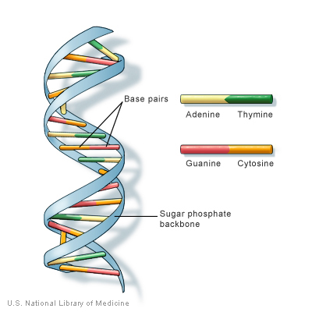
What is DNA?
DNA (deoxyribonucleic acid)
Function
Controls all the structures and functions of the cell
Responsible for the variation between and among species
Passed from parent to offspring
Reproduces itself

Slide 41
What does DNA look like?
Structure
Shape of a coiled ladder (known as a double helix)
Sides of the helix are made of alternating sugars and phosphates
The rungs of the ladder are made up of nitrogen (N) bases
-There are 4 N bases: adenine (A), thymine (T),
cytosine (C), guanine (G)
The sequence of these bases (letters) forms a code
The code controls the production of proteins in cells
Proteins control how a cell is formed and it’s function

Slide 42
Somatic Cells

Slide 43
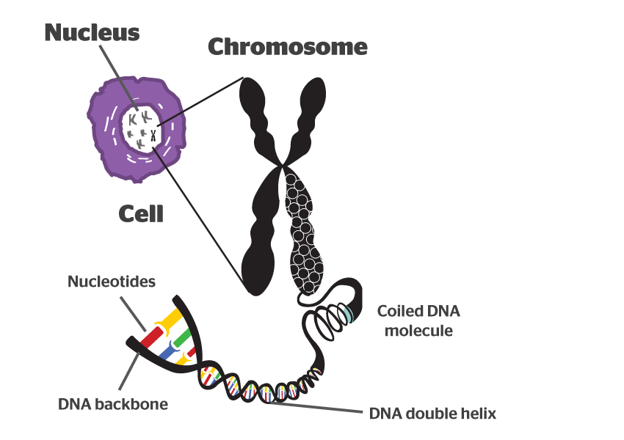
Chromosomes
Chromosome:
Tightly packed strands of DNA
Every human cell contains 23 pairs of chromosomes or 46 chromosomes in total
One copy of each chromosome comes from each parent

Slide 44
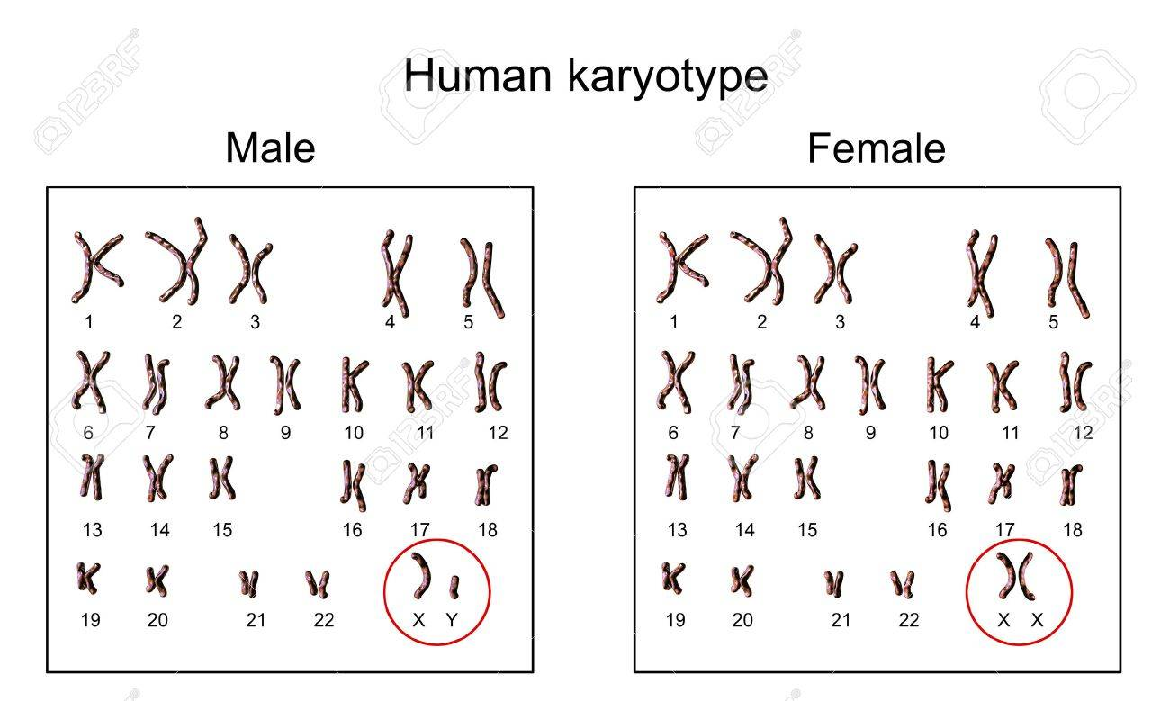

Slide 45
Mitosis
Normal Cell Division (Mitosis)
Somatic cells must be replaced for growth, repair, and development
Before a cell divides, a copy of each chromosome is made
After the cell divides, each new cell has a complete set of chromosomes
The two new cells are genetically identical (see p. 50)

Slide 46
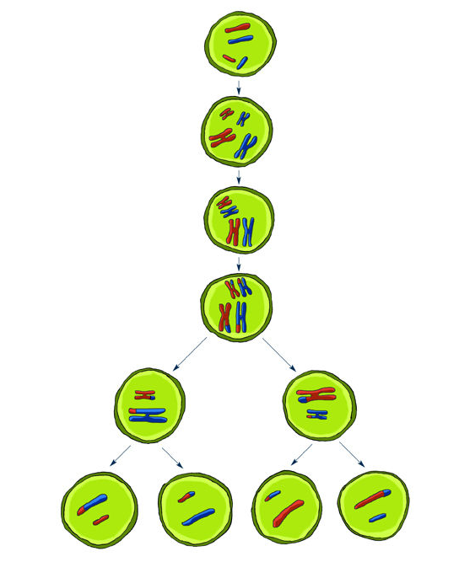
Meiosis
Sex Cell Division (Meiosis)
Meiosis is the process of forming new gametes (sex cells)
Gametes (sperm and eggs) have only 23 chromosomes
When combined, the zygote has 23 pairs or 46 chromosomes
Like mitosis, chromosomes are duplicated and the cell divides
During a second cell division, the chromosomes are separated (see p. 51)
The process of randomly dividing 23 pairs of chromosomes results in 8.4 million different combinations!
Sexual reproduction increases variation within a species

Slide 47
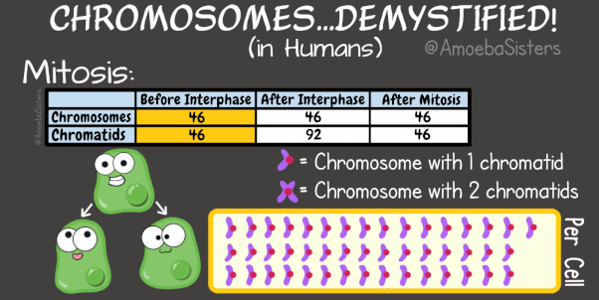
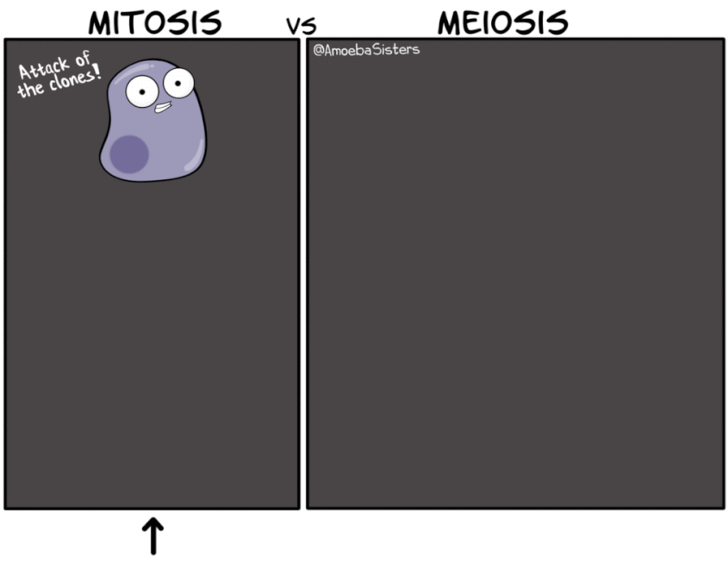
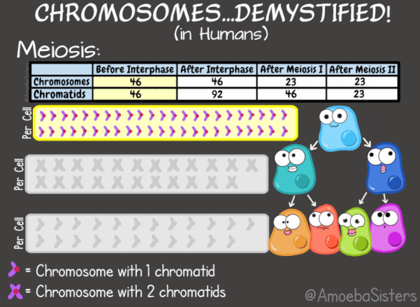

Slide 48
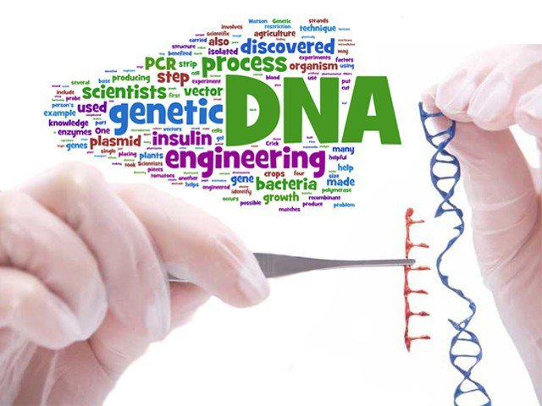
Technology and Variation
Moving pieces of one strand of DNA to other cells is a relatively new technique that has emerged.
In the science of genetics, genetic engineering has enabled scientists to create individuals within a species with desirable traits.
Biotechnologies are beginning to become controversial, now that the genetic code for many species has been unraveled.

Slide 49
Biotechnology and Medicine
One of the first uses of modern biotechnology was to move the human gene for insulin into bacteria. By doing this, bacteria were able to produce large quantities of insulin in a relatively short time, as a waste product, which then was collected and used by diabetes patients.
Bacteria are not the answer to everything, but they have motivated scientists to think about other more complex possibilities. Genetically modified, or transgenic, mammals are produced by adding human genes to the fertilized eggs of the mammal.
Offspring that develop grow up with the human gene that can produce complex proteins, collected in the milk produced, purified and then used in the treatment of many human conditions, including iron deficiency, emphysema, hemophilia and blood clotting.

Slide 50
Biotechnology in Food Production
Genetic engineering has become an important technique for producing food, such as fish. Aquaculture is becoming an increasingly important method of fish farming mass production.
Disease resistance genes, growth hormones and even antifreeze genes enable fish farmers to increase their yield with less chance of disease, in a shorter amount of time, and at all times of the year.
But what happens if these ‘special’ fish make it out into the natural fish population?
Will the natural populations of fish be able to compete with them?

Slide 51
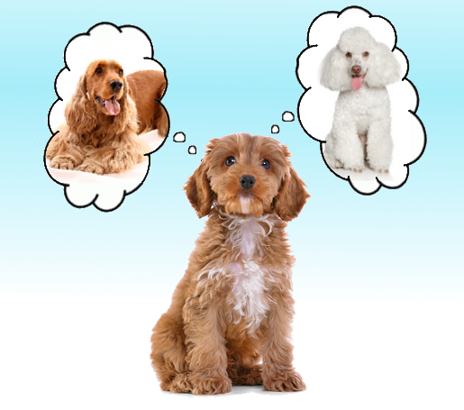
Pure Bred vs Hybrid
To produce purebred organisms, a breeder would choose pure bred parents, those parents whose ancestors have produced only the desired characteristic they want (true-breeding).
If a breeder chooses two different 'true-breeds' then a hybrid would be produced.
Examples???

Slide 52
Investigation – Page 55
Genetically Engineered Foods

Slide 53
Topic 6
The Best Selection

Slide 54
Selection
Key Terms:
Domestic
Artificial Selection
Natural Selection
Selective Breeding
Know These Terms

Slide 55
Artificial Selection in Agriculture
The process of intervention to produce more desirable organisms has been going on for some time. This process takes a long time to see results - usually many generations.
Farmers, dog and horse breeders, along with scientists can now speed up the artificial selection process by using 'low-tech' or 'high-tech' technologies.
Plant breeding is an important part of agriculture. Selective breeding programs bring positive characteristics of two different varieties together to create a new variety that has more desirable characteristics.
A good example is what was done to produce Western Red Spring Wheat. The flour from this grain is used to make pan bread.
Canadian Western Durum is good for making pasta. Other varieties have also been engineered for specific purposes, such as resistance to disease, length of time to mature, resistance to extreme temperatures (hot or cold), and even taste.

Slide 56
Natural Selection – Charles Darwin
The diversity of life in the Galapagos Islands helped Darwin explain his theory of natural selection. It can be summed up in four statements:
All organisms produce more offspring than can possibly survive.
There is incredible variation within each species.
Some of the variations increase the chances of an organism surviving to reproduce.
Over time, variations passed on through offspring lead to changes in the genetic characteristics of a species.

Slide 57
Natural Selection – Charles Darwin
Natural selection happens when factors in the environment determines, or ‘selects’ which individuals, within a species, will be able to survive.
If they are able to live long enough to reproduce, then those individuals with their ‘survival adaptations (characteristics) will have offspring with similar survival characteristics.
These observations and conclusions were supported by another biologist Alfred Wallace.
The Galapagos finches provide the best example of this theory – how the fittest, or best-adapted, organisms for a specific environment survive.

Slide 59
Topic 7
The Sixth Extinction

Slide 60
Extinction
Key Terms:
Biological Indicators
Extinction
Extirpation
Know These Terms

Slide 61
Video – the 6th Extinction

Slide 62
Extinction vs Extirpation
Extinction is the disappearance of every individual of a species from the entire planet. It is a natural part of the Earth's history.
Scientists estimate that 99% of species that have ever existed on the Earth are now extinct (many by mass extinction - sudden environmental change, like the Ice Age). Most extinction take place over long periods of time, but the rate of extinctions is rising, and this is reducing the biological diversity of our planet.
Extirpation is a local extinction, or the disappearance of a species from a particular area.
Most extinctions and extirpations today are caused by human activity, such as habitat destruction

Slide 63
Biological Indicators
As a bio indicator species, the Grizzly Bear helps us to determine the human impact on an ecosystem. This large carnivore’s ability to survive or disappear is historically a sign that human interference in an ecosystem is occurring or not.
Activity – Page 68

Slide 64
Topic 8
Pains and Gains

Slide 65
Our Role in Preserving Biodiversity
Key Terms:
Seed banks
Global Treaties
CITIES
Conservation
Know These Terms

Slide 66
Svalbard Seed Vault

Slide 67
The Role of Zoos
The Calgary Zoo is known as one of the finest zoos in the world. It now is home to over 1100 species, including endangered species such as the Whooping Crane and the Siberian Tiger.
Besides being home to a diverse group of animals and plants, the Zoo is an educational institution that runs school programs for K-12 students. It is also part of a worldwide network that is attempting to protect and preserve endangered species.
Animal exchange programs help to increase the genetic diversity essential to species survival. Support for research is also a large part of their program. Zoos are visible evidence of our attempt to preserve and maintain biological diversity.

Slide 68
A Global Effort
The 1995 Canadian Biodiversity Strategy was created to preserve biodiversity in Canada. It will be done through the cooperation of many levels of government, along with many groups, agencies and individuals, who are dedicated to preserving our bio-diverse future.
Protected Areas (National Parks, Provincial Parks, game preserves, natural areas)
Restoration Programs for Ecosystems and Species (Governments and Nature Conservancy of Canada programs to purchase land for species habitat renewal, individual landowners giving habitat back - in the form of a naturally protected area, Ducks Unlimited CARE program, Swift Fox - restoration of a species - extirpated from Canada and now recovering)
Resource Use Policies (Laws - National Accord for the Protection of Species at Risk - Species at Risk Act - Wildlife Act, 1998)

Slide 69
A Global Effort
Controlling the Introduction and Spread of Exotic Species (Information and teaching about the invasiveness of an exotic species is communicated to the public on a regular basis. Penalties and fines, as well as loss of desirable areas for recreational purposes, has improved the perception of the negative effect an exotic species can have on a local ecosystem.)
Global Treaties: 1975 Convention on International Trade of Endangered Species (CITES) is aimed at preventing endangered plants and animals from being imported or exported. It is illegal to buy or sell animals or animal parts identified for protection by CITES.
1992 Convention on Biodiversity was signed by 180 countries to set up and maintain protected areas for threatened and endangered species.
Canadian Wildlife Federation and Canadian Nature Foundation educate the public about biodiversity issues and lobby the government to conserve our Canadian biodiversity.

