Slide 1
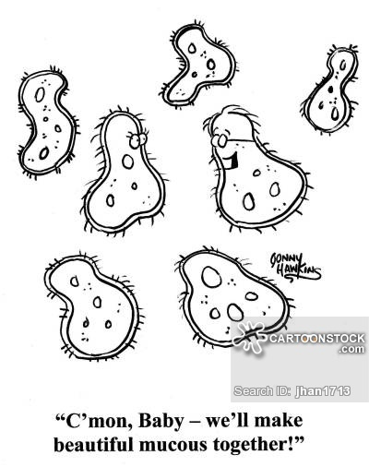
Reproduction and Human Development
R Redding
RWS
Biology 30
Unit B
Chapters 14 & 15

Slide 2
Chapter 14 – The Continuance of Life
14.1 The Male and Female Reproductive Systems
Both the male and female reproductive systems include a pair of gonads. The gonads (testes and ovaries) are the organs that produce reproductive cells: sperm in males and eggs in females.
The male and female reproductive cells are also called gametes.
The gonads also produce sex hormones. Sex hormones are the chemical compounds that control the development and function of the reproductive system.

Slide 3
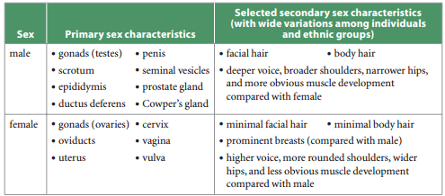
Continued…
The structures that play a direct role in reproduction are called the primary sex characteristics.
Males and females also have a distinct set of features that are not directly related to reproductive function. These are known as secondary sex characteristics.

Slide 4
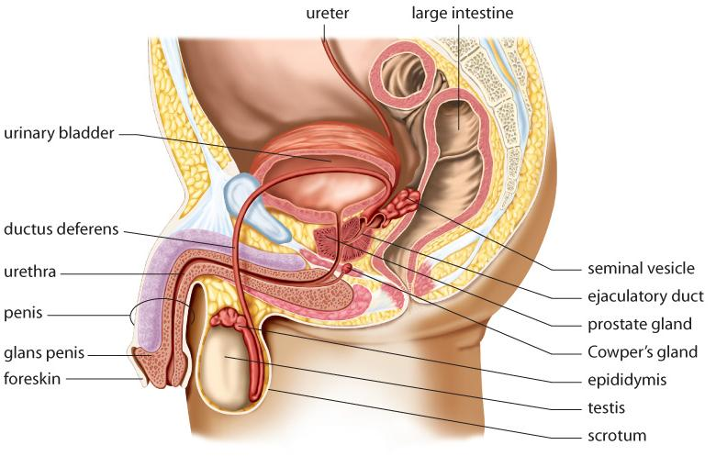
Structures & Functions of the Male Reproductive System
The male reproductive system includes organs that produce and store large numbers of sperm cells (male gametes)
Some of the male reproductive structures are located outside the body, and others are located inside the body. Why?

Slide 5
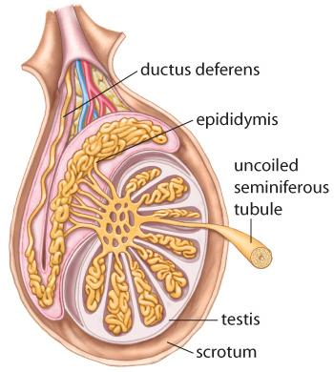
The Testes
The two male gonads are called the testes. The testes are held outside the body in a pouch of skin called the scrotum.
the testes are composed of long, coiled tubes, called seminiferous tubules, as well as hormone-secreting cells, called interstitial cells, that lie between the seminiferous tubules.
The interstitial cells secrete the male hormone testosterone. The seminiferous tubules are where sperm are produced

Slide 6
Continued…
Developing sperm are supported and nourished by Sertoli cells, which are also located in the seminiferous tubules.
From each testis, sperm are transported to a nearby duct called the epididymis.
Within each epididymis, the sperm mature and become motile. The epididymis is connected to a storage duct called the ductus deferens which leads to the penis via the ejaculatory duct.

Slide 7
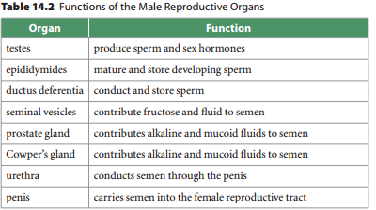
Seminal Fluid
. The seminal vesicles produce a mucus-like fluid that contains the sugar fructose, which provides energy for the sperm.
The prostate gland and Cowper’s gland also secrete mucus-like fluids, as well as an alkaline fluid to neutralize the acids from urine in the urethra.
The combination of sperm cells and fluids is called semen.

Slide 8
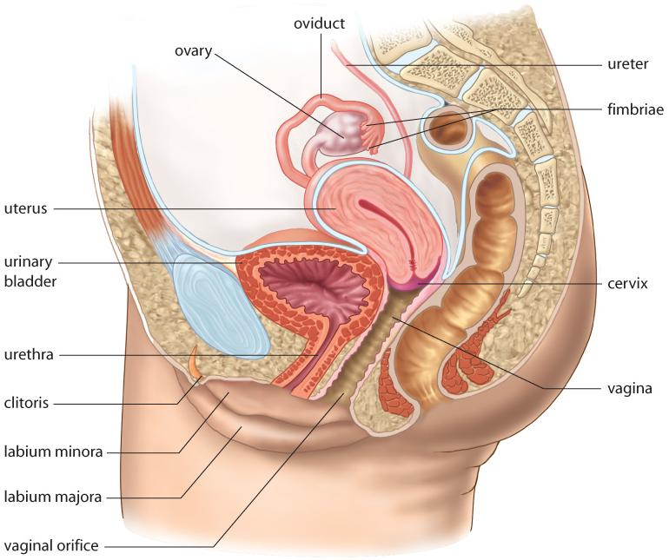
Structures & Functions of the Female Reproductive System
The two female gonads, or ovaries, produce only a limited number of gametes. The female gametes are called eggs, or ova.
Most of the structures of the female reproductive system are located inside the body.

Slide 9
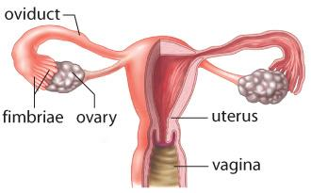
Continued…
The ovary contains specialized cell structures called follicles. A single ovum develops within each follicle.
Each month, a single follicle matures and then ruptures, releasing the ovum into the oviduct. This event is called ovulation.
Thread-like projections called fimbriae continually sweep over the ovary.
When an ovum is released, it is swept by the fimbriae into a cilia-lined tube about 10 cm long called an oviduct.

Slide 10
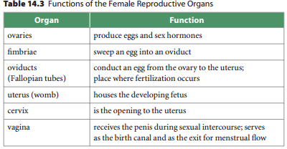
The Uterus and Vagina
The uterus is a muscular organ that holds and nourishes a developing fetus. The uterus is normally about the size and shape of a pear, but it expands to many times it’s size.
The lining of the uterus, called the endometrium, is richly supplied with blood vessels to provide nutrients for the fetus.
At its upper end, the uterus connects to the oviducts. At its base, the uterus forms a narrow opening called the cervix. The cervix, in turn, connects to the vagina.

Slide 11
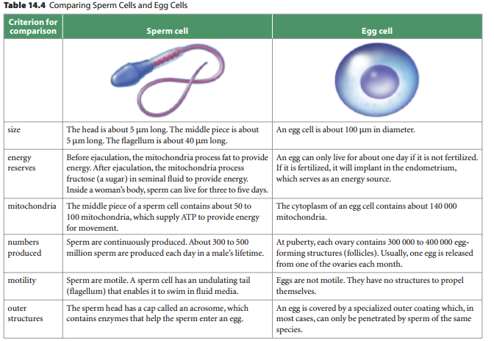

Slide 12

Homework:
Re-Read this section for review
Make note of any key terms or new terminology
Complete the Section 14.1 review on Page 485: Questions 1-4, 7-8

Slide 13
Chapter 14 – The Continuance of Life
14.2 The Effect of STIs on the Reproductive Systems
An infection that is transmitted only or mainly by sexual contact is generally known as a sexually transmitted infection, or STI.
STIs may be caused by viruses, bacteria, and parasites. STIs of greatest concern are those caused by viruses and bacteria.
The most common viral STIs are HIV/AIDS, hepatitis, genital herpes, and human papilloma virus (HPV).
The most common bacterial STIs are chlamydia, gonorrhea, and syphilis.

Slide 14
HIV/AIDS
The acronym AIDS stands for acquired immunodeficiency syndrome.
AIDS is caused by a group of related viruses that are collectively called human immunodeficiency virus, or HIV.
HIV attacks a particular form of white blood cell known as helper T cells, which form part of the immune system.
As the level of helper T cells in the blood decreases, the infected person becomes more vulnerable to infections that may lead to sickness and death in people who are diagnosed with acute AIDS.

Slide 15
Hepatitis
The group of diseases known as hepatitis includes three types of viral infections: hepatitis A, B, and C.
Hepatitis A is usually contracted by drinking water that is contaminated with fecal material. As well, it can be transmitted through oral or anal contact.
Hepatitis B is spread in the same way as HIV—through sexual contact or through other contact with infected body fluids or blood. For this reason, hepatitis B is considered to be an STI.
Hepatitis C is transmitted through blood to blood contact with infected needles or syringes.

Slide 16
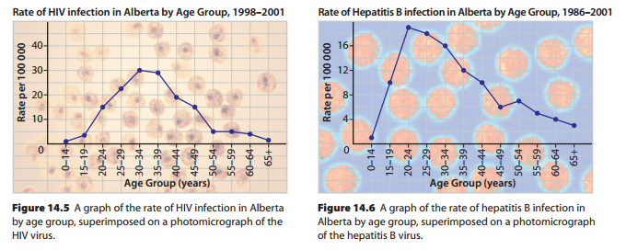

Slide 17
Genital Herpes
Genital herpes is an extremely common viral STI.
The Canadian health system does not maintain statistics on rates of herpes infection.
Based on international data, however, researchers estimate that almost one in three sexually active people in Canada has genital herpes and this number is rising.
Genital herpes is a viral STI that is caused by one of two herpes viruses: herpes simplex 1 (HSV 1) or herpes simplex 2 (HSV 2).
HSV 2 is more likely to be acquired through genital contact, causing genital herpes. HSV 1 commonly causes infections of the mouth (such as cold sores), but also causes genital infections

Slide 18
Human Papilloma Virus (HPV)
The group of viruses known as human papilloma virus (HPV) is responsible for a condition known as genital warts. Like herpes, HPV infection is very common in North America.
It is transmitted by skin-to-skin contact. (Many people who are infected with HPV develop flat or raised warts around the genital area.
Many others, however, show no symptoms. Because the direct symptoms of an HPV infection are not always obvious, many people carry the virus without knowing it.
This is a health concern because HPV can lead to more serious disorders.

Slide 19
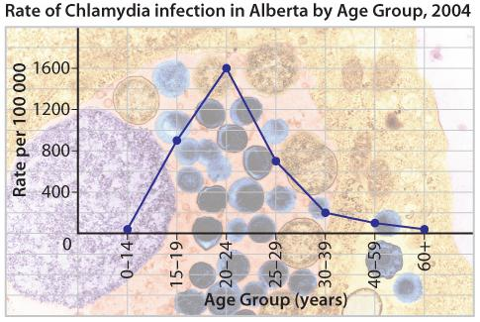
Chlamydia
Chlamydia is a potentially dangerous infection caused by the bacterium Chlamydia trachomatis. It is the most common bacterial STI in Canada, with more than 55 000 new cases reported each year.
People between the ages of 15 and 24 account for the majority of new cases. The rate of infection in young women is more than twice the rate in young men.

Slide 20
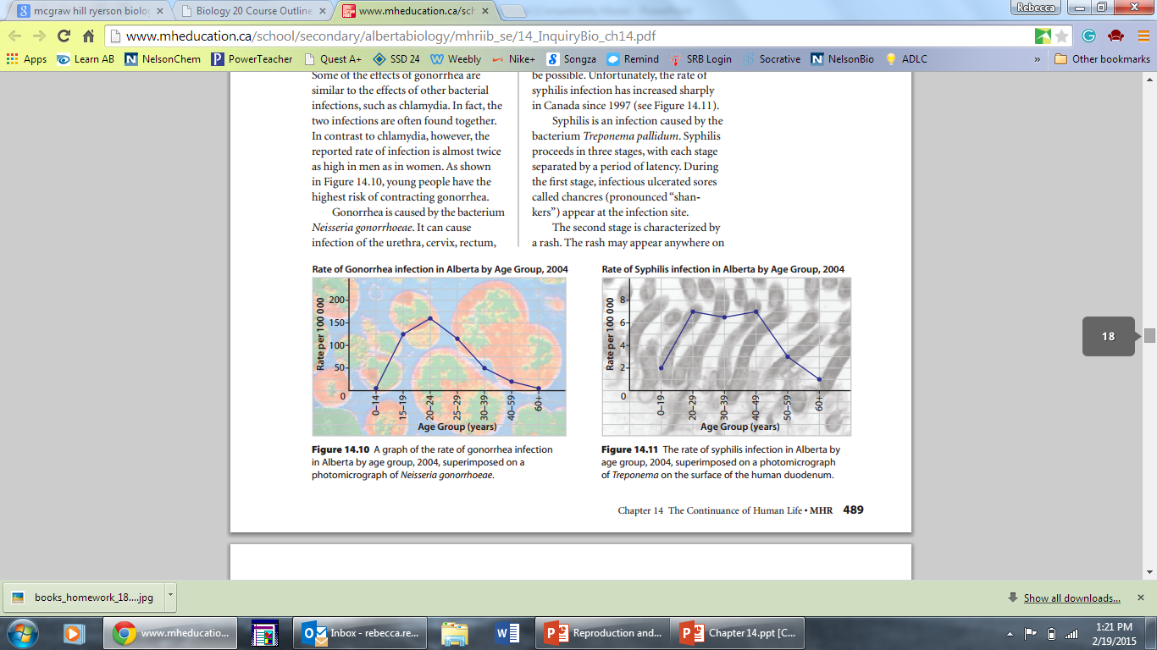
Gonorrhea
Gonorrhea is the second most widespread bacterial STI in Canada. Some of the effects of gonorrhea are similar to the effects of other bacterial infections, such as chlamydia. In fact, the two infections are often found together. In contrast to chlamydia, however, the reported rate of infection is almost twice as high in men as in women.

Slide 21
Syphilis
Syphilis is the least common of the three bacterial STIs.
Until very recently, health practitioners thought that eliminating syphilis completely in Canada would be possible.
Unfortunately, the rate of syphilis infection has increased sharply in Canada since 1997

Slide 22
Homework:
Re-Read this section for review
Make note of any key terms or new terminology
Thought lab 14.1: STI Project – presenting to the class!
Complete the Section 14.2 review on Page 491: Questions 1-5

Slide 23
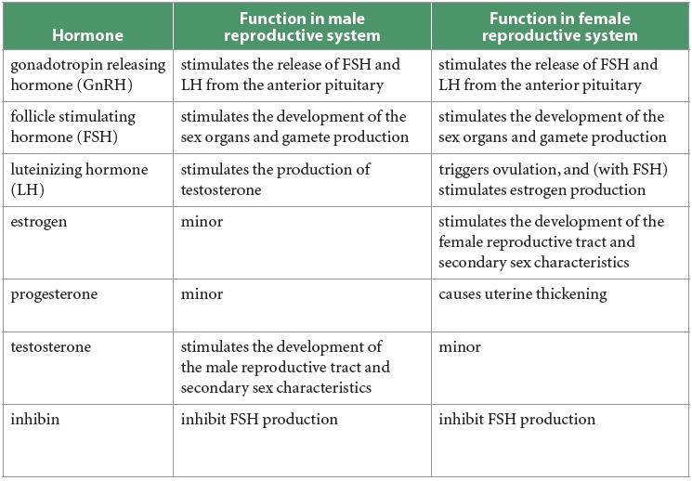
Chapter 14 – The Continuance of Life
14.3 Hormonal Regulation of the Reproductive System

Slide 24
Sex Hormones and the Male Reproductive System
The development of the male sex organs begins before birth.
In embryos that are genetically male, the Y chromosome carries a gene called the testis-determining factor (TDF) gene.
The action of this gene triggers the production of the male sex hormones.
The presence of androgens initiates the development of male sex organs and ducts in the fetus.

Slide 25
Maturation of the Male Reproductive System
Puberty is the period in which the reproductive system completes its development and becomes fully functional.
Most boys enter puberty between 10 and 13 years of age, although the age of onset varies greatly. At puberty, a series of hormonal events lead to gradual physical changes in the body.
These changes include the final development of the sex organs, as well as the development of the secondary sex characteristics.
Puberty begins when the hypothalamus increases its production of gonadotropin releasing hormone (GnRH).

Slide 26
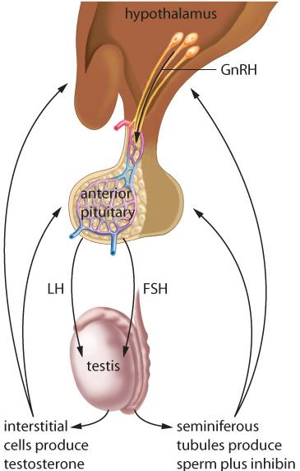
Continued…
GnRH acts on the anterior pituitary gland, causing it to release two different sex hormones: follicle stimulating hormone (FSH) and luteinizing hormone (LH).
In males, these hormones cause the testes to begin producing sperm and to release testosterone. Testosterone acts on various tissues to complete the development of the sex organs and sexual characteristics.

Slide 27
Hormonal Regulation of the Male Reproductive System
As you can see, the release of GnRH from the hypothalamus triggers the release of FSH and LH from the anterior pituitary. FSH causes the interstitial cells in the testes to produce sperm.
At the same time, FSH causes cells in the seminiferous tubules (where sperm are produced) to release a hormone called inhibin. Inhibin acts on the anterior pituitary to inhibit the production of FSH.
A similar feedback loop maintains the secondary sex characteristics. LH causes the testes to release testosterone, which promotes changes such as muscle development and the formation of facial hair. As well, testosterone acts on the anterior pituitary to inhibit the release of LH.

Slide 28
Aging and the Male Reproductive System
A man in good health can remain fertile for his entire life. Even so, most men experience a gradual decline in their testosterone level beginning around age 40. This condition is called andropause.
In some men, the hormonal change may be linked to symptoms such as fatigue, depression, loss of muscle and bone mass, and a drop in sperm production.
However, some studies suggest that low doses of testosterone can help to counter the symptoms of andropause.

Slide 29
Sex Hormones and the Female Reproductive System
Like a baby boy, a baby girl has a complete but immature set of reproductive organs at birth. North American girls usually begin puberty between 9 and 13 years of age.
The basic hormones and hormonal processes of female puberty are similar to those of male puberty. A girl begins puberty when the hypothalamus increases its production of GnRH.
This hormone acts on the anterior pituitary to trigger the release of LH and FSH. In girls, FSH and LH act on the ovaries to produce the female sex hormones estrogen and progesterone.
These hormones stimulate the development of the female secondary sex characteristics and launch a reproductive cycle that will continue until about middle age.

Slide 30
Hormonal Regulation of the Female Reproductive System
In humans, female reproductive function follows a cyclical pattern known as the menstrual cycle. The menstrual cycle ensures that an ovum is released at the same time as the uterus is most receptive to a fertilized egg.
The menstrual cycle is usually about 28 days long, although it may vary considerably from one woman to the next, and even from one cycle to the next in the same woman.
The menstrual cycle is actually two separate but interconnected cycles of events: One cycle takes place in the ovaries and is known as the ovarian cycle. The other cycle takes place in the uterus and is known as the uterine cycle.

Slide 31
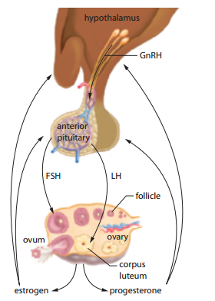
Continued…
The Ovarian Cycle In a single ovarian cycle, one follicle matures, releases an ovum, and then develops into a yellowish, gland-like structure known as a corpus luteum. The corpus luteum then degenerates.
The ovarian cycle can be roughly divided into two stages The follicular stage and the luteal stage. Ovulation marks the end of the follicular stage and the beginning of the luteal stage.

Slide 32
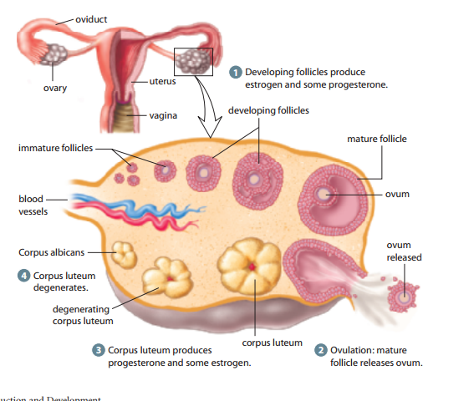
Continued…
A follicle matures by growing layers of follicular cells and a central fluid-filled vesicle. The vesicle contains the maturing ovum. At ovulation, the follicle ruptures and the ovum is released into the oviduct.
The follicle develops into a corpus luteum. If pregnancy does not occur, the corpus luteum starts to degenerate after about 10 days.
*Note that the follicle goes through all the stages in one place.

Slide 33
The Uterine Cycle
The uterine cycle begins on the first day of menstruation (which is also the first day of the ovarian cycle).
On this day, the corpus luteum has degenerated and the levels of the sex hormones in the blood are low.
As a new follicle begins to mature and release estrogen, the level of estrogen in the blood gradually increases.
Beginning around the sixth day of the uterine cycle, the estrogen level is high enough to cause the endometrium to begin thickening.

Slide 34
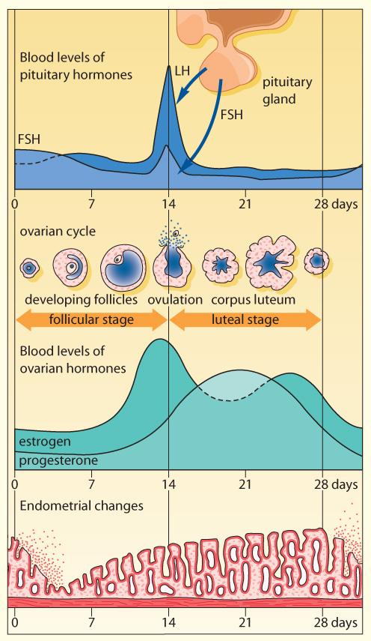
Continued…
After ovulation, the release of progesterone by the corpus luteum causes a more rapid thickening of the endometrium.
Between days 15 and 23 of the cycle, the thickness of the endometrium may double or even triple. If fertilization does not occur, the corpus luteum degenerates.
The levels of the sex hormones drop, the endometrium breaks down, and menstruation begins again.

Slide 35
Aging and the Menstrual Cycle
As hormone levels drop, a woman’s menstrual cycle becomes irregular. Within a few years, it stops altogether.
The end of the menstrual cycle is known as menopause. Among North American women, the average age of menopause is approximately 50, but menopause can begin earlier or later.
. Over the longer term, menopause is associated with rising cholesterol levels, diminishing bone mass, and increased risk of uterine cancer, breast cancer, and heart disease.
For these reasons, many women consider hormone replacement therapy (HRT) during or following menopause.

Slide 36
Homework:
Re-Read this section for review
Make note of any key terms or new terminology
Complete Investigation 14B: The Menstrual Cycle on page 500
Complete the Section 14.3 review on Page 502: Questions 1,3,4,6 and 8

Slide 37
Chapter 15 – Human Development
15.1 Fertilization and Embryonic Development
Biologists also use a complementary system to organize and describe developmental events before birth. This system uses two main periods of prenatal development:
The embryonic period of development: This period of development takes place over the first eight weeks, or the first two thirds of the first trimester. During this time, tremendous change takes place. Cells divide and become redistributed. Tissues and organs form, as do structures that support and nourish the developing embryo.
The fetal period of development: This period of development takes place from the start of the ninth week through to birth. It corresponds to the remaining third of the first trimester and all of the second and third trimesters. During the fetal period, the body grows rapidly and organs begin to function and coordinate to form organ systems.

Slide 38
Fertilization
Human development begins with fertilization. Fertilization involves the joining of male and female gametes to form a single cell that contains 23 chromosomes from each parent, for a total of 46 chromosomes.
When a sperm meets the corona radiata, the sperm’s enzyme-containing acrosome releases its contents. The enzymes digest a path through the corona and zona pellucida.
Meanwhile, the sperm advances farther by means of the lashing actions of its tail, many sperm are involved in this activity. The action of hundreds of sperm may be necessary to clear a path for the one sperm that is able to successfully enter the egg.
Once a sperm enters the egg, the egg’s plasma membrane depolarizes, preventing other sperm from binding with and entering it. A zygote forms

Slide 39
Cleavage and Implantation
This process of cell division without enlargement of the cells is called cleavage.
By the time the zygote is a sphere of 16 cells, it is called a morula. The morula reaches the uterus within three to five days after fertilization.
During this time, it begins to fill with fluid that diffuses from the uterus. As the fluid-filled space develops, two different groups of cells form. The entire spherical structure is now called a blastocyst.
The term blastocyst comes from two Greek words that mean “germ pouch.” Here, the word “germ” refers to cells from which new cells or tissues can develop. Thus, the blastocyst is a hollow structure—a “pouch”—from which new cellular structures can develop.
One group of cells, called the trophoblast, forms the outer layer of the blastocyst. The trophoblast will develop into a membrane called the chorion.
The chorion, in turn, will develop to form part of the placenta. The placenta is a structure that provides nutrients and oxygen to, and removes wastes from, the developing offspring.

Slide 40
Continued…
This nestling of the blastocyst into the endometrium is called implantation. Implantation is complete by the tenth to fourteenth day. With successful implantation, the woman is now said to be pregnant.
About the time that implantation begins, the trophoblast starts to secrete a hormone called human chorionic gonadotropin (hCG). hCG has the same effects as luteinizing hormone (LH), it maintains the corpus luteum past the time when it would otherwise degenerate.
As a result, the secretion of estrogen and progesterone continues, maintaining the endometrium and preventing menstruation

Slide 41
Gastrulation and the Start of Tissue Formation
During the second week, as the blastocyst continues and completes the process of implantation, the inner cell mass changes. A space begins to form between the inner cell mass and the trophoblast. This space, called the amniotic cavity, will soon fill with fluid and is the place where the baby will develop.
At first, the embryonic disk consists of two layers: an outer ectoderm, which is closer to the amniotic cavity, and an inner endoderm. Shortly after, a third layer, called the mesoderm
The process of forming these three layers is called gastrulation, and the three layers are called the primary germ layers. The developing embryo is now called the gastrula.

Slide 42
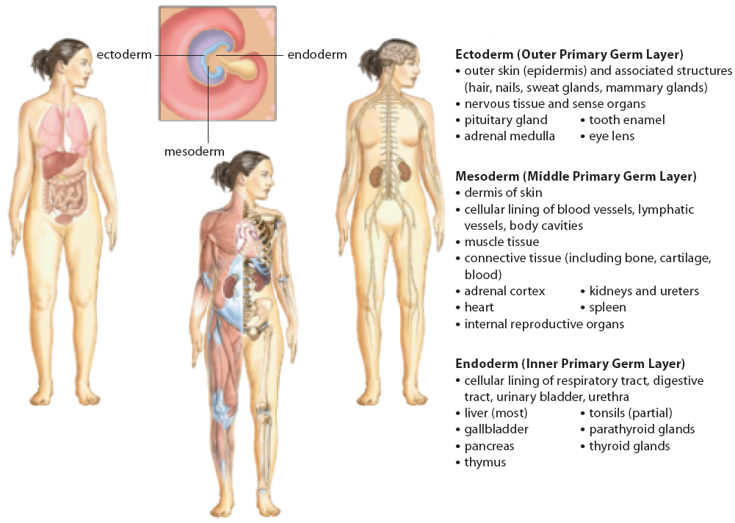
Neurulation & Organ Formation
Between the third and eighth weeks, the organs form. With each passing day, different rates of cell division in the primary germ layers cause tissues to fold into distinct patterns. Gradually, the three-layered embryo is transformed.

Slide 43
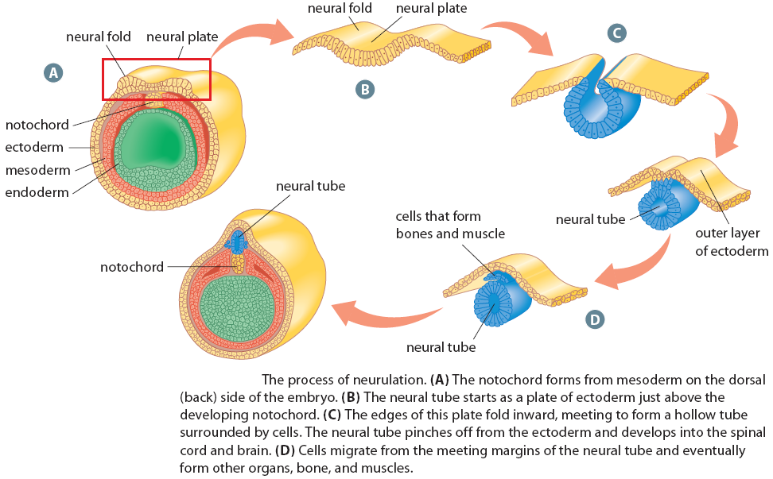

Slide 44
Structures That Support the Embryo
The internal organs of the embryo form between the third and eighth weeks. At the same time, an intricate system of membranes that are external to the embryo are also forming.
These extra-embryonic membranes: the allantois, amnion, chorion, and yolk sac.
The extra-embryonic membranes, along with the placenta and umbilical cord that develop from some of them, are responsible for the protection, nutrition, respiration, and excretion of the embryo (and, later, the fetus).

Slide 45
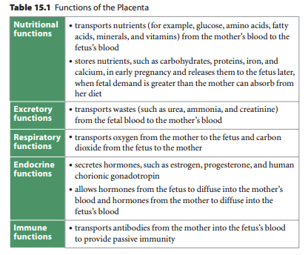
The Placenta and Umbilical Cord
The placenta is a disk-shaped organ that is rich in blood vessels. The embryo (or fetus) is attached to the uterine wall by the placenta, and metabolic exchange occurs through it. The placenta is fully developed by about 10 weeks, with a mass of about 600 g.
Near the end of the eighth week, as the yolk sac shrinks and the amniotic sac enlarges, the umbilical cord forms. The umbilical cord is a rope-like structure that averages about 60 cm long and 2 cm in diameter. Used for gas exchange.

Slide 46
Homework:
Re-Read this section for review
Make note of any key terms or new terminology
Complete the Section 15.1 review on Page 518: Questions 1-6, 8 and 9

Slide 47
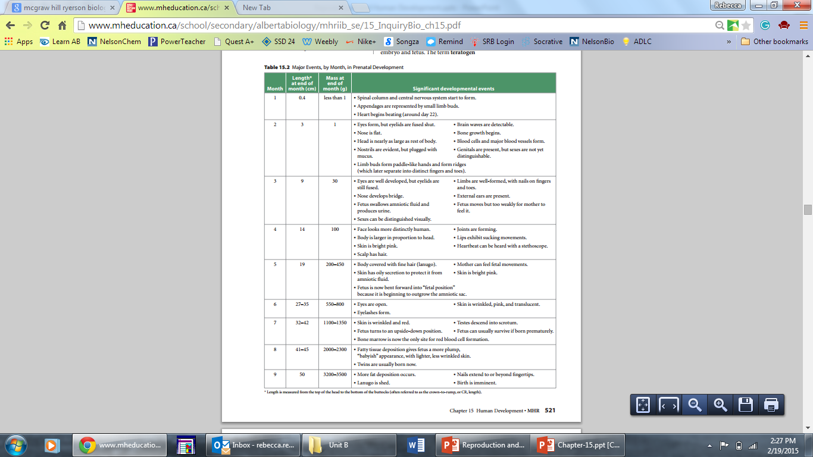
Chapter 15 – Human Development
15.2 Fetal Development and Birth

Slide 48
Chapter 15 – Human Development
15.2 Fetal Development and Birth

Slide 49
Chapter 15 – Human Development
15.2 Fetal Development and Birth

Slide 50
The Effects of Teratogens on Development
Many substances and conditions can affect the normal development of the embryo and fetus. The term teratogen refers to any agent that causes a structural abnormality due to exposure during pregnancy.
Cigarette smoke, for example, can constrict the fetus’s blood vessels, preventing the fetus from getting enough oxygen. Mothers who smoke or who are exposed to second-hand smoke during pregnancy tend to have babies that are underweight. Cigarette smoke during pregnancy also increases the risk of premature births, stillbirths, and miscarriages

Slide 51
Parturition: Delivery of the Baby
The birthing process is called parturition, and all the events associated with parturition are commonly referred to as labour.
These events typically begin with uterine contractions. The uterus experiences contractions throughout pregnancy. At first, these are light, lasting about 20 to 30 seconds and occurring every 15 to 20 minutes. Near the end of pregnancy, the contractions become stronger and more frequent.
The onset of labour is marked by uterine contractions that occur every 15 to 20 minutes and last for 40 seconds or longer.

Slide 52
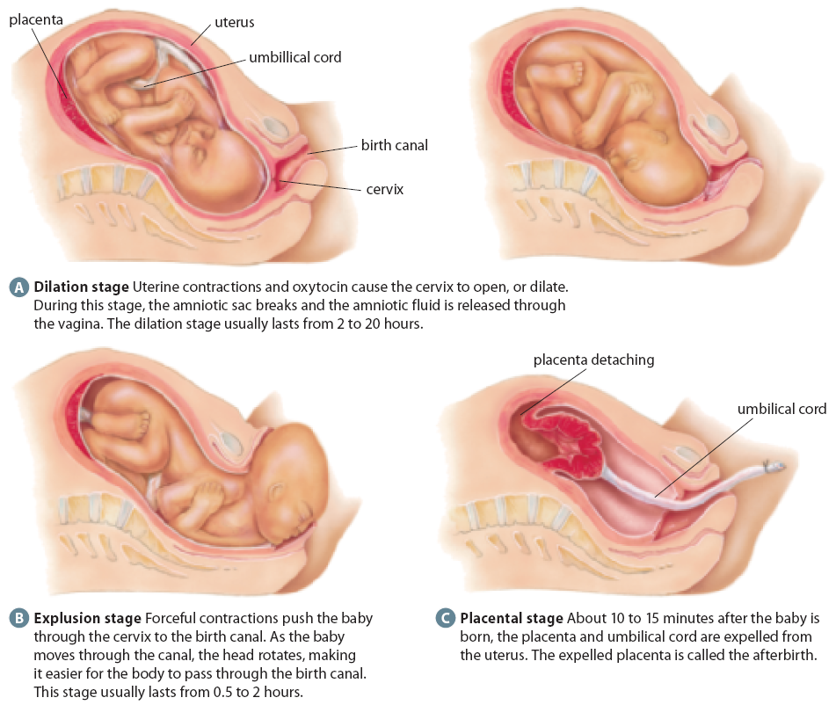
For several reasons, it may not be safe or possible to deliver a baby in the usual way.
For example, the baby may be in a rump-first position. It is difficult for the cervix to expand enough to accommodate this type of birth (called a breech birth), and the baby or mother could be harmed. Instead, the baby is usually delivered by a Caesarean section.
In this procedure, a physician makes an incision in the mother’s abdomen and uterus, and delivers the baby through the incision.
A mother with a sexually transmitted infection, such as herpes, or a mother with a small pelvis may also have her baby delivered by Caesarean

Slide 53
Homework:
Re-Read this section for review
Make note of any key terms or new terminology
Complete the Section 15.2 review on Page 528: Questions 1-6

Slide 54
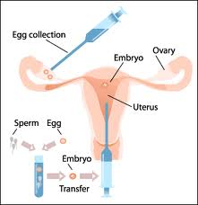
Chapter 15 – Human Development
15.3 Reproduction, Technology and Society
On July 25, 1978, Leslie Brown made history by giving birth to a healthy baby girl. Louise Joy Brown, born in Great Britain, was the world’s first “test tube baby.” Her life began in a laboratory.
Scientists removed an egg from her mother and mixed it with sperm from her father. After two and a half days, scientists placed the fertilized egg in Leslie’s uterus. Almost nine months later, Louise was delivered by Caesarean section.

Slide 55
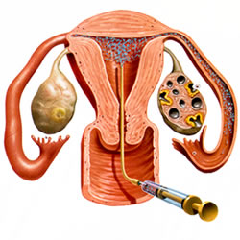
Technologies That Enhance Reproductive Potential
Artificial Insemination
Artificial insemination (AI) has been used for decades as a way to promote breeding success among domestic animals. It had also been used by human couples for years, before the first success of IVF.
Artificial insemination continues to be refined and is still useful when the man is sterile or infertile. In artificial insemination, sperm are collected and concentrated before being placed in the woman’s vagina.

Slide 56
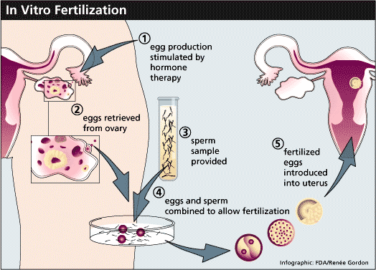
Technologies That Enhance Reproductive Potential
In Vitro Fertilization
As in the case of Leslie Brown, IVF offers a solution for women with blocked oviducts. Today, ultrasound machines are used to identify specific follicles that are close to ovulation.
Immature eggs can be retrieved directly from these follicles. The eggs are combined with sperm in laboratory glassware. After fertilization, the developing embryo is placed in the uterus

Slide 57

Technologies That Enhance Reproductive Potential
Surrogate Mothers
Sometimes, an infertile couple contracts another woman to carry a baby for them.
The woman who carries the baby is called the surrogate mother. Using AI or IVF, one or both gametes may be contributed by the contracting couple.

Slide 58
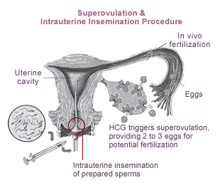
Technologies That Enhance Reproductive Potential
Superovulation
Superovulation is the production of multiple eggs as a result of hormone treatment. Women who ovulate rarely or not at all may receive treatment with hormones that stimulate follicle development and ovulation.
Superovulation is also often used in conjunction with other artificial reproductive technologies.

Slide 59
Technologies That Reduce Reproductive Potential
Abstinence
The surest way to avoid conceiving a child is simply not to have sexual intercourse. Complete abstinence also has the important advantage of ensuring almost total protection from STIs. Not all couples, however, are willing to abstain entirely from a sexual relationship.
Surgical Sterilization
both men and women can have surgery to make them infertile or sterile. In women, a procedure called a tubal ligation is used. Tubal ligation involves cutting the oviducts and tying off the cut ends. This ensures that the ovum never encounters sperm and never reaches the uterus. The ovum disintegrates in the oviduct.
The equivalent procedure in men is called a vasectomy. The ductus deferens is cut and tied. The man is still able to have an erection and ejaculate, but his semen does not contain any sperm

Slide 60
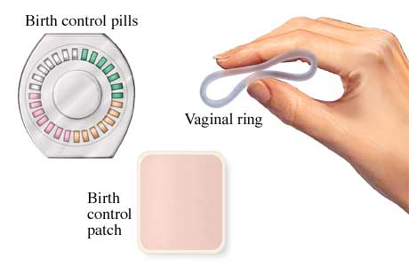
Technologies That Reduce Reproductive Potential
Hormone Treatments
Several contraceptive technologies work by changing the balance of reproductive hormones within a woman’s body. Hormone medications may be taken orally (through an oral contraceptive or birth control pill), by injection, or by implants inserted under the skin. The artificial hormones mimic the effect of progesterone and inhibit the release of FSH and LH from the anterior pituitary.

Slide 61
Technologies That Reduce Reproductive Potential
Physical or Chemical Barriers
Many contraceptive technologies are designed to prevent sperm from reaching the ovum. Physical barriers include male or female condoms, a latex cap—called a diaphragm—that fits over the cervix, and the contraceptive sponge. Spermicides—chemical barriers that kill sperm—include jellies, foams, and creams.
Natural Family Planning
Some couples refrain from sexual intercourse during the time of the woman’s cycle when she is most fertile. This is known as natural family planning or the rhythm method. Because a woman’s cycle can vary from month to month, the couple must pay careful attention to the subtle signals of the woman’s body, such as body temperature and the properties of the cervical mucus. This method is among the least reliable forms of birth control

Slide 62
Homework:
Re-Read this section for review
Make note of any key terms or new terminology
Complete the thought Lab 15.2 on page 533
Complete the Section 15.3 review on Page 534: Questions 1,3,4 and 5

