Slide 1
Photosynthesis and Cellular Respiration
Chapter 5 McGraw Hill Biology
Unit III
Curriculum Weighting – 15%
Redding - 2015

Slide 2
5.1: Matter & Energy Pathways in Living Systems
Photosynthesis
  Capturing and converting light energy from the sun
  Main product is carbohydrates which can be used or stored as fats or converted to starch
  Bi products are oxygen, ATP and heat
Cellular Respiration
  Releasing stored energy
  ATP is the source of energy for cellular activities

Slide 3
ATP! Responsible for a lot!
Active transport of ions and molecules
Moving chromosomes during cell division
Causing cilia and flagella to move
Causing muscles to contract
Synthesizing carbs, fats, proteins and nucleic acids

Slide 4
How does it do it?
ATP supplies energy when the third phosphate breaks off
It turns into ADP
For ADP to turn back into ATP energy is required to reattach a phosphate group
This happens thousands of times in a day!

Slide 5
Back to Photosynthesis…
The chloroplast
Site of photosynthesis - A typical leaf can have up to 500 000 of them per square millimeter!
They are bound by an inner and outer membrane
Fluid filled inner space, Stroma, concentrated area containing protein and other chemicals used in the making of carbohydrates

Slide 6
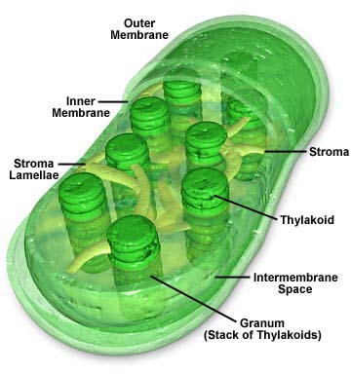

Slide 7
Within the Stroma…
The stroma contains interconnected, flattened sacs called thylakoid discs.
These are staked and form grana
Chlorophyll molecules are contained within the thylakoid membranes and help trap solar energy

Slide 8
The Mighty Mitochondria!
Site of cellular respiration
Contained in the cells of all eukaryotic organisms
This organelle allows organisms the ability to extract energy from their food
Like chloroplasts, they are bound by two membranes

Slide 9
Continued…
The inner membrane is fluid filled – matrix, it has numerous folds called cristae, which provide a large surface area for the production of ATP!

Slide 10
Metabolism
Enzymes catalyze cellular metabolism and energy production
Refers to chemical reactions that occur within a cell to support its life
There are two broad categories:
  Anabolic and Catabolic

Slide 11
Metabolism
Anabolic
Catabolic
Synthesize large molecules from small ones
Require energy
Must be activated to occur by a catalyst
Break down large molecules into smaller ones
Release energy
Must be activated to occur by a catalyst

Slide 12
Chemistry!
Remember this for later!
When an atom loses an electron, another atom but be gaining an electron!
Oxidation – Loss of electrons (LEO)
Reduction – Gain of electrons (GER)
Reduced atoms contain more energy than they do in their oxidized form

Slide 13
Summary
Why is ATP the energy currency of cells?
Define the term metabolism
What are the areas within a chloroplast?
What does chlorophyll do?

Slide 14
5.2: Photosynthesis Stores Energy in Organic Compounds
Plants produce structural and metabolic substances for their own use.
Humans have also found ways to take advantage of these properties

Slide 15
Photosynthesis
What plants make
What we them use it for
Poison
Fragrance
Protein
Cellulose
Oils and fats
Sucrose
starch
Pharmaceuticals
Perfume
Source of AA to construct human proteins
Fiber for clothing
Personal care products
Fast release source of energy
Slow release source of energy

Slide 16
Photosynthesis - Divided
Light dependent
Light independent
Generates ATP and NADPH (reduced nicotinamide adenine dinucleotide phosphate), high energy compounds
ATP and NADH are then used to reduce carbon dioxide to make glucose into starch for storage

Slide 17
Light Dependent Reactions:
Within the thylakoid membrane is chlorophyll, which absorbs solar energy
The thylakoid discs are divided into two photosystems (PS1 and PS2); they are named because of the order they were discovered not the order they occur in!
Each Photosystem contains a molecule that accepts electrons (chlorophyll ‘a’), called a reaction center

Slide 18
Continued…
When a reaction center has received the energy passing onto it, an electron in the center becomes ‘excited’ (raised to a higher energy level)
This electron is then passed to an electron accepting molecule which becomes reduced (GER!)
Page 173 of your text has a great illustration! Lets have a look!

Slide 19
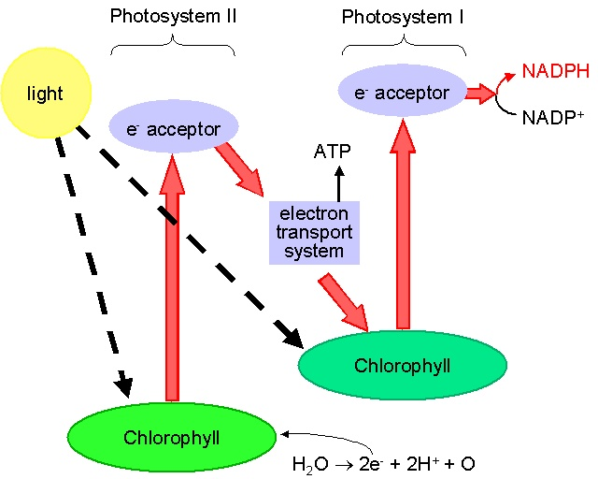

Slide 20
Exercise
Review and summarize the 4 steps of the light independent reactions of photosynthesis
Teach some one in class!
  Pick a partner and explain what you know about it, then have them re-explain the process to you showing what they know about the light independent reactions!

Slide 21
Making ATP: Chemiosmosis
Hydrogen cannot diffuse back across the membrane of stroma from the thylakoid membrane because the membrane is impermeable to the charge
A special structure called ATP Synthase provides a pathway for hydrogen!
  In turn the hydrogen helps ADP become ATP – chemiosmosis!

Slide 22
Light Independent Reactions
When there is a sufficient amount of ATP and NADPH in the stroma, the energy from these molecules can be used to synthesize glucose in the presence or absence of light
This occurs through the Calvin-Benson Cycle

Slide 23
Calvin-Benson Cycle:
Divided into three steps:
Fixing
  Carbon dioxide fixation
  Carbon is fixed to RuBP making a six carbon compound (unstable) which splits into two, 3 carbon compounds (stable)

Slide 24
Continued…
Reduction
  Newly formed three carbon compounds are in a low energy state – we need to convert them to high energy. We do this by activating them with ATP and reducing them with NADPH.
  The result is 2 molecules of PGAL (glyceraldehyde-3-phosphate) some (2) of which leave the cycle and go to make glucose. The rest stays and moves onto the next phase

Slide 25
Continued…
Replacing
  Most of the PGAL molecules (10) are then used to make RuBP.
  Energy supplied by ATP is required to break the bonds and reform the 5 carbon RuBP molecule
  Textbook page 177 illustrates this cycle!

Slide 26
Summary
Read page 177 and 179 – Quiz Soon!
Write down the bullets to help you remember the steps – teach someone!
Review Questions 5.2 – 1,2,4,6,7,9,11
  Due next class – I will be checking!

Slide 27
Part B – Cellular Respiration
Redding – 2012
Biology 20 – Unit III

Slide 28
Review
Photosynthesis reduces carbon dioxide to glucose
Hydrogen ions and electrons are chemically added to carbon dioxide to produce high energy molecules of glucose
Cellular respiration oxidizes glucose back to carbon dioxide, energy is released

Slide 29
Three pathways
There are three energy releasing pathways of cellular respiration and it depends on the organism as to which kind is carried out:
  Aerobic respiration
  Anaerobic respiration
  Fermentation

Slide 30
Lets take a look:
Aerobic
anaerobic
Oxic
Oxygen containing
Organisms that live in oxygen rich environments
Requires oxygen to produce ATP
Mostly eukaryotic
Anoxic
Lack of oxygen
Organisms that live in oxygen poor environments
Does not require oxygen to produce ATP
Mostly archaea and bacteria

Slide 31
Fermentation
Releasing energy from food sources
Anaerobic process but different from true anaerobic respiration
Mostly yeasts and bacteria but also occurs in muscle cells of animals

Slide 32
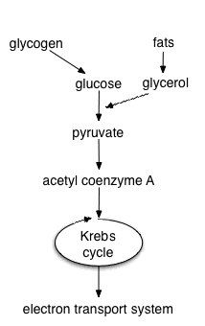

Slide 33
Examining Aerobic Respiration
Begins with glycolysis – occurs in the cytoplasm of cells, requires 2 ATP
Glycolysis is an anaerobic process which generates a small amount of ATP but the major product of glycolysis is pyruvate which contains a lot of energy that can later be used
If oxygen is not available to eukaryotic cells fermentation occurs

Slide 34
Continued...
When sufficient oxygen is present pyruvate is transported to the mitochondria where it is prepared (acetyl CoA) and goes into the Krebs cycle
The Krebs cycle takes acetyl CoA and transforms it into reduced NADH and FADH₂
These molecules supply high energy electrons to a transport chain which produces ATP and water (page 186)

Slide 35
Continued...
Lets draw the cycle
The purpose of the Krebs cycle is to transfer the energy stored in glucose
So Far:
  Glycolysis – generates pyruvate
  Krebs Prep – makes acetyl CoA
  Krebs – produces electrons and hydrogen ions for electron transport and releases CO2
      occurs in the matrix of the mitochondria

Slide 36
Last stage: electron transport system
Produces a large amount of ATP
The transport system causes the build up of ions creates a concentration gradient – the energy of this gradient is used to take ADP back to ATP through a process called chemiosmosis
Occurs in the intermembrane space of the mitochondria

Slide 37
Continued...
Electrons move from acceptor to acceptor until they reach oxygen (the final acceptor) this is why the process is called aerobic!
Without oxygen the whole process would ultimately fail because the previous electron acceptors would not be able to move their electrons and NADH and FADH2 would be unable to lose theirs!

Slide 38
Anaerobic Respiration
Sometimes oxygen is not available for cells to use. The production of a small amount of chemical energy from glucose in the absence of oxygen is called anaerobic respiration. Anaerobic respiration in muscles results in a build up of lactic acid. This produces a feeling of fatigue or burning sensation during hard exercise. Too much lactic acid can cause muscles to cramp and if it builds up in the heart can lead to severe pain or a heart attack.

Slide 39
Continued...
In eukaryotic organisms, anaerobic respiration provides energy for a very short period of time. It is often just an emergency measure until oxygen becomes available again. Brain and heart cells cannot survive long on the amount of energy produced by anaerobic respiration.
Page 189-90 (please read this paragraph)

Slide 40
Fermentation
Typically occurs in the cytoplasm of the cell – do not require an electron transport chain to make ATP
Includes glycolysis and one or two reactions that oxidize NADH to NAD+ by reducing pyruvate
Less efficient, only produces ATP during glycolysis

Slide 41
Two common types
Lactate
ethanol
Single celled organisms and animal cells use this when out of oxygen
Use NADH to convert pyruvate to lactate (lactic acid)
The resulting NAD+ is recycled and reused
Organisms that do not function aerobically
Pyruvate is converted to ethanol and carbon dioxide
Involves two steps
Conversion of pyruvate to a two carbon molecule and then to ethanol
NADH oxidizes to NAD+

Slide 42
Lactic Acid Fermentation
This occurs when there is oxygen debt in the body and the pyruvate builds up because it cannot be broken down by the krebs cycle fast enough
Lactic acid is converted back to pyruvate when the body recovers and oxygen supply is restored

Slide 43
Read and Practice
Page 191 and 193 cover the rest of fermentation
Read the Connections article on page 192
5.3 Review on page 194 is preceded by a summary of the section that you might find useful
5.3 review : Qu`s 2,4,5,7,8 and 9

