Slide 1
Chemical Reactions and Stoichiometry
Redding 2019
Chemistry 20

Slide 2
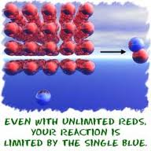
Chemical Reaction Equations
Limiting Reagents
A reactant whose entities are completely used during the reaction
Excess Reagents
A reactant whose entities are in surplus to what the reaction requires and therefore has left over once the reaction is completed

Slide 3
7.2 Gravimetric Stoichiometry
Finding unknown mass of reactant or product
You will study gas stoichiometry in the next section using temperature and pressures.
You will look at solution stoichiometry in the last section of this chapter which deals with concentration of solutions.

Slide 4
Steps to solving Gravimetric Stoichiometry Problems
Write a balanced chemical equation
List all of the variables you know and what you are solving for
Convert mass of measured substance into moles
Calculate amount of chemical substance required by doing a mole ratio
Convert the required number of moles into mass

Slide 5
Example:
If you decompose 1.00g of malachite (Cu(OH)2CuCO3), what is the mass of copper II oxide that would be formed?
Note: this compound breaks down into water and carbon dioxide as well.

Slide 6
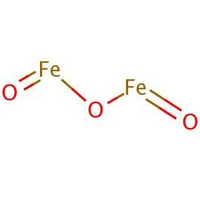
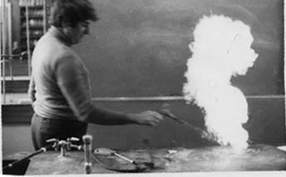
Problems:
Iron is most widely used metal in North America. It may be produced by the reaction of iron III oxide with carbon monoxide to produce iron metal and carbon dioxide. What mass of iron (II) oxide is required to produce 100.0 grams of iron metal?
Powdered Zinc metal reacts violently with sulphur when heated to produce zinc sulphide. Predict the mass of sulphur required to react 25grams of zinc

Slide 7
Calculating % Yield
Sometimes when performing a reaction the theoretical amount of substance you are supposed to get and the actual amount the experiment yields are two different numbers.
Both solutes and solvents may be gases, liquids, or solids, producing a number of different combinations
There are many factors that can affect your actual yield
When calculating % yield use the following calculation:

Slide 8
7.3 Gas Stoichiometry
The method of stoichiometry applies to all chemical reactions. This section extends to the stoichiometry of gases, using volume, pressure and temperature, molar volume and the ideal gas law.

Slide 9
Remember the steps!
Write
Write the balanced chemical equation
Write down
Write down what you know and what you are trying to find out
Convert
Convert the measured quantity to moles (chemical amount) using the appropriate equation
Calculate
Calculate the required chemical amount using a mole ratio
Convert
Convert the chemical amount to the final quantity requested using the appropriate formula

Slide 10
Problems:
If 275grams of propane burns in a gas barbecue, what volume of oxygen measured at STP is required for the reaction?
Hydrogen gas is produced when sodium metal is added to water. What mass of sodium is necessary to produce 20.0L of hydrogen at SATP?
Ammonia, which is widely used as fertilizer, is produced from the reaction of nitrogen and hydrogen, What volume of ammonia at 450 kPa and 80 degrees can be obtained from the complete reaction of 7.5kg of hydrogen?

Slide 11
7.4 Solution Stoichiometry
The method of stoichiometry applies to many chemical reactions. We are using concentration calculations and volume of solution equations as conversion factors in this section!

Slide 12
Recall from last class:
Write
Write the balanced chemical equation
Write down
Write down what you know and what you are trying to find out
Convert
Convert the measured quantity to moles (chemical amount) using the appropriate equation
Calculate
Calculate the required chemical amount using a mole ratio
Convert
Convert the chemical amount to the final quantity requested using the appropriate formula

Slide 13
Problems:
Solutions of ammonia and phosphoric acid are used to produce ammonium hydrogen phosphate fertilizer. What volume of 14.8mol/L ammonia is needed for the ammonia to react completely with 1.00kL of 12.9mol/L phosphoric acid to produce fertilizer?
A technician determines the amount concentration of a sulphuric acid solution. In the experiment a 10.00mL sample of the acid reacts completely with 15.9mL of 0.150mol/L potassium hydroxide solution. Calculate the amount concentration of the sulphuric acid

