Slide 1
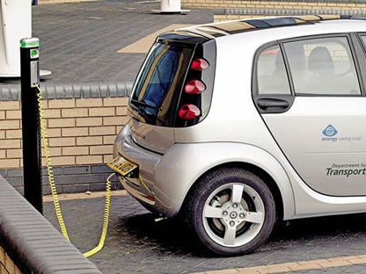
Electrochemical Cells
Reference: Chapter 14 (pg. 610-669)

Slide 2
Electrochemical Cells
Today’s objectives:
Define anode, cathode, anion, cation, salt bridge/porous cup, electrolyte, and voltaic cell
Predict and write the half-reaction equation that occurs at each electrode in an electrochemical cell

Slide 3
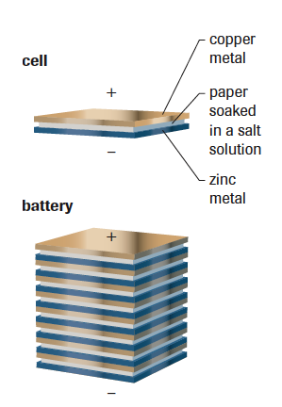
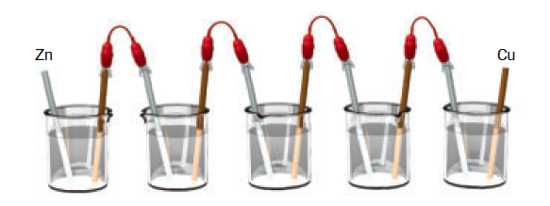
Introduction to Electrochemistry
An electric cell converts chemical energy into electrical energy
Alessandro Volta invented the first electric cell but got his inspiration from Luigi Galvani. Galvani’s crucial observation was that two different metals could make the muscles of a frog’s legs twitch. Unfortunately, Galvani thought this was due to some mysterious “animal electricity”. It was Volta who recognized this experiment’s potential.
An electric cell produces very little electricity, so Volta came up with a better design:
A battery is defined as two or more electric cells connected in series to produce a steady flow of current
Volta’s first battery consisted of several bowls of brine (NaCl_{(aq)}) connected by metals that dipped from one bowl to another
His revised design, consisted of a sandwich of two metals separated by paper soaked in salt water.

Slide 4
Introduction to Electrochemistry
Alessandro Volta’s invention was an immediate technological success because it produced electric current more simply and reliably than methods that depended on static electricity.
It also produced a steady electric current –something no other device could do.

Slide 5
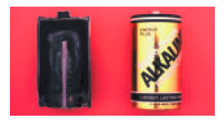
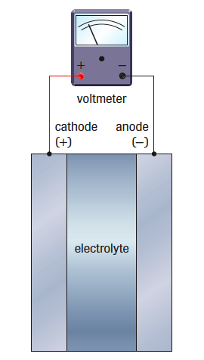
Introduction to Electrochemistry
Electric cells are composed of two electrodes – solid electrical conductors and at least one electrolyte (aqueous electrical conductor)
In current cells, the electrolyte is often a moist paste (just enough water is added so that the ions can move). Sometimes one electrode is the cell container.
The positive electrode is defined as the cathode and the negative electrode is defined as the anode
The electrons flow through the external circuit from the anode to the cathode.
To test the voltage of a battery, the red(+) lead is connected to the cathode (+ electrode), and the black(-) lead is connected to the anode (- electrode)

Slide 6
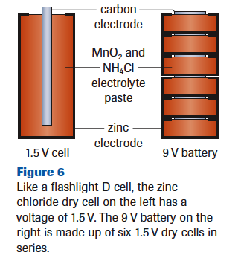
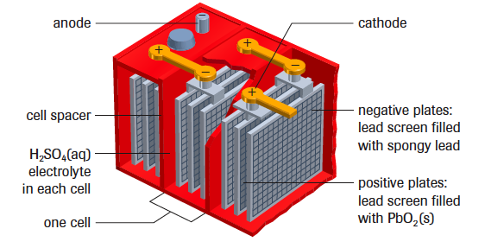
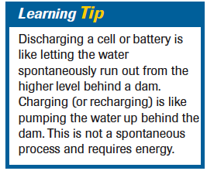
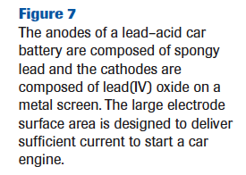
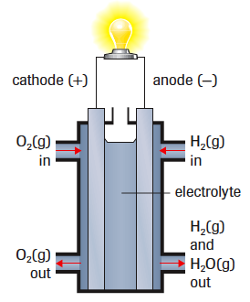
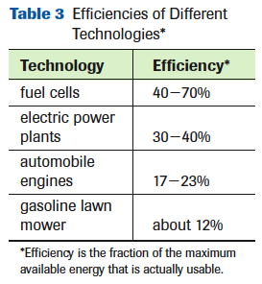
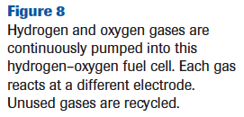
Secondary cells can be recharged using electricity, but are expensive
Primary cells cannot be recharged, but are relatively inexpensive
Fuel cells produce electricity by the reaction of a fuel that is continuously supplied.
More efficient, and used for NASA vehicles, but still too expensive for general or commercial applications

Slide 7
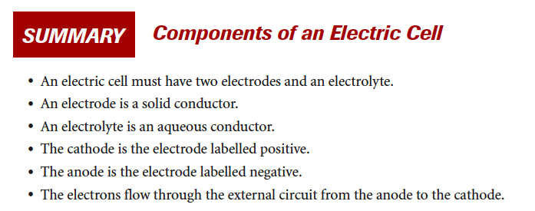

Slide 8
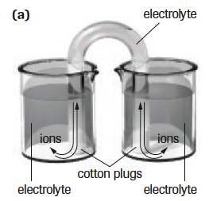
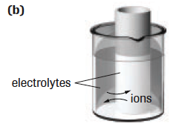
Voltaic Cells
A device that spontaneously produces electricity by redox
Uses chemical substances that will participate in a spontaneous redox reaction.
The reduction half-reaction (SOA) will be above the oxidation half-reaction (SRA) in the activity series to ensure a spontaneous reaction.
Composed of two half-cells; which each consist of a metal rod or strip immersed in a solution of its own ions or an inert electrolyte.
Electrodes: solid conductors connecting the cell to an external circuit
Anode: electrode where oxidation occurs (-)
Cathode: electrode where reduction occurs (+)
The electrons flow from the anode to the cathode (“a before c”) through an electrical circuit rather than passing directly from one substance to another
A porous boundary separates the two electrolytes while still allowing ions to flow to maintain cell neutrality
Often the porous boundary is a salt bridge, containing an inert aqueous electrolyte (such as Na₂SO_{4(aq)} or KNO_{3(aq)}),
Or you can use a porous cup containing one electrolyte which sits in a container of a second electrolyte.

Slide 9
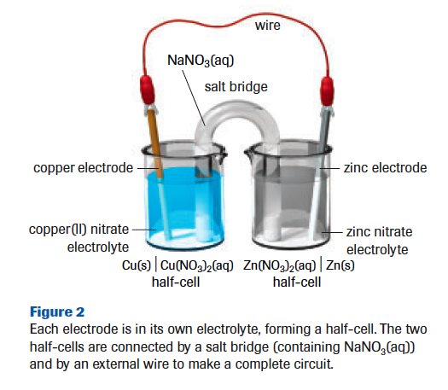
Voltaic Cells (aka Galvanic Cells)
Voltaic cells can be represented using cell notation:
The SOA present in the cell always undergoes reduction at the cathode
The SRA present in the cell always undergoes oxidation at the anode
The single line represents a phase boundary (electrode to electrolyte) and the double line represents a physical boundary (porous boundary)
RED CAT
AN OX

Slide 10
Create a cell notation to match the description
Copper placed in a solution of copper(II) chloride and tin metal placed in a solution of tin(II) ions
A copper-magnesium cell
Magnesium in a solution of magnesium chloride and tin in a solution of tin(II) chloride
A tin(IV) ion solution containing tin and a solution of magnesium ions containing magnesium
Two tin electrodes in solution of tin(II) chloride and tin (IV) chloride respectively
Copper place in a copper(II) solution and tin place in a tin(IV) solution

Slide 11
Voltaic Cells – What is going on?
Example: Silver-Copper Cell Cu_{(s)} Cu²⁺_{(aq)} Ag⁺_{(aq)} Ag_{(s)}
Use the activity series to determine which of the entities is the SOA.
The SOA present in the cell always undergoes a reduction at the cathode.
Write the reduction half reaction
Use the activity series to determine which of the entities is the SRA.
The SRA present in the cell always undergoes an oxidation as the anode.
Write the oxidation half-reaction
Balance the half-reactions and add together to create the net equation.
The cathode is the electrode where the strongest oxidizing agent present in the cell reacts.
The anode is the electrode where the strongest reducing agent present in the cell reacts.
Memory device:
“An ox ate a red cat”
Anode oxidation; reduction cathode

Slide 12
Example: Silver-Copper Cell
Silver ions are the strongest oxidizing agents in the cell, so they undergo a reduction half-reaction at the cathode, creating more Ag_{(s)}
Copper atoms are the strongest reducing agents in the cell, so they give up electrons in an oxidation half-reaction and enter the solution (Cu²⁺ ⁼ blue ions) at the anode.
Electrons released by the oxidation of copper atoms at the anode travel through the connecting wire to the silver cathode. (Ag⁺_{(aq)} win in the tug of war for e⁻’s over Cu²⁺_{(aq)})
Since the positive silver ions are being removed from solution, you would assume that the solution would become negatively charged. This does not happen. Why?
Cations (positively charged ions) move from the salt bridge into the solution in the cathode compartment to maintain an electrically neutral solution.
Anions (negatively charged ions) move from the salt bridge into the solution in the anode compartment to maintain an electrically neutral solution.
Voltaic Cells – What is going on?

Slide 13
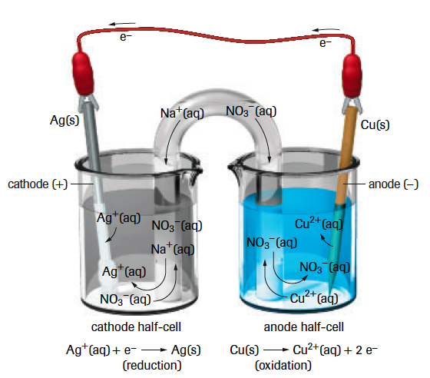
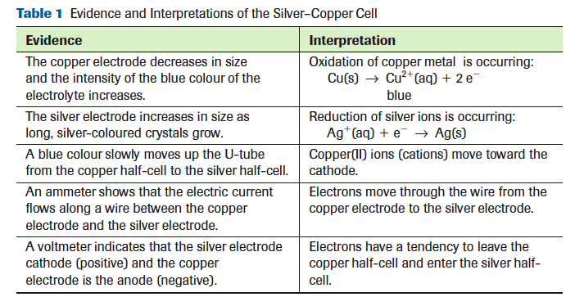
Voltaic Cell Animation

Slide 14
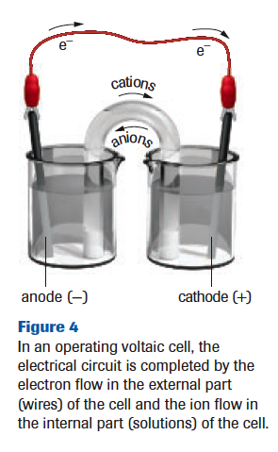
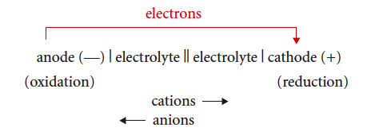
Voltaic Cell Summary
A voltaic cell consists of two-half cells separated by a porous boundary with solid electrodes connected by an external circuit
SOA undergoes reduction at the cathode (+ electrode) – cathode increases in mass
SRA undergoes oxidation at the anode (- electrode) – anode decreases in mass
Electrons always travel in the external circuit from anode to cathode
Internally, cations move toward the cathode, anions move toward the anode, keeping the solution neutral

Slide 15
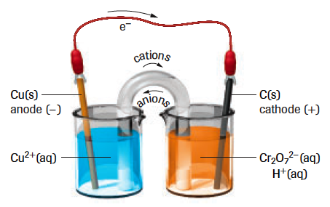
Voltaic Cells with Inert Electrodes
Inert electrodes are needed when the SOA or SRA involved in the reaction is not solid. If this is the case, usually a graphite (C_{(s)}) rod or platinum strip is used as the electrode.
Inert (unreactive) electrodes provide a location to connect a wire and a surface on which a half-reaction can occur.
Example: a) Write equations for the half-reactions and the overall reaction that occur in the following cell: C_{(s)} Cr₂O₇²⁻_{(aq)} H⁺_{(aq)} Cu²⁺_{(aq)} Cu_{(s)}
b) Draw a diagram of the cell labeling electrodes, electrolytes, the direction of electron flow and the direction of ion movement.
The copper electrode will decrease in mass and the blue colour of the electrolyte increases (Cu²⁺), which indicates oxidation at the anode.
The carbon electrode remains unchanged, but the orange colour of the dichromate solution becomes less intense and changes to greenish-yellow (Cr³⁺), evidence that reduction is occurring in this half cell

Slide 16
Electrochemical Cells
Today’s objectives:
Explain that the values of standard reduction potential are all relative to the E_{r} = 0.00 V set for the hydrogen electrode at standard conditions
Calculate the standard cell potential for electrochemical cells
Predict the spontaneity of redox reactions based on standard cell potentials

Slide 17
Standard Cells and Cell Potentials
A standard cell is a voltaic cell where each ½ cell contains all entities necessary at SATP conditions and all aqueous solutions have a concentration of 1.0 mol/L
Standardizing makes comparisons and scientific study easier
Standard Cell Potential, E⁰ cell = the electric potential difference of the cell (voltage)
E⁰ cell = E⁰_{r} cathode – E⁰_{r} anode
Where E⁰_{r} is the standard reduction potential, and is a measure of a standard ½ cell’s ability to attract electrons.
The higher the E⁰_{r} , the stronger the OA
All standard reduction potentials are based on the standard hydrogen ½ cell being 0.00V. This means that all standard reduction potentials that are positive are stronger OA’s than hydrogen ions and all standard reduction potentials that are negative are weaker.
If the E⁰ cell is positive, the reaction occurring is spontaneous.
If the E⁰ cell is negative, the reaction occurring is non-spontaneous

Slide 18
Rules for Analyzing Standard Cells
Determine which electrode is the cathode. The cathodes is the electrode where the strongest oxidizing agent present in the cell reacts.
I.e. The OA that is closet to the top on the left side of the redox table = SOA
If required, copy the reduction half-reaction for the strongest oxidizing agent and its reduction potential
Determine which electrode is the anode. The anode is the electrode where the strongest reducing agent present in the cell reacts.
I.e. The RA that is closet to the bottom on the right side of the redox table = SRA
If required, copy the oxidation half-reaction (reverse the half-reaction)
Determine the overall cell reaction. Balance the electrons for the two half reactions (but DO NOT change the E⁰_{r}) and add the half-reaction equations.
Determine the standard cell potential, E⁰_{cell} using the equation:
E⁰ cell = E⁰_{r} cathode – E⁰_{r} anode

Slide 19
Standard Cells and Cell Potentials #1
Example: What is the standard potential of the cell represented below:
Determine the cathode and anode
Determine the overall cell reaction
Determine the standard cell potential
Notes:
Cathode – copper
Anode – hydrogen
Ecell – 0.34Cathode – copper
Anode – hydrogen
Ecell – 0.34v

Slide 20
Standard Cells and Cell Potentials #2
Example: What is the standard potential of an electrochemical cell made of a cadmium electrode in a 1.0 mol/L cadmium nitrate solution and chromium electrode in a 1.0 mol/L chromium(III) nitrate solution?
Notes:
Cadmium SOA
Chromium SRA
Ecell +0.51V
Spontaneous

Slide 21
Standard Cells and Cell Potentials #3
Example: A standard lead-dichromate cell is constructed. Write the cell notation, label the electrodes, and calculate the standard cell potential.
Notes:
SOA – dichromate
SRA – lead
Ecell = +1.36

Slide 22
Standard Cells and Cell Potentials #4
Example: A standard scandium-copper cell is constructed and the cell potential is measured. The voltmeter indicates that copper the copper electrode is positive.
Notes:
SOA – copper
SRA – scandium
Ecell = -2.02

Slide 23
Electrochemical Cells
Today’s objectives:
Identify the similarities and differences between a voltaic cell and an electrolytic cell
Predict the spontaneity of redox reactions based on standard cell potentials.
Recognize that predicted reactions do not always occur.

Slide 24
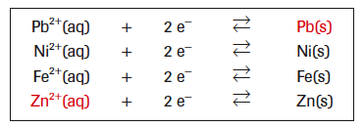
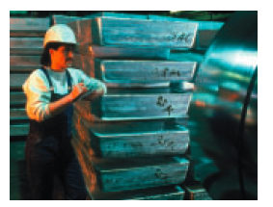
Electrolytic Cells
The term “electrochemical cell” is often used to refer to a:
Voltaic Cell – one with a spontaneous reaction
SOA over SRA on the activity series
Eº_{cell} greater than zero = spontaneous
Electrolytic cell – one with a nonspontaneous reaction
SOA below SRA – i.e. zinc sulfate and lead solid cell
Eº_{cell} less than zero= nonspontaneous
Why would anyone be interested in a cell that is not spontaneous?
This would certainly not a good battery choice, but by supplying electrical energy to a nonspontaneous cell, we can force this reaction to occur.
This is especially useful for producing substances, particularly elements. I.e. the zinc sulfate cell discussed above is similar to the cell used in the industrial production of zinc metal.

Slide 25
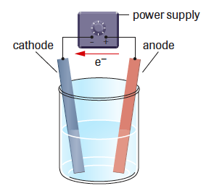
Electrolytic Cells
Electrolytic Cell – a cell in which a nonspontaneous redox reaction is forced to occur; a combination of two electrodes, an electrolyte and an external power source.
Electrolysis – the process of supplying electrical energy to force a nonspontaneous redox reaction to occur
The external power source acts as an “electron pump”; the electric energy is used to do work on the electrons to cause an electron transfer
Electrons are pulled from the anode and pushed to the cathode by the battery or power supply

Slide 26
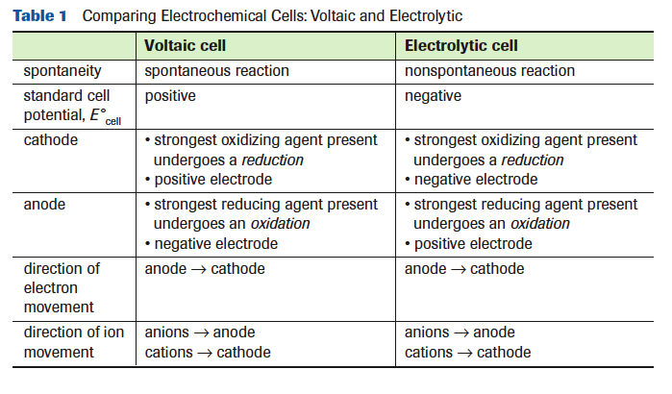
Comparing Electrochemical Cells: Voltaic and Electrolytic
It is best to think of “positive” and “negative” for electrodes as labels, not charges.

Slide 27
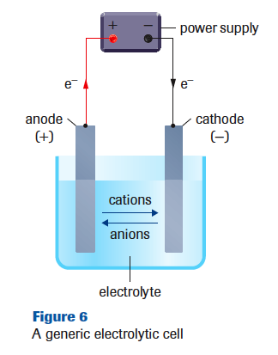
Procedure for Analyzing Electrolytic Cells
Identify the SOA and SRA
Write equations for the reduction (cathode) and oxidation (anode) half-reactions. Include the reduction potentials if required.
Balance the electrons and write the net cell reaction including the cell potential. E⁰ cell = E⁰_{r} cathode - E⁰_{r} anode
If required, state the minimum electric potential (voltage) to force the reaction to occur. (The minimum voltage is the absolute value of E⁰ cell)
If a diagram is requested, use the general outline in Figure 6, and add specific labels for chemical entities.

Slide 28
Analyzing Electrolytic Cells #1
Example: What are the cell reactions and the cell potential of the aqueous potassium iodide electrolytic cell?
Identify major entities and identify the SOA and SRA.
Write the half-reaction equations and calculate the cell potential.
State the minimum electric potential (voltage) to force the reaction to occur.

Slide 29
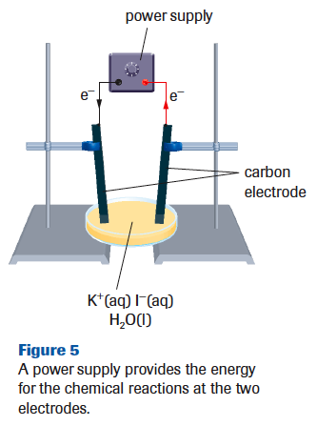
Potassium-Iodide Electrolytic Cell
In the potassium iodide electrolytic cell, litmus paper does not change colour in the initial solution and turns blue only near the electrode from which gas bubbles. Why?
At the other electrode, a yellow-brown colour and a dark precipitate forms. The yellow brown substance produces a purplish-red colour in the halogen test (pg. 805). Why?

Slide 30
Analyzing Electrolytic Cells #2
Example: An electrolytic cell containing cobalt(II) chloride solution and lead electrodes is assembled. The notation for the cell is as follows:
Predict the reactions at the cathode and anode, and in the overall cell.
Draw and label a cell diagram for this electrolytic cell, including the power supply.
What minimum voltage must be applied to make this cell work?

Slide 31
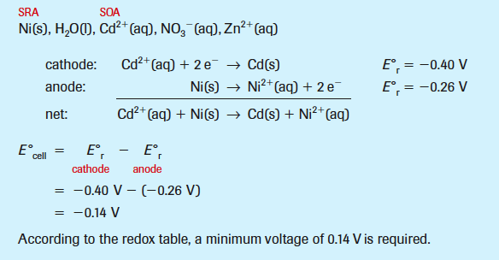
Analyzing Electrolytic Cells #3
Example: An electrolytic cell is set up with a power supply connected to two nickel electrodes immersed in an aqueous solution containing cadmium nitrate and zinc nitrate.
Predict the equations for the initial reaction at each electrode and the net cell reaction. Calculate the minimum voltage that must be applied to make the reaction occur.

Slide 32
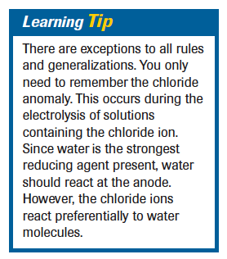
The Chloride Anomaly (Diploma!)
Some redox reactions predicted using the SOA and SRA from a redox table do not always occur in an electrolytic cell.
The actual reduction potential required for a particular half-reaction and the reported half-reaction reduction potential may be quite different (depending on the conditions or half-reactions)
This difference is known as the half-cell overvoltage.
“As an empirical rule, you should recognize that chlorine gas is produced instead of oxygen gas in situations where chloride and water are the only reducing agents present.”

Slide 33
Electrolytic Cells
Summary:
An electrolytic cell is based upon a reaction that is nonspontaneous; the Eº_{cell} for the reaction is negative.
An applied voltage of at least the absolute value of Eº_{cell} is required to force the reactions to occur.
The SOA undergoes reduction at the cathode (- electrode)
The SRA undergoes oxidation at the anode (+ electrode)
Electrons are forced by a power supply to travel from the anode to the cathode through the external circuit.
Internally, anions move toward the anode and cations move toward the cathode

Slide 34
Applications of Electrolytic Cells
Read pg. 646-650
Summary:
In molten-salt electrolysis, metal cations are reduced to metal atoms at the cathode and nonmetal anions are oxidized at the anode.
Electrorefining is a process used to obtain high grade metals at the cathode from an impure metal at the anode.
Electroplating is a process in which a metal is deposited on the surface of an object placed at the cathode of an electrolytic cell.

Slide 35
Electrochemical Cells
Today’s Objectives:
Calculate mass, amounts, current, and time in single voltaic and electrolytic cells by applying Faraday’s law and stoichiometry
Predict and write the half-reaction equation that occurs at each electrode in an electrochemical cell

Slide 36
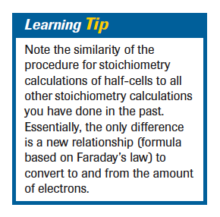
Cell Stoichiometry Summary
Write the balanced equation for the half-cell reaction of the substance produced or consumed. List the measurements and conversion factors for the given and required entities.
Convert the given measurements to an amount in moles by using the appropriate conversion factor. (M, c, F)
Calculate the amount of the required substance by using the mole ratio from the half-reaction equation.
Convert the calculated amount to the final quantity by using the appropriate conversion factor. (M, c, F)

Slide 37
Background
Charge (Q) is determined by multiplying the electric current (I), (measured in C/s) by the time (t) measured is seconds.
Q = It
(C) = (Ampere)(second)
(Coulomb) = (Coulombs per second) x (second)
One coulomb is the quantity of charge transferred by a current of 1 Ampere during 1second.
Example: Calculate the charge that passes through one 300kA cell in a 24 hour period.
Q = It
= (300kA x 1000A/kA)(24 h x 3600s/h)
= (300000C/s )(86400s) = 2.6 x 10¹⁰C

Slide 38
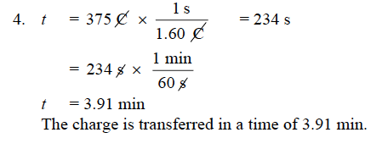
Practice: Calculating Charge
Pg. 653 #1-4

Slide 39
Faraday’s Law
“The mass of an element produced or consumed at an electrode is directly proportional to the time the cell operated, as long as the current was constant.”
He also found that “9.65 x 10⁴C of charge is transferred for every mole of electrons that flows in the cell. This value is the molar charge of electrons, also called Faraday’s constant”
F = 9.65 x 10⁴ C _
mol e⁻
This constant can by used as a conversion factor in converting electric charge to moles, very similarly to the way that molar mass is used to convert mass to a chemical amount.

Slide 40
Practice: Faraday’s Law #1
Convert a current of 1.74 A for 10.0 min into an amount of electrons

Slide 41
Practice: Faraday’s Law #2
How long, in minutes, will it take a current of 3.50 A to transfer 0.100 mol of electrons?
Remember: Amperes = Coulombs/second

Slide 42
Practice: Calculating Charge
Pg. 654 #5-7

Slide 43
Half Cell Calculations
Since the mass of an element produced at an electrode depends on the amount of transferred electrons (Faraday’s Law), a half-reaction equation showing the number of electrons involved is necessary to do stoichiometric calculations.
This applies to all electrochemical cells, whether voltaic or electrolytic.
Separate calculations are carried out for each electrode, although the same charge and therefore the same amount of electrons passes through each electrode in a cell.
The only new part of the stoichiometry is the calculation involving the amount of electrons based on Faraday’s constant

Slide 44
Practice: Half-Cell Calculations #1
What is the mass of copper deposited at the cathode of a copper electrorefining cell operated at 12.0 A for 40.0 min?
First identify and write the appropriate half-cell.
Copper is being deposited at the cathode, copper(II) ions must be gaining electrons to form copper metal.
Write the equation for this reduction and list all the information given.
Do we have enough information to solve for the amount of electrons (moles of electrons)?

Slide 45
Practice: Half-Cell Calculations #1
What is the mass of copper deposited at the cathode of a copper electrorefining cell operated at 12.0 A for 40.0 min?
Yes, we can solve for the number of moles, and then use the mole ratio to convert from a chemical amount of one substance to another.
The last step is to convert to the quantity requested in the question, in this case the mass of the copper metal
Could we do this as one equation instead?

Slide 46
Practice: Half-Cell Calculations #2
Silver is deposited on objects in a silver electroplating cell. If 0.175 g of silver is to be deposited from a silver cyanide solution in a time of 10.0 min, predict the current required.
Write the balanced equation for the half-cell reaction, list the measurements and conversion factors.
Convert to moles, use the mole ratio, convert to the current (C/s)

