Slide 1
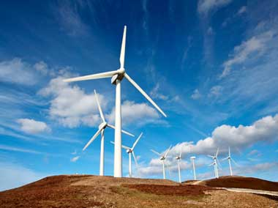
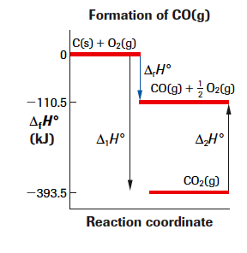
UNIT A: ThermoChem
CHAPTER ELEVEN

Slide 2
DO YOU REMEMBER??
The Law of Conservation of Energy
During physical and chemical processes, energy may change form, but it may never be created nor destroyed.
If a chemical system gains energy, the surroundings lose energy
If a chemical system loses energy, the surroundings gain energy
Examples:
When octane (C₃H₈, the main component of gasoline) is burned in your car engine, chemical bond energy (potential energy) is converted into mechanical energy (pistons moving in the car engine; kinetic energy) and heat.
When we turn on a light switch, electrical energy is converted into light energy and, you guessed it, heat energy.

Slide 3
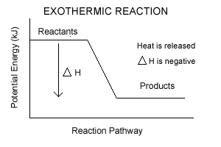
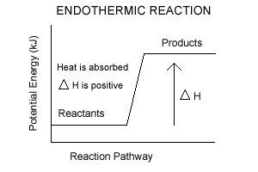
DO YOU REMEMBER??
Exothermic
ENDOTHERMIC
A change in a chemical energy where energy/heat EXITS the chemical system
Results in a decrease in chemical potential energy
A change in chemical energy where energy/heat ENTERS the chemical system
Results in an increase in chemical potential energy

Slide 4
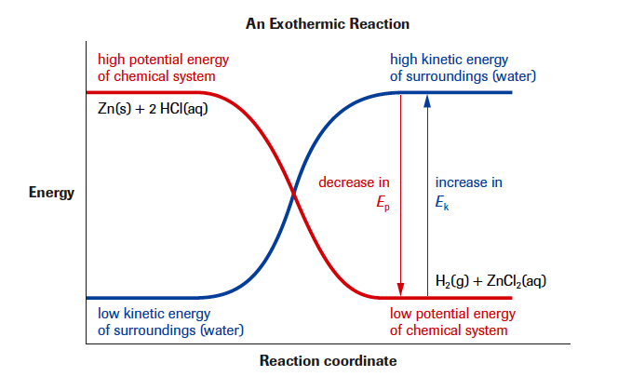
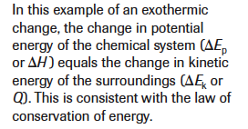
THE LAW OF CONSERVATION OF ENERGY

Slide 5
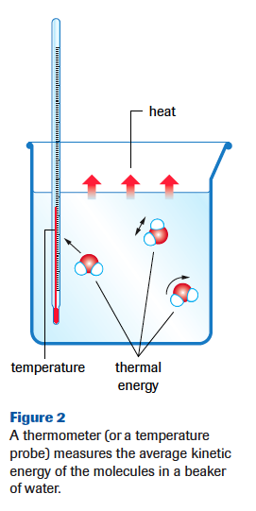
An Introduction to Energetics
Roll mouse over for a particle motion and heat transfer demo
Kinetic Energy (E_{k}) is related to the motion of an entity
Molecular motion can by translational (straight-line), rotational and vibrational
Chemical Potential Energy (E_{p}) is energy stored in the bonds of a substance and relative intermolecular forces
Thermal Energy is the total kinetic energy of all of the particles of a system. Increases with temperature.
Symbol (Q), Units (J), Formula used (Q=mcΔT)
Temperature is a measure of the average kinetic energy of the particles in a system
Heat is a transfer of thermal energy. Heat is not possessed by a system. Heat is energy flowing between systems.

Slide 6
Do You Remember?
Heating and Cooling Curves
Why does the graph plateau?
Remember, a phase change is primarily changing a substances potential energy.
Bonds are being broken or formed, changing the Ep, during the plateau of the graph.
Remember it takes energy to break bonds, and energy is released when bonds are formed
When the graph is climbing, the kinetic energy of the particles is increasing because additional thermal energy is being added.

Slide 7
An Introduction to Enthalpy
Which has more thermal energy, a hot cup of coffee or an iceberg?
An iceberg! Put very roughly, thermal energy is related to the amount of something you have multiplied by the temperature. Let's assume your iceberg is at the freezing point of water - 0 degrees Celsius (~273 Kelvin). Now your cup of coffee might be 75 degrees Celsius (~350 Kelvin).
350 isn't a whole lot more than 270, but an iceberg is thousands of times larger than a cup of coffee. Even though the iceberg is at a lower temperature, it contains more thermal energy because the particles are moving and it's much larger than the cup of coffee.

Slide 8
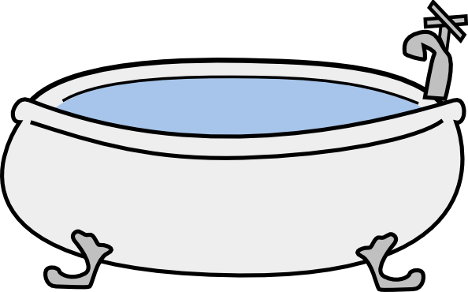
Thermal Energy Calculations
There are three factors that affect thermal energy (Q = mcΔt):
Mass (m)
Type of substance (c)
c is the specific heat capacity, the quantity of energy required to raise the temperature of one gram of a substance by one degree Celsius
Temperature change (Δt)
I.e. Consider a bathtub and a teacup of water! All water has the same specific heat capacity which is 4.19J/g•°C. However, the bathtub would take considerably more energy to heat up!

Slide 9
Thermal Energy Calculations
Example: Find the quantity of heat energy necessary to warm a cup (250 mL) of water in an electric kettle from 22.0 °C to its normal boiling point.
The density of a dilute aqueous solution is the same as that of water; that is, 1.00g/mL or 1.00kg/L
c _{water} = 4.19J/g •°C or 4.19 kJ/kg •°C or 4.19 kJ/L •°C
Notes:
(81.7 kJ)

Slide 10
Thermal Energy Calculations
Example: Assuming a specific heat capacity the same as pure water, calculate the heat energy that must be removed from a 250 mL soft drink from 22 °C to 5 °C.
Notes:
(18 kJ)

Slide 11
Thermal Energy Calculations
Example: What mass of aluminum absorbs 1.00 MJ of heat energy, when its temperature rises from 22 °C to 100 °C?
Notes:
(14 kg)

Slide 12
Thermal Energy Calculations
Example: Equal 100 g masses of Cu(s), Al(s), and Fe(s) (c_{Fe} = 0.449 J/g°C) at 300 °C are placed into separate identical calorimeters each containing 200g of water at 22.0°C. Which calorimeter will have the highest final temperature? Explain.
Notes:
(14 kg)

Slide 13
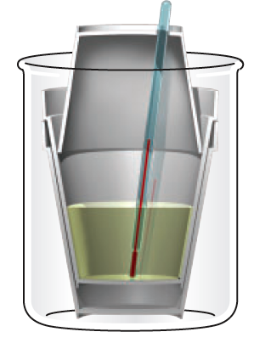
How do we measure Q?
With a simple laboratory calorimeter, which consists of an insulated container made of three nested polystyrene cups, a measured quantity of water, and a thermometer.
The chemical is placed in or dissolved in the water of the calorimeter.
Energy transfers between the chemical system and the surrounding water is monitored by measuring changes in the water temperature.
“Calorimetry is the technological process of measuring energy changes of an isolated system called a calorimeter”
Includes: Thermometer, stirring rod, stopper or inverted cup, two Styrofoam cups nested together containing reactants in solution

Slide 14
Comparing Q’s
Negative Q value
An exothermic change
Heat is lost by the system
The temperature of the surroundings increases and the temperature of the system decreases
Example: Hot Pack
Question Tips: “How much energy is released?”
Positive Q value
An endothermic change
Heat is gained by the system
The temperature of the system increases and the temperature of the surroundings decreases
Example: Cold Pack
Question Tips: “What heat is required?”

Slide 15
Other Calorimetry assumptions. . .
• All the energy lost or gained by the chemical system is gained or lost (respectively) by the calorimeter; that is, the total system is isolated.
• All the material of the system is conserved; that is, the total system is isolated.
• The specific heat capacity of water over the temperature range is 4.19 J/(g•°C). (** IN YOUR DATA BOOK)
• The specific heat capacity of dilute aqueous solutions is 4.19 J/(g•°C).
• The thermal energy gained or lost by the rest of the calorimeter (other than water) is negligible; that is, the container, lid, thermometer, and stirrer do not gain or lose thermal energy.

Slide 16
Today’s homework: Do you remember how to rearrange formulas?? Practice rearranging Q=mcΔt for m, c, and Δt Pg. 487 #3-8 Worksheet – Thermal Energy Calculations
Curricular outcomes:
1.1K: Recall the application of Q = mcΔt to the analysis of heat transfer
1.2K: Explain, in a general way, how stored energy in the chemical bonds of hydrocarbons originated from the sun
1.9k: Identify the reactants and products of photosynthesis, cellular respiration and hydrocarbon combustion
1.10K: Classify chemical reactions as endothermic or exothermic

Slide 17
ENTHALPY
CHAPTER ELEVEN

Slide 18
Today’s Agenda: Review homework Enthalpy PowerPoint Practice
Curricular outcomes:
1.3k: Define enthalpy and molar enthalpy for chemical reactions
1.4k: Write balanced equations for chemical reactions that include energy changes
1.5k: Use and interpret ΔH notation to communicate and calculate energy changes in chemical reactions
1.8k: Use calorimetry data to determine the enthalpy changes in chemical reactions

Slide 19
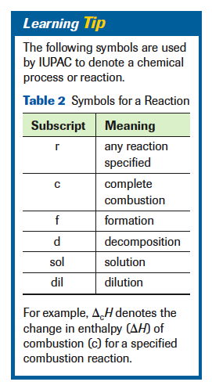
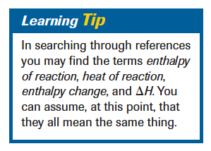
Enthalpy
The total of the kinetic and potential energy within a chemical system is called its enthalpy. (Energy possessed by the system)
Enthalpy is communicated as a difference in enthalpy between reactants and products, an enthalpy change, Δ_{r}H
.
Units (usually kJ)

Slide 20
ENTHALPY CHANGES
In a simple calorimetry experiment involving a burning candle and a can of water, the temperature of 100 mL of water increases from 16.4°C to 25.2°C when the candle is burned for several minutes. What is the enthalpy change of this combustion reaction?
Assuming: Δ_{c}H = Q (The energy lost by the chemical system, (burning candle), is equal to the energy gained by the surroundings (calorimeter water)
Assuming: Q = mcΔt then Δ_{c}H = mcΔt
Is the value of Δ_{c}H going to be positive or negative??
We will use
Δ_{c}H = - mcΔt
Notes:
If the surroundings gained energy (water), then the system (burning candle) lost it. So based on the evidence, the enthalpy change of combustion for this reaction is -3.69J

Slide 21
ENTHALPY CHANGES
When 50 mL of 1.0 mol/L hydrochloric acid is neutralized completely by 75 mL of 1.0 mol/L sodium hydroxide in a polystyrene cup calorimeter, the temperature of the total solution changes from 20.2°C to 25.6°C. Determine the enthalpy change that occurs in the chemical system.
Is this an Endothermic or Exothermic reaction??
Notes:
Based upon the evidence available, the enthalpy change for the neutralization of hydrochloric acid in this context is recorded as -2.83 kJ.

Slide 22
Molar Enthalpy
Molar enthalpy: Δ_{r}H_{m} the change in enthalpy expressed per mole of a substance undergoing a specified reaction (kJ/mol)
Have we had other quantities expressed per mole? YES!
How will we calculate this?

Slide 23
Molar Enthalpy Practice
Predict the change in enthalpy due to the combustion of 10.0 g of propane used in a camp stove. The molar enthalpy of combustion of propane is -2043.9 kJ/mol.
Predict the enthalpy change due to the combustion of 10.0 g of butane in a camp heater. The molar enthalpy of combustion of butane is -2657.3 kJ/mol.

Slide 24
Molar Enthalpy and Calorimetry
Can we measure the molar enthalpy of reaction using calorimetry?
Yes, but indirectly. We can measure a change in temperature, we can then calculate the change in thermal energy (Q=mc∆t). Then, using the law of conservation of energy we can infer the molar enthalpy.
In doing so, we must assume that the change in enthalpy of the chemicals involved in a reaction is equal to the change in thermal energy of the surroundings.
From this equation, any one of the five variables can be determined as an unknown.

Slide 25
Molar Enthalpy Practice
In a research laboratory, the combustion of 3.50 g of ethanol in a sophisticated calorimeter causes the temperature of 3.63 L of water to increase from 19.88°C to 26.18°C. Use this evidence to determine the molar enthalpy of combustion of ethanol.
** You don’t have to equate the two formulas to solve this. Instead, you can calculate Q, then use that value as Δ_{r}H, and solve for either the chemical amount or the molar enthalpy of reaction.

Slide 26
Molar Enthalpy Practice
Some 8.00 g of fresh sodium hydroxide are added to 100 g of deionized water in a Styrofoam cup calorimeter, initial temperature 20.6 °C. The reactant is gently swirled and eventually it reaches a maximum temperature of 40.4 °C. What is the molar enthalpy of solution for the salt?
Notes:
(-41.5 kJ/mol)

Slide 27
Molar Enthalpy Practice
When a 10.0 g sample of pure sulfuric acid is added to 100 mL of water in a calorimeter. The initial temperature of the water is 20.0 °C. The highest temperature reached by the solution is 31.2 °C.
a. What is the energy change of this reaction?
b. What is the molar enthalpy of solution of the acid?
Notes:
(4.69 kJ)
(-46 kJ/mol)

Slide 28
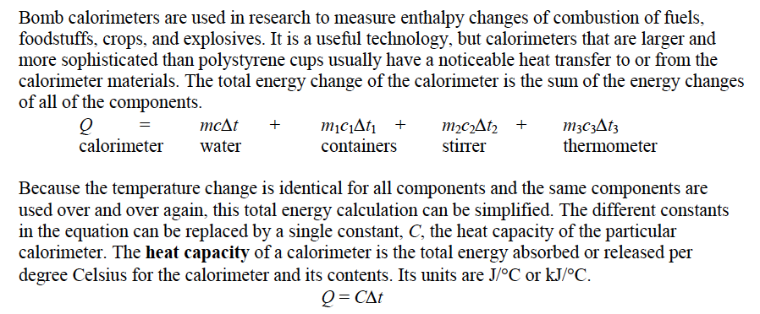
Heat Capacity
Q = CΔt

Slide 29
Today’s homework: Read over the first 2 sections of the chapter, make sure you are comfortable with the material we are going through Worksheet – Enthalpy Change and Calorimetry
Curricular outcomes:
1.3k: Define enthalpy and molar enthalpy for chemical reactions
1.4k: Write balanced equations for chemical reactions that include energy changes
1.5k: Use and interpret ΔH notation to communicate and calculate energy changes in chemical reactions
1.8k: Use calorimetry data to determine the enthalpy changes in chemical reactions

Slide 30
COMMUNICATING ENTHALPY CHANGES
CHAPTER ELEVEN

Slide 31
Today’s Agenda: Review homework Communicating Enthalpy PowerPoint
Curricular outcomes:
1.3k: Define enthalpy and molar enthalpy for chemical reactions
1.4k: Write balanced equations for chemical reactions that include energy changes
1.5k: Use and interpret ΔH notation to communicate and calculate energy changes in chemical reactions

Slide 32
Communicating Enthalpy
We will be learning how to communicate enthalpy changes in four ways:
By stating the molar enthalpy of a specific reactant in a reaction
By stating the enthalpy change for a balanced reaction equation
By including an energy value as a term in a balanced reaction equation
By drawing a chemical potential energy diagram

Slide 33
COMMUNICATING ENTHALPY #1
By stating the molar enthalpy of a specific reactant in a reaction
Why do we use standard conditions in chemistry (i.e. SATP)?
We use a standard set of conditions so that scientists can create tables of precise, standard values and can compare other values easily
Do we have standard conditions for enthalpy??
Yes, we will be using SATP (but liquid and solid compounds must only have the same initial and final temperature – most often 25°C)
How do we communicate that standard conditions are used for reactants and products?
With a ° superscript, such as Δ_{f}H_{m}° or Δ_{c}H_{m}° (See data booklet pg. 4 and 5)
*For well-known reactions such as formation and combustion, no chemical equation is necessary, since they refer to specific reactions with the Δ_{f} or Δ_{m}
** Would the sign for Δ_{f}H_{m}° be the opposite of the sign for Δ_{d}H_{m}° (decomposition)? YES!
*For equations that are not well known or obvious, then the chemical equation must be stated along with the molar enthalpy.

Slide 34
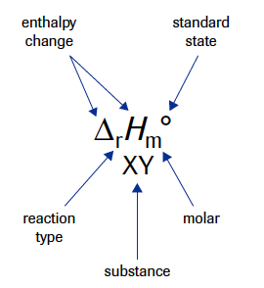
COMMUNICATING ENTHALPY #1
By stating the molar enthalpy of a specific reactant in a reaction
Example #1:
This means that the complete combustion of 1 mol of methanol releases 725.9 kJ of energy according to the following balanced equation
Example #2:
This does not specify a reaction, so a chemical equation must be stated along with the molar enthalpy.
This is not a formation reaction, since not all of the reactants are elements, so this could not have been communicated with Δ_{f}

Slide 35
COMMUNICATING ENTHALPY #2
By stating the enthalpy change beside a balanced reaction equation
Do we know how to calculate enthalpy change??
The enthalpy change for a reaction can be determined by multiplying the chemical amount (from the coefficient in the equation) by the molar enthalpy of reaction (for a specific chemical)
Example: Sulfur dioxide and oxygen react to form sulfur trioxide. The standard molar enthalpy of combustion of sulfur dioxide, in this reaction, is -98.9 kJ/mol. What is the enthalpy change for this reaction?
Start with a balanced chemical equation.
Then determine the chemical amount from the equation (this is an exact #, don’t use for sig digs)
Then use to determine the enthalpy change for the whole reaction.
Then report the enthalpy change by writing it next to the balanced equation.
Notes:
2mol x -98.9kj/mol = -197.8

Slide 36
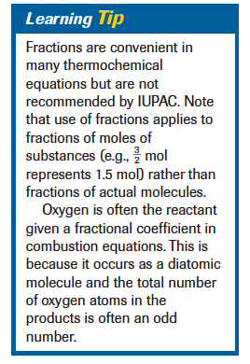
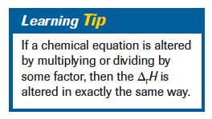
COMMUNICATING ENTHALPY #2
By stating the enthalpy change beside a balanced reaction equation
THE ENTHALPY CHANGE DEPENDS ON THE ACTUAL CHEMICAL AMOUNT OF REACTANTS AND PRODUCTS IN THE CHEMICAL REACTION. THEREFORE, IF THE BALANCED EQUATION IS WRITTEN DIFFERENTLY, THE ENTHALPY CHANGE SHOULD BE REPORTED DIFFERENTLY
Both chemical reactions agree with the empirically determined molar enthalpy of combustion for sulfur dioxide

Slide 37
COMMUNICATING ENTHALPY #2
By stating the enthalpy change beside a balanced reaction equation
EXAMPLE: The standard molar enthalpy of combustion of hydrogen sulfide is -518.0 kJ/mol. Express this value as a standard enthalpy change for the following reaction equation:
SOLUTION:

Slide 38
COMMUNICATING ENTHALPY #3
By including an energy value as a term in a balanced reaction equation
If a reaction is endothermic, it requires additional energy to react, so is listed along with the reactants
If a reaction is exothermic, energy is released as the reaction proceeds, and is listed along with the products
In order to specify the initial and final conditions for measuring the enthalpy change of the reaction, the temperature and pressure may be specified at the end of the equation

Slide 39
COMMUNICATING ENTHALPY #3
By including an energy value as a term in a balanced reaction equation
EXAMPLE: Ethane is cracked into ethene in world-scale quantities in Alberta. Communicate the enthalpy of reaction as a term in the equation representing the cracking reaction.
Does the +136.4 kJ mean exothermic or endothermic?

Slide 40
COMMUNICATING ENTHALPY #4
By drawing a chemical potential energy diagram
During a chemical reaction, observed energy changes are due to changes in chemical potential energy that occur during a reaction. This energy is a stored form of energy that is related to the relative positions of particles and the strengths of the bonds between them.
As bonds break and re-form and the positions of atoms are altered, changes in potential energy occur. Evidence of a change in enthalpy of a chemical system is provided by a temperature change of the surroundings.
A chemical potential energy diagram shows the potential energy of both the reactants and products of a chemical reaction. The difference is the enthalpy change (obtained from calorimetry)
Guidelines: The vertical axis represents E_{p}. The reactants are written on the left, products on the right, and the horizontal axis is called the reaction coordinate or reaction progress.

Slide 41
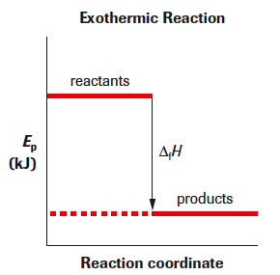
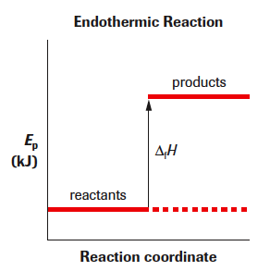
COMMUNICATING ENTHALPY #4
During an exothermic reaction, the enthalpy of the system decreases and heat flows into the surroundings. We observe a temperature increase in the surroundings.
During an endothermic reaction, heat flows from the surroundings into the chemical system. We observe a temperature decrease in the surroundings.

Slide 42
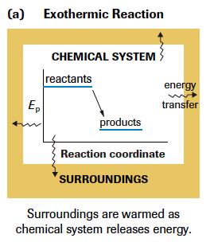
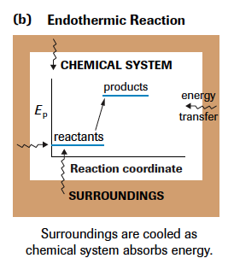
COMMUNICATING ENTHALPY #4

Slide 43
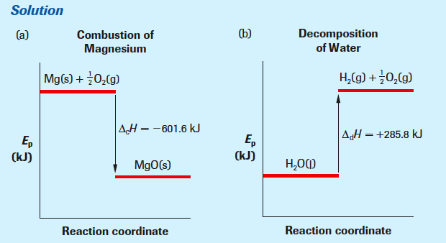
COMMUNICATING ENTHALPY #4
EXAMPLE: Communicate the following enthalpies of reaction as a chemical potential energy diagram.
The burning of magnesium to produce a very bright emergency flare.
The decomposition of water by electrical energy from a solar cell.

Slide 45
Communicating Enthalpy Practice
Communicate each of the following process in the four ways shown.
When a mole of magnesium sulfate forms, 1284.9 kJ of energy is released
The formation of zinc sulfide.
The decomposition of one mole of ammonia.

Slide 46
Today’s homework: Communicating Enthalpy Changes Practice Questions Worksheet – Representing Enthalpy Changes
Curricular outcomes:
1.3k: Define enthalpy and molar enthalpy for chemical reactions
1.4k: Write balanced equations for chemical reactions that include energy changes
1.5k: Use and interpret ΔH notation to communicate and calculate energy changes in chemical reactions

Slide 47
HESS’ LAW
CHAPTER ELEVEN

Slide 48
Today’s Agenda: Review homework Hess’ Law PowerPoint
Curricular outcomes:
1.7k: Explain and use Hess’ law to calculate energy changes for the net reaction from a series of reactions

Slide 49
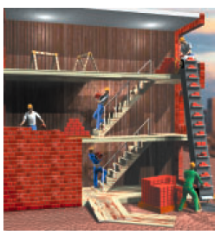
HESS’ LAW
Do you think it is convenient or possible to use a calorimeter to test all chemical reactions?
NO! Sometimes two products are created simultaneously, sometimes a reaction is too small to be able to measure accurately. So what do scientists do?
Theoretically, we assume that the enthalpy change of a physical or chemical process depends only on the initial and final conditions. It is independent of the pathway, process or number of intermediate steps required.
Illustration: Bricks are being moved from the ground up to the second floor. But there are two pathways to do this:
Move from the 1st to 2nd floor
Move to third floor and then carry down one flight
In both cases, the overall change in position is the same.

Slide 50
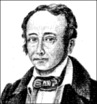
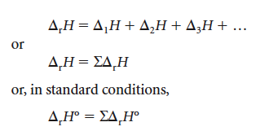
Hess’ Law
G.H. Hess suggested in 1840, that “the addition of chemical equations yields a net chemical equation whose enthalpy change is the sum of the individual enthalpy changes.” This is called Hess’ Law
Hess’s Law can be written as an equation:
The uppercase Greek Letter, Σ (sigma) means “the sum of”
Hess’ discovery allows us to determine enthalpy change without direct calorimetry, using two rules that you already know:
1) If a chemical equation is reversed, then the sign of Δ_{r}H changes
2) If the coefficients of a chemical equation are altered by multiplying or dividing by a constant factor, then the Δ_{r}H is altered by the same factor

Slide 51
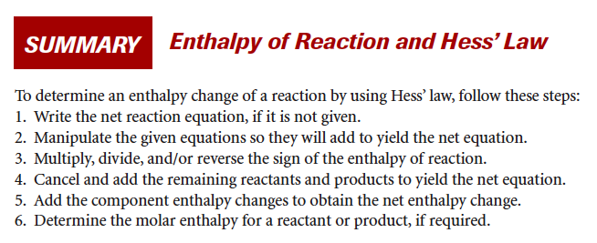
Hess’ Law
Hess's Law
The enthalpy change for any reaction depends only on the energy states of the initial reactants and final products and is independent of the pathway or the number of steps between the reactant and product.

Slide 52
Hess’ Law #1
Example: Use Hess’ Law to determine the enthalpy change for the formation of carbon monoxide.
This reaction can not be studied calorimetrically but we are given the following information to help solve this equation
Our job now, is to manipulate the equations so they will add to yield the net equation
We need 1 mol of C(s) to start the equation, so leave (1) unaltered
However, we want 1 mol of CO as a product, so reverse equation (2) and divide all terms by 2
** Remember whatever you do to the equation, affects the ΔH the same way
Δ_{c}H = -566.0kJ (original equation)
1) Reversed equation; ΔH = + 566.0kJ
2) Divide equation by 2; Divide ΔH by 2 = +283.0kJ

Slide 53
Hess’ Law #1
Example: Use Hess’ Law to determine the enthalpy change for the formation of carbon monoxide.
Now cancel and add the remaining reactants and products to yield the net equation.
Add the component enthalpy changes to obtain the net enthalpy change.
The process of using Hess’ Law is a combination of being systematic and using trial and error. Do what needs to be done to the given equations so they add to get the equation you want.

Slide 54
Hess’ Law #1
Example: Use Hess’ Law to determine the enthalpy change for the formation of carbon monoxide.
Sketching a potential energy diagram might help you ensure that you have made the appropriate additions and subtractions

Slide 55
Hess’ Law #2
Example: One of the methods the steel industry uses to obtain metallic iron is to react iron(III) oxide with carbon monoxide
Fe₂O_{3(s)} + 3CO_{(g)} → 3CO_{2(g)} + 2Fe_{(s)} Δ_{r}H = ??
1) CO_{(g)} + ½ O2(g) → CO_{2(g)} Δ_{f}H = -283.0 kJ
2) 2Fe_{(s)} + 3/2O_{2(g)} → Fe₂O_{3(s)} Δ_{f}H = -822.3 kJ
Notes:
3( CO_{(g)} + ½ O2(g) → CO_{2(g)}) Δ_{f}H =3(-283.0 kJ) = -849.0 kJ
reverse Fe₂O_{3(s)} → 2Fe_{(s)} + 3/2O_{2(g)} Δ_{f}H = -822.3 kJ = +822.3 kJ
Fe₂O_{3(s)} + 3CO_{(g)} → 3CO_{2(g)} + 2Fe_{(s)} Δ_{r}H = -26.7 kJ

Slide 56
Hess’ Law #3
Example: What is the standard enthalpy of formation of butane? Δ_{f}H_{m}° = ???
First, we need to be able to write this balanced formation equation.
4C_{(s)} + 5H_{2(g)} → C₄H_{10(g)}
The following values were determined by calorimetry:
What will we need to do to get our net equation?

Slide 57
Hess’ Law #4
Example: Use the following equations
¹/₂ N₂(g) + ³/₂ H₂(g) → NH₃(g) ∆_{f}H˚ = -74.6 kJ
N₂(g) → 2 N(g) ∆_{d}H˚ = +945.8 kJ
H₂(g) → 2 H(g) ∆_{d}H˚ = +435.2 kJ
to calculate the enthalpy an for the reaction that forms three moles of N-H bonds in ammonia
N(g) + 3 H(g) → NH₃(g) ∆_{net}H˚ = ?

Slide 58
Today’s Homework: Pg. 505 #1-4 Worksheet – Hess’ Law
Curricular outcomes:
1.7k: Explain and use Hess’ law to calculate energy changes for the net reaction from a series of reactions

Slide 59
MOLAR ENTHALPIES OF FORMATION
CHAPTER ELEVEN

Slide 60
Today’s Agenda: Review homework Standard Enthalpies of Formation PowerPoint Practice
Curricular outcomes:
1.6k: Predict the enthalpy change for chemical equations using standard enthalpies of formation

Slide 61
Molar Enthalpy of Formation
Molar enthalpies of formation are defined as the enthalpy change when one mole of a compound forms from its elements
NOTE: The enthalpy of formation for an element is 0 kJ
Examples: Using your data booklet, find the following:
Δ_{f} H_{m} ° CH_{4(g)} = -74.6 kJ/mol
Δ_{f} H_{m} ° O_{2(g)} = 0 kJ/mol (Δ_{f} H _{elements} = 0)
Δ_{f} H_{m} ° CO_{2(g)} = - 393.5 kJ/mol
Δ_{f} H_{m} ° H₂O_{(g)} = - 241.8kJ/mol

Slide 62
Molar Enthalpy of Formation
Why do we care about the standard molar enthalpies of formation, Δ_{f}H° ???
Because we are going to use them to predict standard enthalpy changes for chemical reactions. How? Using this crazy formula!!
What does it mean? The net enthalpy change for a chemical reaction, Δ_{r}H°, is equal to the sum of the chemical amounts times the molar enthalpies of formation of the products, ΣnΔ_{f p}H_{m} °, minus the chemical amounts times the molar enthalpies of formation of the reactants, ΣnΔ_{f R}H_{m} °
Clear as mud?? Basically, the equation says that the change in enthalpy is the total chemical potential energy of the products minus the reactants. Ep_{products} – Ep_{reactants}
We will need to use an example to figure this out.

Slide 63
Molar Enthalpy of Formation
Methane is burned in furnaces and in some power plants. What is the standard molar enthalpy of combustion of methane? Assume that water vapour is a product.
Need a balanced chemical equation: CH_{4(g)} + O_{2(g)} → CO_{2(g)} + 2H₂O_{(g)}
Use the formula and the data booklet to calculate the Δ_{c}H°
We found all of the Δ_{f} H_{m} for the compounds two slides ago
Notes:
-802.5 kJ??

Slide 64
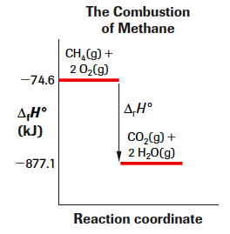
Molar Enthalpy of Formation
Methane is burned in furnaces and in some power plants. What is the standard molar enthalpy of combustion of methane? Assume that water vapour is a product.
This can also be communicated as an enthalpy change diagram. Note that the labeling of the y-axis is different from that in a chemical potential energy diagram.
Ep_{products} – Ep_{reactants}

Slide 65
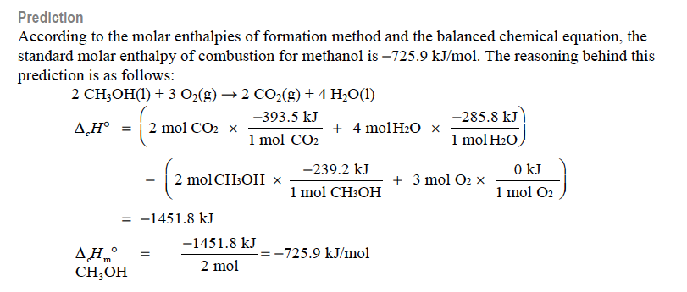
Lab Exercise 11.D

Slide 66
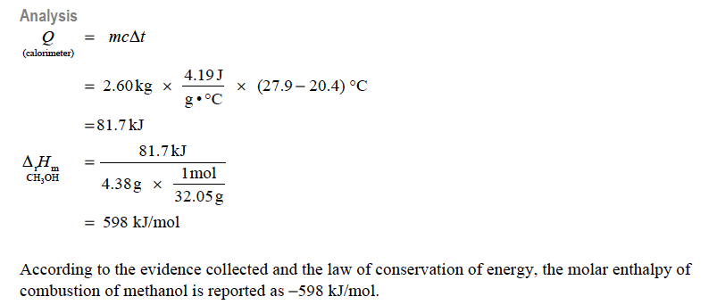
Lab Exercise 11.D

Slide 67
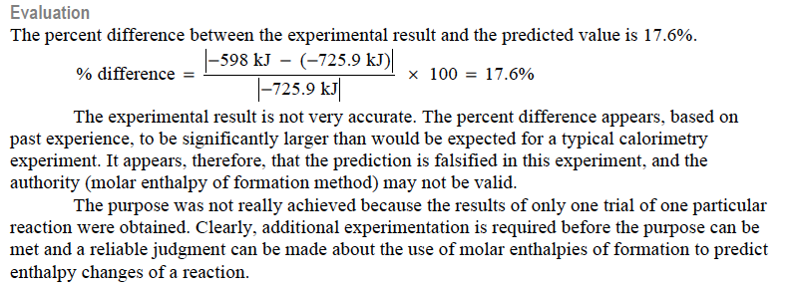
Lab Exercise 11.D

Slide 68
Practice
Calculate the enthalpy of combustion for one mole of each of the following fuels when they burn to give gaseous products:
Methane (-802.5 kJ)
Ethanol (-1234.8 kJ)
Calculate the enthalpy changes of the following reactions:
Photosynthesis of glucose (+2802.5 kJ)
Yeast fermentation of glucose according to the unbalanced equation:
___C₆H₁₂O₆(s) → ___CO₂(g) + ___ C₂H₅OH(l) (-68.9kJ)

Slide 69
Today’s Homework: Review concepts this far Worksheet – Predicting using standard enthalpies of formation
Curricular outcomes:
1.6k: Predict the enthalpy change for chemical equations using standard enthalpies of formation

Slide 70
ACTIVATION ENERGY
CHAPTER TWELVE

Slide 71
Today’s Agenda: Kinetics, Bond Energy and Catalysts
Curricular outcomes:
2.1k: Define activation energy as the energy barrier that must be overcome for a chemical reaction to occur
2.2k: Explain the energy changes that occur during chemical reactions, referring to bonds breaking and forming and changes in potential and kinetic energy
2.3k: Analyze and label energy diagrams of a chemical reaction, including reactants, products, enthalpy change and activation energy
2.4k: Explain that catalysts increase reaction rates by providing alternate pathways for changes, without affecting the net amount of energy involved; e.g., enzymes in living systems.

Slide 72
Kinetics = Rates of Reaction
Collision-Reaction Theory
A chemical sample consists of entities (ions, atoms, molecules) that are in constant, random motion at various speeds.
For a reaction to proceed, reactants must collide
An effective collision requires sufficient energy to react and the correct orientation, so that bonds can be broken and new bonds formed
The more collisions there are, the greater the potential for effective collision.

Slide 73
Kinetics = Rates of Reaction
Collision-Reaction Theory
Ineffective collisions involve entities that rebound and do not rearrange and form new substances.

Slide 74
Kinetics = Rates of Reaction
Factors affecting Reaction Rate:
Concentration: more reactant particles in a given volume increases the number of collisions per second
Surface Area: more opportunity for collisions, the more collisions there will be
Temperature: the faster the particles are moving, the more energy they have to create an effective collision

Slide 75
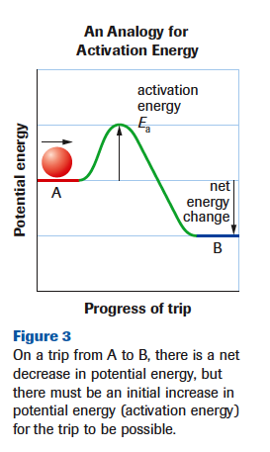
ACTIVATION ENERGY OF A REACTION
Activation Energy – (E_{A})
The minimum collision energy required for effective collision
Dependant on the kinetic energy of the particles (depend on T)
Analogy: If the ball does not have enough kinetic energy to make it over the hill – the trip will not happen. Same idea, if molecules collide without enough energy to rearrange their bonds, the reaction will not occur. (ineffective collision)

Slide 76
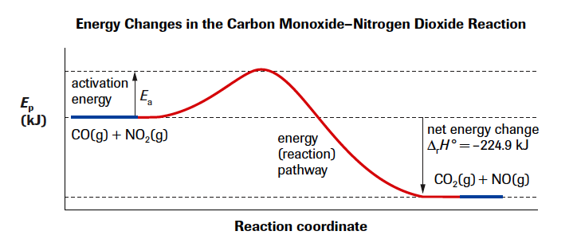
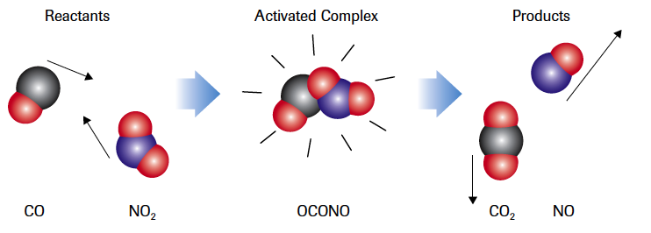
ACTIVATION ENERGY OF A REACTION
The activated complex occurs at the at the maximum potential energy point in the change along the energy pathway.
Is this an exothermic or endothermic change?
Exothermic. This means the initial energy absorbed to break the nitrogen-oxygen bond is less than the energy released when a new carbon-oxygen bond forms.
In general, the greater the E_{A}, the slower the reaction. It takes longer for more particles to achieve kinetic energy necessary for effective collision.

Slide 77
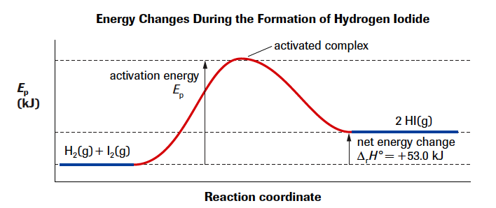
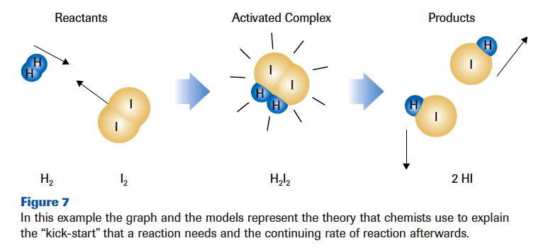
ACTIVATION ENERGY OF A REACTION
Is this an exothermic or endothermic change?
Endothermic. A continuous input of energy, usually heat, would be needed to keep the reaction going, and the enthalpy change would be positive.

Slide 78
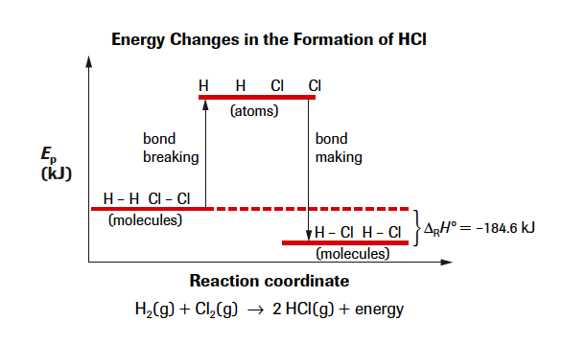
Bond Energy and Enthalpy Changes
Bond energy is the energy required to break a chemical bond; it is also the energy released when a bond is formed.
- bonded particles + energy → separated particles
- separated particles → bonded particles + energy
The change in enthalpy represents the net effect from breaking and making bonds.
Δ_{r}H = energy released from bond making – energy required for bond breaking
Exothermic reaction: making > breaking (Δ_{r}H is negative)
Endothermic reaction: breaking > making (Δ_{r}H is positive)

Slide 79
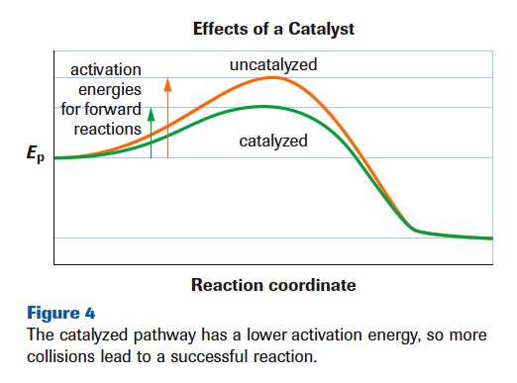
CATALYSTS AND REACTION RATE
A catalyst is a substance that increases the rate of a chemical reaction without being consumed itself in the overall process.
A catalyst reduces the quantity of energy required to start the reaction, and results in a catalyzed reaction producing a greater yield in the same period of time than an uncatalyzed reaction.
It does not alter the net enthalpy change for a chemical reaction
Catalysts lower the activation energy, so a larger portion of particles have the necessary energy to react = greater yield

Slide 80
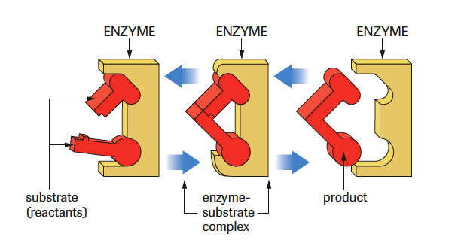
CATALYSTS AND REACTION RATE
How do catalysts work??
Scientists do not really understand the actual mechanism. Catalysts are also usually discovered through trial and error.
What they do know is that they provide an alternative, lower energy pathway from reactants to products.
Most of the catalysts (enzymes) for biological reactions work by shape and orientation. They fit substrate proteins into locations on the enzyme as a key fits into a lock, enabling only specific molecules to link or detach on the enzyme.
Almost all enzymes catalyze only one specific reaction

Slide 81
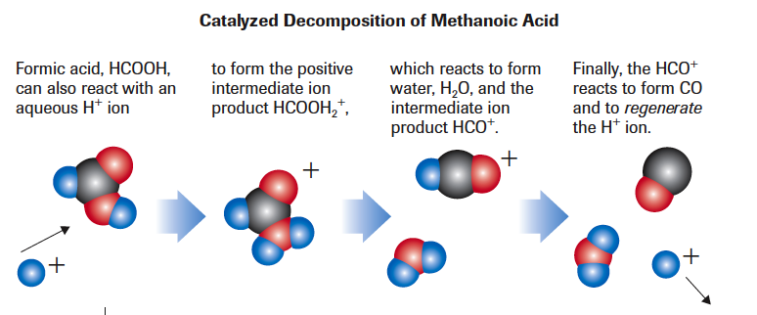
CATALYSTS AND REACTION RATE
Reaction Mechanisms
Steps making up the overall reaction
Each step = elementary reaction
Reaction intermediates: substances formed in one elementary reaction and consumed in another
The rate-determining step of a reaction is the step with the highest activation energy.
It is called the rate-determining step because it is the slowest step.

Slide 82
