Slide 1
Chapter 9
Excretion and the Interaction of Systems

Slide 2
Chapter 9
Excretion and the Interaction of Systems
9.1 The Structures and Function of the Excretory System
9.2 Urine Formation in the Nephron
9.3 Excretory System Health

Slide 3
Chapter 9 Excretion and the Interaction of Systems
In this chapter, you will learn:
Each kidney receives blood that is processed to form urine, which drains through a ureter and into the urinary bladder for excretion.
Each kidney contains over one million nephrons that process blood to form urine.
The functional unit of the kidney is the nephron.
Each nephron filters blood, reabsorbs substances such as sodium and glucose for reuse in the body, and secretes excess or toxic substances such as urea to produce urine.

Slide 4
Chapter 9 Excretion and the Interaction of Systems
Antidiuretic hormone (ADH) regulates the amount of water reabsorbed in the distal tubule.
Aldosterone regulates the amount of salt that is reabsorbed or secreted.
The acid-base balance of the blood is adjusted by the secretion of hydrogen ions and reabsorption of bicarbonate ions.
Various technologies are used to solve problems involving dysfunctions and disorders of the excretory system.

Slide 5
9.1 The Structures and Function of the Excretory System
In this section, you will:
identify the main structures and functions of the human excretory system
explain the function of the nephron
dissect a mammalian kidney and observe its structure

Slide 6
The Kidneys
Regulate the bodies composition of bodily fluids
Removal of wastes – Na, Cl, carbon dioxide, water, ammonia, hydrogen etc...
Some wastes have a higher priority to be removed, like nitrogenous wastes
Can you identify some other metabolic wastes produced by the body that are removed?

Slide 7
Organs of the Excretory System

Slide 8
Kidneys
The view in (A) includes some blood vessels to reinforce the connection between the circulatory and excretory systems. The views in (B) and (C) do not include blood vessels, and identify the three regions of the kidney: renal cortex, renal medulla, and renal pelvis. The view in (C) introduces the functional unit of the kidney: the nephron.

Slide 9
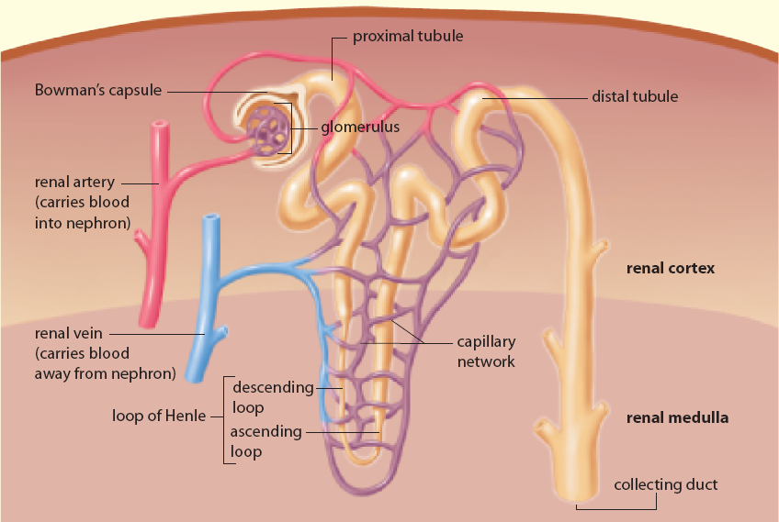
Nephron

Slide 10
Functional Regions of the Nephron
1. A Filter: The filtration structure at the top of each nephron is a cap-like formation called the Bowman’s capsule. Within each capsule, a renal artery enters and splits into a fine network of capillaries called a glomerulus. The walls of the glomerulus act as a filtration device. They are impermeable to proteins, other large molecules, and red blood cells, so these remain within the blood. Water, small molecules, ions, and urea—the main waste products of metabolism—pass through the walls and proceed further into the nephron. The filtered fluid that proceeds from the glomerulus into the Bowman’s capsule of the nephron is referred to as filtrate.

Slide 11
Functional Regions of the Nephron
2. A Tubule: The Bowman’s capsule is connected to a small, long, narrow tubule that is twisted back on itself to form a loop. This long, hairpin loop is a reabsorption device. The tubule has three sections: the proximal tubule, the loop of Henle, and the distal tubule. Like the small intestine, this tubule absorbs substances that are useful to the body, such as glucose and a variety of ions, from the filtrate passing through it. Unlike the small intestine, this tubule also secretes substances into the tissues surrounding it.

Slide 12
Functional Regions of the Nephron
3. A Duct: The tubule empties into a larger pipe-like channel called a collecting duct. The collecting duct functions as a water-conservation device, reclaiming water from the filtrate passing through it so that very little precious water is lost from the body. The filtrate that remains in the collecting duct is a suspension of water and various solutes and particles. It is now called urine. Its composition is distinctly different from the fluid that entered the Bowman’s capsule. The solutes and water reclaimed during reabsorption are returned to the body via the renal veins.

Slide 13
9.2 Urine Formation in the Nephron
In this section, you will:
explain the function of the nephron in maintaining the composition of blood plasma
describe the function of the kidney in excreting metabolic wastes and expelling them into the environment

Slide 14
Urine Formation

Slide 15
Reabsorption in the Loop of Henle

Slide 16
Parts of the Nephron and Their Functions
Glomerulus | Filtration • Glomerular blood pressure forces some of the water and dissolved substances from the blood plasma through the pores of the glomerular walls
Bowman’s capsule | Receives filtrate from glomerulus
Proximal tubule | Reabsorption • Active reabsorption of all nutrients, including glucose and amino acids • Active reabsorption of positively charged ions such as sodium, potassium, calcium • Passive reabsorption of water by osmosis • Passive reabsorption of negatively charged ions such as chloride and bicarbonate by electrical attraction to positively charged ions Secretion • Active secretion of hydrogen ions
Descending loop of Henle | Reabsorption • Passive reabsorption of water by osmosis
Ascending loop of Henle | Reabsorption • Active reabsorption of sodium ions • Passive reabsorption of chloride and potassium ions
Distal tube | Reabsorption • Active reabsorption of sodium ions • Passive reabsorption of water by osmosis • Passive reabsorption of negatively charged ions such as chloride and bicarbonate Secretion • Active secretion of hydrogen ions • Passive secretion of potassium ions by electrical attraction to chloride ions
Collecting tube | Reabsorption • Passive reabsorption of water by osmosis

Slide 17
9.3 Excretory System Health
In this section, you will:
describe how the kidneys contribute to homeostasis with respect to water and ions
perform a urinalysis using simulated urine samples
relate the design of dialysis technologies to the design of the kidney

Slide 18
The release of ADH controls the amount of water reabsorbed or excreted in urine.

Slide 19
Kidney Stones

Slide 20
Hemodialysis & Peritoneal Dialysis

Slide 21
Chapter 9 Review
Draw a diagram or flowchart to show how the excretory system works.
What wastes are produced by the human body?
Describe the functions of each major structure in the excretory system.
How does the excretory system interact with blood and circulation?
Why do wastes need to be eliminated from the body?

Slide 22
Concept Organizer

Slide 23
Chapter 9 Summary
The metabolic activities of cells, including energy release, maintenance, and repair, produce substances that change the balance of the volume of water and the concentration and composition of dissolved substances in the body’s fluids. The excretory system removes these materials to maintain the optimal volume of water and composition of body fluids, dispose of wastes, and recycle the non-waste substances. The substances in question include carbon dioxide; water; ions of sodium (Na⁺), chloride (Cl–), and hydrogen (H⁺); and other compounds resulting from the breakdown of proteins and nucleic acids. The excretory system also plays a key role in maintaining the acid-base balance (pH) in the blood.
The organs of the excretory system are the kidneys, the ureters, the urinary bladder, and the urethra. The kidneys contain millions of tiny nephrons that each contain a filter, a tube, and a duct. The nephrons filter out waste and reabsorb substances such as sodium and water for reuse by the body’s systems. The resulting filtrate, known as urine, is sent through the ureters to the urinary bladder for temporary storage until it is eliminated from the body through the urethra.
Disorders of the excretory system include urinary tract infections, kidney stones, and renal insufficiency. Renal insufficiency may require dialysis or a kidney transplant in order to ensure that wastes are secreted rather than building up to toxic levels in the body.

