Slide 1
Chapter 7
The Respiratory System

Slide 2
Chapter 7
The Respiratory System
7.1 Structures of the Respiratory System
7.2 Breathing and Respiration
7.3 Respiratory Health

Slide 3
Ch. 7 The Respiratory System
The upper respiratory tract filters, warms, and moistens oxygen-containing air, and channels it into the lungs.
The lower respiratory tract is made up of specialized structures that exchange oxygen for carbon dioxide in the bloodstream.
Humans ventilate their lungs by the mechanism of breathing, which involves inspiration and expiration.
The volume of air that is taken into the lungs can increase if the need for oxygen increases, such as during exercise.
External respiration takes place in the lungs, between the air in the alveoli and the blood in the capillaries.
Internal respiration takes place between the blood in the capillaries and tissue cells.
Gas exchange occurs through the processes of simple diffusion and facilitated diffusion.
Some disorders are specific to the respiratory system. Technologies are available to treat respiratory disorders, but they may not be able to restore the respiratory system to optimal health.
Smoking causes respiratory diseases. Technologies can help some symptoms of smoking, but many symptoms are untreatable.

Slide 4
7.1 Structures of the Respiratory System
In this section, you will:
identify the principal structures of the respiratory system
identify the principal functions of the respiratory system
observe and identify the major respiratory structures

Slide 5
Respiration: Stages & Structures
• Breathing involves two basic processes: inspiration (breathing in, or inhaling) and expiration (breathing out, or exhaling). Inspiration moves air from the external environment to the lungs inside the body. Expiration moves air from the lungs back to the external environment.
• External respiration is the exchange of oxygen and carbon dioxide between the air and the blood.
• Internal respiration is the exchange of oxygen and carbon dioxide between the body’s tissue cells and the blood.
• Cellular respiration is the series of energy-releasing chemical reactions that take place inside the cells. Cellular respiration is the final stage in respiration. It is the sole means of providing energy for all cellular activities, and it helps the body maintain homeostasis.

Slide 6
Upper Respiratory Tract
Air enters through mouth/nostrils
Nostrils serve to warm, moisturize and clean incoming air
Very thin bones, turbinate bones, increase the surface area of nasal passages and are covered in cilia
The pharynx moves air to the lungs through the epiglottis
Air also passes over the vocal cords causing reverberation. Larynx
Air moves into the trachea (wind pipe)

Slide 7
Review:
Name the structures of the upper respiratory tract
What does mucus and cilia do in terms of aiding respiration?
How are internal and external respiration different?

Slide 8
Lower Respiratory Tract
Tracheas branches into two bronchi which also branch into bronchioles
Both are lined with cilia and mucus
Each lung is divided into distinct lobes
Right lung has three and left lung has two – why?
Each lung is surrounded by a pleural membrane, the outer layer of this membrane attaches to the inside of the chest wall

Slide 9
Continued…
The inner membrane attaches to the lung.
Fluid fills the space between these two membrane layers – this allows them to respond to the movement of the chest cavity
Each bronchiole ends with a cluster of tiny sacs (alveoli) that facilitate gas exchange during external respiration
Capillaries surround the alveoli and connect to arteries and veins

Slide 10
Each bronchiole ends in several clusters of alveoli. Surrounding each alveolus is a fine network of capillaries from the circulatory system. Gas exchange occurs between the blood in the capillaries and the air in the alveolus, so that blood leaving the lungs has a high oxygen content.

Slide 11
Homework:
7.1 Summary Questions
  1,3,5,6,7,9,10,12

Slide 12
7.2 Breathing and Respiration
In this section, you will:
explain the mechanics of breathing
explain how gases are exchanged between the human respiratory system and the external environment
perform an experiment to examine factors that affect the rate of respiration

Slide 13
The Mechanics of Breathing

Slide 14
Inhalation
External ribs muscles and diaphragm contract
Rib cage expands up and out and the floor of the chest cavity downward
Volume in the thoracic cavity increases, pressure decreases
Air pressure in the lungs becomes less than external environment
Air moves from high to low pressure and rushes in

Slide 15
Exhalation
External ribs muscles and diaphragm relax
Rib cage relaxes down and in and the floor of the chest cavity upward
Volume in the thoracic cavity decreases, pressure increases
Air pressure in the lungs becomes more than external environment
Air moves from high to low pressure and rushes out

Slide 16
Respiratory Volume - Spirograph
Measures the amount of air that moves into the lungs with each breath. Each of the following are considered:
Tidal Volume
Inspiratory reserve
Expiratory reserve
Vital Capacity
Residual Volume

Slide 17
Continued…
Tidal Volume – volume of air normally inhaled or exhaled
Inspiratory reserve – additional volume of air that can be taken in beyond tidal volume
Expiratory reserve – additional volume of air that can be expelled beyond tidal volume
Vital Capacity – total lung capacity including reserve space
Residual Volume – amount of gas that remains in the system even after exhalation – never leaves the respiratory system or lungs would collapse

Slide 18
A Typical Spirograph

Slide 19
Homework:
Read pages250 and 252 from text dealing with gas exchange.
We will be doing a small lab next class dealing with rate of respiration
Summary Questions:
  Page 254 – 2,3,4a,5,7,9

Slide 20
Lab: Rate of Respiration
Page 253 in your textbook outlines the lab
Communicate your results in the form of a chart and attach your analysis, conclusion and extension questions

Slide 21
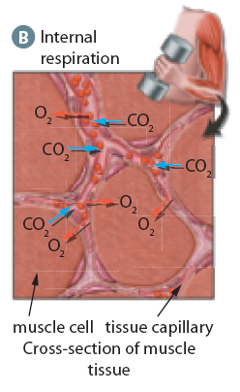
External vs. Internal Respiration
External respiration (A) occurs between alveoli and the capillaries next to them. As blood moves away from the body tissues, it is oxygen-poor and carbon dioxide-rich. As it moves through the lung capillaries, oxygen from the air in the alveoli diffuses into the capillaries and carbon dioxide diffuses out of the blood. Internal respiration (B) occurs between the capillaries and the body tissues. Oxygen diffuses from the blood into the oxygen-poor tissues while carbon dioxide diffuses from the tissues into the blood.

Slide 22
7.3 Respiratory Health
In this section, you will:
identify specific diseases that are associated with the respiratory system
identify technologies that may be used to treat these respiratory diseases
summarize the physiological effects of smoking and the limitation of technologies to address these effects

Slide 23
Upper Respiratory Tract Infections
Tonsillitis is an infection of the tonsils, which are located in the pharynx. A viral infection, rather than a bacterial infection, is the more common cause of tonsillitis. The tonsils can be removed surgically if the infections are frequent and breathing is impaired. In the past, many children had their tonsils removed as a precaution, but this surgery is no longer as common. The tonsils help to prevent bacteria and other foreign pathogens from entering the body, so removing them can increase the number of infections later in life.

Slide 24
Upper Respiratory Tract Infections
Laryngitis is an inflammation of the larynx. Recall that the larynx contains the vocal cords. The most common cause of laryngitis is a viral infection; allergies and overstraining of the voice can also lead to laryngitis. When the larynx is inflamed, the vocal cords are not able to vibrate as they normally do. This reduces the ability to speak in a normal voice or even to speak at all. Symptoms of laryngitis include a sore throat and hoarseness.

Slide 25
Lower Respiratory Tract Infections
Bronchitis is a disorder that causes the bronchi to become inflamed and filled with mucus, which is expelled by coughing.
Pneumonia is a disease that occurs when the alveoli in the lungs become inflamed and fill with liquids. This interferes with gas exchange, and the body becomes starved for oxygen.

Slide 26
Lower Respiratory Tract Infections
Pleurisy is a lung disorder that is caused by the swelling and irritation of the pleura, the membranes that surround the lungs.
Emphysema is an obstructive respiratory disorder in which the walls of the alveoli break down and lose their elasticity. This reduces the surface area for gas exchange and causes oxygen shortages in the tissues.
Cystic fibrosis is a serious genetic condition that affects the lungs. Cystic fibrosis is caused by an abnormal gene that disrupts the function of the cells lining the passageways of the lungs.

Slide 27
Lower Respiratory Tract Infections
Asthma is a chronic obstructive lung disease that affects the bronchi and bronchioles, making breathing difficult or impossible because of reduced air flow.
Lung cancer is the uncontrolled and invasive growth of abnormal cells in the lungs. It is the leading cause of cancer deaths for men and women in Canada.

Slide 28
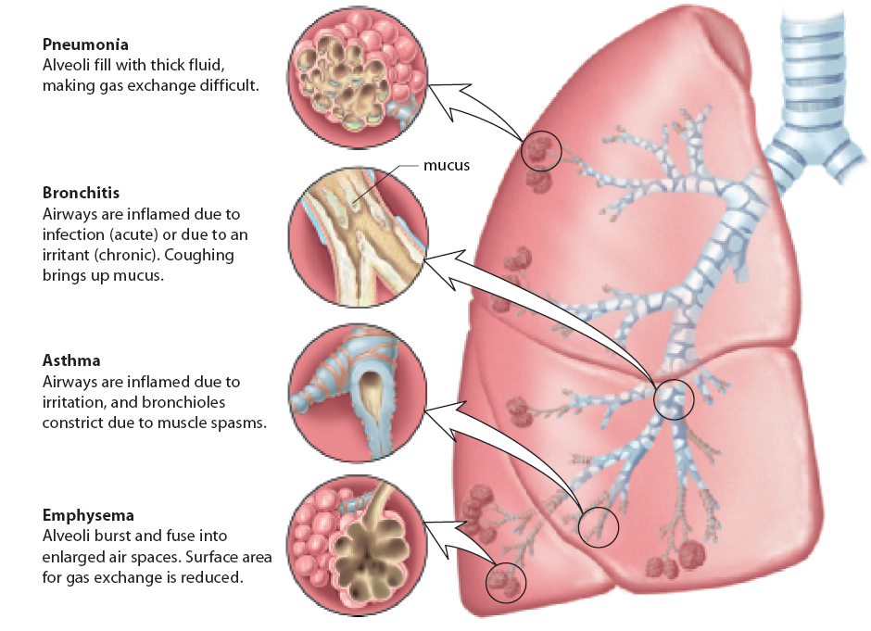
Lower Respiratory Tract Disorders

Slide 29
Normal Lungs vs. Diseased Lungs
(A) These normal lungs have healthy red tissue. (The heart is visible near the lower centre.) (B) These diseased lungs have black tissue caused by heavy smoking. The white areas are tumours, or carcinomas.

Slide 30
Carcinoma of the Lung
The large ball of cells in the centre of the image is a carcinoma that has developed from the interior surface cells of the human lung. The carcinoma continues to grow and invade surrounding tissues, including the lymphatic and blood vessels in the lung. The lymphatic and blood vessels circulate through the body and carry the cancerous cells, or metastatic cells, to new locations where they can grow and invade new tissues.

Slide 31
Chapter 7 Review
Create a flowchart or diagram showing the path of oxygen through the respiratory system.
Explain how each of the major respiratory structures function.
What is cellular respiration?
Compare and contrast a normal lung with smoker’s lung.
Identify three respiratory diseases. Briefly describe their symptoms and how they are diagnosed.

Slide 32
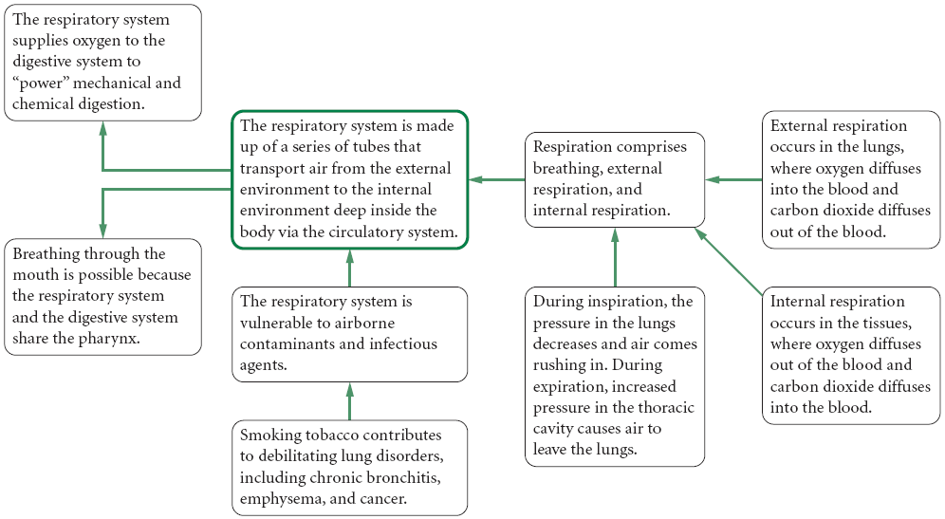
Concept Organizer

Slide 33
Chapter 7 Summary
Respiration enables the body to take oxygen from the external environment and process it for delivery to the cells and, at the same time, rid itself of carbon dioxide.

Slide 34
Chapter 7 Summary
Oxygen is delivered to the cells and carbon dioxide is removed from the cells and the body in a number of exchanges.
Inspiration (breathing in, inhaling) and expiration (breathing out, exhaling) exchange air between the environment and the lungs.
External respiration exchanges oxygen and carbon dioxide between the air in the lungs and the blood.
Internal respiration exchanges oxygen and carbon dioxide between the blood and the body’s tissue cells.
Cellular respiration is the final step, when the oxygen delivered to the cells is used to provide the energy for all cellular activities; carbon dioxide is the waste product of cellular respiration.

Slide 35
Chapter 7 Summary
The respiratory tract is the passageway for air to move from the external environment into the lungs.
The upper respiratory tract begins at the nostrils and includes the nasal passages, pharynx, larynx, and trachea.
These passageways all clean and warm the air as it passes through.
The lower respiratory tract consists of two bronchi that each lead to a lung.
Within the lungs are small, fine tubes called bronchioles, where the air continues to be cleaned and warmed.
The exchange of gases takes place in a cluster of tiny sacs at the end of each bronchiole, called alveoli, where the oxygen diffuses through the membranes of the alveoli into the capillaries of the circulatory system.

Slide 36
Chapter 7 Summary
A number of disorders of the respiratory tract can impair the delivery of oxygen to the cells, including bronchitis, pneumonia, pleurisy, emphysema, cystic fibrosis, asthma, and lung cancer.
These are all disorders of the lower respiratory tract.
Infections of the upper respiratory tract, such as tonsillitis and laryngitis are short term infections that do not obstruct breathing.

