Slide 1
Chapter 10
The Muscular System and Homeostasis

Slide 2
Chapter 10
The Muscular System and Homeostasis
10.1 Movement and Muscle Tissue
10.2 Muscles, Health, and Homeostasis

Slide 3
10.1 Movement and Muscle Tissue
In this section, you will:
observe and compare the three types of muscle tissue
describe, in general, the action of actin and myosin in muscle contraction and heat production
identify the sources of energy for muscle contraction

Slide 4
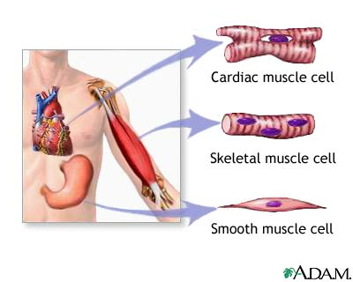
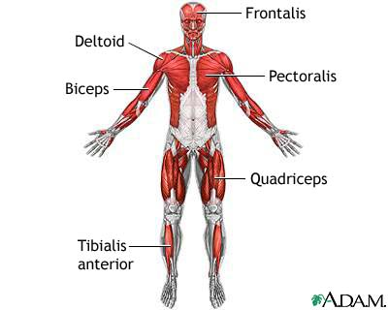
Muscles
Howstuffworks "Cardiac and Smooth Muscle"
The 3 main types of Muscles

Slide 5
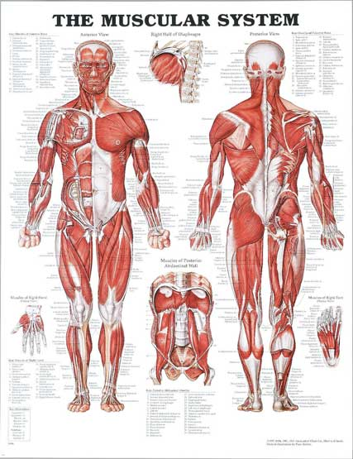
The body has more then 600 muscles!

Slide 6
Types of Muscles
Cardiac Muscles: heart muscles: Found only in the heart
Involuntary contraction and relaxation. Why? It is controlled by nerves of the autonomic nervous system and always has to be pumping in order to pump blood (which contains oxygen, nutrients, and other important molecules) to all of the cells of the body.
Skeletal Muscles
-Unlike cardiac and smooth muscles, these type of muscles are voluntarily controlled. These muscles allow you to walk, talk, ride a bike, swim, jump, etc. Skeletal muscles attach to bones by tendons Skeletal muscles are key in helping you keep warm. 80% or all energy used in muscle contraction is lost as heat!

Slide 7
Types of Muscles
Smooth Muscles: lining of gut and organs
Found in the hollow parts of the body, for instance the lining of organs such as: the stomach, esophagus, uterus, and walls of blood vessels.
-Smooth muscle contractions are required for such things as: pushing food through the digestive system or pushing a baby through the vagina. Similar to cardiac muscles contraction, smooth muscle contraction is involuntary

Slide 8
Muscle Cells

Slide 9
Review:
What are the three types of muscle?
How are each different?

Slide 10
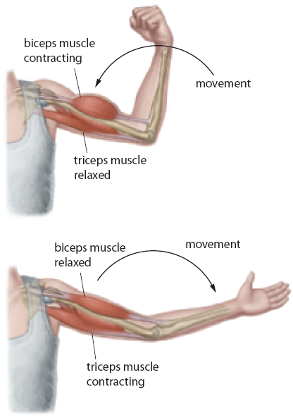
Muscle Function
Skeletal muscle supports the body.
Skeletal muscle makes the bones move.
Skeletal muscle helps to maintain a constant body temperature.
Skeletal muscle helps to protect the internal organs and stabilize the joints.

Slide 11
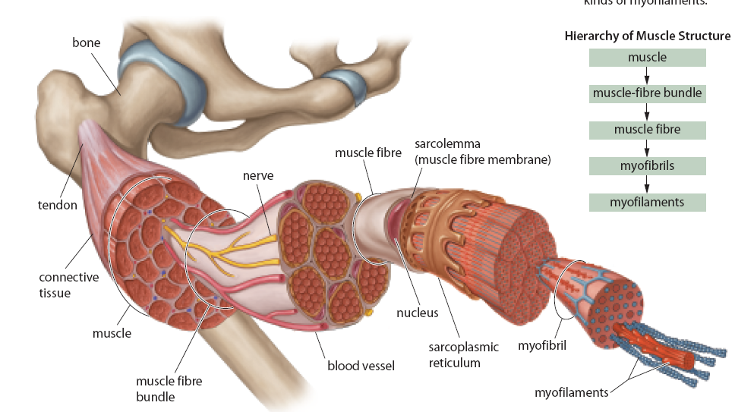
Muscle Fibres

Slide 12
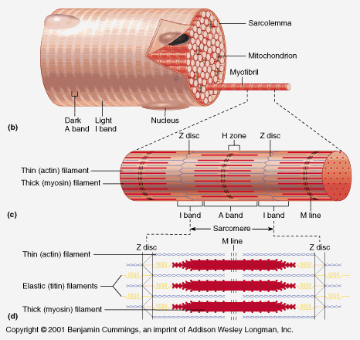
Structure of Skeletal Muscles
An individual section of the myofilament is called a sarcomere
The length of one sarcomere is defined by the Z-Line. The Z-lines anchors the actin to each other and to the bone.
The length of the myosin is defined by the A-Band. It contains both actin and myosin.
The I-Band only contains actin and it is the space in between 2 myosin.
The H-Zone is the empty space between 2 actin. Myosin is only found in this space

Slide 13
Components of Skeletal Muscle Fibres
Component | Description | Function
Muscle fibre | single muscle cell | is responsible for muscle contractions
myoglobin | oxygen-binding pigment (similar to hemoglobin) in a skeletal muscle fibre | stores oxygen for use during muscle contractions
sarcolemma | membrane of a muscle fibre | surrounds the muscle fibre and regulates the entry and exit of materials
sarcoplasm | cytoplasm of a muscle fibre | is the site of metabolic processes for normal cell activities; contains myoglobin and glycogen (which stores energy for muscle contractions)
sarcoplasmic reticulum | smooth endoplasmic reticulum in a muscle fibre | stores calcium ions needed for muscle contractions
Myofibrils | organized bundles of myofilaments; cylindrical structures, as long as the muscle fibre itself | contain myofilaments that are responsible for muscle contractions
thick filament | fine myofilament composed of bundles of protein called myosin (about 11 nm in diameter) | binds to actin and causes muscle contractions
thin filament | fine myofilament composed of strands of protein called actin (about 5 nm in diameter) | binds to myosin and causes muscle contractions

Slide 14
The Mechanism of Muscle Contraction
Actin: a myofilament that consists of two strands of protein (actin) that are wrapped around each other.
Myosin: ten times longer than actin and different in shape (rod like with globular heads)

Slide 15
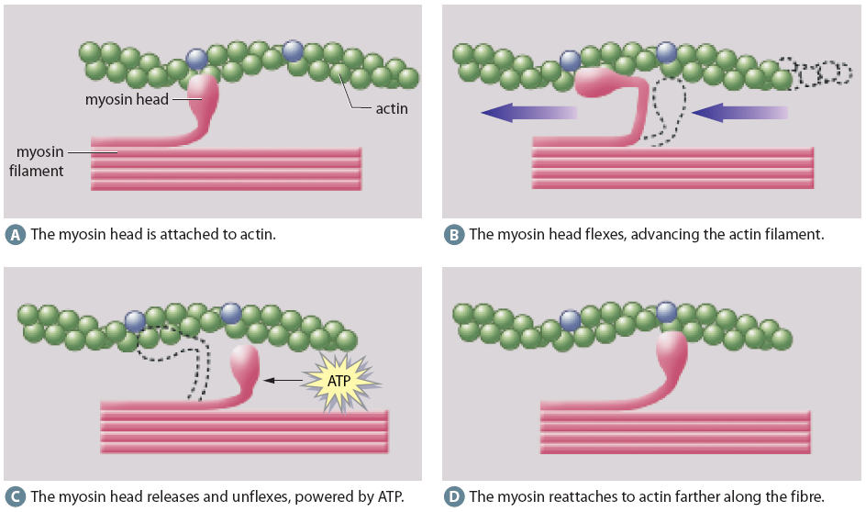
The Movement of Actin and Myosin

Slide 16
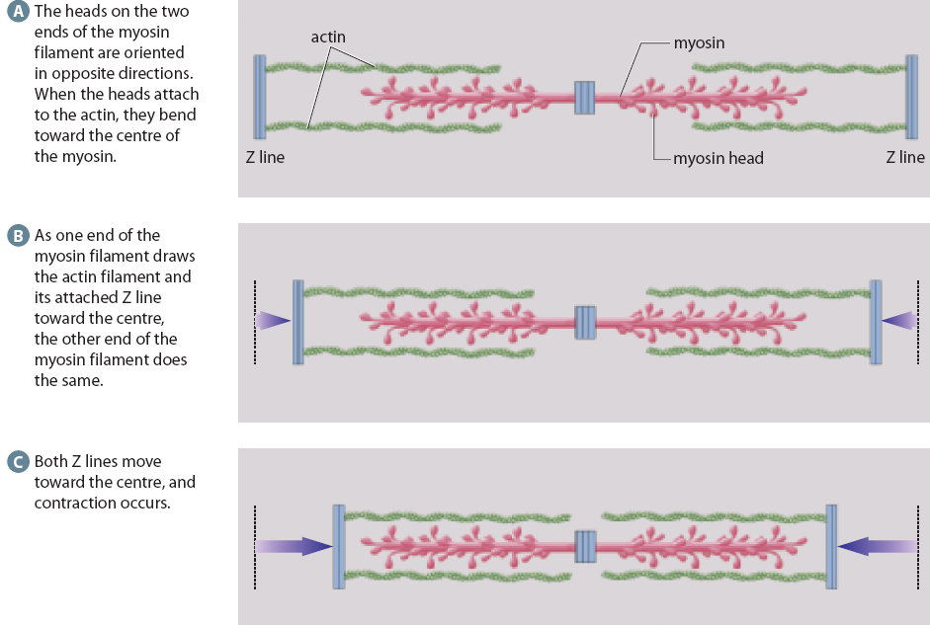
Sliding Filament Model

Slide 17
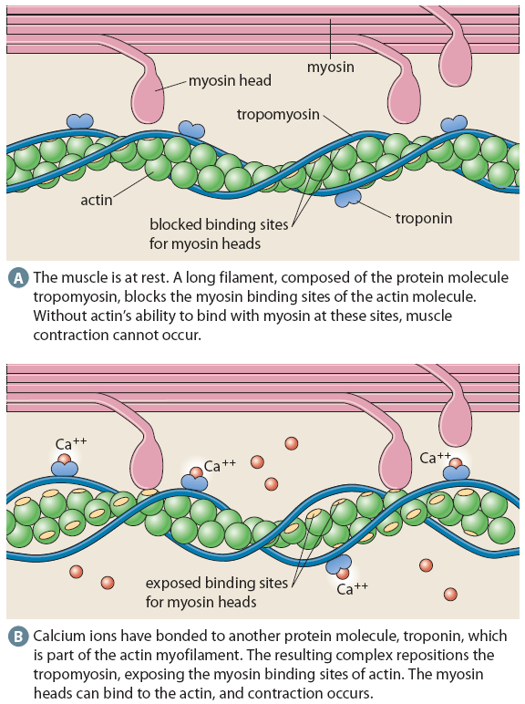
Calcium Controls Muscle Contractions http://www.vetmed.wsu.edu/van308/muscleanimation.htm

Slide 18
During each contraction:
1) A neurotransmitter is released from a nerve to the muscles, signaling contraction
2) The muscle cell’s endoplasmic reticulum release Calcium (Ca²⁺ ions) near the actin
3) Calcium ions attach to the actin and this then allows myosin to attach to the actin as well, forming an ‘Actin-Myosin Cross-Bridge’
4) The actin and myosin attach and de-attach, over an over. With each re-attachment of the actin the muscle fibers get pulled closer together. This carries on until full contraction of the muscles occurs

Slide 19
Creatine phosphate builds up and is stored in resting muscle (purple). For the muscle to contract (green), it needs to acquire ATP. (A) When the muscle starts contracting, it breaks down stored creatine phosphate (B) To continue, the muscle carries out aerobic cellular respiration as long as oxygen is available and then carries out fermentation for a limited period of time and lactate builds up. Once the muscle resumes resting (purple), creatine phosphate builds up again.

Slide 20
Summary: Chapter 10 The Muscular System and Homeostasis
Summary:
There are three types of muscle tissue: skeletal muscle, smooth muscle, and cardiac muscle.
Skeletal muscle produces body movement, maintains body temperature, and provides support for the body.
Muscle fibres are filled with myofibrils that house thin (actin) and thick (myosin) contractile protein myofilaments.
Actin and myosin slide past each other during a muscle contraction.
Creatine phosphate, fermentation, and aerobic cellular respiration provide energy for muscle contractions.

Slide 21
10.2 Muscles, Health, and Homeostasis
In this section, you will:
explain how the skeletal muscles of the motor system support other body systems to maintain homeostasis
identify conditions that impair the healthy functioning of muscles and technologies that are used to treat or prevent these conditions
describe the benefits of exercise for maintaining the healthy structure and functioning of muscles

Slide 22
Muscular Atrophy

Slide 23
Common Disorders & Ailments of Skeletal Muscles
Condition | Description
muscular dystrophy | a collective term for several hereditary conditions in which the skeletal muscles degenerate, lose strength, and are gradually replaced by fatty and fi brous tissue that impedes blood circulation; this, in turn, accelerates muscle degeneration in a fatal spiral of positive feedback
botulism | a potentially fatal muscular paralysis caused by a toxin produced by the bacterium Clostridium botulinum; the toxin prevents the release of a muscle-stimulating compound (acetylcholine) released by muscle-related cells of the nervous system, thus leading to paralysis
cramps | painful muscle spasms triggered by strenuous exercise, extreme cold, dehydration, salt (electrolyte) imbalance, low blood glucose, or reduced blood fl ow
contracture | abnormal muscle shortening not caused by nerve stimulation; can result from inability to remove calcium ions from the sarcoplasm or from the contraction of scar tissue (as in people who have experienced severe burns)
fibromyalgia | chronic muscular pain and tenderness often associated with fatigue and sleep disturbances; can be caused by infectious diseases, physical or emotional trauma, or medications
crush syndrome | a shock-like state following massive crushing of the muscles (as in, for example, the aftermath of an earthquake, the collapse of a building following an explosion, or a traffi c accident); associated with high fever, heart irregularities caused by potassium ions released from the muscles, and kidney failure caused by blockage of the renal tubules with myoglobin released by the traumatized muscles
delayed onset muscle soreness | pain, stiffness, and tenderness felt from several hours to a day after strenuous exercise; associated with trauma to the muscles, disruptions in the myofi brils and sarcolemma, and increased levels of myoglobin and muscle-fibre enzymes in the blood
myositis | muscle inflammation and weakness resulting from infection or an autoimmune disease

Slide 24
Muscle Twitch
Muscle twitch – is a muscle contraction that lasts a fraction of a second that occurs in three stages:
Latent stage – time between stimulus and initiation of the contraction
Contraction stage – time it takes for the muscle fibers to shorten
Relaxation stage – time it takes for the muscle to return to its regular length.

Slide 25
Myograms
These graphs show the force of muscle contraction with time. (A) A simple muscle twitch has three periods: latent, contraction, and relaxation. (B) When a muscle is not allowed to relax completely between stimuli, the contraction gradually increases in intensity until it reaches a maximum, which is sustained until the muscle fatigues.

Slide 26
Types of Twitch
Slow twitch – smaller muscle fibers that contract slowly and resist fatigue because they are surrounded by more blood vessels and have more mitochondria.
i.e. postural back muscles, leg muscles
Fast twitch– larger muscle fibers that contract quickly to give more power, but depend upon anaerobic energy production. They are rich in glycogen, and have fewer mitochondria and blood vessels surrounding them.
i.e. lateral rectus muscle in the eye, biceps

Slide 27
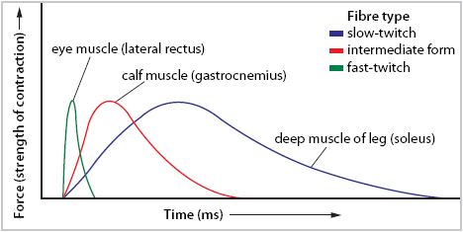
Skeletal muscles have different proportions of fast-twitch and slow-twitch fibres. Thus, the force and response times of their contractions differ.

Slide 28
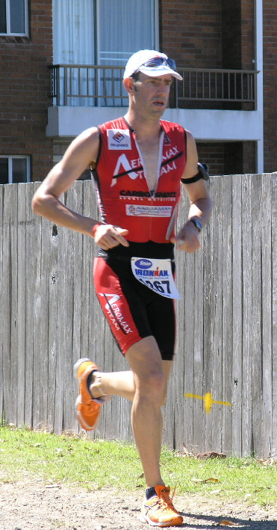
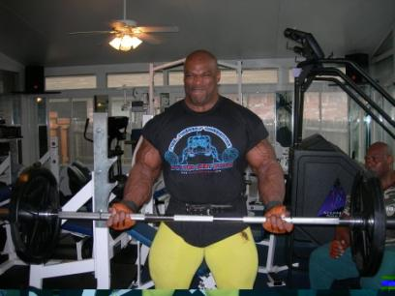
The effects of exercise
Endurance training – increases the development of slow-twitch muscle fibres and has no impact on the size of the muscles.
Resistance / strength training – thickens fast-twitch muscles, causing an increase in muscle size.

Slide 29
Continued…
Tetanus: a state of constant muscle contraction. Often caused by bites, or rusted metals entering the blood stream.
Muscle spasms: involuntary contraction of a muscle. Often caused by a pinched nerve.

Slide 30
Homework:
Page 349
Questions: 1,2,3,6,8-13

Slide 31
Chapter 10 Review
What body systems do muscles support?
How do muscles support these systems?
Explain the difference in muscle composition between a person who is not active versus someone who is very active?
Describe two different types of muscle injuries. Recommend appropriate treatments for each.
Explain how muscles change with strength training? With endurance training? With inactivity?

Slide 32
Summary: Chapter 10 The Muscular System and Homeostasis
Summary:
Three types of skeletal muscle—slow-twitch, fast-twitch, and an intermediate type—are found in different parts of the body.
Muscles atrophy with inadequate stimulation and can hypertrophy with appropriate repeated stimulation.
The muscular system works with other body systems to maintain homeostasis.

